Slide 1
Medical Cost Prediction
Here is where your presentation begins

Slide 2
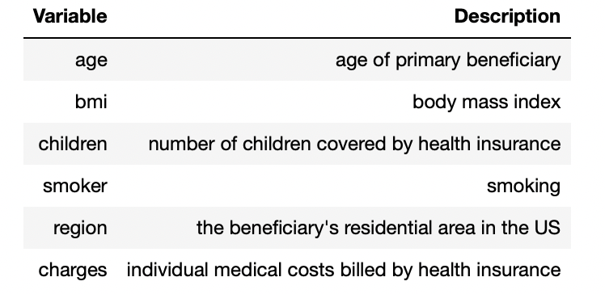
Introduction
The aim of this analysis is to predict the medical expense based on the patients’ information. The dataset used for this analysis is Insurance dataset from Kaggle. The variables are as follows:

Slide 3
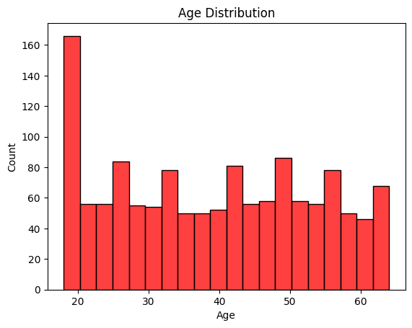
Here we can see that most of person are under 19 years.

Slide 4
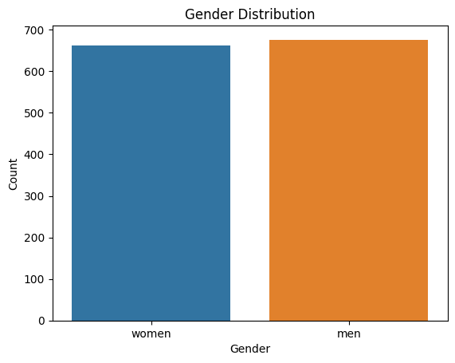
It is clear that the number of males and females are almost equal in the dataset.

Slide 5
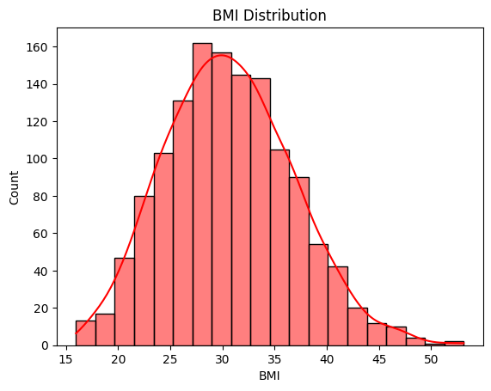
Most patients have BMI between 25 and 40, which is considered overweight and could be a major factor in increasing the medical cost.

Slide 6
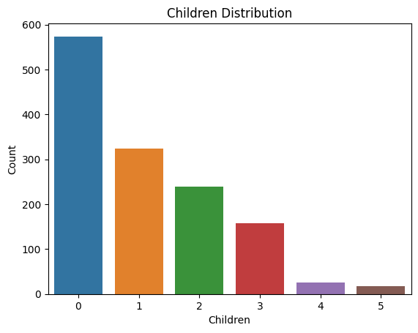
The graph clearly shows that most of the patients have no children and very few patients have more than 3 children.

Slide 7
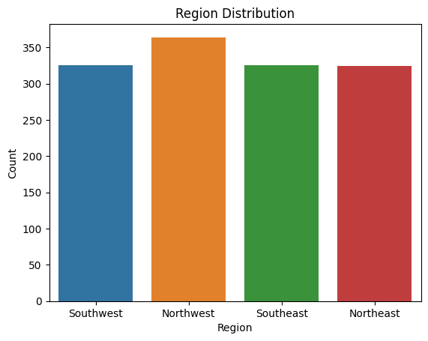
The count of the patient from the northwest is slightly higher than in the other regions, but the number of patients from other regions is almost equal.

Slide 8
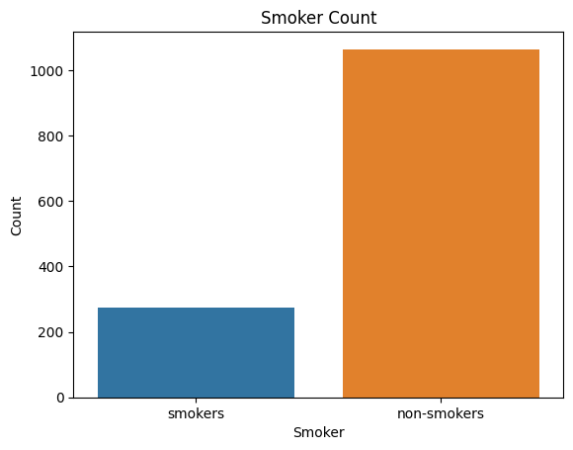
Smokers are very few in the dataset. Nearly 80% of the patients are non-smokers.

Slide 9
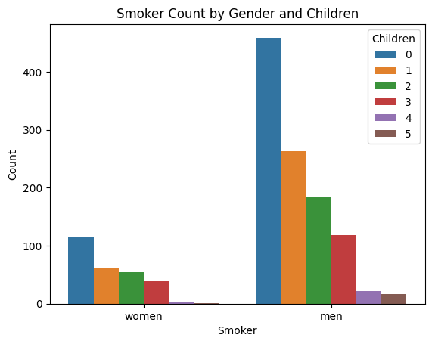
Here we can see that people without children smokes more than people with children, and also men smokes more then women.

Slide 10
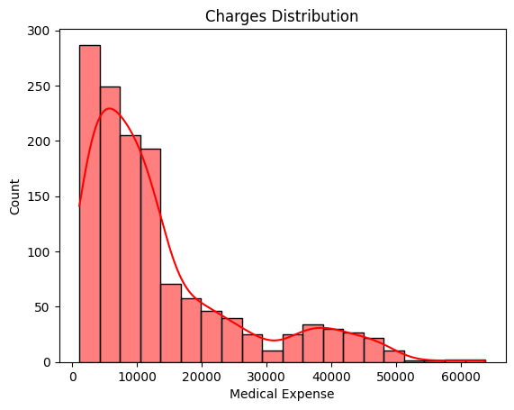
Most of the medical expenses are below 20000, with negligible number of patients having medical expenses above 50000. From all the above plots, we clearly understand the count of patients under each category of the variables.

Slide 11
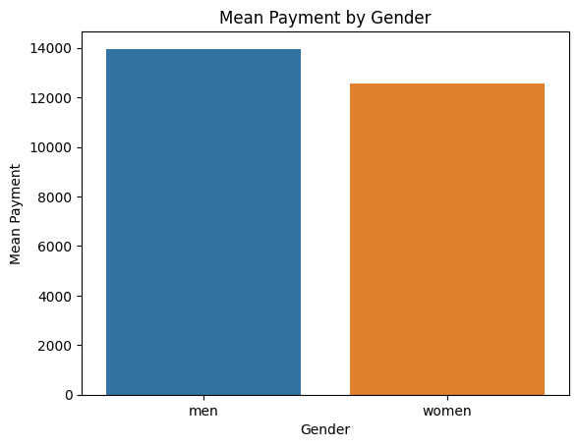
Here we can see that men pays more than women.

Slide 12
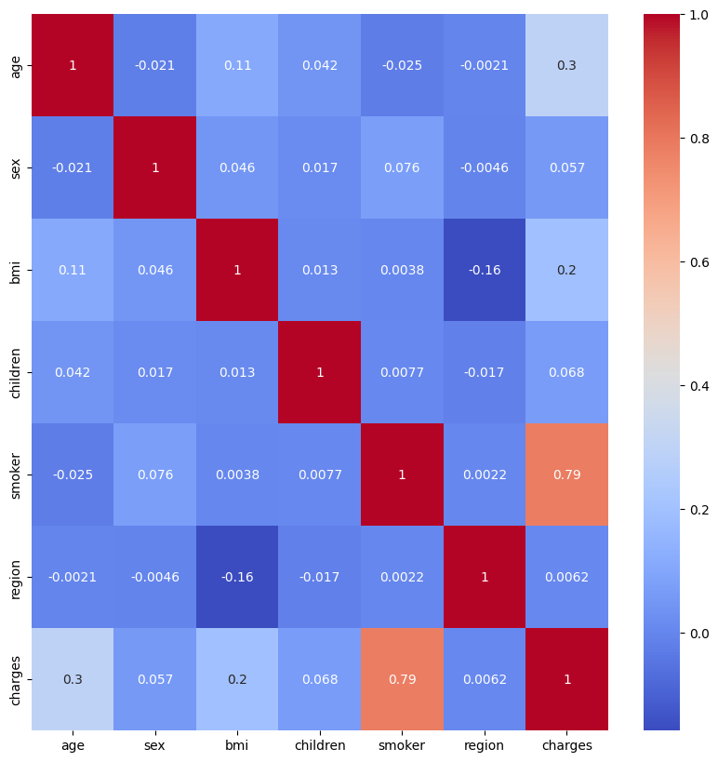
The variable smoker shows a significant corelation with the medical expenses.

Slide 13
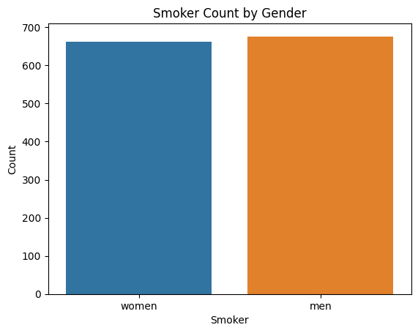
We can notice more male smokers than female smokers. So, I will assume that medical treatment expense for males would be more than females, given the impact of smoking on the medical expenses.

Slide 14
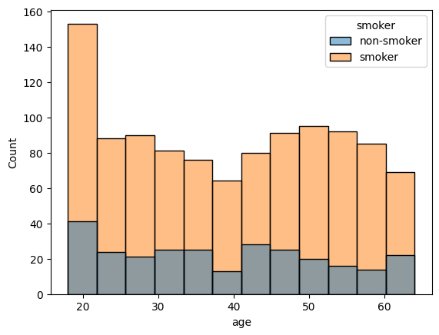
From the graph, we can see that there significant number of smokers of age 19.

Slide 15
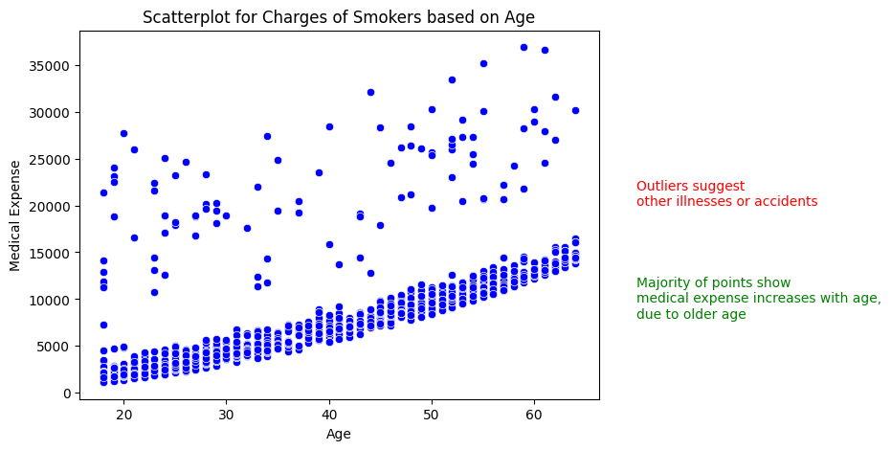
Majority of the points shows that medical expense increases with age which may be due to the fact that older people are more prone to illness. But there are some outliners which shows that there are other illness or accidents which may increase the medical expense.

Slide 16
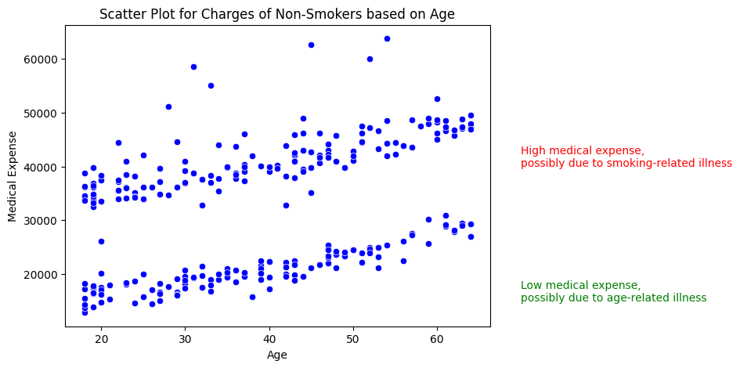
Here we see peculiarity in the graph. In the graph, there are two segments, one with high medical expenses which may be due to smoking-related illness, and the other with the low medical expense which may be due to age-related illness.

Slide 17
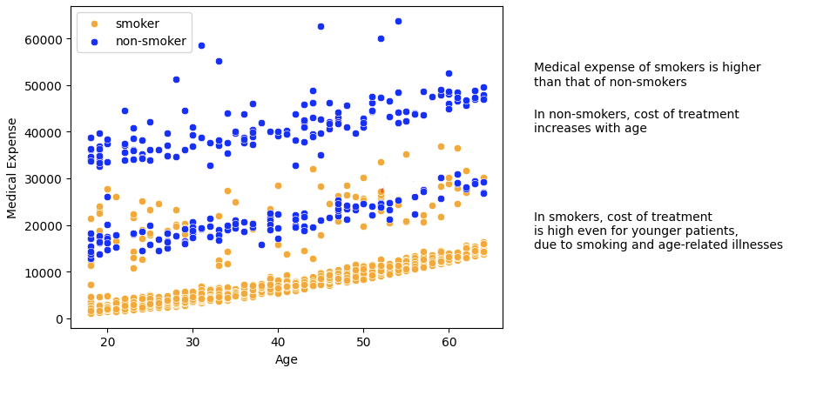
Now, we clearly understand the variation in charges with respect to age and smoking habits. The medical expense of smokers is higher than that of non-smokers. In non-smokers, the cost of treatment increases with age which is obvious. But in smokers, the cost of treatment is high even for younger patients, which means the smoking patients are spending on their smoking-related illnesses as well as age-related illnesses.

Slide 18
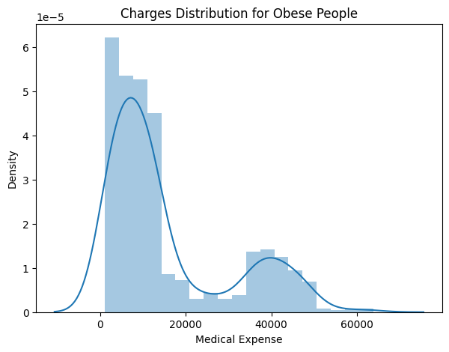
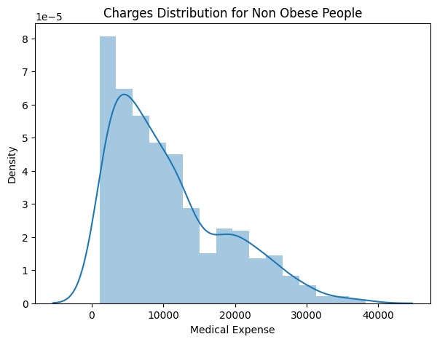
Therefore, patients with BMI less than 30 are spending less on medical treatment than those with BMI greater than 30.

Slide 19
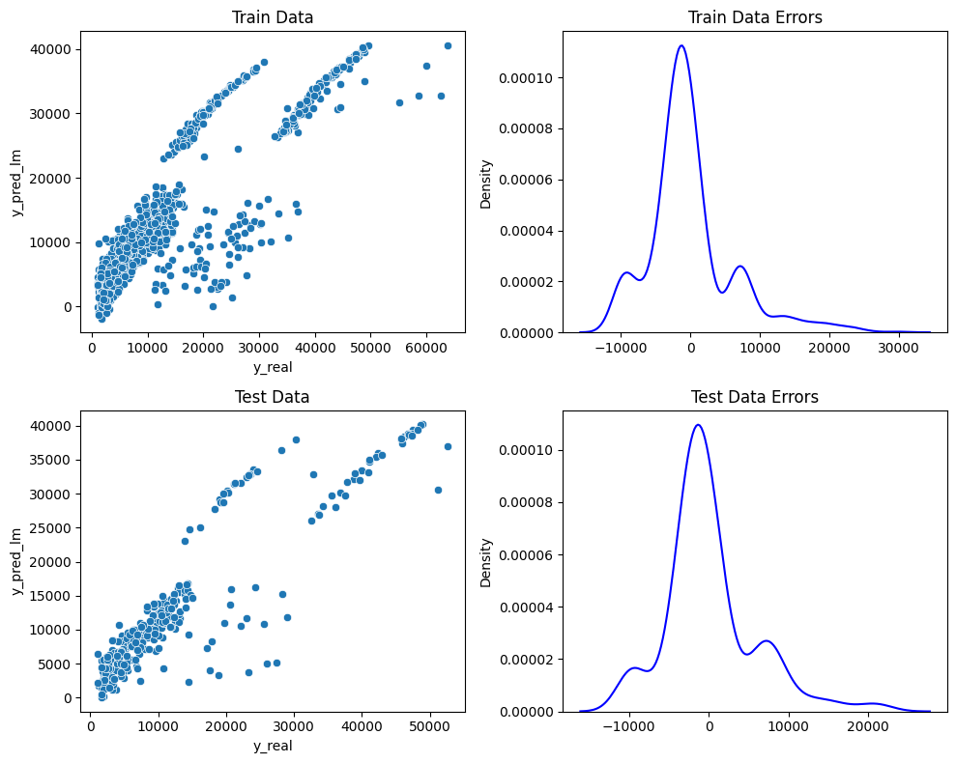
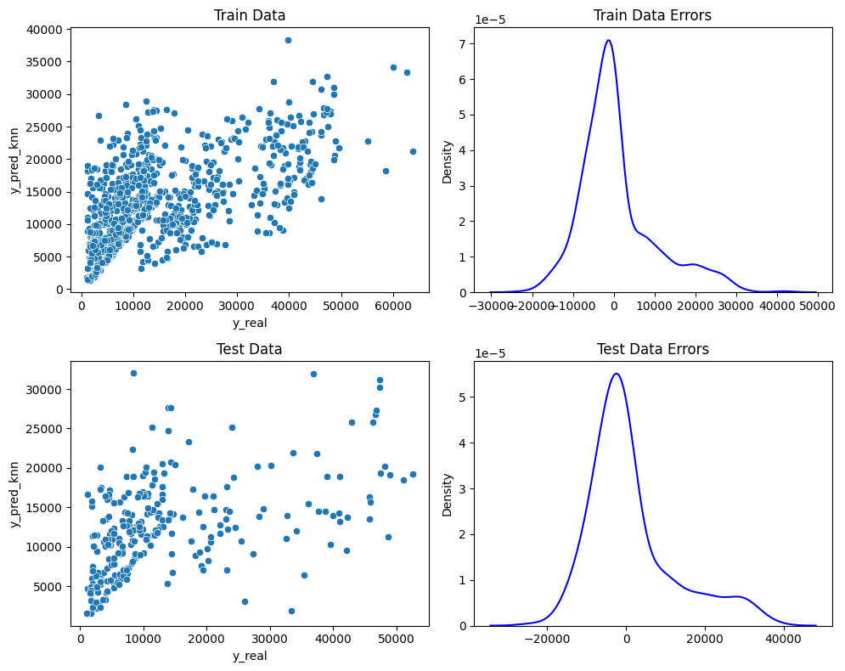
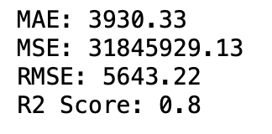
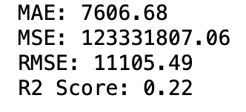
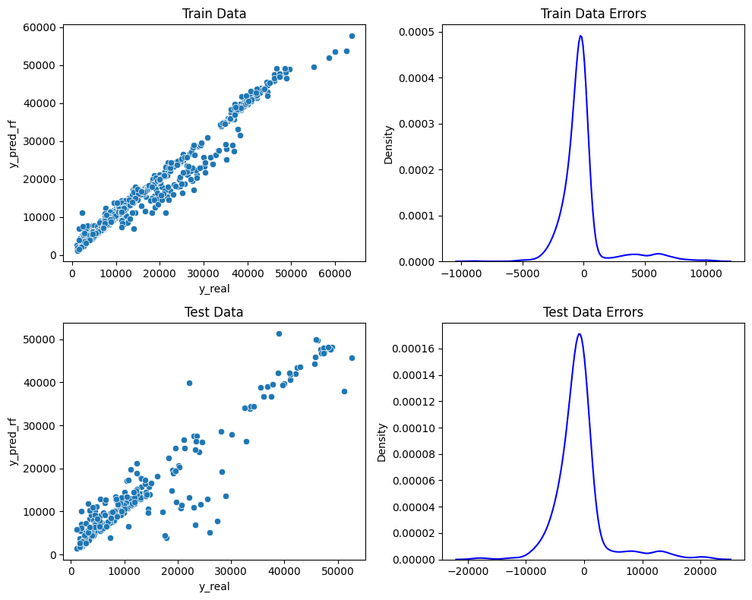
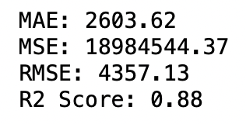
Linear Regressor
K-Nearest Neighbors(KNN)
Random Forest Regressor
Notes:
From the above models, we can see that KNN and Linear regression are giving the best results.

Slide 20
Conclusions
Moreover, the medical expense of smokers is higher than that of non-smokers. The medical expense of patients with BMI greater than 30 is higher than that of patients with BMI less than 30. The medical expense of older patients is higher than that of younger patients.
Thus, from the overall analysis, we can conclude that the medical expense of patients depends on their age, BMI, smoking habits.

Slide 21
Thanks

