Slide 1
Popularity/Prestige J.D. Porter
( a Ph.D. candidate in English at Stanford University
He works on American modernism, theories of race and ethnicity, and digital humanities)
Презентацию подготовила: Мария Ростовская

Slide 2
the resulting structure of the canon as a complex cultural space: Its entanglement with what Pierre Bourdieu might call “consecration”; its organization of different kinds of cultural fields; its relationship to the archive; and even its mechanisms of formation

Slide 3
What is the canon?
the canon and the archive
Which works are in the canon?
morphological signatures of canonicity?
Is Melville’s Pierre more canonical than Stephen King’s The Shining?
“that portion of published literature that has been preserved—in libraries and elsewhere”
multiple canons
You’re either in or you’re out
to stretch the binary into a spectrum (William Shakespeare might be more canonical than Herman Melville, who is more canonical than Nathanael West, and so on down )

Slide 4
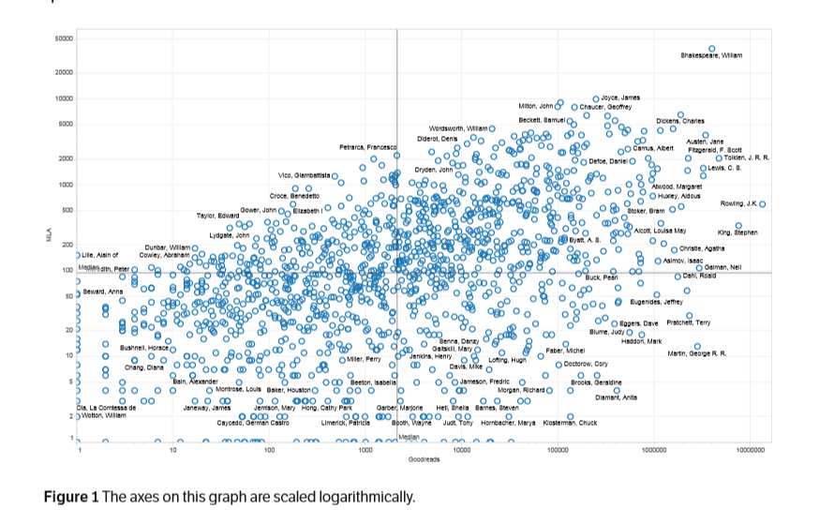
1,406 authors
The sources include ECCO, the Raven-Garside-Schöwerling bibliography, the Chadwyck-Healey Nineteenth-Century Fiction corpus, the Internet Archive of the University of Illinois, Stanford PhD exam lists, and the 20th century best-of lists
The X axis measures their number of ratings on the website Goodreads
On the Y axis, authors are arranged according to statistics drawn from the MLA International Bibliography
“multiple, explicit, and measurable”

Slide 5
2 different ways of entering the canon
being read by many
being prized by an elite few
popularity
what have people read?
prestige
contemporaneous reviews in prestigious magazines
prizes
how often writers refer to each other

Slide 6
the market and the school
“The particular authors who happen to be canonical have a minor role in this system of reproduction, but the far larger role belongs to the school itself, which regulates access to literary production by regulating access to literacy, to the practices of reading and writing. The literary syllabus is the institutional form by means of which this knowledge is disseminated...” Guillory, John. Cultural Capital: The Problem of Literary Canon Formation. Chicago: University of Chicago Press, 1993.

Slide 7
The structure of the canon and a cultural space
both widely read and widely written about
John Gower or Thomas Wyatt, discussed somewhat often in scholarly journals, but little read by the public
canonical
prestigious
popular
not quite forgotten, but not often remembered
(important to specialists—critics like Leslie Fiedler and thinkers like Alain Locke, highly important within their fields, but not broadly known)
George R.R. Martin or E.L. James who
have sold a lot of books, but who remain largely unnoticed in the academy

Slide 8
Distance within the canon or archive may be greater than distance between the canon and archive
Different ways of being canonical
The archive is also a fairly complex space
The archive, no less than the canon, can only correctly be considered as a complex cultural space embodying multiple methods of being forgotten

Slide 9
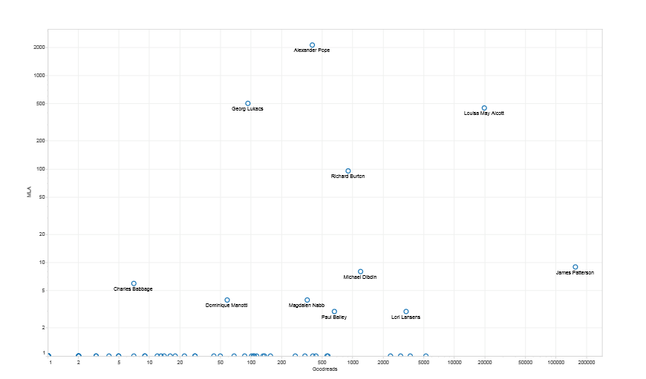
To examine this truism of canon/archive studies, we generated a list of 116 somewhat randomly selected books and checked the Goodreads and MLA scores for their authors

Slide 10
Popularity and prestige may successfully locate Haldeman slightly closer to Le Guin than to Sidney, but is that just a coincidence?
It would be surprising if they were able to replicate some semblance of genre, form, period, etc.—and yet, to an unexpected degree, they do.
In the group Romantic Poets, for instance, we looked on the graph for six authors: William Wordsworth, Samuel Coleridge, William Blake, Percy Shelley, George Gordon (Lord Byron), and John Keats.

Slide 11
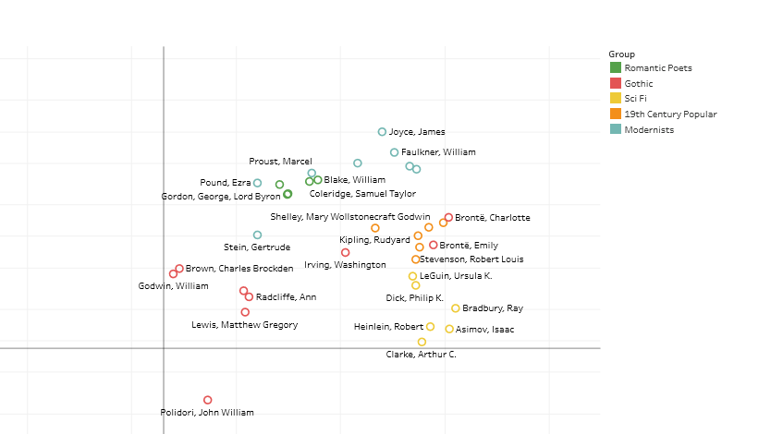

Slide 12
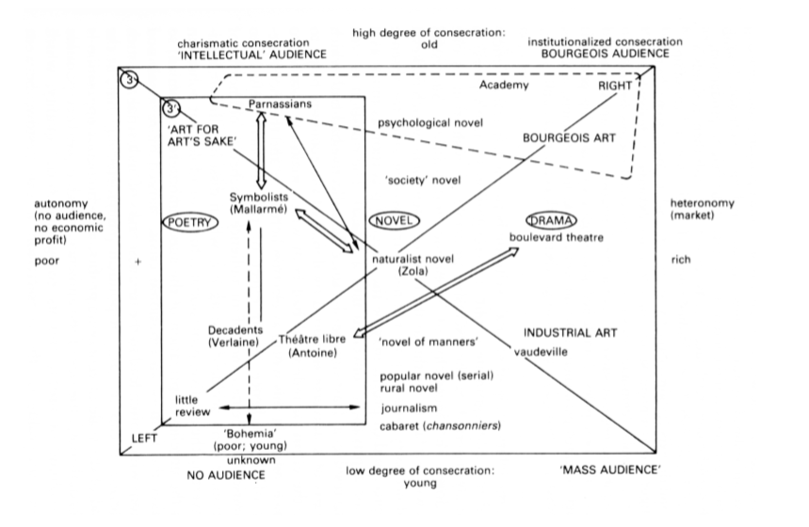
On a broad level, real-world data about popularity and prestige appear to confirm Bourdieu’s intuitions.

Slide 13
The logic of his approach suggests there is essentially no way for something to be both respected by the intelligentsia and popular with the public at large.
The problem is that Shakespeare has every kind of consecration—on Bourdieu’s chart, he should probably be at the top left and the top right.
The idea that intellectual appreciation is on a sliding scale with institutional appreciation ultimately appears to make Bourdieu’s chart unworkable for our canon.

Slide 14
Ways of being canonical
Hannah Walser developed an explanation for the Moby-Dick question:
the selection of writers like Hawthorne, Poe, Melville, and Dickinson as the exemplars of American literature was a 20th century phenomenon orchestrated by prestigious critics like D.H. Lawrence and F.O. Matthiessen
neither metric shows the canon as it changes over time

Slide 15
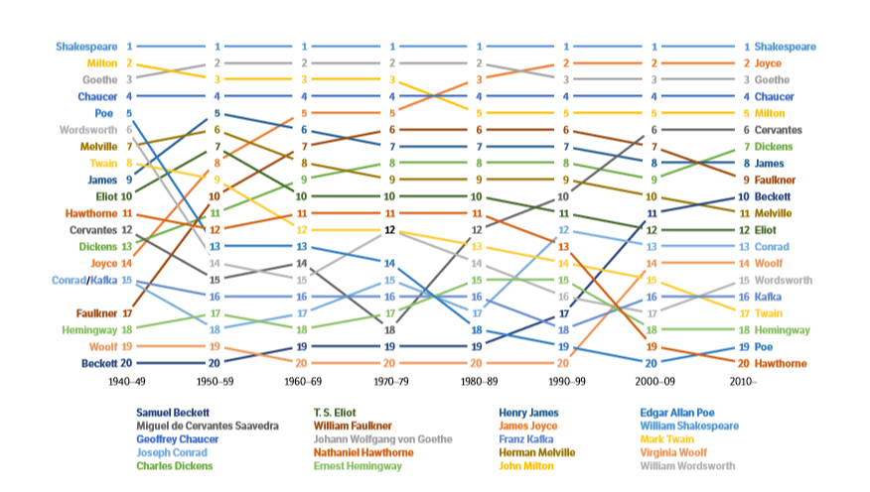

Slide 16
Either prestige is, eventually, randomly historically distributed, or methods of entering the canon change over time, and the texts that use those methods retain traces of them even as the canon ages.
The prevailing literary critical wisdom, in other words, is reflected in the chart even with its historical limitations

Slide 17
Вопросы к автору…
Любопытная, претенциозная, иллюстративная (благодаря использованию цифровых инструментов) статья оставляет нас после прочтения с еще большим багажом вопросов, чем тот, что встречал в начале текста.
Стоило ли на один граф помещать произведения, читательская аудитория которых могла совершенно не совпадать?
Такое обобщение не позволяет прийти ни к каким выводам, кроме суждения о сложности и непредсказуемости канона.
Возможно, более убедительно выглядели бы диаграммы, иллюстрирующие множество канонов (об этом говорилось в начале статьи, но эта идея почему-то так и осталась нераскрытой): автор или его произведение попадает в канон и располагается там в зависимости от оценки его потенциальных читателей и критиков.

