Slide 1
EXPLORING THE MASK RELEVANCE IN TEXT-OBJECT RETRIEVAL

Slide 2
Pipeline idea
Image
Segmentation model
Text Prompt
Text Encoder
Selected Object

Slide 3
Comparing YOLO & SAM
Image
Image
YOLO
SAM
Text Prompt
Text Prompt
CLIP
CLIP
Selected Object
Selected Object

Slide 4
Segmentation models
YOLO
SAM

Slide 5
Segmentation models
YOLO

Slide 6
Segmentation models
YOLO
Output vector
Output tensor
p(C)
BB

Slide 7
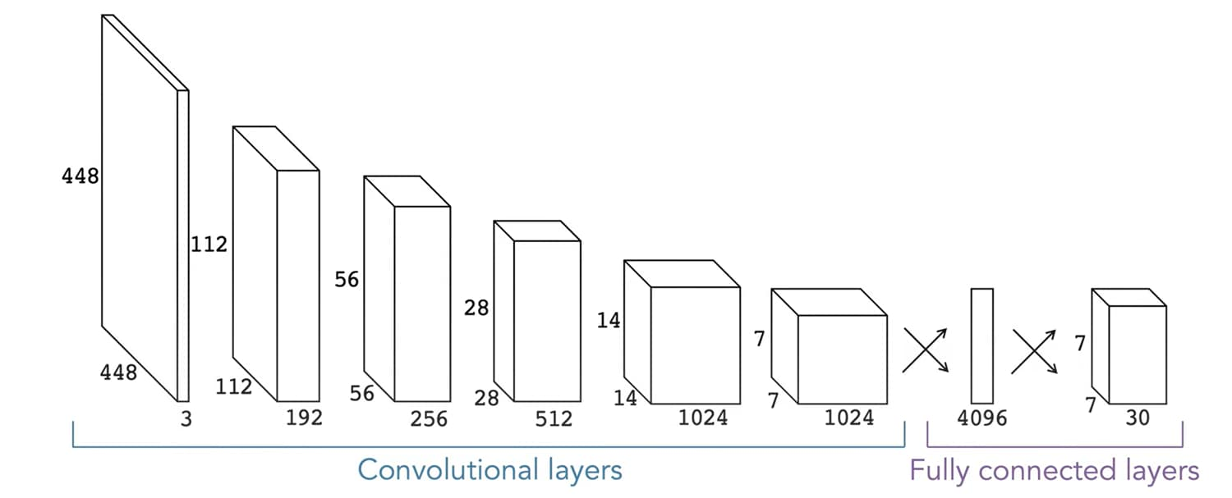
Segmentation models
YOLO
Screen capture from: How YOLO Object Detection Works

Slide 8
Segmentation models
SAM
Some info from: AI SAM

Slide 9
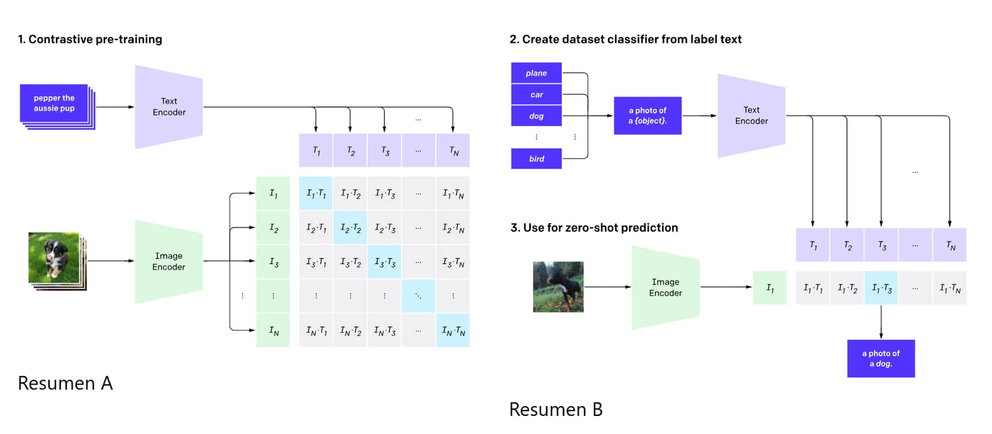
Vision-Language model
CLIP
Pipeline from: CLIP OpenIA

Slide 10
Vision-Language model
CLIP
Cosine Similarity
Text
Image

Slide 11
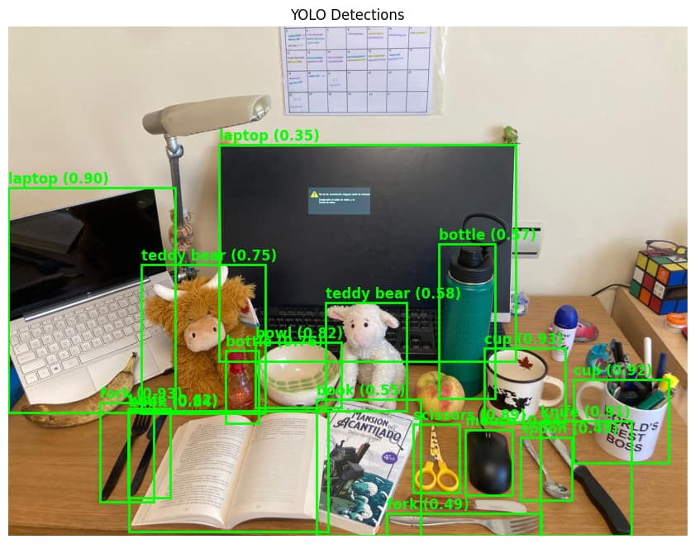
YOLO

Slide 12
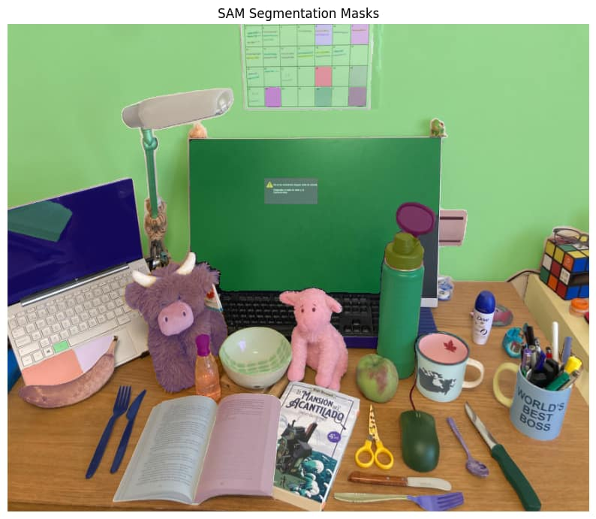
SAM

Slide 13
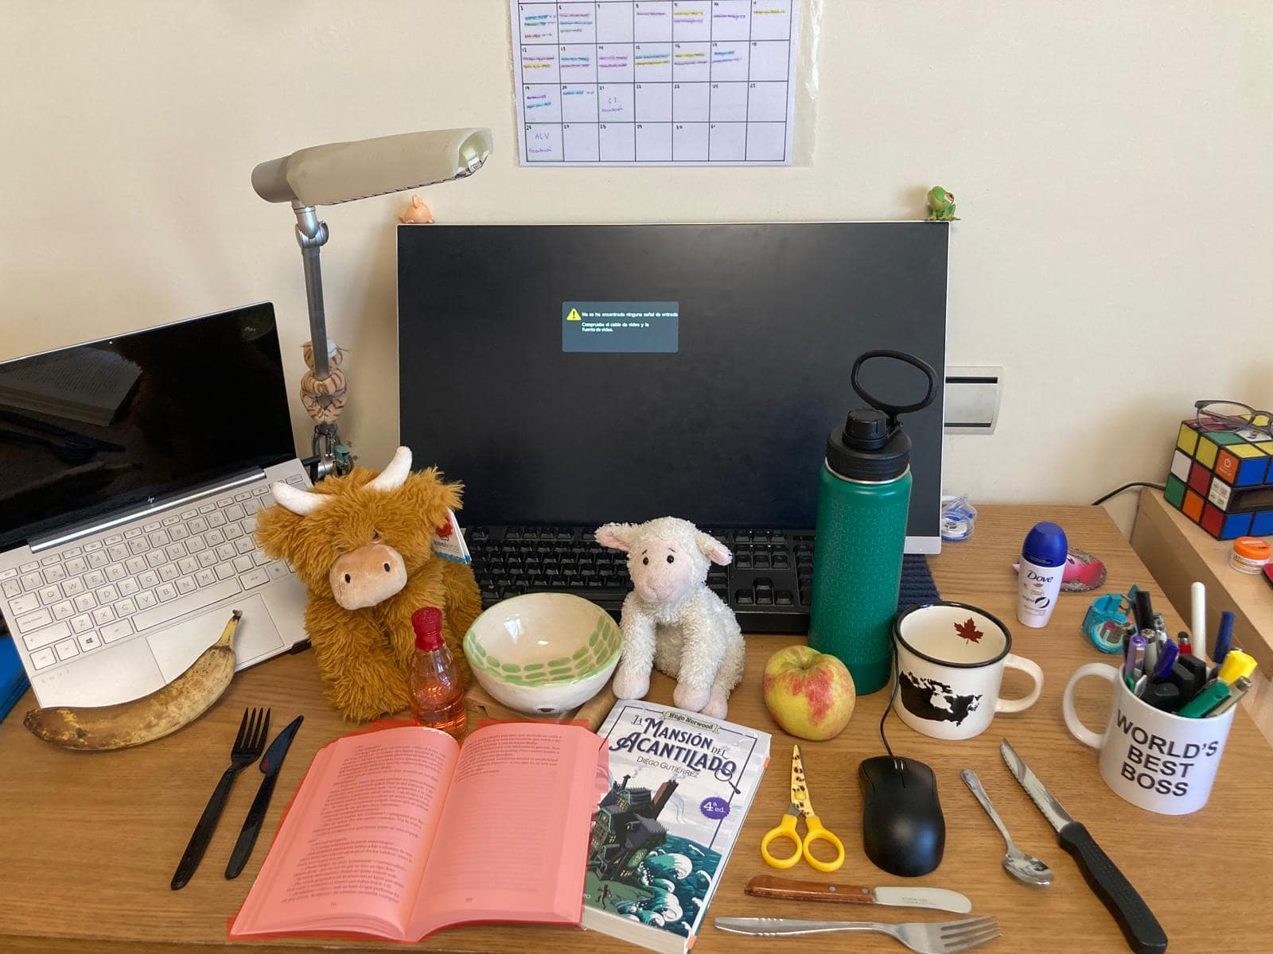

YOLO + CLIP
An open book
A closed book
SAM + CLIP
An open book
A closed book

Slide 14
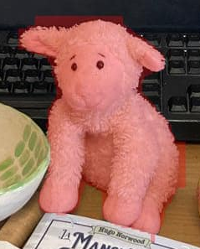


YOLO + CLIP
A sheep
A cow
SAM + CLIP
A sheep
A cow

Slide 15

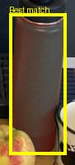
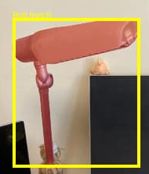
YOLO + CLIP
A plastic fork
A weapon
SAM + CLIP
A plastic fork
A weapon

Slide 16
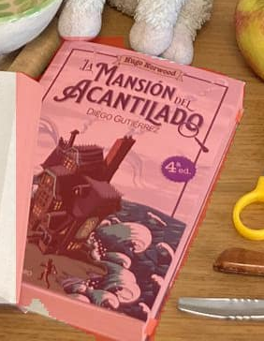

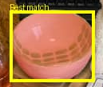

YOLO + CLIP
A hemispherical object
A container for food
SAM + CLIP
A hemispherical object
A container for food

Slide 17
First conclusions
Geometry prompts seem to work
No consistent results
YOLO masks seem to perfom better

Slide 18
Closing the gap
YOLO
SAM
Classified mask
Mask
CLIP
CLIP
CLIP
Classified mask
Text-Object
Text-Object

Slide 19
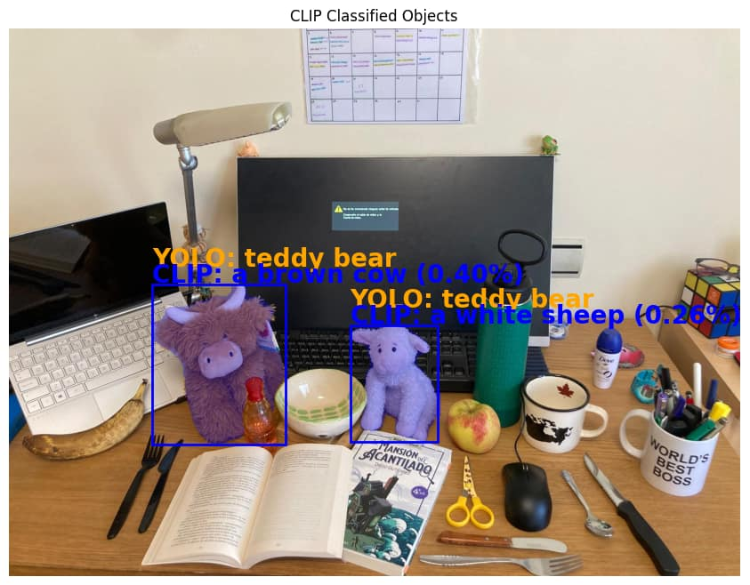

Testing Prompts
["a sheep", "a white sheep", "a stuffed sheep", "a fluffy white sheep", "a fluffy sheep", "a cute sheep", "a tagged animal"]
YOLO + CLIP
SAM + CLIP^2
A Brown cow
A white sheep 0.26
0.32
Teddy bear

Slide 20
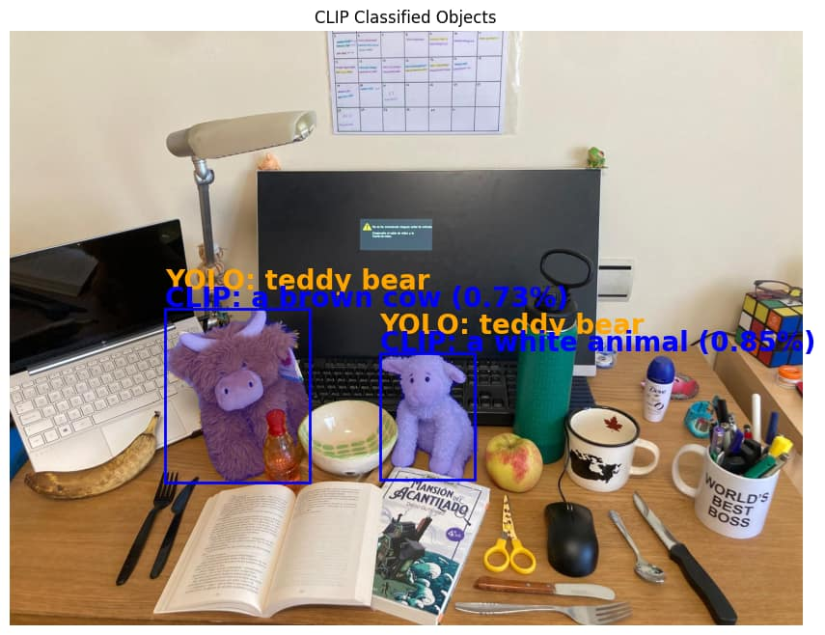

Testing Prompts
["a cow","a white animal", "a brown cow "]
YOLO + CLIP
SAM + CLIP^2
A white animal
0.28
A Brown cow
0.32
Teddy bear

Slide 21
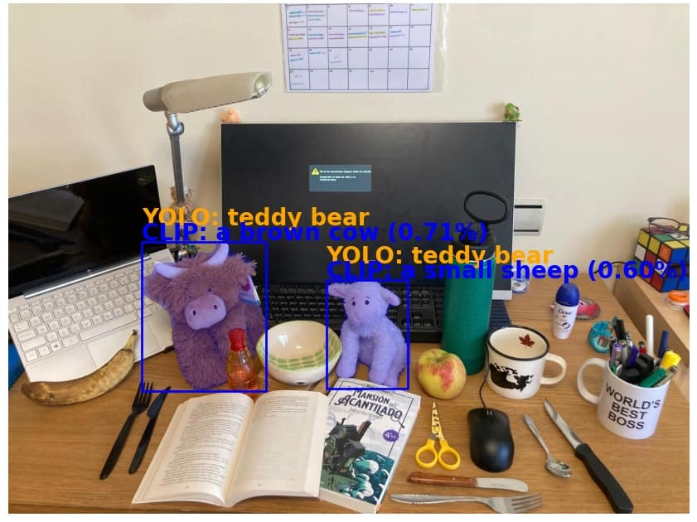

Testing Prompts
["a sheep","a small sheep","a big sheep"]
YOLO + CLIP
SAM + CLIP^2
A small sheep 0.26
0.32
A Brown cow
Teddy bear

Slide 22
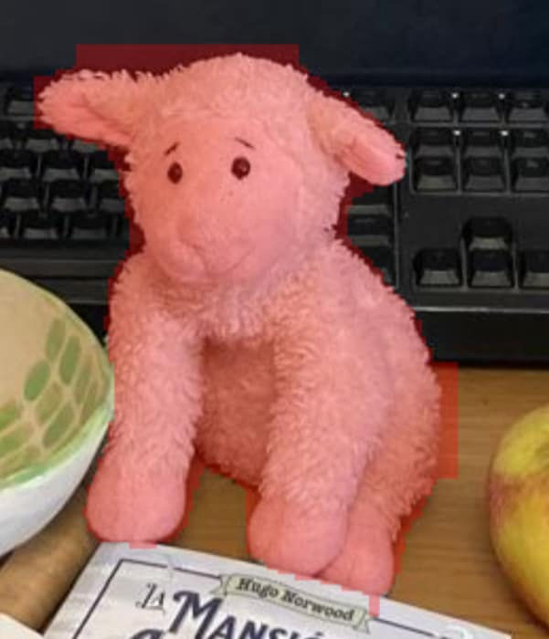
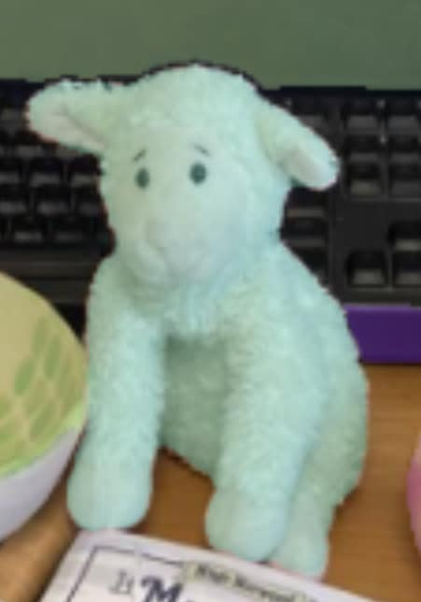
Testing Prompts
The difference in the bounding box difference might be linked to how each model mask the objects
YOLO
SAM
SAM’S mask is sharper, higher resolution, but for a deep neural network like CLIP is better to have the natural padding that YOLO provides

Slide 23
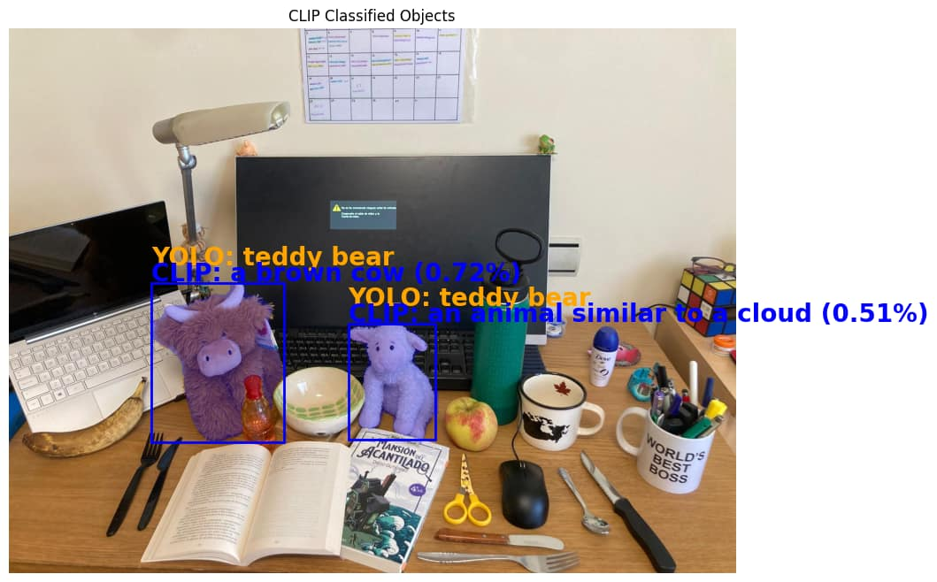

Testing Prompts
["an animal similar to a cloud","a big sheep"]
YOLO + CLIP
SAM + CLIP^2
An animal similar to a cloud 0.26
A Brown cow 0.32
Teddy bear

Slide 24
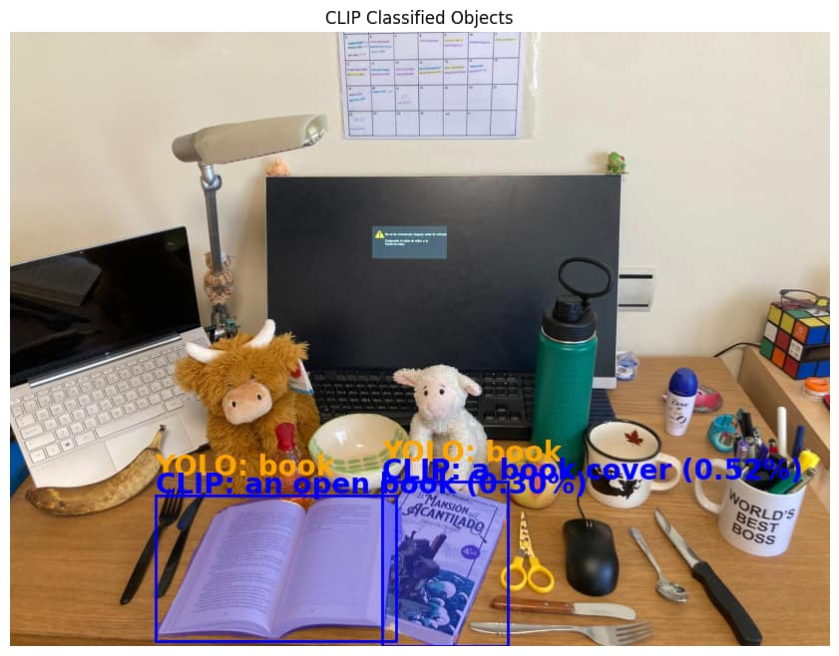
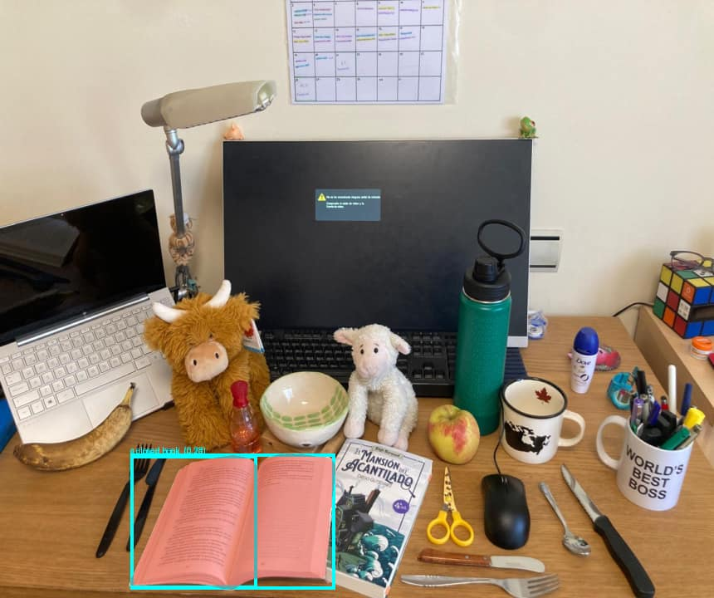
Testing Prompts
["a closed book ","an open book", "a book cover", "a book fourth edition", "a soft cover book", "la mansion del acantilado book", "a child book", "a teenager book"]
YOLO + CLIP
SAM + CLIP^2
A closed book 0.28
A closed book 0.28
Book

Slide 25
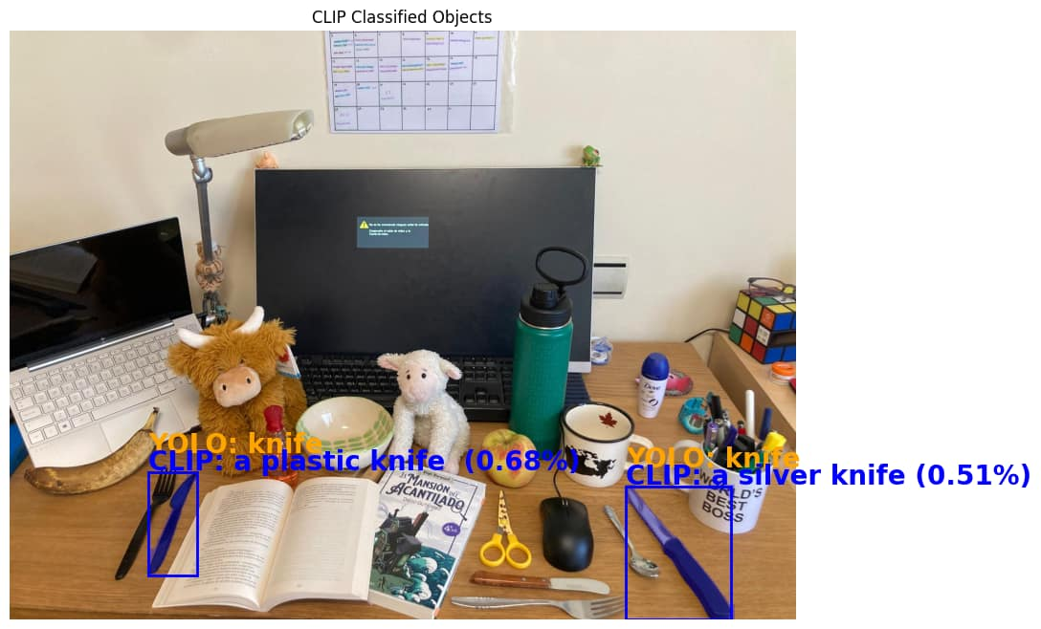

Testing Prompts
["a plastic knife ","a silver knife"]
YOLO + CLIP
SAM + CLIP^2
Knife

Slide 26
Final conclusions
There are advantages and disadvantages to both methods
YOLO is fast and accurate but limited
SAM is slow, offers more flexibility but this can lead to ambiguity
Potential for object understanding

