Slide 1
Null Hypothesis Test:
Is crime related to population?
where (p) is the Probability of (c) Crime increase
If crime IS related to population count
Then the incidence of crime (Total Population / Count of Incidence) between 2012-2015 in the city of Chicago will be higher when population increases
If crime IS NOT related to population count
Then crimes incidences will be equal to or lower if population increases
This dataset reflects reported incidents of crime that occurred in the City of Chicago from 2012 to 2015 along with National Census data

Slide 2
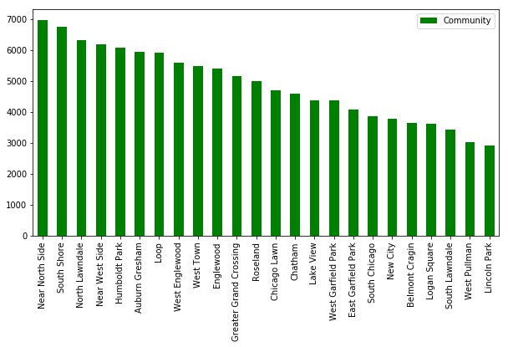
Chicago crime data update by Public Use Area
Chicago is made up of 77 community areas that are often grouped into 9 districts or “sides.”
Reported crimes happened between 2012 to 2015, there are 199862 crimes that have been updated.
Most of these updated Chicago crimes happened in the Chicago Northside area
Notes:
M. Musa

Slide 3
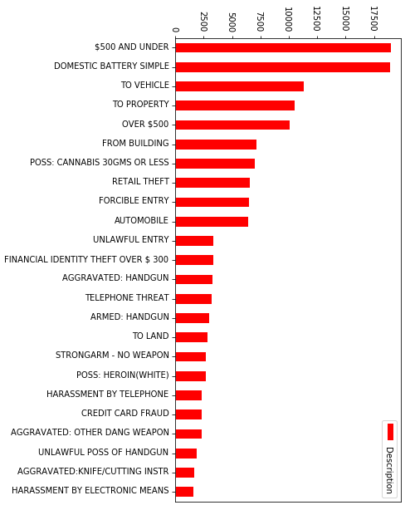
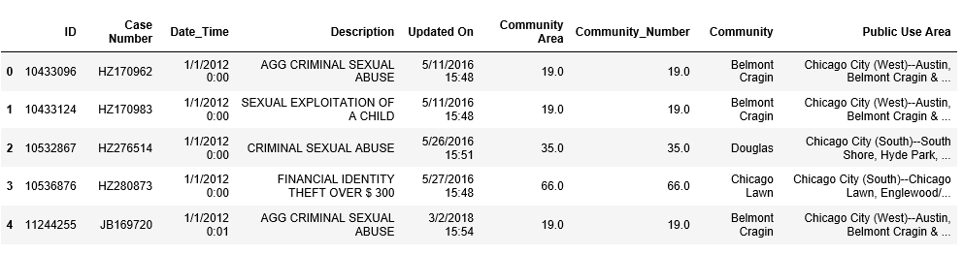
Chicago crime data update by crime Description
Most the updated Chicago crimes between 2012 to 2015 was theft of $500 and under and domestic battery.
Those two categories (Theft under $500 and Battery) make up to 20% of the total updated crimes committed.
Notes:
M. Musa

Slide 4
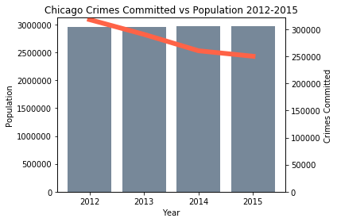
Crime Rate and Population
We hypothesized that areas with higher population density would have higher crime rate, therefore if population increased the crime rate would also increase.
Our data does not support our hypothesis, as the number of crimes committed decreased population in Chicago has remained stable
Notes:
Jacklyn Rapp

Slide 5
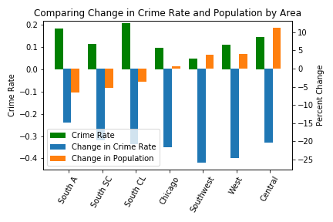
Comparing Individual Areas
Three areas with largest population growth:
Chicago City (Central)--Near North Side, Loop & Near South Side
Chicago City (West)--West Town, Near West Side & Lower West Side
Chicago City (Southwest)--Gage Park, Garfield Ridge & West Lawn
Three areas with smallest population growth:
Chicago City (South)--Auburn Gresham, Roseland, Chatham, Avalon Park & Burnside
Chicago City (South)--South Chicago, Pullman, West Pullman, East Side & South Deering
Chicago City (South)--Chicago Lawn, Englewood/West Englewood & Greater Grand Crossing
Notes:
Jacklyn Rapp

Slide 6
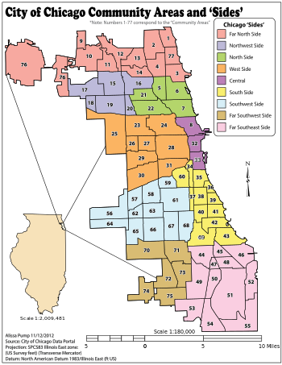
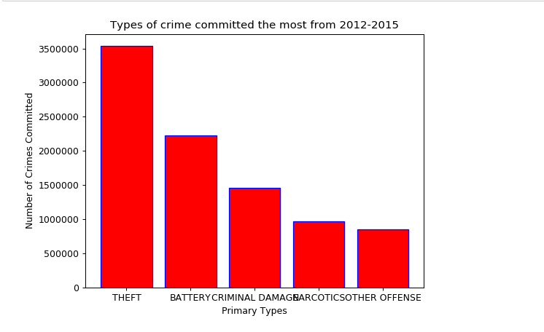
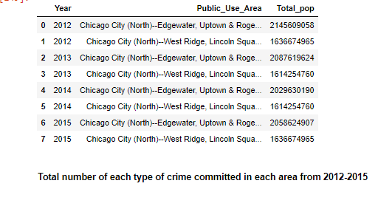
Primary Types of Crimes Committed
Notes:
Maria

Slide 7
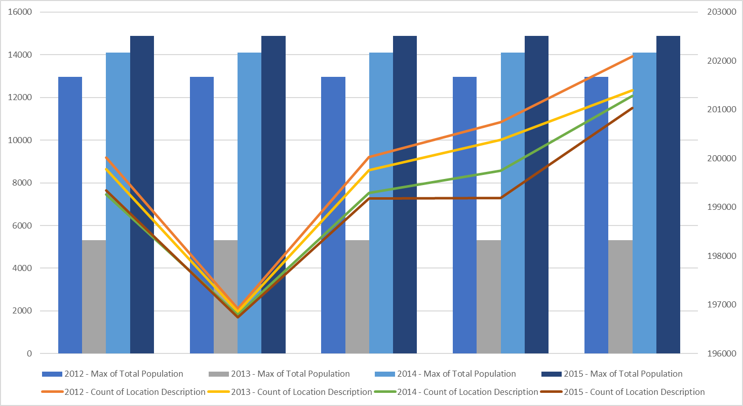
Top 5 Community Area and Location Description

Slide 8
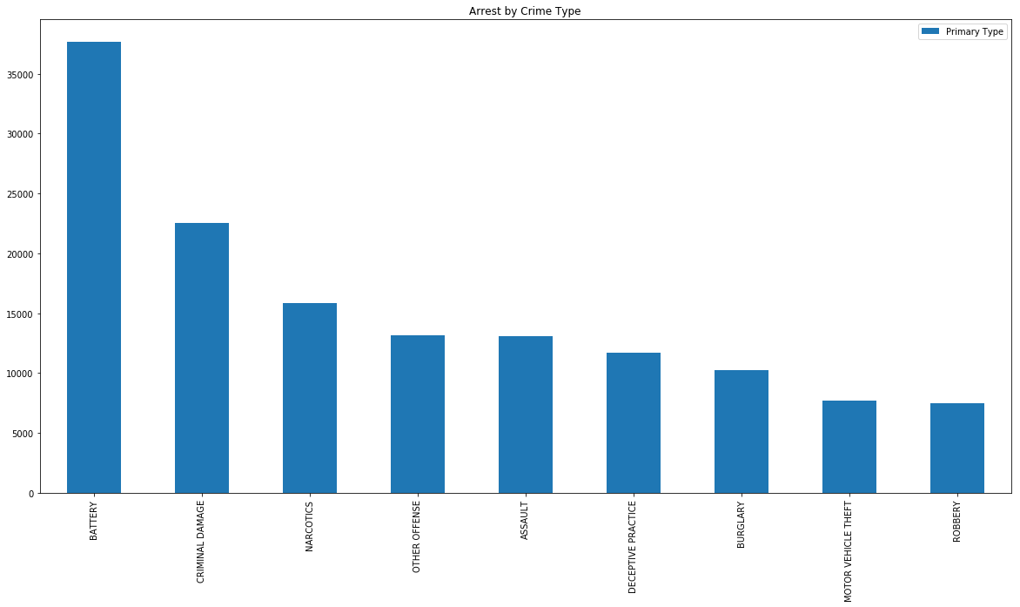
ARREST BY CRIME TYPE

Slide 9
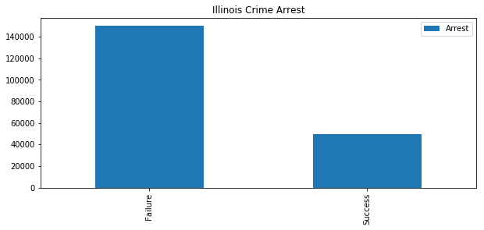
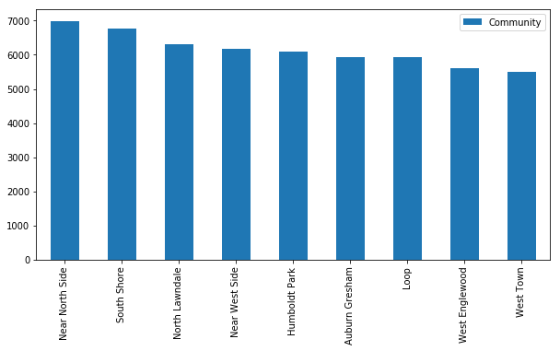
Crime Arrests
Success:49894
Failure:149968
Near North Side: 6981
West Town:5491
Notes:
Mohamed Abdirisaa Ahmed

