Slide 1

Sprocket Central Pty Ltd
Data analytics approach
Maria Tayo, Data Analyst

Slide 2
Agenda
Introduction
Data Exploration
Model Development
Interpretation

Slide 3
Introduction
Business Problem and Objective
To identify the top 1000 new customers to be targeted and recommend a suitable marketing strategy.
Contents of Data Analysis
Sprocket Central Pty Ltd are a mid-sized company who specialises in high-quality bikes and accessible cycling accessories to bike riders.
Their Marketing team is looking to boost business and expand into a new market by analysing their existing customer dataset to determine customer trends and behaviour.
Age distributions (“Old” and “New” customers)
Wealth Segmentation by Age Category
Bike related purchases over the past three years by Gender.
Job Industry Categorisation.
Bike related purchases based on Industry.
RFM Analysis and Customer Segmentation.

Slide 4
Data Exploration
Data Quality Assessment and Data Cleaning
Summary Table | Accuracy | Completeness | Consistency | Currency | Relevancy | Validity
Customer Demographic | Date of birth stated as 21.12.1843 which would not be accurate. This has been removed. Spelling errors under Job title and Job industry corrected. | Blanks removed for a few columns including job industry. | Lack of consistency for gender (F, M, Female and Male) corrected. | Deceased customers have been filtered out. | Default column removed as not relevant.
Customer Address |  |  | Inconsistencies with the states have been corrected.
Transaction Data | Three of the currencies in the standard cost column needed to be reformatted as currency. Profit was missing and has now been added. | Blanks in the online order and brand column have been filtered out. | There are more customer ids which is inconsistent with the Customer Demographic sheet. | The product first sold date is from 1991-2016 which is a huge time period. | Cancelled orders under “order status” have now been filtered out. | List price and product sold date needed reformatting.

Slide 5
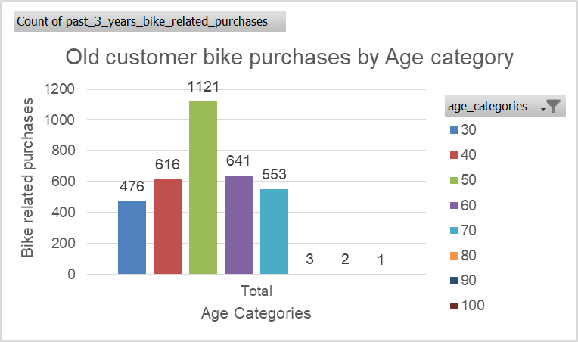
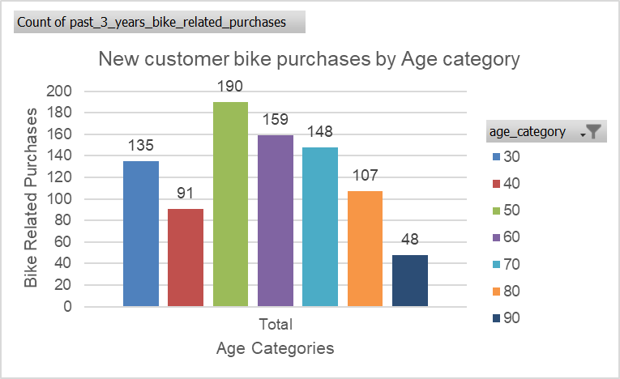
Data Exploration
Age Distributions (“New” and “Old” Customers)
The majority of customers (both old and new) who have made bike related purchases in the last three years are between the age of 40-49. For new customers, there is a steady decrease following this age category.
Age categories (30 = 20-29, 40 = 30-39, 50 = 40-49, 60 = 50-59, 70 = 60-69, 80 = 70-79, 90 = 80-89, 100 = 90-99)

Slide 6
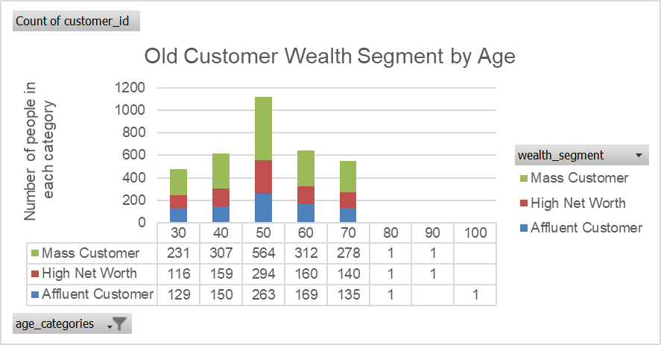
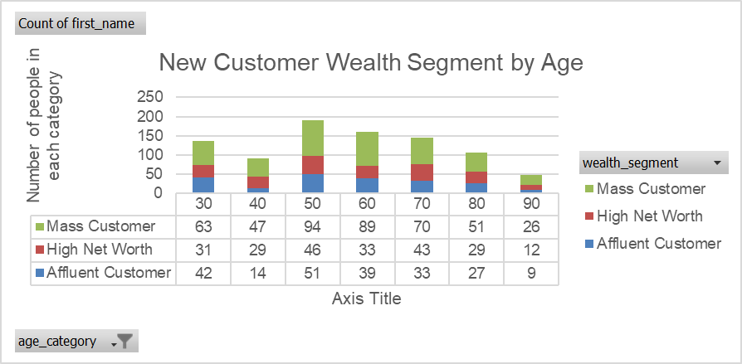
Data Exploration
Wealth Segmentation by Age Category
The largest number of customers fall within the “Mass Customer” wealth segment for both old and new customers, and this again falls within the 40-49 age category.
This is followed by “High-Net-Worth” customers and “Affluent” customers.

Slide 7
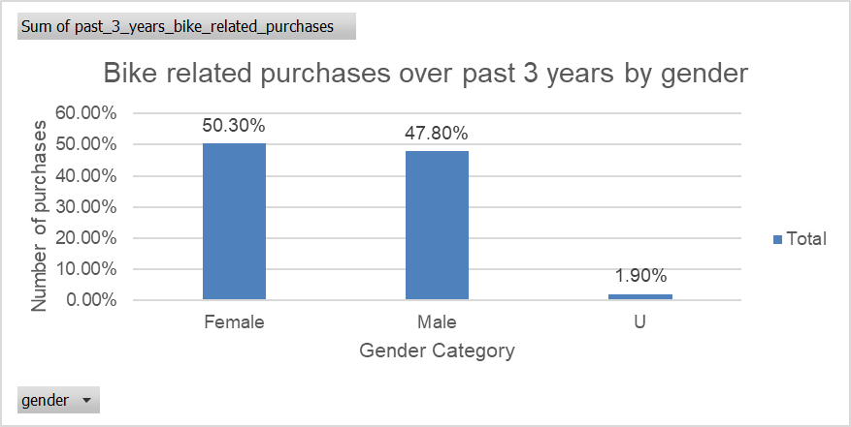
Data Exploration
Percentage of Bike related purchases over the past 3 years by gender
The majority of bike related purchases over the last three years have been made by females at just over 50%, followed by 47.80% for males. Just under 2% of bike related purchases were made by an unknown gender.

Slide 8
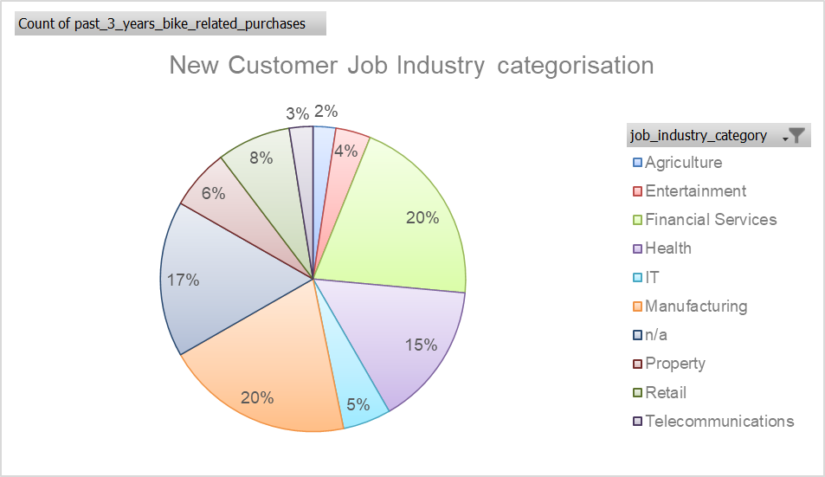
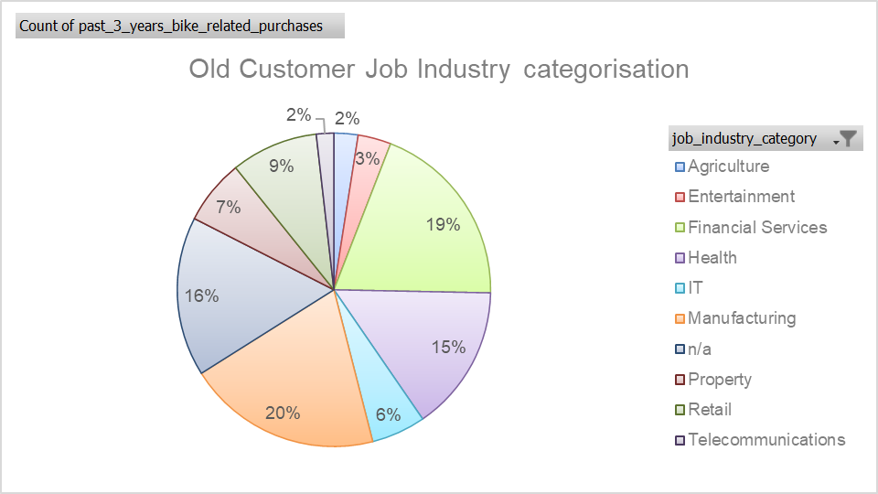
Data Exploration
Job Industry Categorisation
(Old and New Customers)
The top three industries of those who have made bike related purchases over the last three years (both old and new customers) are the manufacturing industry (20%), financial services (19% for old customers and 20% for new customers) and health (15%).
There is also a high level of those who have made bike related purchases who have n/a as their industry.

Slide 9
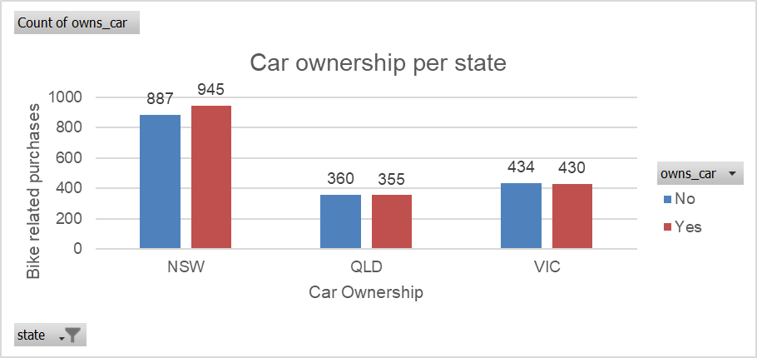
Data Exploration
Car Ownership by State
NSW (New South Wales) has the largest amount of people who have made bike related purchases, followed by Vic (Victoria) and then QLD (Queensland). This is the same case whether they own a car or not.
This revealed that the number of customers who own a car is almost equal to the number of customers who don’t own a car. Therefore, car ownership does not have a massive impact on bike related purchases.

Slide 10
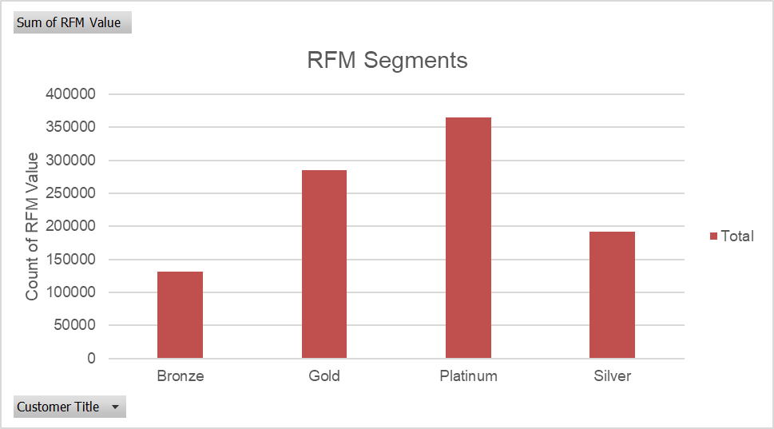
Model Development
RFM Analysis and Customer Segmentation
RFM is a type of customer segmentation and behavioural targeting used to help businesses rank and segment customers based on recency, frequency, and monetary value of a transaction. This is the marketing strategy used as part of our analysis.
The sum of the RFM values shows that the majority of customers are Platinum customers.

Slide 11
Model Development
Customer Classification
Based on the data analysis and data insights these are the type of customers that should be targeted:
Customers between the age of 40-59 (middle aged customers).
Customers within the Mass Customer wealth segment.
Mainly Females should be targeted as they make up the majority of bike related sales.
Customers working within the Manufacturing industry, Health, and Financial services, as well as customers whose job industry is classified as N/A.
Customers from New South Wales and Victoria. According to additional data from the Australian Bureau of Statistics, New South Wales has the highest population followed by Victoria (at around 1.5 million less in population). From our analysis, New South Wales also has the highest number of bike purchases, followed by Victoria.

Slide 12





Model Development
Customer Classification
Based on the data analysis and data insights these are the type of customers that should be targeted:
Customers between the age of 40-59 (middle aged customers).
Customers within the Mass Customer wealth segment.
Customers from New South Wales and Victoria.
Customers working within the Manufacturing industry, Health, and Financial services, as well as customers whose job industry is classified as N/A.
Mainly Female customers.

Slide 13
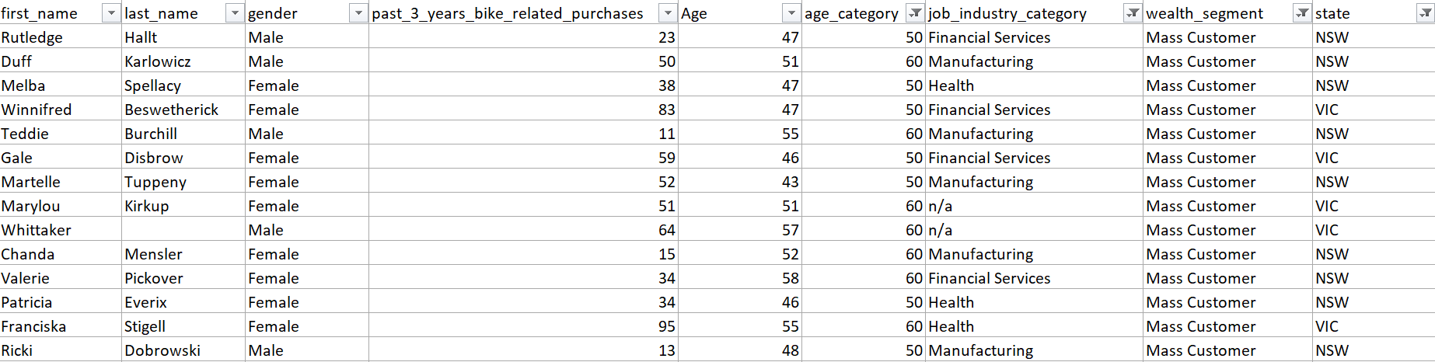
Interpretation
Summary Table for High Value Customers
This is a list of a few customers identified under the high value customer classification.

Slide 14
Appendix

Slide 15
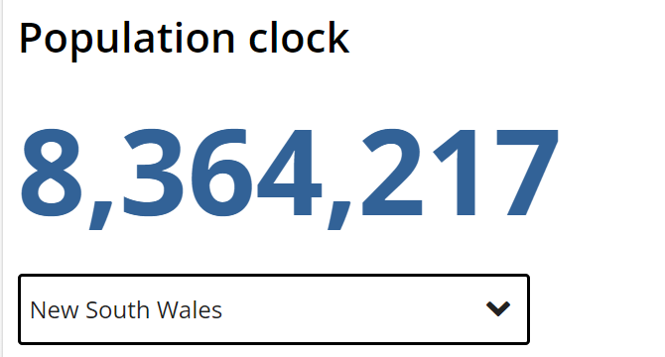
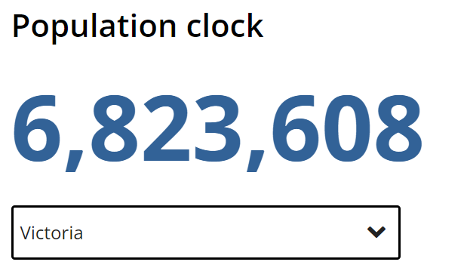
Appendix
Additional Data from the Australian Bureau of Statistics (18 August 2023)
According to additional data from the Australian Bureau of Statistics, New South Wales has the highest population followed by Victoria (at around 1.5 million less in population).

