Slide 1
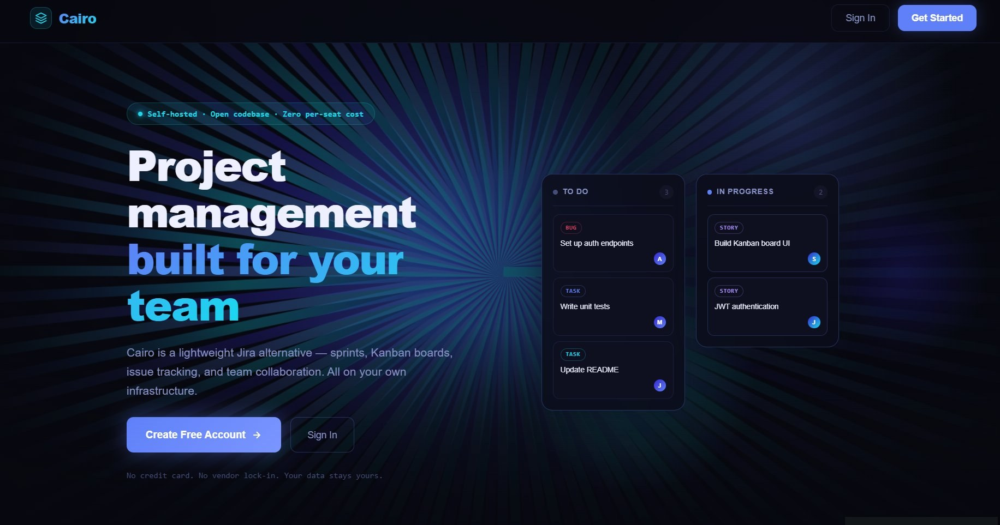
C
Cairo
Project Management
Application
★ Fun Fact
Maria Aguilar · UCI 2123: Systems Engineering with AWS · Capstone 2026
Cairo is named after my son — it means "The Victorious" in Arabic. Did you know? "Jira" is short for Gojira — the Japanese name for Godzilla!
React 18
Spring Boot 4
MySQL 8
JWT

Slide 2
THE PROBLEM
THE SOLUTION
Why teams struggle
with tools like Jira
Cairo gives teams
full control
$8–$15
$0
per user / month just to manage your own work
→
per user / month — forever. Self-hosted, yours to own.
⏱
Complex setup takes days — not hours
🏠
Free & self-hosted — zero per-seat licensing
🔒
Your data sits on vendor servers
⚡
Deploys locally in minutes, README included
📦
Teams pay for features they never use
🛡️
All data stays on your own infrastructure
🚫
No lightweight self-hosted option exists
🔧
Open codebase — extend it for your needs

Slide 3
Architecture Overview
Three-tier full-stack application
Frontend
Backend
Database
React 18 + Vite
Spring Boot 4
MySQL 8
React Router (10 routes)
Axios API client
JWT token storage
useContext + useReducer
CSS Modules + Syne font
PrismaticBurst animation
7 REST Controllers
Service + DTO layer
Spring Security + JWT
JPA / Hibernate ORM
Global Exception Handler
Rate limiting filter
10 relational tables
FK constraints + indexes
ENUM types for status
Cascade delete rules
Issue audit history
Seed data included
JPA / SQL
HTTP/JSON

Slide 4
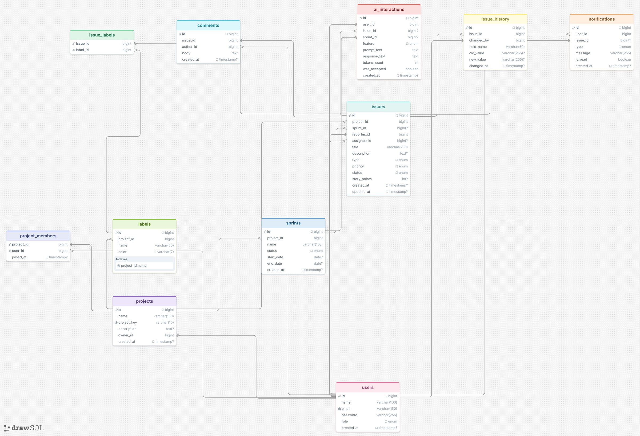
Database Schema
10 relational tables — MySQL 8 · Designed with DrawSQL

Slide 5
User Stories
12 user stories — all completed ✓
US-01
✓
US-02
✓
US-03
✓
Create an Issue
Update Issue Status
Assign Issues to Members
Developer · 3 pts
Developer · 2 pts
Developer · 2 pts
US-04
✓
US-05
✓
US-06
✓
Comment on Issues
Receive Notifications
Create Project & Add Members
Developer · 3 pts
Developer · 5 pts
Project Manager · 5 pts
US-07
✓
US-08
✓
US-09
✓
Manage Sprints
View Kanban Board
Filter Issues
Project Manager · 8 pts
Project Manager · 8 pts
Project Manager · 3 pts
US-10
✓
US-11
✓
US-12
✓
Register and Login
Assign USER/ADMIN Roles
Remove Members
Admin · 5 pts
Admin · 3 pts
Admin · 2 pts

Slide 6
Demo Flow
DEMO
Follow this sequence during the live demo
Live
01
Register → Login
JWT token issued, role set to USER
02
Create Project
Running on
Add team members from the user list
localhost:5173
Frontend
localhost:8081
Backend
03
Sprint Planning
Create sprint → Add issues → Start sprint
📋 README.md has full setup instructions
04
Kanban Board
Move issues ← → through 4 columns
05
Notifications
Comment on issue → bell updates live
06
Admin Panel
Promote a user to ADMIN role

Slide 7
Technical Deep Dive
// IssueService.java — Status update with full audit trail
📝 Audit Trail
public Issue updateStatus(Long issueId, Issue.IssueStatus newStatus, User changedBy) { // 1. Write audit trail BEFORE updating IssueHistory entry = IssueHistory.builder() .issue(issue).changedBy(changedBy)
.fieldName(
"status") .oldValue(issue.getStatus().name()) .newValue(newStatus.name()).build(); historyRepository.save(entry); // 2. Update status issue.setStatus(newStatus); // 3. Notify assignee if someone else changed it if (issue.getAssignee() != null && !issue.getAssignee().getId().equals( changedBy.getId())) { notificationRepository.save(...); } return issueRepository.save(issue);
}
Every status change writes to issue_history — who changed it, from what, to what.
🔔 Smart Notifications
Assignee notified only when someone ELSE moves the issue — no self-spam.
🔒 Role Guards
ADMIN bypasses ownership. Reporters can edit their own issues.

Slide 8
Security & Local Setup
1
2
3
4
5
POST /auth/login
email + password
→
BCrypt validates
password hash
→
JWT signed
24h TTL
→
Bearer token
every request
→
JwtAuthFilter
validates JWT
🔒 Security
⚙️ Local Setup
BCrypt
Stateless JWT
MySQL 8
Cairo.sql
cost factor 10
no sessions
Port 3306
10 tables + FK
CORS locked
Rate limiting
seed.sql
npm run dev
localhost:5173
10 req/min/IP
4 users · 14 issues
localhost:5173
Env variables
No plaintext
mvn spring-boot:run
admin@cairo.com
secrets safe
passwords ever
localhost:8081
password123

Slide 9
Lessons Learned
Three key takeaways from the 7-day sprint
Database Design First
🏗️
Spent Day 1 on the full ERD before writing a single line of code. Never changed a table during the entire build — designing first kept everything organized and simple.
Handle Errors Properly
🔧
Wrong password returned a 500 instead of a 401 — confusing and unprofessional. One extra exception handler fixed it. Small fix, big difference.
When a Tool Fails, Build It
🔑
The animation library wouldn’t install. Wrote the entire canvas animation from scratch — better outcome since every line is understood and fully owned.

Slide 10
Future Enhancements
🤖
AI-Powered Workflow Assistant
PRIORITY ENHANCEMENT
Integrate an AI assistant to help project managers auto-prioritise backlogs, suggest sprint assignments based on team velocity,
detect bottlenecks in real-time, and summarize stand-up updates automatically from issue history.
📱
Mobile App
⚡
Real-Time Notifications
📊
Analytics Dashboard
React Native iOS & Android client
WebSockets instead of polling
Velocity charts & burndowns
🔗
Third-Party Integrations
🌐
Multi-Language Support
☁️
AWS Cloud Deployment
GitHub, Slack, Google Calendar
i18n for global distributed teams
ECS + RDS + SSM Parameter Store

Slide 11
Questions?
Cairo — Capstone Project · Maria Aguilar · UCI 2123 · 2026
🔗 github.com/Mariaa97-rodri
🌐 localhost:5173
📧 admin@cairo.com
Thank you for your time!

