Slide 1
Battle of Neighborhoods
May 2020
Coursera

Slide 2

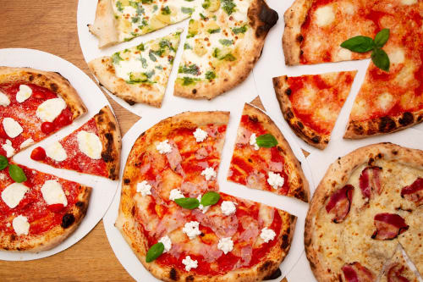
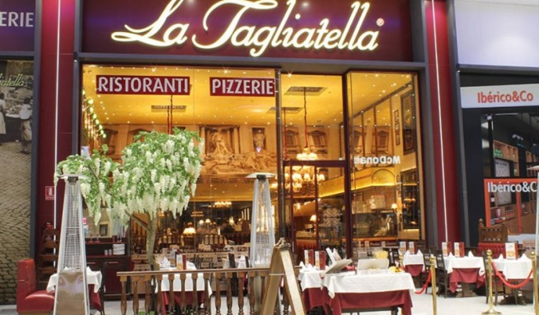
Introduction
Which borough and which neighborhood has a stronger presence of Italian culture in Barcelona?
Analyze the number of Italian restaurants in each borough and neighborhood

Slide 3
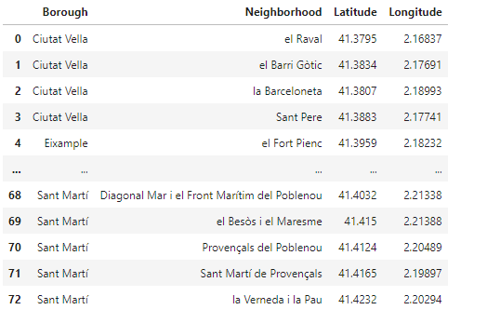
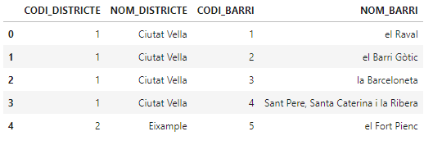
Acquisition of data
Catalan government database
Before cleaning
After cleaning
Translate Catalan to English
Drop useless columns
Add Latitude and Longitude with geocode

Slide 4
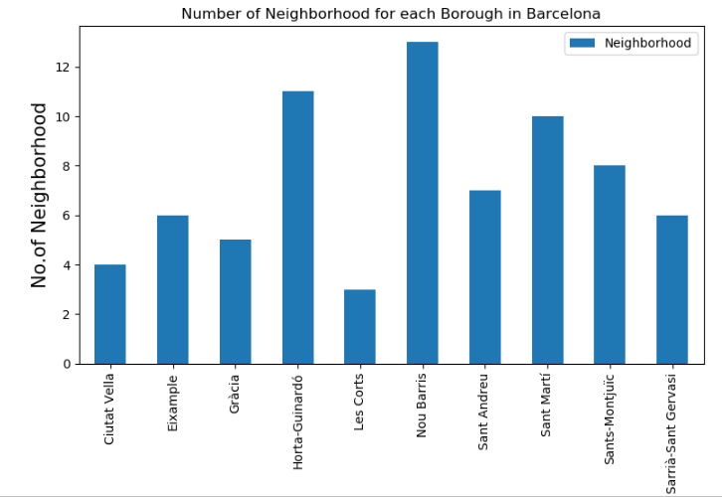
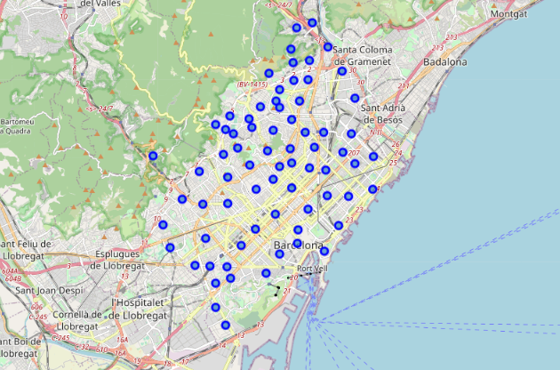
Methodology
Visualization of data

Slide 5
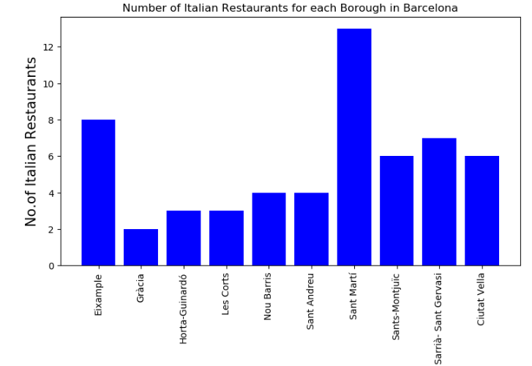
Results

Slide 6
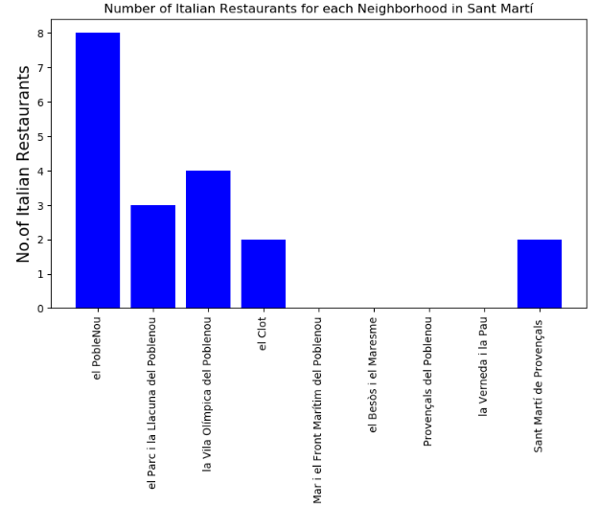
Results

Slide 7
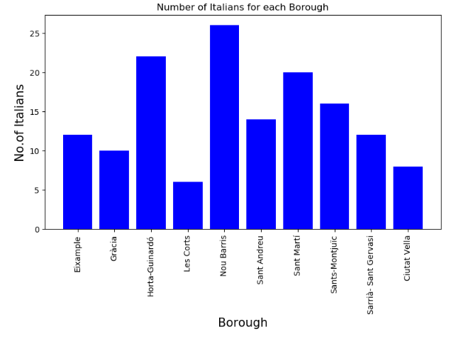
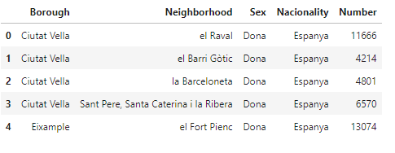
Discussion

Slide 8
Conclusion
The neighborhood in Barcelona with the strong presence of Italian culture is Poblenou-Sant Martí

