Slide 1

Collaborative Practices in Software Construction
Lecture 06
By Maria Manzoor
maria.manzoor@iqraisb.edu.pk

Slide 2
Agenda
Explain why collaborative software development needs version control.
Describe repositories, commits, branches, merges, and pull requests.
Use advanced Git features to coordinate work and resolve conflicts.
Identify tools that support Agile planning, communication, code review, and automation.
Apply collaboration practices to a realistic software construction scenario.
Goal: make team changes traceable, reviewable, and safe.

Slide 3
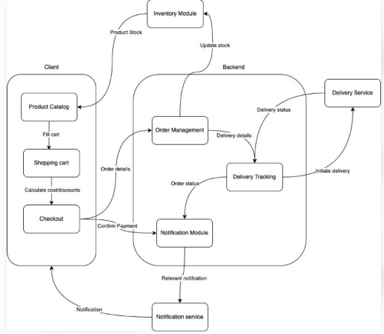
Why Collaboration Matters in Construction
Software is usually built by multiple people working on related components.
Developers may edit the same files or depend on each other’s work.
Without coordination, teams can overwrite changes, introduce defects, or duplicate effort.
Collaborative practices create a shared process for planning, coding, reviewing, testing, and releasing.
Good collaboration is not just using tools—it also requires agreed rules and communication.
Tools support teamwork; they do not replace teamwork.

Slide 4
Version Control System (VCS): Meaning
A foundation for safe, traceable collaboration
A VCS records changes to files over time.
It helps a team see who changed what, when, and why.
Earlier versions can be inspected or restored when needed.
Developers can work in parallel without directly overwriting each other’s work.
Git is a widely used distributed version control system.

Slide 5
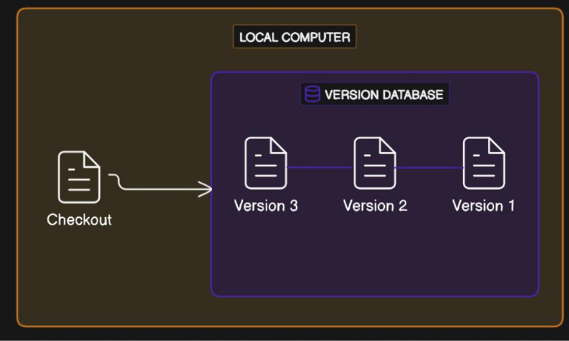
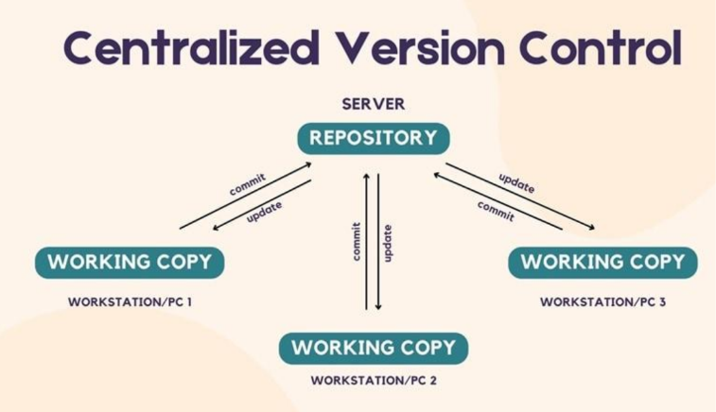
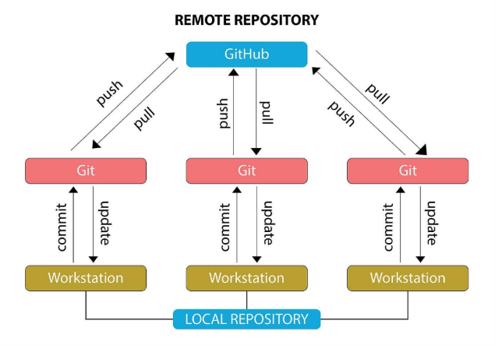
Types of Version Control Systems
Local VCS: keeps version history on one computer.
Centralized VCS: uses a central server as the main repository (for example, SVN).
Distributed VCS: each developer can have a full local repository (for example, Git).
Distributed systems support offline commits and flexible branching.
A remote repository is still useful for sharing and backup.
Git is distributed—even when a team uses GitHub or GitLab as its shared remote.

Slide 6
Core Git Concepts
Repository (repo): project files plus their version history.
Commit: a saved snapshot of selected changes, with a message and identifier.
Branch: an independent line of development.
Merge: combines changes from different branches.
Remote: a shared repository hosted elsewhere.
Working directory and staging area: places where edits are made and prepared before committing.

Slide 7
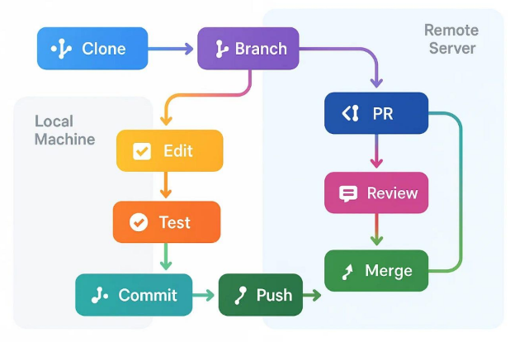
A Typical Git Workflow
1. Clone or pull the latest project from the remote repository.
2. Create a branch for a specific task or bug fix.
3. Edit code and run relevant tests locally.
4. Stage and commit a small, meaningful set of changes.
5. Push the branch and open a pull/merge request.
6. Respond to review feedback, pass checks, then merge.
Keep commits focused and messages meaningful.

Slide 8
Useful Git Commands
Command examples for a basic team workflow
git clone <url> — copy a remote repository to your computer.
git status — check changed, staged, and untracked files.
git switch -c feature/login — create and switch to a branch.
git add <file> and git commit -m "Add login validation" — prepare and record changes.
git pull — fetch and integrate remote changes; git push — publish local commits.
git log --oneline --graph — inspect project history.

Slide 9
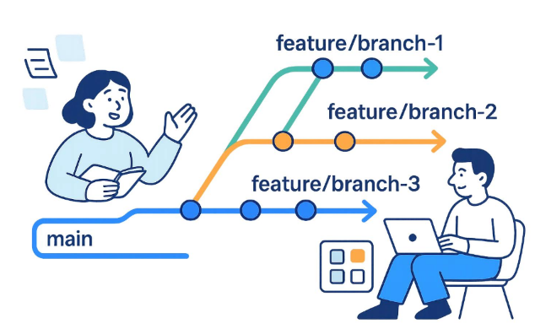
Branching Strategies for Teams
Feature branches: each task is developed separately before review and integration.
Main branch: should remain stable and meet the team’s quality rules.
Short-lived branches: reduce long-running divergence and difficult merges.
Release branches may be used when a team must stabilize a specific version.
Choose a strategy that fits team size, release frequency, and deployment process.
A branch should represent a clear task, not a permanent personal workspace.

Slide 10
Advanced Git: Stashing, Cherry-Picking, Rebase
Powerful tools for managing changes
git stash: temporarily shelves uncommitted changes so you can switch tasks.
git cherry-pick: applies a specific commit to the current branch.
git rebase: replays commits on top of another base to create a more linear history.
Interactive rebase can help tidy local commits before sharing them.
Use history-rewriting commands carefully on commits that others already depend on.

Slide 11
Merging and Resolving Conflicts
A conflict occurs when Git cannot automatically combine overlapping changes.
Read the conflict markers and understand both developers’ intentions.
Edit the file to create the correct combined result; remove conflict markers.
Run tests, inspect the diff, then stage and commit the resolution.
Discuss the decision with the teammate when behavior or requirements are unclear.
Do not resolve conflicts by blindly choosing “ours” or “theirs.”

Slide 12
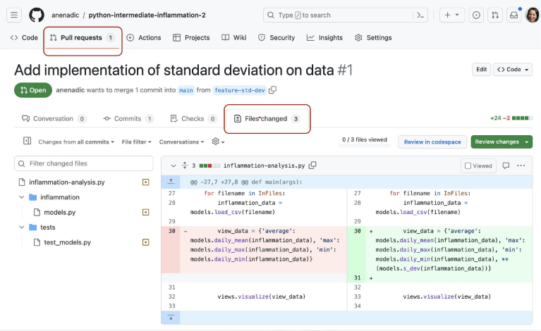
Pull Requests and Code Review
A pull request (PR) or merge request proposes changes for integration.
Reviewers check correctness, readability, maintainability, security, and tests.
Small PRs are easier to understand and review than large, mixed-purpose changes.
Automated checks can run builds, tests, linters, and security scans.
Review comments should be specific, respectful, and focused on the code—not the person.
Review early; treat feedback as a quality practice, not a personal criticism.

Slide 13
Collaboration Safety and Repository Hygiene
Never commit passwords, API keys, tokens, or private credentials.
Use .gitignore for generated files, local settings, and build output where appropriate.
Protect the main branch with required reviews and passing checks.
Use clear commit messages and keep README/setup instructions current.
Use tags and releases to identify versions delivered to users.

Slide 14
Collaborative Tools for Agile Development
Tools support the Agile cycle: plan → build → inspect → adapt
Planning and tracking: Jira, Trello, Azure Boards, GitHub Projects.
Code hosting and review: GitHub, GitLab, Bitbucket, Azure Repos.
Communication: Microsoft Teams, Slack, Discord, project channels, and stand-ups.
Continuous integration: GitHub Actions, GitLab CI/CD, Jenkins, Azure Pipelines.
Documentation and knowledge sharing: Confluence, wikis, Markdown, shared docs.
Choose tools that integrate and keep the team’s workflow visible.

Slide 15
How Tools Support Agile Practices
Product backlog: records features, user stories, priorities, and acceptance criteria.
Sprint planning: selects work the team can realistically complete.
Daily coordination: communicates progress, blockers, and dependencies.
Continuous integration: checks changes frequently rather than waiting until the end.
Sprint review and retrospective: demonstrate working software and improve the process.
A single source of truth reduces conflicting task status and scattered decisions.

Slide 16
Example: Building a University Portal
Team members work on student records, attendance, examination, and fee modules.
Each developer creates a task branch and commits focused changes.
A pull request is reviewed for interface compatibility and test coverage.
CI runs unit tests, integration tests, and code-quality checks automatically.
The team tracks stories and bugs on an Agile board and discusses blockers daily.
Shared interfaces and agreed coding standards reduce integration problems.
Scenario: a fee-module change must not unexpectedly break student registration.

Slide 17
Common Collaboration Problems and Solutions
Large conflicts → use smaller commits, short-lived branches, and frequent integration.
Unclear ownership → assign tasks and define module interfaces.
Unreviewed defects → require code review and automated tests.
Hidden work or blockers → keep task boards current and communicate early.
Broken main branch → protect branches and require CI checks before merging.
Lost knowledge → document decisions, setup steps, and important trade-offs.

Slide 18
Class Activity: Team Git Workflow
Scenario: three developers are building a library management system.
Developer A changes book search; Developer B adds member registration; Developer C fixes a shared validation function.
In groups, decide how to name branches, write commits, review changes, and handle a conflict.
Identify which automated checks should run before merging.
Discuss: what could go wrong if everyone commits directly to the main branch?
Deliverable: a short workflow diagram or a 5-step team policy.

Slide 19
Exam Preparation Questions
1. What problems does a Version Control System solve in a software team?
2. Differentiate between a commit, branch, merge, and remote repository.
3. When might a developer use stash, cherry-pick, or rebase?
4. Why are pull requests and code reviews important?
5. How can Agile planning tools and CI support a team building a university portal?

Slide 20
Thank You
Maria Manzoor
maria.manzoor@iqraisb.edu.pk

