Slide 1
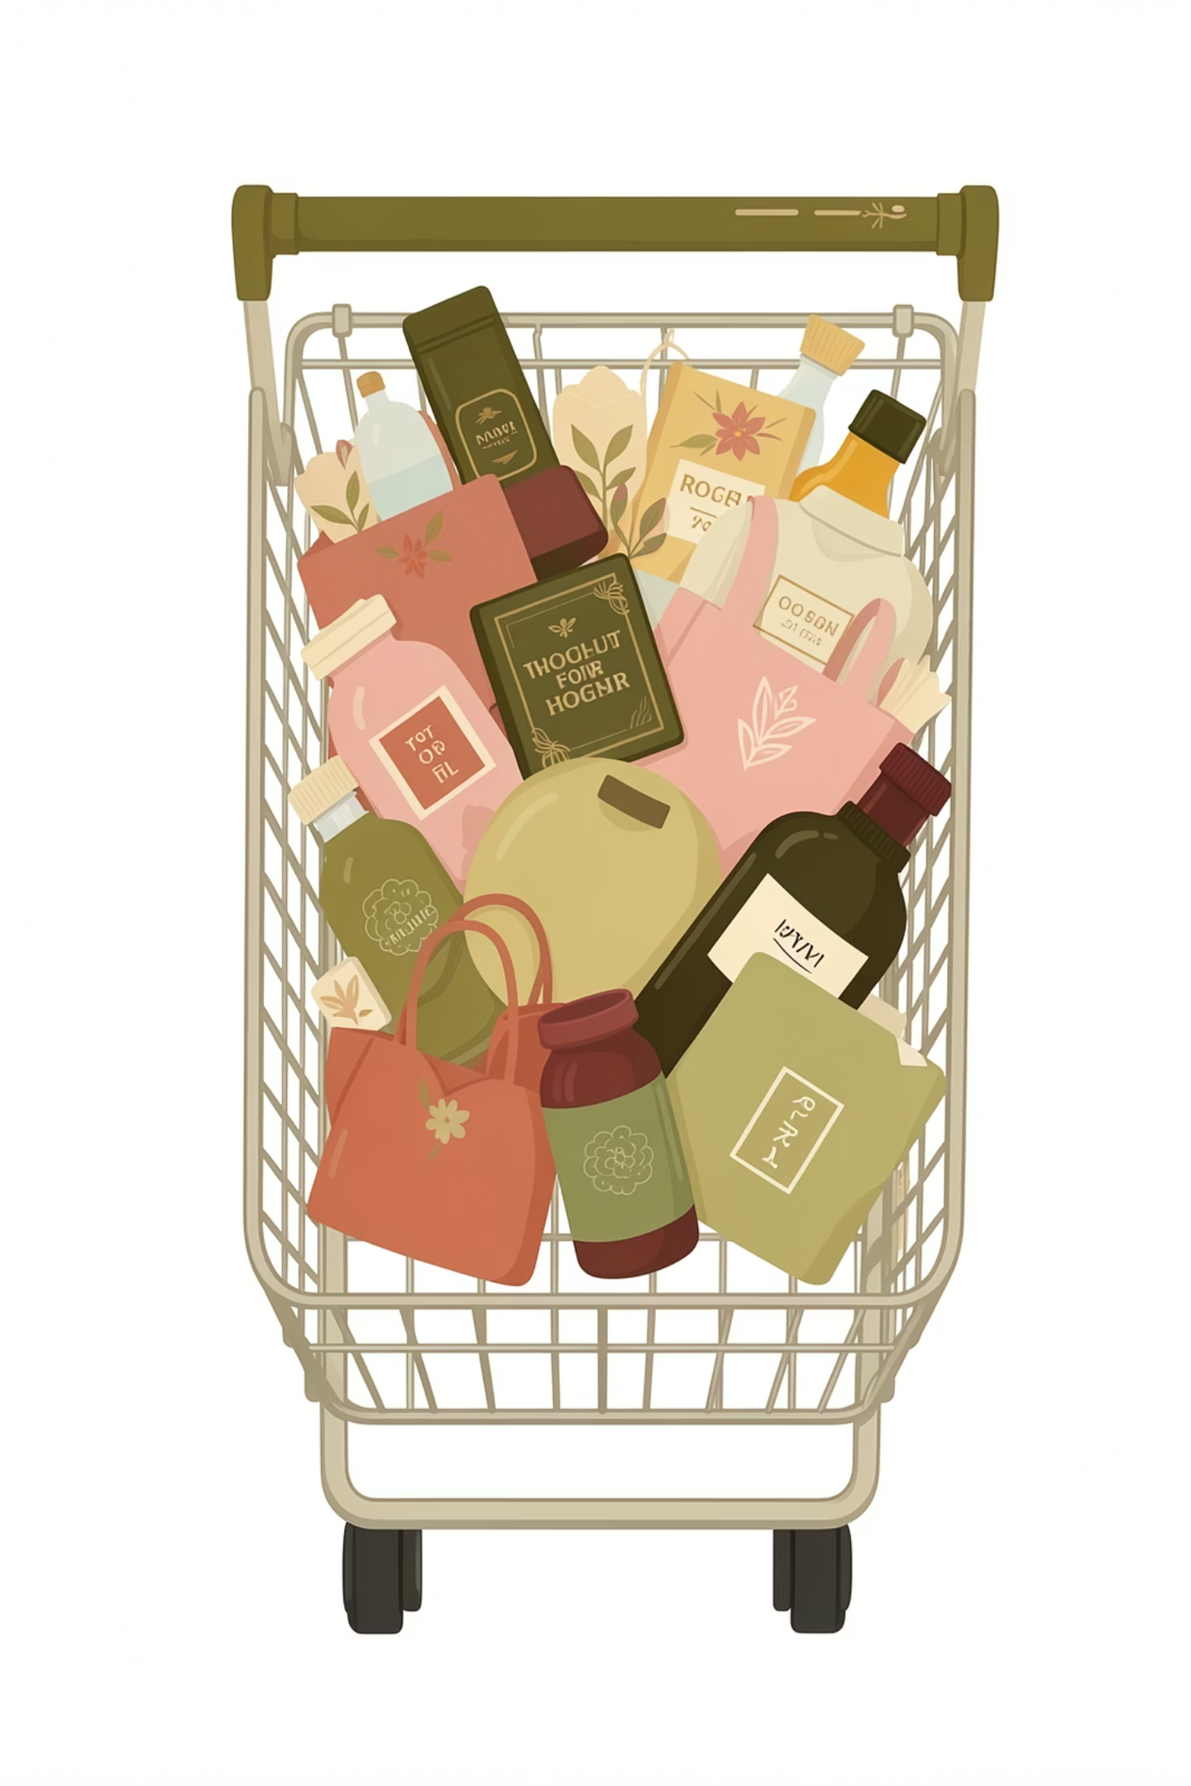
Customer Shopping Behavior Analysis
Uncovering spending patterns, customer segments, product preferences, and subscription behavior from 3,900 transactions across multiple product categories — to guide strategic business decisions.

Slide 2

Dataset & Methodology
Dataset at a Glance
Python Data Prep
Key features include demographics, purchase details, and shopping behavior metrics.
Load & Explore
Imported with pandas; used df.info() and .describe()
Clean & Engineer
Imputed missing ratings; created age_group and purchase_frequency_days
Load to PostgreSQL
Connected Python to PostgreSQL for SQL analysis
3,900
18
37
Transactions
Feature Columns
Missing Ratings

Slide 3

SQL Analysis: Revenue & Spending
Revenue by Gender
Males generated $157,890 vs. females at $75,191 in total revenue.
High-Spend Discount Users
839 customers used discounts yet spent above the average purchase amount.
Shipping Type
Express shoppers spent slightly more ($60.48) vs. Standard ($58.46) on average.
Subscribers vs. Non-Subscribers
Non-subscribers (2,847) drive $170,436 in revenue; subscribers (1,053) average $59.49 spend.

Slide 4
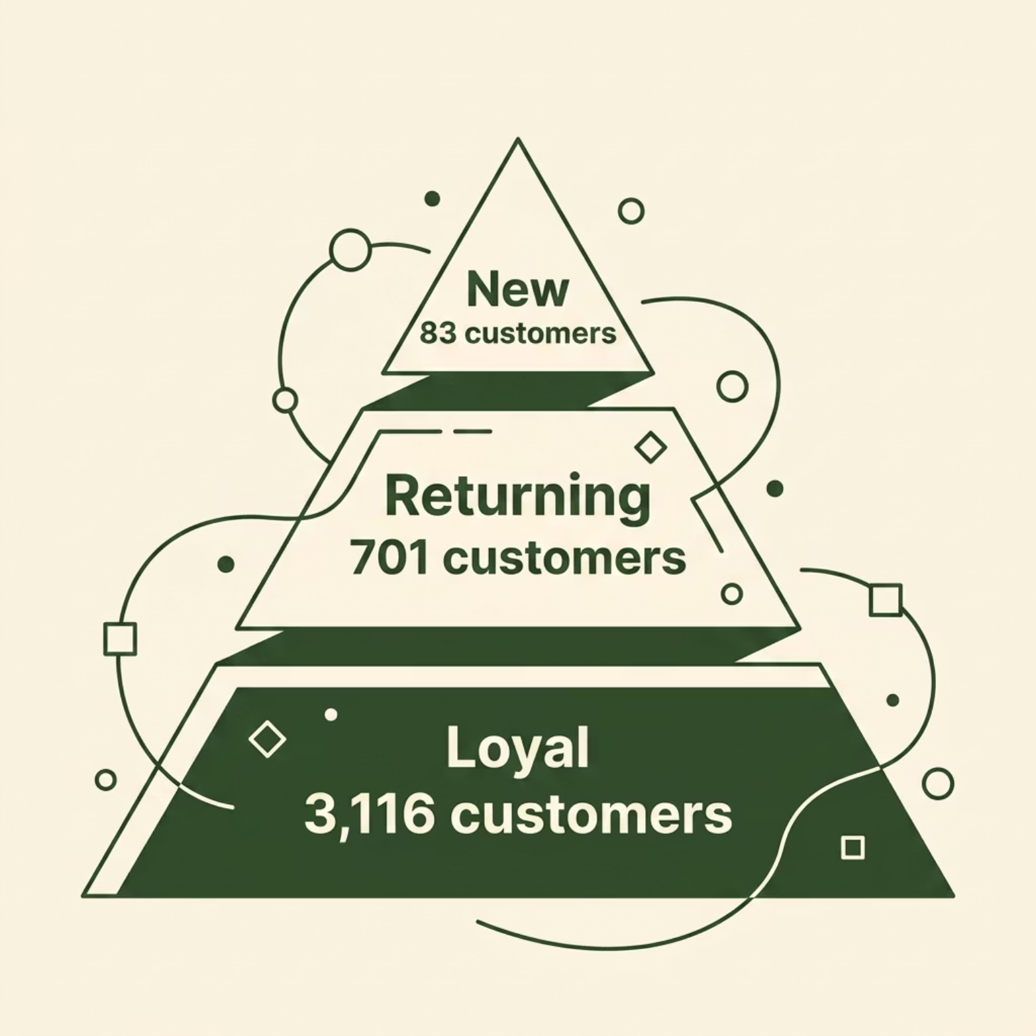


Customer Segments & Top Products
Top Products by Category
Category
#1 Product
Orders
Accessories
Jewelry
171
Clothing
Blouse
171
Footwear
Sandals
160
Outerwear
Jacket
163
Top-rated items: Gloves (3.86), Sandals (3.84), Boots (3.82)

Slide 5
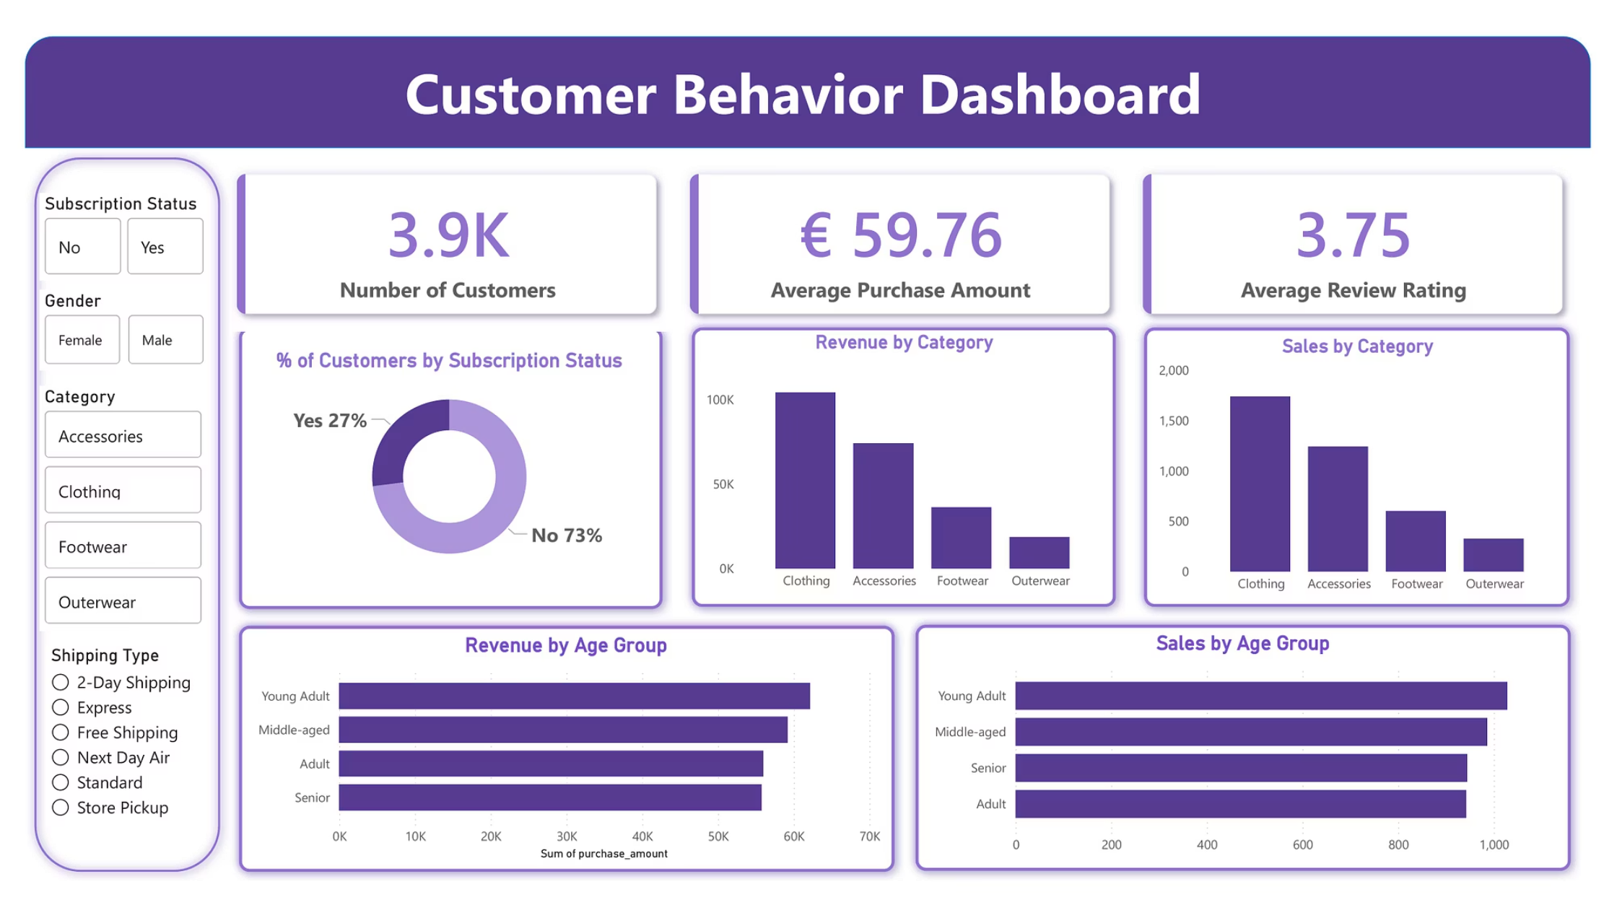
Power BI Dashboard
Dashboard includes filters by subscription status, gender, category, and shipping type — with charts for revenue and sales by category and age group.

Slide 6

Business Recommendations
Boost Subscriptions
Promote exclusive benefits to convert the 73% non-subscriber base.
Loyalty Programs
Reward repeat buyers to accelerate movement into the Loyal segment.
Review Discount Policy
Balance sales boosts with margin control — especially for Hat, Sneakers, and Coat.
Targeted Marketing
Focus on high-revenue age groups (Young Adults) and express-shipping users.

