Slide 1
Sales & Demand Performance Dashboard – Strategic Insights A Global Superstore Sales Analysis from a Supply Chain Lens
Presented by: Mariam Abdulazeez

Slide 2

Executive Summary
Objective:
Provide strategic insights on sales, profitability, and product performance across regions, customer segments, and time periods to support data-driven demand planning and inventory optimization..
Overview of Analysis:
Analyzed Total Sales, Profit, and Order Volume by Year and Quarter to uncover seasonal trends.
Evaluated geographical performance by Country and Region using map and bar visuals.
Segmented data by Customer Segment and Product Category to pinpoint margin contributors.
Identified Top 10 high-volume SKUs to inform replenishment strategy.
Created dynamic KPIs and interactive slicers (Year, Region, Segment, Category) for flexible decision-making
Key Business Value:
Seasonality insights enable proactive procurement and production planning.
Regional and segment-level trends help reallocate resources toward high-margin opportunities.
SKU-level analysis supports inventory planning, avoiding stockouts of high-demand items.
Dynamic dashboard empowers executives to drill down and align supply chain strategy with demand signals.
DD/MM/YYYY
Feature Name/Product
Your Company Name

Slide 3
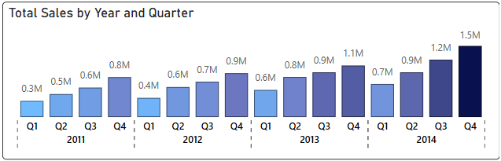
Overview – Business Performance (2011 to 2014)
Over the 4-year period from 2011 to 2014, the Global Superstore experienced steady growth in sales and profitability. A comprehensive analysis of order volume trends highlights increasing market penetration and customer engagement year-over-year.
Analysis:
Total Sales increased from $2.3M in 2011 to $4.3M in 2014, showing a consistent upward trend.
Total Profit also improved each year, reflecting better cost management and/or higher-margin product performance.
Total Orders grew from approximately 4,400 in 2011 to over 8,500 by 2014, indicating expanding demand across regions.
Insights:
Q4 consistently recorded the highest sales and profit across all years, indicating a seasonal surge (possibly holiday or year-end corporate spending).
2013 to 2014 saw the sharpest year-on-year profit increase, suggesting operational or pricing efficiency improvements.
The upward trend in orders shows increased market coverage and potentially improved customer retention.
Recommendation:
DD/MM/YYYY
Feature Name/Product
Your Company Name
Plan for seasonal spikes in Q4 by ramping up inventory and logistics readiness in Q3.
Conduct a deep dive into 2013–2014 improvements to replicate successful strategies across other periods.
Leverage historical demand patterns to build a rolling forecast model that accounts for both trend and seasonality.

Slide 4
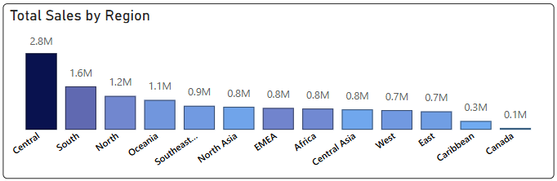
Overview – Regional & Country-Level Demand
Analyzing demand across regions and countries reveals significant disparities in revenue contribution and order volumes. These geographic insights help identify strongholds and opportunities for deeper market penetration or strategic realignment
Analysis:
USA leads in both total sales and profit, followed by India, Australia, and Germany.
North America drives the bulk of revenue, while APAC and EU regions show varying order volumes with mixed profitability.
Several emerging markets have high order counts but lower profitability, possibly due to discounting or operational inefficiencies.
Insights:
The USA contributes over XX% of global revenue but may be nearing saturation.
India shows strong order volumes with moderate profits, indicating potential for expansion through pricing strategies or upselling.
Regions like Africa and LATAM are underrepresented—presenting untapped potential if barriers to entry can be addressed.
Recommendation:
Double down on high-performing countries (e.g., USA, India) with tailored forecasting and supply alignment.
Audit low-margin markets to identify profitability bottlenecks (e.g., shipping, warehousing, or pricing).
Consider a regional demand model to adapt planning strategies for localized market conditions and reduce overstock or stockouts.
DD/MM/YYYY
Feature Name/Product
Your Company Name

Slide 5
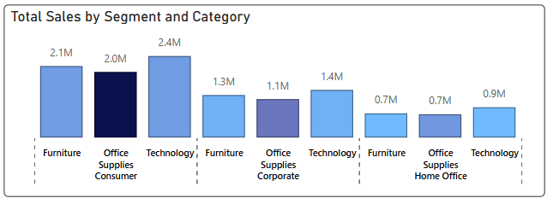
Overview – Segment & Category-Level Performance
Understanding how different customer segments and product categories contribute to overall sales and profit is critical for fine-tuning inventory and marketing strategies. This analysis helps align demand planning efforts with revenue-driving segments.
Analysis:
Consumer segment generated the highest number of orders, followed by Corporate and Home Office.
Technology category had the highest average profit per order, while Furniture recorded large sales but thinner margins.
Office Supplies maintained steady order volumes across all segments but delivered the lowest profit overall.
Insights:
The Consumer segment is volume-driven, requiring efficient fulfillment strategies and lean stock cycles.
Corporate segment shows higher profit margins, making it ideal for focused B2B planning and strategic account targeting.
Furniture has long lead times and low profit, making it vulnerable to stockouts or overstock—requiring tighter inventory control.
Recommendation:
Prioritize demand forecasting for Technology and Corporate segment products, where margins are strong.
Implement differentiated planning strategies for each segment—volume optimization for Consumers, profitability maximization for Corporate.
Reassess Furniture category logistics and pricing to enhance profitability and service levels.
DD/MM/YYYY
Feature Name/Product
Your Company Name

Slide 6
Overview – Top 10 High-Volume SKUs
A focused review of high-volume SKUs reveals the products that consistently drive order traffic and impact inventory turnover. These items are essential to track closely for accurate forecasting, stock availability, and fulfillment efficiency.
Analysis:
The top 10 SKUs account for 4% of total orders, concentrated across the Office Supplies and Technology categories.
Several top-performing SKUs (e.g., Binders, Phones, and Chairs) show high order frequency but varying profit margins.
One or two items exhibit high volume but negative or minimal profit, indicating potential pricing or cost structure issues.
Insights:
These top SKUs are critical for customer satisfaction and require prioritized replenishment to avoid stockouts.
Profit margins vary widely among high-volume items—suggesting opportunities to renegotiate supplier terms or adjust pricing.
Demand for these SKUs is consistent across multiple regions and segments, making them ideal for centralized stocking strategies.
Recommendation:
Implement SKU-level forecasting models for high-volume items to improve stock accuracy and reduce backorders.
Monitor profitability per unit for these items—consider bundling, re-pricing, or sourcing alternatives where margins are low.
Flag top SKUs as essential inventory items and apply tighter reorder points and safety stock policies.
DD/MM/YYYY
Feature Name/Product
Your Company Name

Slide 7
Strategic Demand Planning Actions
Plan for Q4 Demand Peaks
Historical data confirms a strong Q4 sales trend annually — adjust production and procurement cycles accordingly.
Use rolling forecasts that account for both year-over-year growth and seasonal spikes.
Double Down on High-Performing Regions & Segments
Prioritize North America and the Consumer segment for volume-focused planning.
Invest in B2B growth opportunities through the Corporate segment, where margins are highest.
Streamline High-Volume SKU Management
Apply SKU-level forecasting models for top 10 items to avoid stockouts and backorders.
Review profitability of high-volume SKUs and adjust pricing or sourcing where necessary.
Differentiate Inventory Strategy by Product Category
Fast-moving items (e.g., Office Supplies) need lean inventory strategies.
High-margin, slower-moving categories (e.g., Furniture) require tighter cost control and optimized stocking levels.
Enable Self-Service Insights for Stakeholders
The interactive dashboard allows executives and planners to filter by Year, Region, Segment, and Category — making data exploration easier and faster for decision-making.
DD/MM/YYYY
Feature Name/Product
Your Company Name

