Slide 1

Uber Trips Analysis Insights for Operational Efficiency and Strategic Planning
Presented by: Mariam Abdulazeez

Slide 2

Executive Summary
Objective:
To uncover key trends and operational insights from Uber trip data to support data-driven decision-making in supply chain planning and fleet operations.
Overview of Analysis:
Timeframe: 1-month dataset of Uber pickups in NYC
Tools: Power BI (Data cleaning, modeling, and dashboarding)
Focus Areas: Demand patterns, peak periods, popular locations, trip volumes
Key Business Value:
Enable better driver allocation, demand forecasting, and cost optimization through data visibility.
DD/MM/YYYY
Feature Name/Product
Your Company Name

Slide 3
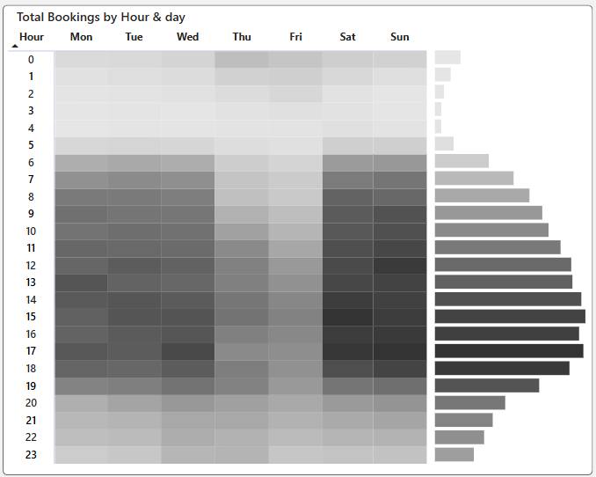
Demand Trends by Time
Understanding when customers request rides most frequently helps optimize fleet availability and operational efficiency. This analysis highlights peak demand periods by hour, day, and month, revealing key behavioral patterns in rider activity.
Analysis:
Hourly Trends: Sharp demand peaks between 5 PM to 8 PM daily.
Weekly Patterns: Friday and Saturday see highest ride volumes.
Monthly Breakdown: Gradual increase in demand toward the end of the period
Insights:
Evening rides align with post-work commute and nightlife.
Weekly spikes indicate weekend recreational travel.
Recommendation:
DD/MM/YYYY
Feature Name/Product
Your Company Name
Increase driver availability during peak evening hours and weekends.
Use these insights to adjust shift scheduling and dynamic pricing strategies.

Slide 4
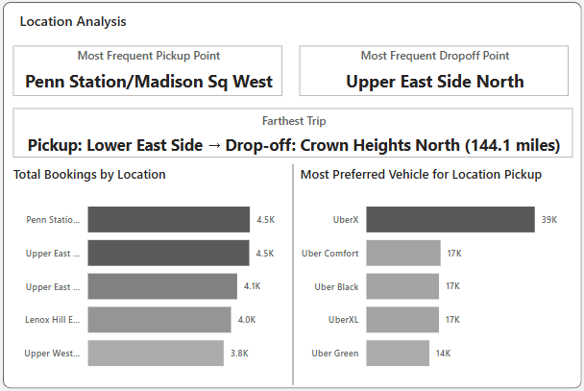
Geographic Trip Distribution
Analyzing trip distribution by location reveals where demand is most concentrated and where opportunities for growth may exist. This spatial insight supports better decision-making in resource allocation, zone prioritization, and expansion planning.
Analysis:
Top pickup zones: Financial District, Midtown, East Village
High trip density along Manhattan grid
Sparse activity in outer boroughs
Insights:
Central business districts are key demand zones.
Opportunities exist to expand coverage or marketing in underutilized areas.
Recommendation:
Focus fleet and marketing strategies on high-volume zones.
Partner with businesses in hot zones for promotions or priority pickups.
DD/MM/YYYY
Feature Name/Product

Slide 5
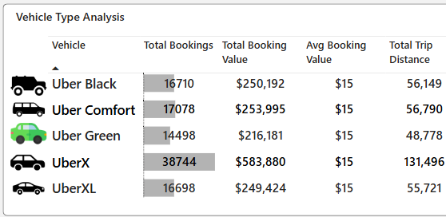
Vehicle Type Preferences and Performance
Understanding customer preferences across vehicle types enables Uber to tailor its fleet strategy, improve service offerings, and optimize margins. This analysis highlights which vehicle categories perform best and identifies growth opportunities through demand segmentation.
Analysis:
Highest number of trips are completed using the Standard UberX service.
UberXL and Black SUV services account for a small portion of trips but generate higher revenue per ride.
Premium vehicle types tend to have longer idle time between rides compared to economy options.
Insights:
The dominance of UberX indicates price sensitivity among riders.
Larger vehicle types may be underutilized due to lack of targeted marketing or incorrect fleet distribution.
Profitability can be improved by aligning premium services with specific zones or rider profiles.
Recommendation:
Use targeted promotions to boost demand for UberXL and Black SUV during events or in affluent neighborhoods.
Rebalance supply of premium vehicles to high-demand areas (e.g., airports, hotels, financial districts).
Implement smart ride-matching based on rider history and price sensitivity to increase conversion on premium options.
DD/MM/YYYY
Feature Name/Product
Your Company Name

Slide 6
Strategic Recommendations & Next Steps
Short-Term Actions:
Medium-Term Goals:
Long-Term Vision:
Adjust driver shift schedules to cover peak periods.
Use historical data to create a demand forecast model.
Expand analytics to include fare data, wait times, and cancellations.
Integrate weather and event data for demand prediction.
Build a dynamic supply chain model for ride services.
Enable real-time analytics and mobile dashboards for field managers.
DD/MM/YYYY
Feature Name/Product
Your Company Name

