Slide 1


Signal Analysis
Objectives:
To explain the most fundamental signal
To describe the classification of the signals
To describe the classification of the systems
To introduce special functions
To introduce Fourier series
To explain the concept of negative frequency
To show how the signal may be described in either the time domain or the frequency domain and establish their relationship.
To study Fourier transform
To determine signal power
To study convolution and autocorrelation

Slide 2
Signal Analysis
In a communication system, the received waveforms contain two parts:
signal desired part
noise undesired part
Signal -- usually a function of time.
The most fundamental signal sinusoidal signal.
Why the sinusoidal signal is the most fundamental?
If a sinusoidal signal is applied at the input of a linear system, the output waveform is also sinusoidal with the same frequency as the input, except for a constant transmission delay and attenuation (or gain).

Slide 3
Signal Analysis
Communication systems may involve complex waveforms, it is desirable to revolve them in terms of sinusoidal functions.
Signal analysis is a tool for achieving this aim.
Principle of signal analysis:
To break up all the signals into summations of sinusoidal components.
⇒
A given signal can be described in terms of sinusoidal frequencies.

Slide 4
Signal Analysis
Classification of signals:
Signals can be classified in various ways which are not mutually exclusive:
Continuous (analog) and discrete (digital) signals:
Continuous signals are those that do not have any discontinuity
in the time domain.
Discrete signals are those that assume only specific values at a certain time (and thus have discontinuities).
Information-carrying signals can be either continuous or discrete.
e.g. signals associated with a computer are digital because they take on only two values (binary signals)

Slide 5
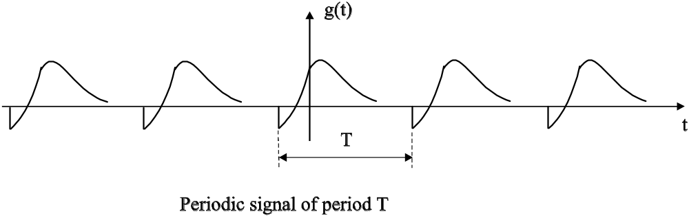
Signal Analysis
Periodic and nonperiodic signals
A periodic signal is one that repeats itself exactly after a fixed length of time. g(t) = g(t + T) for all t
where the smallest positive number that satisfies the above equation is called the period.
Information-carrying signals are normally nonperiodic.

Slide 6
Signal Analysis
Deterministic and random signals
A deterministic signal can be mathematically characterized completely in the time domain.
Known only in terms of probabilistic description, rather than its complete mathematical or graphical description
-- random signal
All signals encountered in telecommunications, i.e. all noise and information-carrying signals, are random signals.
If a message is used to convey information, it must have some uncertainty (randomness) about it.

Slide 7
Signal Analysis
Therefore,
all signals we have to deal with in telecommunications are random nonperiodic signals in reality.
However,
frequently we will use deterministic periodic signals to demonstrate a point because they are much easier to work with mathematically.

Slide 8
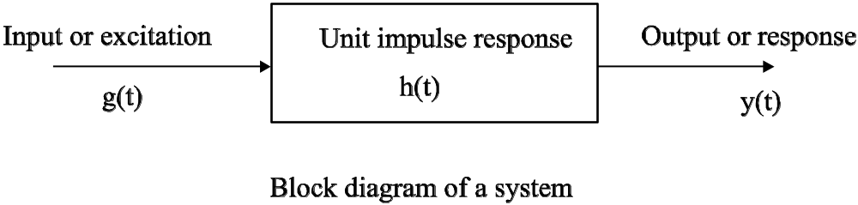
Signal Analysis
System
A system is defined as a set of rules that associates an output time function to an input time function.
g(t) -- input signal (or source signal);
y(t) -- output signal (or response signal);
h(t) -- the system response when input is a unit impulse function (unit impulse response)
Input and response are represented as g(t) → y(t) and read as input g(t) causes a response y(t).

Slide 9
Signal Analysis
Classification of systems
Linear and nonlinear systems
A system is said to obey superposition when the output obtained due to a sum of inputs is equal to the sum of the outputs caused by individual inputs, i.e., if
g₁(t) → y₁(t) and g₂(t) → y₂(t)
then g₁(t) + g₂(t) → y₁(t) + y₂(t)
A system is said to be linear if for all values of the constants a₁ and a₂,
a₁g₁(t) + a₂g₂(t) → a₁y₁(t) + a₂y₂(t)
otherwise, the system is nonlinear.

Slide 10
Signal Analysis
Time-invariant and time-varying systems
A system is time-invariant if a time shift in the input results in a corresponding time shift in the output so that
g(t – t₀) → y(t – t₀) for any t₀.
The output of a time-invariant system depends on time difference and not on absolute values of time.
Any system not meeting this requirement is said to be time-varying.
Example: y(t) = x(t)cos2πf₀t
The response to x(t): y(t) = x(t)cos2πf₀t
The response to x(t – t₀): x(t – t₀)cos2πf₀t ≠ y(t – t₀).

Slide 11
Signal Analysis
Singularity functions
Singularity functions are discontinuous or have discontinuous derivatives.
Singularity functions are mathematical idealizations and, strictly speaking, do not occur in physical systems.
They serve as good approximations to certain limiting conditions in physical systems.
Two types of singularity functions:
unit step function and unit impulse function
will be discussed

Slide 12
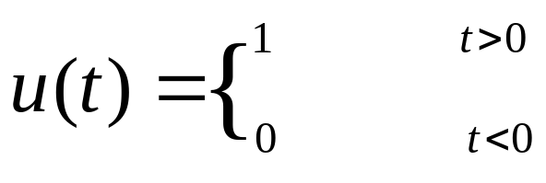
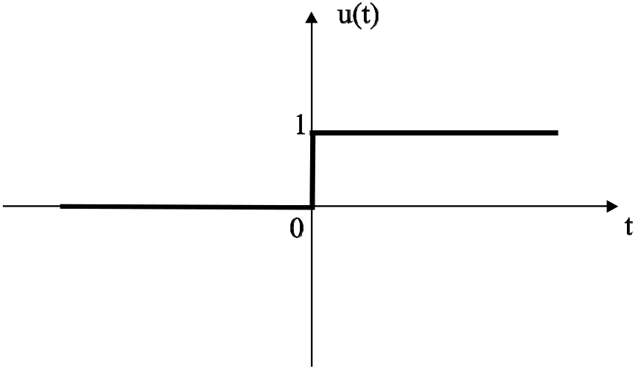
Signal Analysis
Unit step function
The unit step function is defined by
(u(t) has no definition at t = 0, or you may define u(0) = 1 or u(0) = ½)

Slide 13
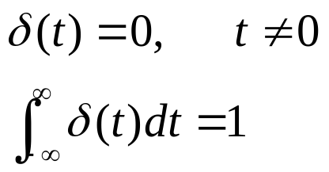
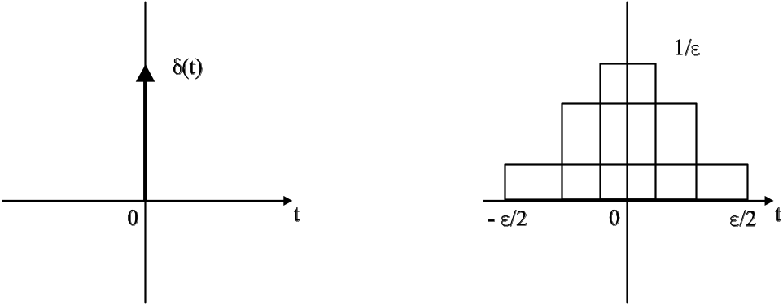
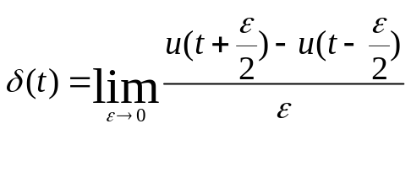
Signal Analysis
Unit impulse function
The unit impulse function is defined as follows:

Slide 14
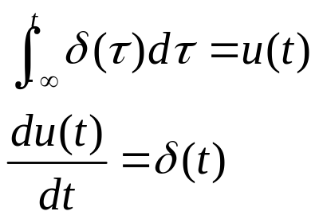
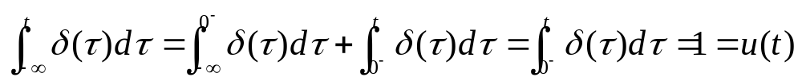
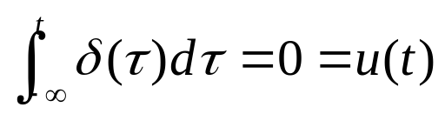
Signal Analysis
Relationship between δ(t) and u(t)
Proof
(1) When t > 0,
When t < 0,

Slide 15
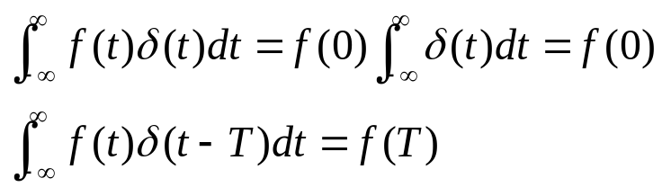

Signal Analysis
Multiplication of a function by δ(t)
f(t)δ(t) = f(0)δ(t), f(t) continuous at 0.
f(t)δ(t – t₀) = f(t₀)δ(t – t₀), f(t) continuous at t₀.
Proof
(1) f(t) is continuous at 0, then f(0) exists.
when t = 0, f(t)δ(t) = f(0)δ(t)
when t ≠ 0, f(t)δ(t) = 0 = f(0)δ(t)
so that f(t)δ(t) = f(0)δ(t),
Sampling property of δ(t)
Proof
(2)

Slide 16
Signal Analysis
Fourier analysis
A signal can be represented in either the time domain (where it is a waveform as a function of time) or in the frequency domain (where the signal is defined in terms of its spectrum).
If the signal is specified in the time domain, we can determine its spectrum.
Conversely, if the spectrum is specified, we can determine the corresponding waveform.
Fourier analysis provides a link between the time domain and the frequency domain.

Slide 17
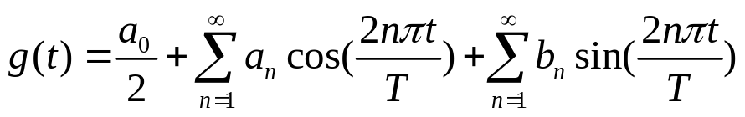
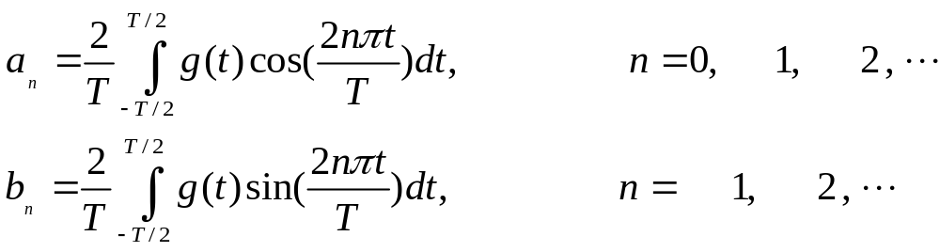
Signal Analysis
Fourier series
A periodic function g(t) of period T, can be expressed as an infinite sum of sinusoidal waveforms. This summation is called Fourier series.
Fourier series can be written in several forms. One such form is the trigonometric Fourier series:
where

Slide 18
Signal Analysis
Any repetitive waveform can be represented in terms of an infinite number of sine or cosine waves having frequencies which are multiples of a fundamental frequency (“harmonics”) and a dc component.
The frequency domain representation of a sine or cosine time signal is an impulse having the amplitude of the sine wave and being at the frequency of the sine wave.

Slide 19
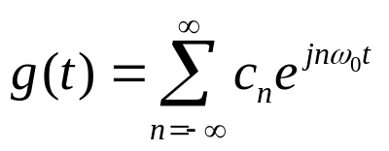
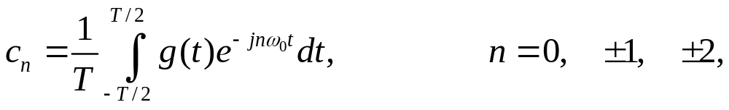
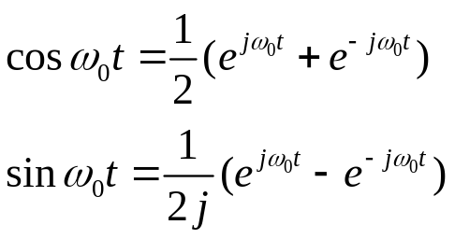
Signal Analysis
Exponential Fourier series
Another more compact form is exponential Fourier series
where
are the complex Fourier coefficients and ω₀ = 2πf₀ = 2π/T. We have used the Euler’s identities

Slide 20
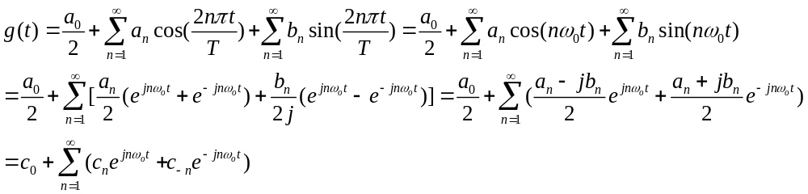
Signal Analysis
Exponential Fourier series
The trigonometric Fourier series can be further simplified by the use of Euler’s identities
Assuming ω₀ = 2π/T, then
where c₀ = a₀ / 2, c_{n} = (a_{n} – jb_{n}) / 2 and c_{-n} = (a_{n} + jb_{n}) / 2,
nω₀ is the frequency of exponential Fourier series.

Slide 21
Signal Analysis
The formula can be written in the compact form
where
The exponential Fourier series is equivalent to resolving the function in terms of harmonically related frequency components of a fundamental frequency.
c_{n} is called spectral amplitude and represents the amplitude of n^{th} harmonic.
Graphic representation of spectral amplitude along with the spectral phase is called complex frequency spectrum.

Slide 22
Signal Analysis
Since n takes negative values, the concept of “negative frequency” arises. This is only a mathematical concept, and is used for convenience.
In reality, frequencies can only have positive values, the spectrum of the trigonometric Fourier series exists only for positive frequency.
However, it is more convenient to use exponential representation rather than trigonometric.

Slide 23
Signal Analysis
We have verified that a signal can be specified in two equivalent ways:
Time domain representation -- waveform.
Frequency domain representation -- spectrum.
If the signal is specified in time domain, we can determine its spectrum and vice versa.
*What equipment can help us to observe the spectrum in the frequency domain?

Slide 24
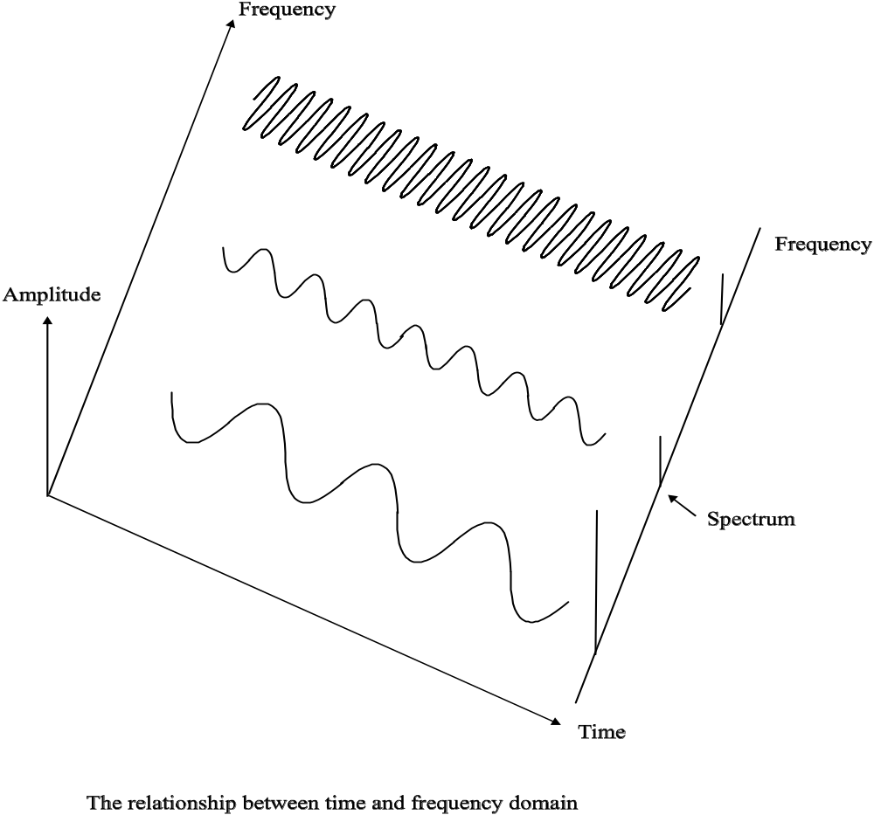
Signal Analysis

Slide 25
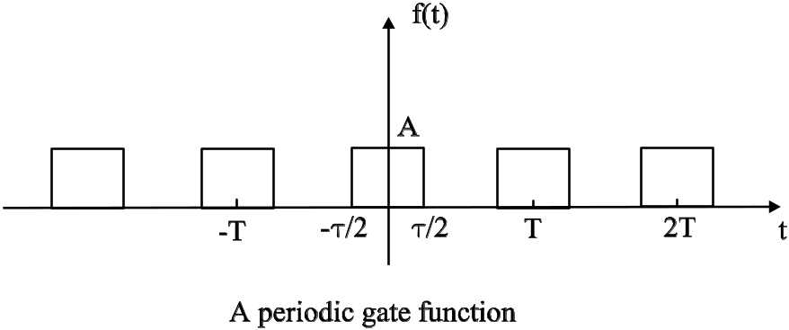
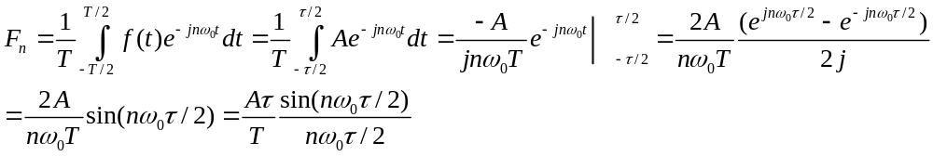
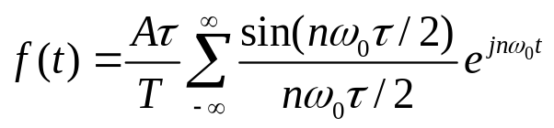
Signal Analysis
Example
For the gate function as shown in the figure,
Find the Fourier series of this waveform;
Sketch the signal spectrum;
Solution
(a)
and the Fourier series is given by

Slide 26
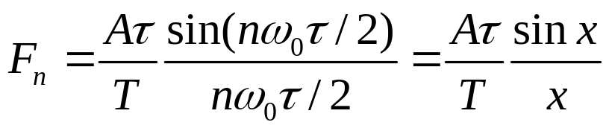
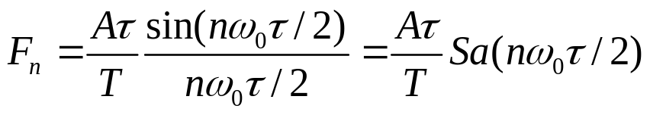
Signal Analysis
(b) The spectrum is the plot of F_{n} as function of nω₀. Since F_{n} is real, only amplitude plot is required. If we define a normalized and dimensionless variable given by x = nω₀τ/2, then
The function sin(x)/x, is known as sampling function. We may rewrite F_{n} in terms of sampling function as follows
When nω₀ = 2π/τ, Sa(nω₀τ/2) = 0 -- zero crossing point

Slide 27
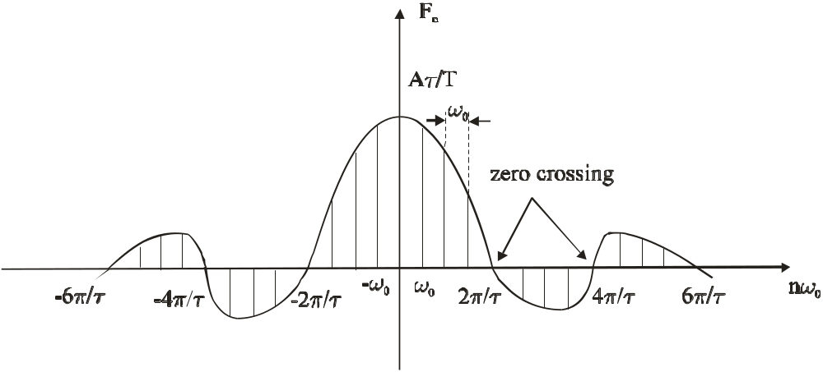
Signal Analysis
The amplitude plot of F_{n} is a discrete spectrum existing at ω = 0, ±ω₀, ±2ω₀, ±3ω₀, … , have amplitudes Aτ/T, (Aτ/T)Sa(πτ/T), (Aτ/T)Sa(2πτ/T), … , etc. respectively.

Slide 28
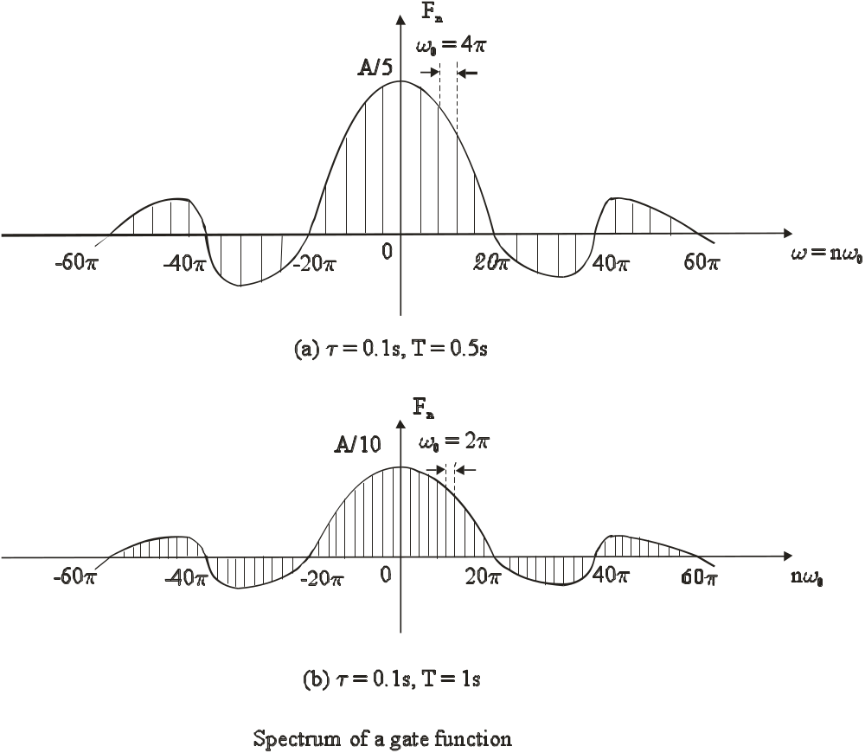
Signal Analysis
Interesting phenomena

Slide 29
Signal Analysis
When T is larger, ω₀ becomes smaller, the spectrum becomes denser.
When T goes to infinity,
Only a single pulse of width τ in the time domain.
ω₀ ≈ 0, i.e., no spacing is left between two line-components;
Thus, the spectrum becomes continuous and exists at all frequencies. (However, there is no change in the shape of the envelope of the spectrum).
The continuous spectrum corresponds to a single non-repetitive pulse;
i.e., a non-periodic function existing over the entire interval (-∞ < t < ∞) has a continuous spectrum.

Slide 30
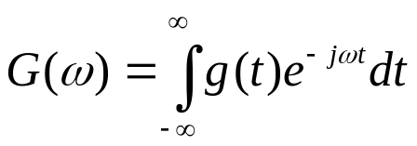
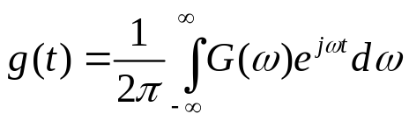
Signal Analysis
Fourier transform (Fourier integral)
The Fourier transform of a signal g(t) is defined by
and g(t) is called the inverse Fourier transform of G(ω)
The functions g(t) and G(ω) constitute a Fourier transform pair:
g(t) ⇔ G(ω)
G(ω) = F[g(t)] and g(t) = F ⁻¹[G(ω)]
What is the difference between Fourier transform and Fourier series?

Slide 31
Signal Analysis
Fourier transform is different from the Fourier Series in that its frequency spectrum is continuous rather than discrete.
Fourier transform is obtained from Fourier series by letting T → ∞ (for a nonperiodic signal).
Fourier transform is most useful for analyzing signals involved in communication systems.
(The original time function can be uniquely recovered from its Fourier transform).

Slide 32
Signal Analysis
Please keep in mind that
A periodic signal spectrum has finite amplitudes and exists at discrete frequencies.
A non-periodic signal has a continuous spectrum and G(ω) is its spectral density.

Slide 33
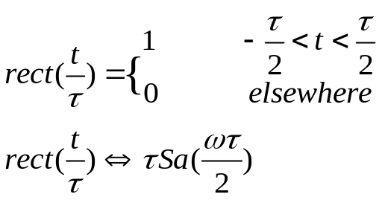
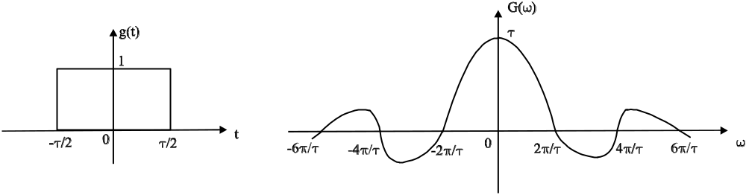
Signal Analysis
Fourier transform of some useful functions
Rectangular function:
Proof

Slide 34
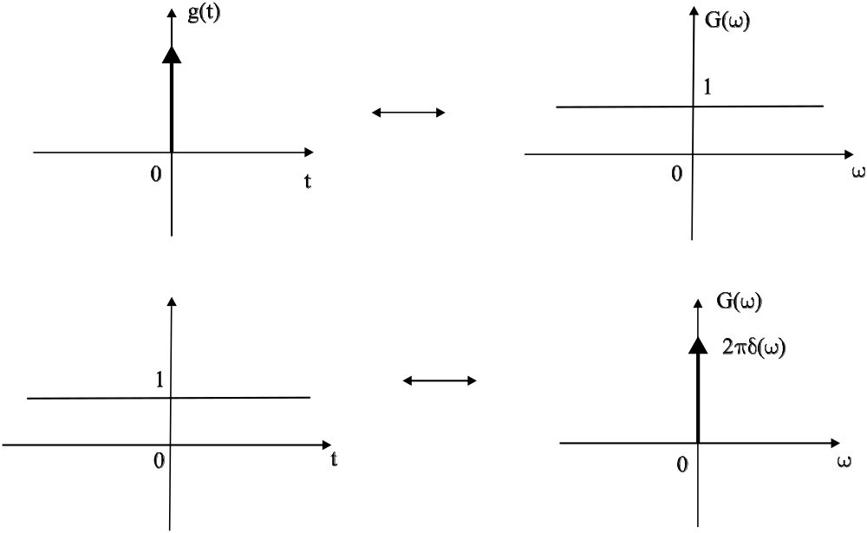
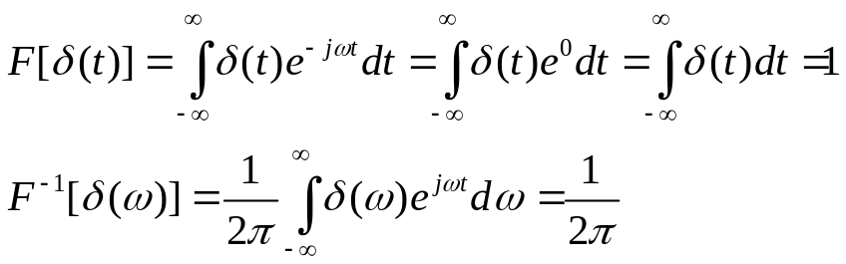
Signal Analysis
Unit impulse function: δ(t) ⇔ 1 and 1 ⇔ 2πδ(ω)
Proof

Slide 35
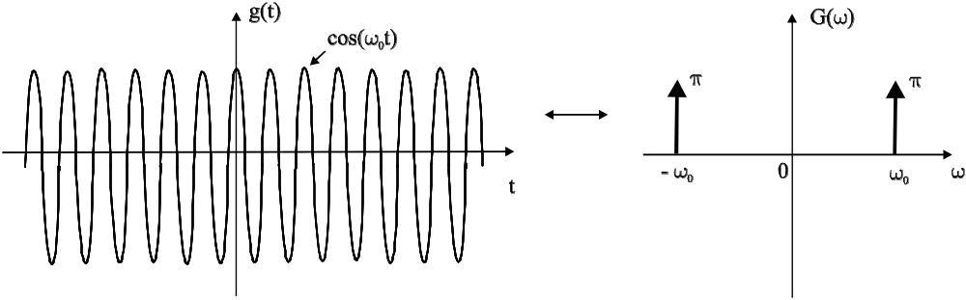
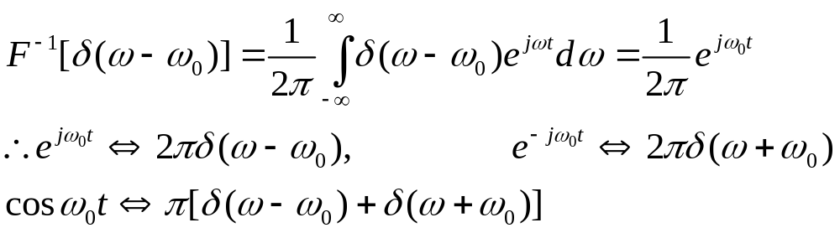
Signal Analysis
Sinusoidal function cos(ω₀t)
cos(ω₀t) ⇔ π[δ(ω + ω₀) + δ(ω - ω₀)]
Proof

Slide 36
Signal Analysis
Properties of Fourier transform
It gives simple solutions to complicated Fourier transform
It helps in finding the effect of time domain operations on frequency domain.
Linearity property
If g₁(t) ⇔ G₁(ω) and g₂(t) ⇔ G₂(ω)
then a₁g₁(t) + a₂g₂(t) ⇔ a₁G₁(ω) + a₂G₂(ω)
where a₁ and a₂ are constants
This property is proved easily by linearity property of integrals used in defining Fourier transform

Slide 37
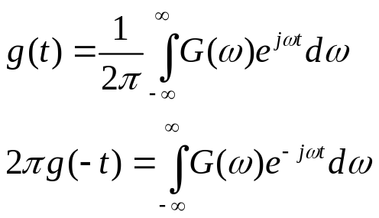
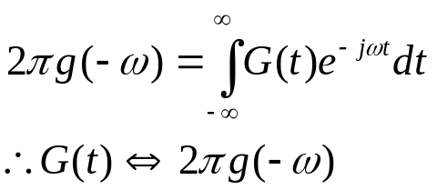
Signal Analysis
Symmetry property
If g(t) ⇔ G(ω), then G(t) ⇔ 2πg(- ω)
Proof
we can interchange the variable t and ω, i.e. let t → ω, ω → t, then

Slide 38
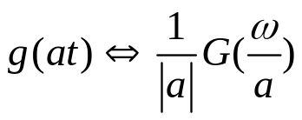
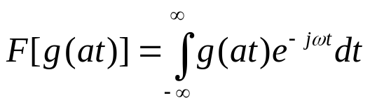
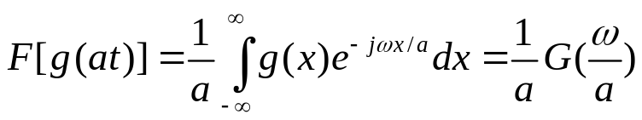
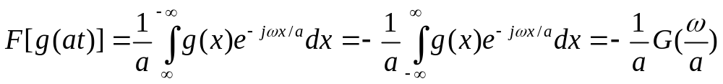
Signal Analysis
Time scaling property
Proof
let x = at, then dt = dx/a,
case 1: when a > 0,
case 2: when a < 0, then t → ∞ leads to x → - ∞,
Combined, the two cases are expressed as,

Slide 39
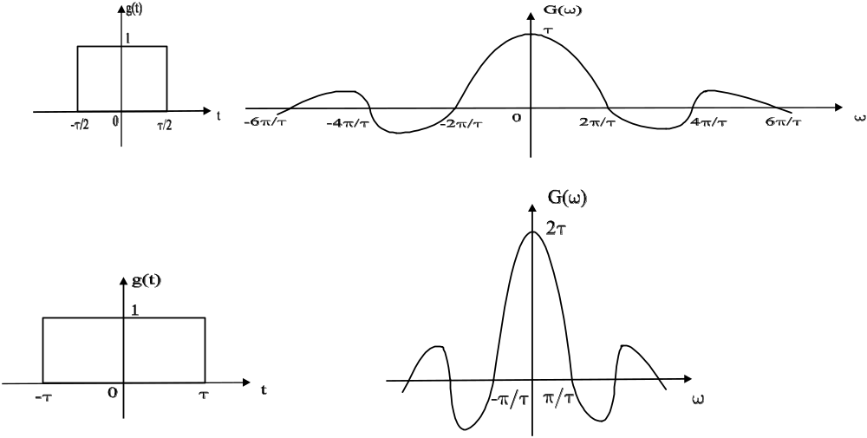
Signal Analysis
Significance
Time domain compression of a signal results in spectral expansion
Time domain expansion of a signal results in spectral compression

Slide 40

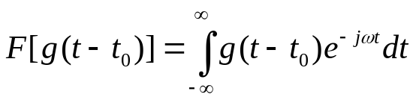
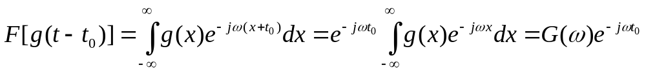

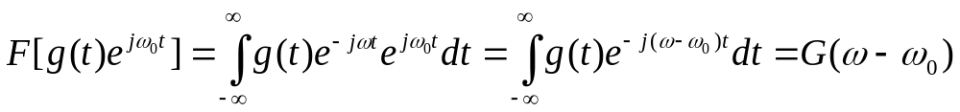
Signal Analysis
Time shifting property
Proof
put t – t₀ = x, so that dt = dx, then
Frequency shifting property
Proof

Slide 41
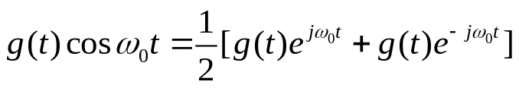
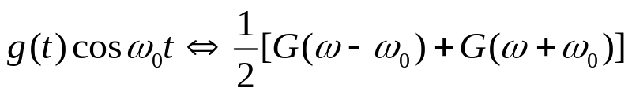
Signal Analysis
Significance
Multiplication of a function g(t) by exp(jω₀t) is equivalent to shifting its Fourier transform in the positive direction by an amount ω₀. -- Frequency translation theorem.
Translation of a spectrum helps in achieving modulation, which is performed by multiplying the known signal g(t) by a sinusoidal signal.
Therefore,

Slide 42
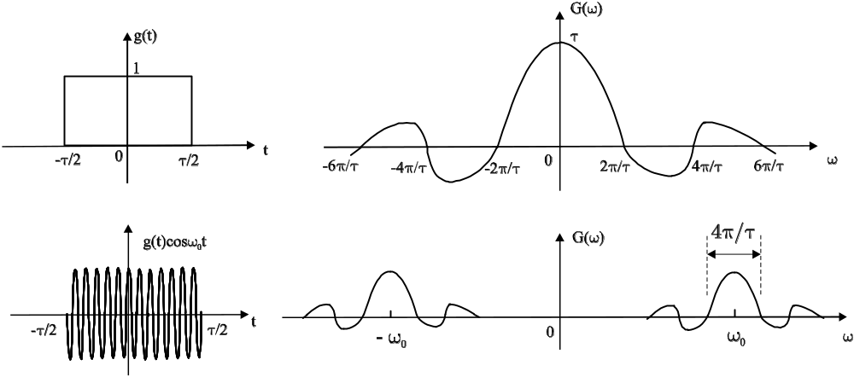
Signal Analysis
Significance Modulation theorem
The multiplication of a time function with a sinusoidal function translates the whole spectrum G(ω) to ±ω₀.
exp(jω₀t) can also provide frequency translation, but it is not a real signal. Hence, sinusoidal function is used in practical modulation system.

Slide 43
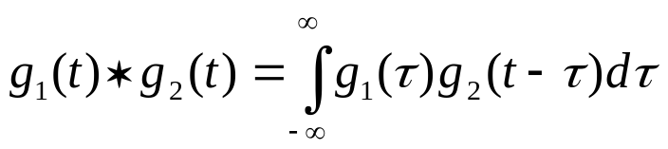
Signal Analysis
Convolution
Suppose that g₁(t) ⇔ G₁(ω) and g₂(t) ⇔ G₂(ω), then,
what is the waveform of g(t) whose Fourier transform is the product of G₁(ω) and G₂(ω)?
This question arises frequently in spectral analysis, and is answered by the convolution theorem.
The convolution of two time function g₁(t) and g₂(t), is defined by the following integral

Slide 44
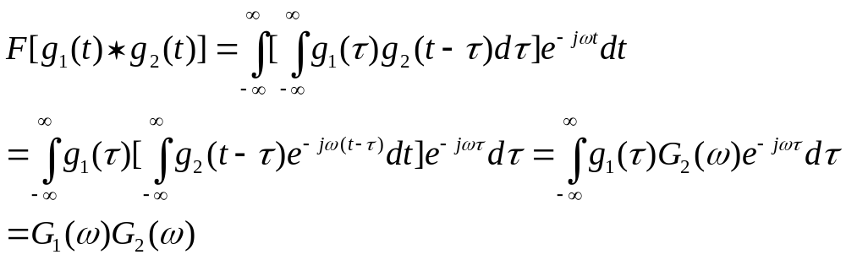
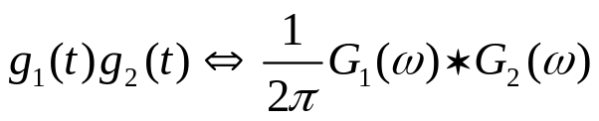
Signal Analysis
Time convolution theorem
If g₁(t) ⇔ G₁(ω) and g₂(t) ⇔ G₂(ω)
Then g₁(t) * g₂(t) ⇔ G₁(ω)G₂(ω)
Frequency convolution theorem
If g₁(t) ⇔ G₁(ω) and g₂(t) ⇔ G₂(ω)
Then
The proof is similar to time convolution theorem.

Slide 45
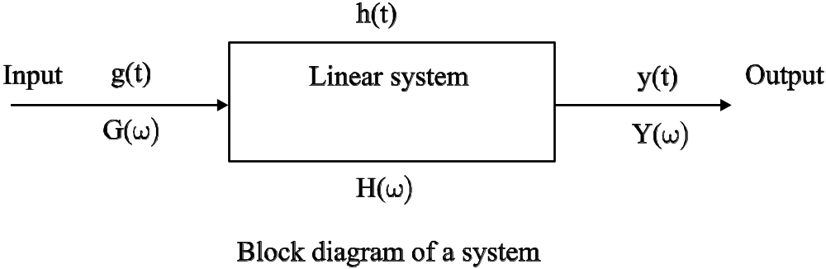
Signal Analysis
Signal transmission through a linear system
y(t) = g(t) * h(t)
when g(t) ⇔ G(ω), h(t) ⇔ H(ω), y(t) ⇔ Y(ω), h(t) is the
impulse response, i.e. if the input is δ(t), then y(t) = h(t).
By convolution theorem
Y(ω) = G(ω)H(ω)
where H(ω) is the system transfer function.

Slide 46

If the input is a delta function at t = τ, i.e. it is δ(t − τ), then the
output is h(t − τ) and
This means that, convolving a pulse x(t) located near t = 0 with a
delta function located at t = τ has the effect of shifting x(t) to
around t = τ. This also applies in the frequency domain, and is
shown schematically below.
_

Slide 47

Signal Analysis
Signal power
Signal-to-noise ratio (S/N) is an important parameter used to evaluate the system performance.
Noise, being random in nature, cannot be expressed as a time function, like deterministic waveform. It is represented by power.
Hence, to evaluate the S/N, it is necessary to evolve a method for calculating the signal power.
For a general time domain signal g(t), its average power is given by

Slide 48


Signal Analysis
For a periodic signal, each period contains a replica of the function, and the limiting operation can be omitted as long as T is taken as the period.
For a real signal
Example
Find the power of a sinusoidal signal cosω₀t.
Solution
Is it also possible to determine the signal power in frequency domain?

Slide 49
Signal Analysis
Frequency domain representation for signals of arbitrary waveshape
When dealing with deterministic signals, knowledge of the spectrum implies knowledge of the time domain signal.
For an arbitrary (random) signal, Fourier analysis cannot be used because g(t) is not known analytically.
For such an undeterministic signal (which include
information signals and noise waveforms), the power spectrum S_{g}(ω) (or power spectral density) concept is used.

Slide 50

Signal Analysis
The power spectrum describes the distribution of power versus frequency.
The average signal power is then given by
where S_{g}(ω) > 0 for all ω.
Another way to evaluate the signal power!

Slide 51

Signal Analysis
Correlation
Correlation measure of similarity between one waveform, and
time delayed version of the other waveform.
The autocorrelation function is a special case of convolution,
and it measures the similarity of a function with its delayed
replica, and is given by

Slide 52


Signal Analysis
Important properties of autocorrelation
(1) the autocorrelation for τ = 0 is average power of the signal
The third way to evaluate signal power!
(2) power spectral density S_{g}(ω) and autocorrelation function of a power signal are Fourier transform pair

Slide 53
Questions (Signal Analysis)
What type signal is the most fundamental?
How do you define a periodic signal?
Does a periodic signal exist within a limited time period?
Is the message signal a deterministic signal?
Does negative frequency physically exist?
What equipments you are going to use in order to observe the signal waveform and spectrum?
How does a pulsed signal differ from a sinusoidal signal?
What is the frequency domain description of a signal? Is it more or less useful than the time domain?

Slide 54
Questions (Signal Analysis)
9. Suppose that g₁(t) ⇔ G₁(ω) and g₂(t) ⇔ G₂(ω), what is the waveform of g(t) whose Fourier transform is the product of G₁(ω) and G₂(ω)?
10. How do you measure the similarity between the signal and its delayed replica?
11. How many methods you know for signal power calculation?
*12. What is the significance of the time- and frequency- scaling property of Fourier Transform?

Slide 55





Exercise Problems (Signal Analysis)
1. Evaluate the integrals
2. Simplify the following expressions:
[sint/(t + 2)] δ(t); (b) [1/(jω +2)] δ(ω + 3);
(c) [sin(kω)/ω] δ(ω);
3. Calculate the (a) average value, (b) ac power, and (c) average power of the periodic waveform v(t) = 1 + cosω₀t.

Slide 56

Exercise Problems (Signal Analysis)
4. Prove that
5. If g(t) ⇔ G(ω), then show that g*(t) ⇔ G*(-ω).
6. Find the Fourier transform of the signal f(t) = [A + f_{m}(t)]cosω_{c}t
if f_{m}(t) has a spectrum F_{m}(ω).
7. If f(t) has a spectrum F(ω), find the Fourier transform of the following functions: (a) f(t/2 – 5); (b) f(3 – 3t); (c) f(2 + 5t);
8. Determine the average power of the following signals:
(a) Acosω₀t + B sinω₀t; (b) (A + sinω₀t) cosω₀t;

Slide 57
Exercise Problems (Signal Analysis)
*9. Find the autocorrelation function of the signal, g(t) = Ecosω₀t;
10. For a power signal, g(t) = Acos(200πt)cos(2000πt), determine the average power.

Slide 58


Math. Table
Trigonometric Identities
Selected Fourier Transform Pairs

Slide 59


Math. Table
Properties of Fourier Transform
Linearity: a₁g₁(t) + a₂g₂(t) ⇔ a₁G₁(ω) + a₂G₂(ω)
Symmetry: If g(t) ⇔ G(ω), then G(t) ⇔ 2πg(- ω)
Time scaling:
Time shifting:
Frequency shifting:
Modulation theorem:
Time convolution: g₁(t) * g₂(t) ⇔ G₁(ω)G₂(ω)
Frequency convolution:
Conjugate functions: g*(t) ⇔ G*(-ω)
Time differentiation:
Time integration:

