Slide 1

Food Calorie
Estimator
COMPUTER VISION
& IMAGE PROCESSING
from Image
Final Project — 2026
Deep Learning · PyTorch · Streamlit Deployment
TEAM
Mariam Khalil Ibrahim — 230101792
CNN from Scratch
Transfer Learning
MobileNetV2
Regression
Mahmoud Usama Abdelhameed — 230103270
Omar Abdulaal Reda — 230103273
github.com/Mariam-Nassar/Food-Calorie-Estimator

Slide 2


PROJECT OVERVIEW
Goal
Mariam Khalil Ibrahim
ID: 230101792
Estimate the caloric content of a food dish directly from a single overhead photograph — framed as a continuous regression problem.
Dataset + Preprocessing
Omar Abdulaal Reda
PIPELINE
ID: 230103273
Dataset (Nutrition5k)
CNN + Transfer Learning
Preprocessing & Augmentation
CNN from Scratch + MobileNetV2
Mahmoud Usama
Evaluation (MAE, MSE, RMSE, R²)
ID: 230103270
Evaluation + App + Report
Streamlit Deployment ⭐ Bonus

Slide 3


DATASET
Nutrition5k — Google Research
Preprocessing Steps
github.com/google-research-datasets/Nutrition5k
Metadata Linking
Real-world overhead food photos · Calorie metadata per dish
Dish ID joined to calorie CSV
Image Cleaning
PIL decode check — corrupted files removed
1,021
712
153
153
Resize
All images → 224 × 224 px (RGB)
Total Images
Training
Validation
Test Set
Normalization
ImageNet mean/std applied
Augmentation
Flip · Rotation ±15° · Color jitter (train only)
Split
70 / 15 / 15 · SEED = 42
224 × 224 px · RGB · Target: Calories (kcal) · No library datasets used

Slide 4
MODEL 1 — CNN FROM SCRATCH
INPUT
224×224×3
BLOCK 1
Conv+BN+ReLU+Pool
32 filters
BLOCK 2
Conv+BN+ReLU+Pool
64 filters
BLOCK 3
Conv+BN+ReLU+Pool
128 filters
BLOCK 4
Conv+BN+ReLU+Pool
256 filters
FC HEAD
Dense·Drop·Dense
→ 1 (kcal)
224×224×3
112×112×32
56×56×64
28×28×128
14×14×256
1 kcal
Loss Function
Optimizer
Epochs
Batch Size
Parameters
MSE
Adam
10
16
26.1 M

Slide 5
MODEL 2 — TRANSFER LEARNING (MobileNetV2)
Phase 1 — Frozen Backbone
5 Epochs
Phase 2 — Fine-Tuning
5 Epochs
MobileNetV2 backbone loaded with ImageNet weights.
All backbone parameters FROZEN
(requires_grad = False)
Only the custom regression head trains — learns to map ImageNet features → calories.
Last layers of backbone UNFROZEN.
Backbone + head train jointly at a lower learning rate.
Higher-level features adapt to food-domain calorie regression.
Custom Regression Head (every layer explicitly defined in code)
Dropout
Linear
ReLU
Dropout
Linear (Output)
p = 0.3
in_features → 256
—
p = 0.2
256 → 1 (kcal)
Total: 1,854,273 trainable parameters · 10 epochs (5 frozen + 5 fine-tuning)

Slide 6

EVALUATION RESULTS
MAE
RMSE
R²
MSE
CNN 104.91
CNN 142.45
CNN 0.604
CNN 20,293
MNet 149.85
MNet 199.56
MNet 0.223
MNet 39,825
kcal
kcal
score
kcal²

Slide 7
MODEL COMPARISON
Criterion | CNN from Scratch | MobileNetV2 TL | Winner
Parameters | 26,145,793 | 1,854,273 | MobileNetV2 (14× fewer)
Training Time | 166.24 s | 125.46 s | MobileNetV2 (faster)
MAE (kcal) ↓ | 104.91 | 149.85 | CNN Scratch ✓
MSE (kcal²) ↓ | 20,293 | 39,825 | CNN Scratch ✓
RMSE (kcal) ↓ | 142.45 | 199.56 | CNN Scratch ✓
R² Score ↑ | 0.604 | 0.223 | CNN Scratch ✓
CNN from Scratch wins on all 4 regression metrics despite having more parameters. MobileNetV2 is faster and lighter but the ImageNet classification pretraining did not transfer as effectively to the calorie regression task within the given training budget.

Slide 8



⭐ BONUS — STREAMLIT DEPLOYMENT [ COMPLETED IN FULL ]
Tab 1
Tab 2
Tab 3
Tab 4
Overview
Metrics & Curves
Dataset
Predict Calories
Project description, architecture summary, GitHub link
Comparison table + bar charts of MAE, RMSE, R² for both models
Train/val/test split table + food image preview grid
Upload image → select model → Estimate → get kcal. Ground-truth shown for known images.
TECH STACK
Streamlit
PyTorch + torchvision
Pillow (PIL)
pandas / numpy
run_app.ps1
Live Deployment URL
food-calorie-sut.streamlit.app
Scan QR code to open the live app instantly
Bonus Marks Claimed: +1 to +4 · Web Application (Streamlit) + publicly deployed · Fully functional

Slide 9
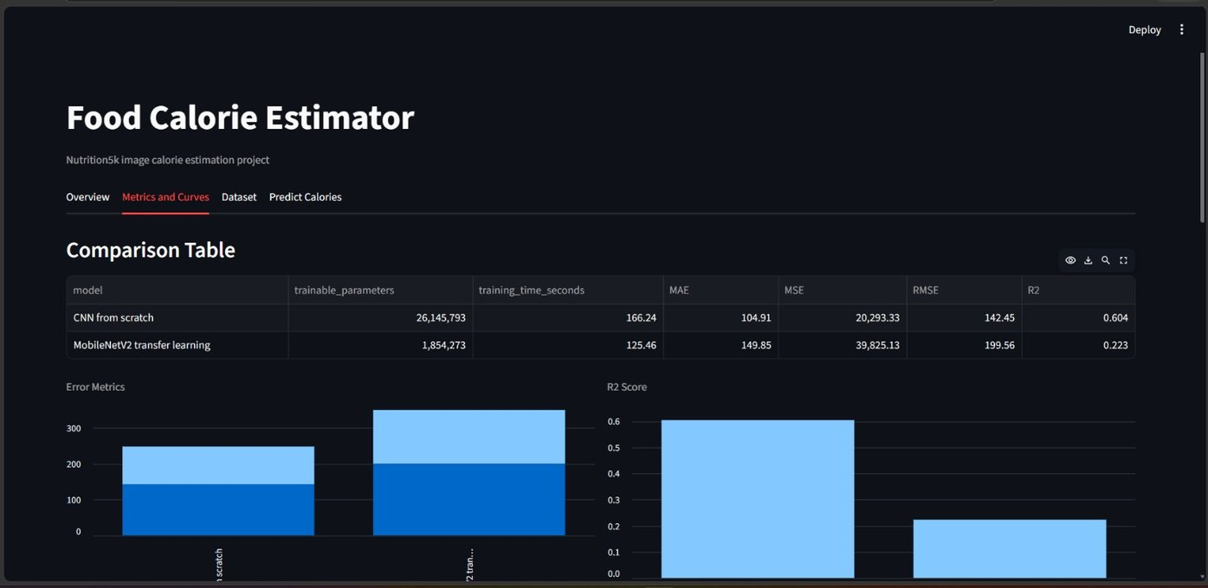
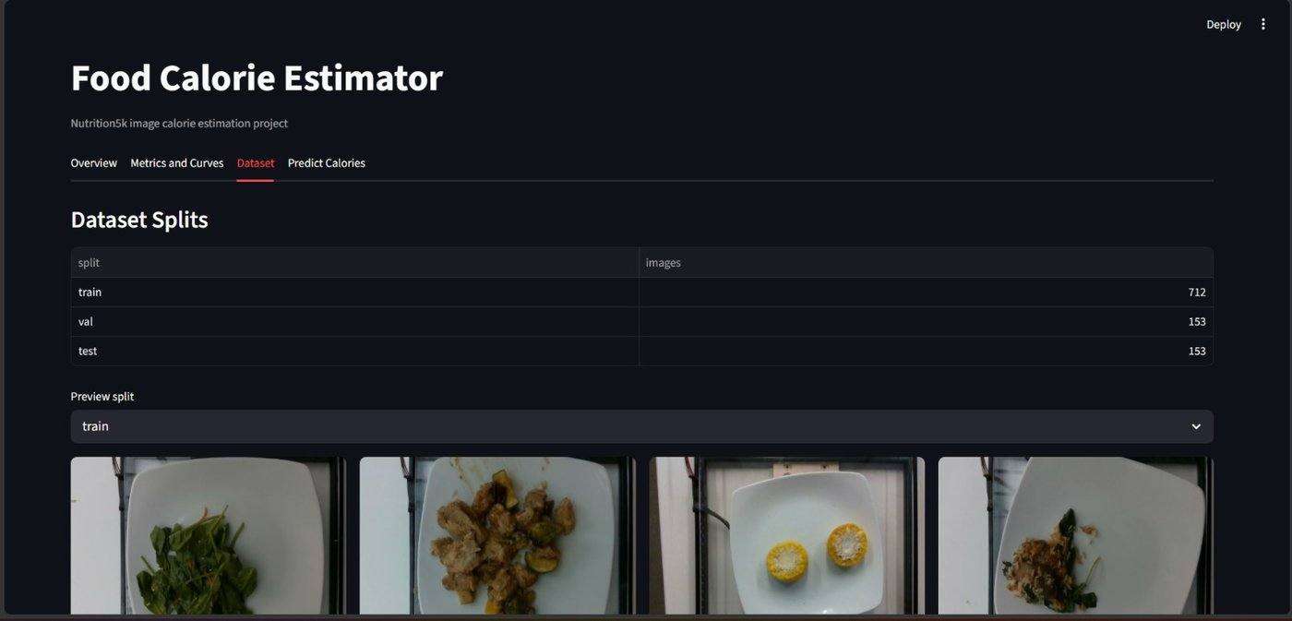
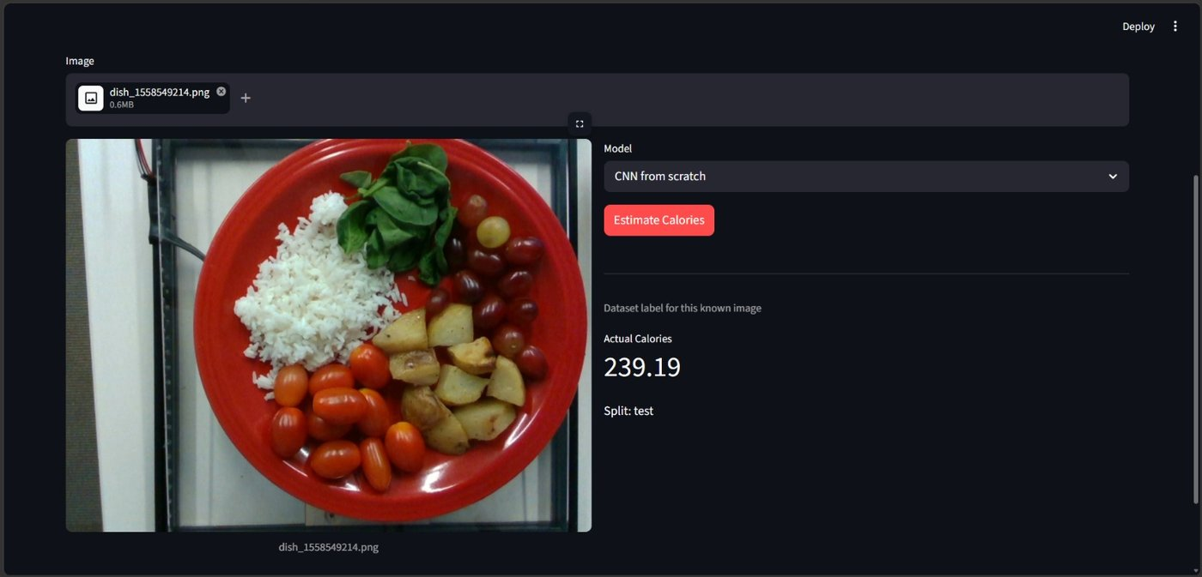
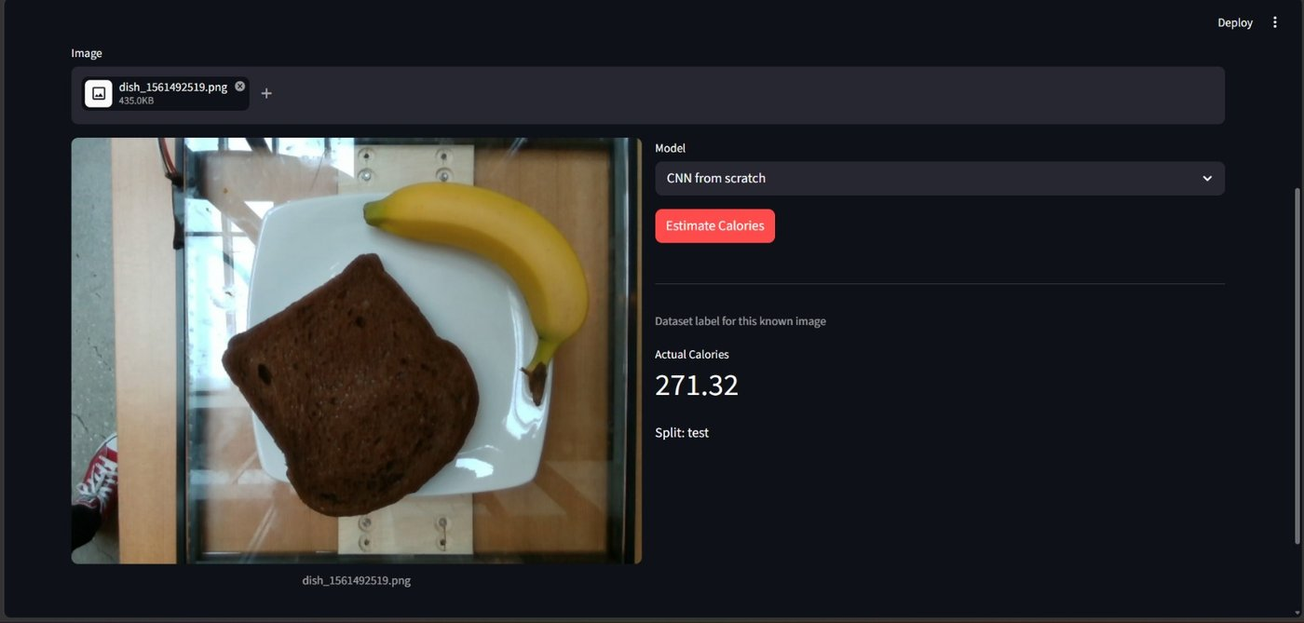
LIVE APP SCREENSHOTS — food-calorie-sut.streamlit.app
Tab 2 — Metrics & Curves
Tab 3 — Dataset Splits
Tab 4 — Predict · Actual: 239.19 kcal
Tab 4 — Predict · Actual: 271.32 kcal

Slide 10



CONCLUSION & RECOMMENDATIONS
Key Findings
Limitations
CNN Scratch → R² 0.604, MAE 104.91 kcal
Only 1,021 images — high calorie variance
MobileNetV2 → R² 0.223, MAE 149.85 kcal
2D overhead → no depth/weight info
CNN wins all 4 accuracy metrics
MobileNetV2 needed more fine-tuning epochs
MobileNetV2 trains 25% faster, 14× smaller
Streamlit app deployed — bonus complete ⭐
Classification pretraining ≠ regression task
Future Recommendations
Expand dataset — download more Nutrition5k files toward full 5k images
Add depth map or weight as auxiliary inputs
Try EfficientNet-B0 or ResNet50 as alternative transfer learning backbones
Deploy app publicly via Streamlit Community Cloud
Explore multi-task learning: predict protein, fat, carbs alongside calories

Slide 11
Thank You!
Questions?
Food Calorie
Estimator
1,021
0.604
104.91
4 tabs
Images
Best R²
Best MAE
App
github.com/Mariam-Nassar/
Food-Calorie-Estimator
TEAM
Mariam Khalil Ibrahim — 230101792
Mahmoud Usama Abdelhameed — 230103270
Omar Abdulaal Reda — 230103273
Computer Vision & Image Processing — May 2026

