Slide 1
Project Demonstration
A University Club Management System
Presented by
[Mariam Ahmed | Renada Ahmed |Eman Gaber | Ahmed Saad | Mohamed Abo Elhaggag | Mostafa Mohamed]
Supervisor : Prof. Wessam Ahmed

Slide 2
Project Overview
Problem Statement: lack of centralized, Official platform for university clubs to manage Events, Announcements, and Lost& Found items.
Our core vision is to enhance campus engagement and streamline club management operations.

Slide 3
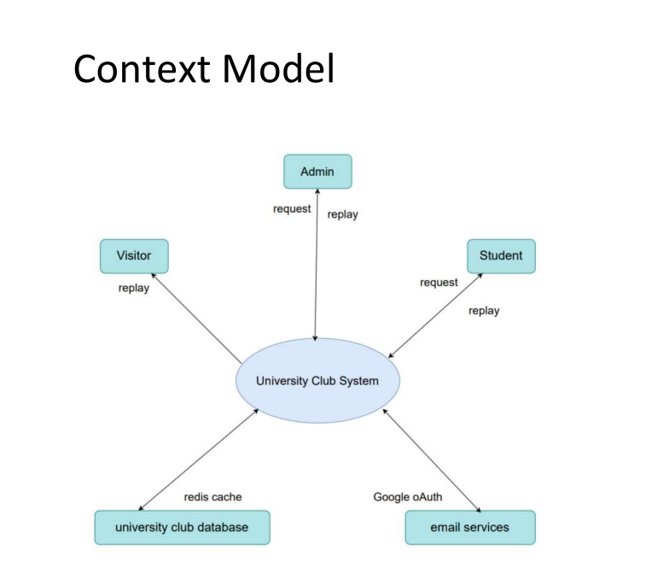
System Architecture – High level view
Context model diagram (summary):
  Actors : Student, Admin, Visitor
  Core System: University Club System
  External Services : Google OAuth (Authentication), Email Service, Redis cache
Architecture Pattern : Model-View-Controller(MVC)
Separation Concerns:
Front-end: React.js (User Interface)
Back-end: Express.js (Business logic & API)
Database: PostgreSQL with Prisma ORM (data persistence)
Cache: Redis (Performance)

Slide 4
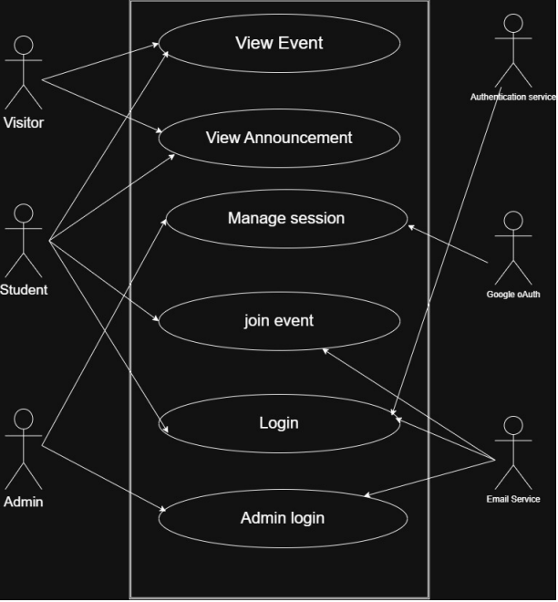
User Roles & permissions
Three-tier Role-based Access control(RBCA):
  Visitor (Public):
    View Events, Announcements, Lost & Found items
    No personal data access
  Student (Authenticated Member):
    All visitor Privileges
    Join Events and Announcements
    Claim Lost & Found items via Admin contact
    Manage personal Profile
  Admin (Club management):
    Full CRUD (Create, Read, Update, Delete) on Events, Announcements and Lost & Found
    Manage Students Accounts
    Access to administrative dashboard

Slide 5
Multi-Level Authentication System
Student registration/login (Local + Google OAuth)
Admin registration/login (Requires approval - pending)
Different roles (Student, Admin, Public)
Google OAuth integration for quick signup
Session Management with Redis

Slide 6
Events Management
Create/edit/delete events (Admin Only)
View events (Public)
Filters: Upcoming/past/current events
Attach photos for each event
Sort by date

Slide 7
Announcements System
Create new announcements (Admin Only)
Student registration for announcements
View registered students
Delete/edit announcements

Slide 8
Gallery System
Upload photos with categories (event, team, campus, activity)
Filter by category
Public photo viewing
Photo management by Admin

Slide 9
Team Management
Add team members (Admin)
View available positions

Slide 10
Contact System
Send support messages (Public)
Admin responses to messages
Message status tracking (Pending, In Progress, Resolved)
Message statistics in Dashboard

Slide 11
Lost & Found System
Add items (Admin)
Claim items (Admin)
Item statuses: Lost, Found, Claimed
Public item viewing

Slide 12
Admin Dashboard
(Events, Members, Gallery, etc.)
Quick management of events and announcements
View incoming messages
Quick content addition

Slide 13
Security Features
Rate Limiting (100 requests/15min)
XSS Protection
CORS Configuration
Session Storage in Redis
Input Validation
File Upload Security

Slide 14
Performance Features
Caching with Redis (5-10 minutes)
Optimized Queries
WebSocket Ready for real-time notifications
Pagination for large datasets

Slide 15
Frontend Features (from designs)
Responsive Design
User-friendly Forms with validation
Interactive UI with animations
Real-time Updates

Slide 16
Database Features
Normalized Schema
Table relationships
Indexing for fast queries
Soft Deletes (if applicable)

Slide 17
API Features
RESTful API
Comprehensive Documentation
Enhanced Error Handling
Consistent Response Formatting
Advanced Query Parameters for filtering

Slide 18
Technical Features
Modular Architecture
Environment Configuration
Logging System
Backup & Recovery ready
Future Scalability

Slide 19
Integration Features
Google OAuth
Email Service ready
File Storage integration
Third-party APIs ready

Slide 20
Deployment Features
Docker Support
CI/CD Ready
Environment Variables
Health Checks

Slide 21
Unique Features in Your System
1. Admin Approval System: No one becomes admin without another admin's approval
2. Google OAuth for Students: Quick and secure login
3. Dynamic Announcement Registration: Students can register for announcements
4. Integrated Lost & Found: Complete system for lost items within university
5. Categorized Gallery: Organized photo viewing
6. Integrated Contact System: From sending to response and tracking
8. Multi-role Dashboard: Each role has different dashboard

Slide 22
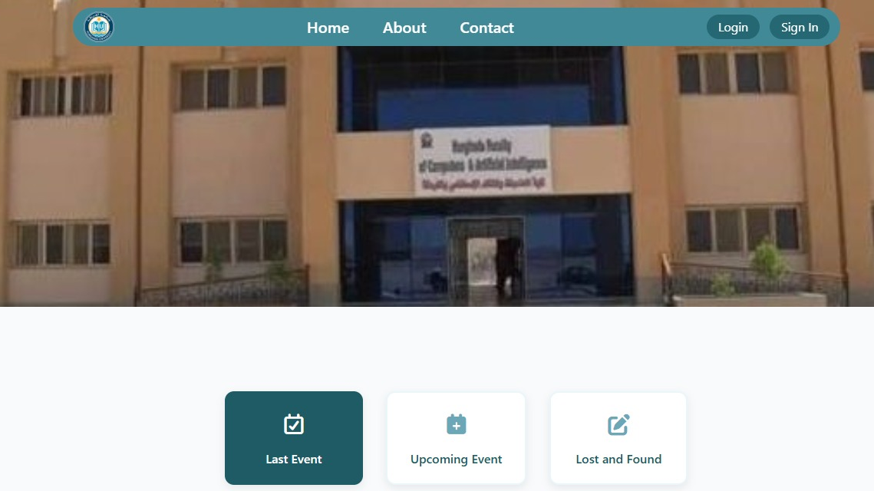

Slide 23
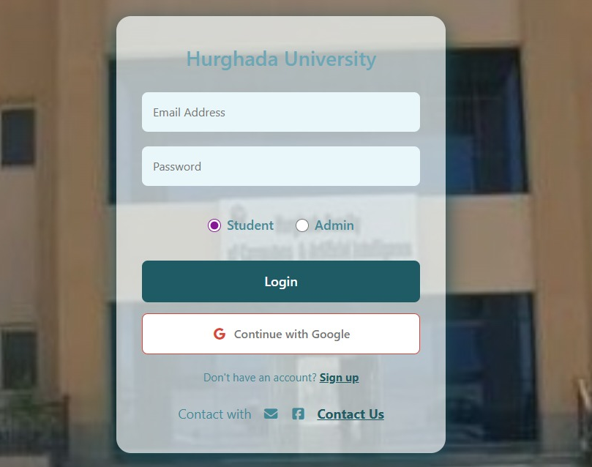
Student Login

Slide 24
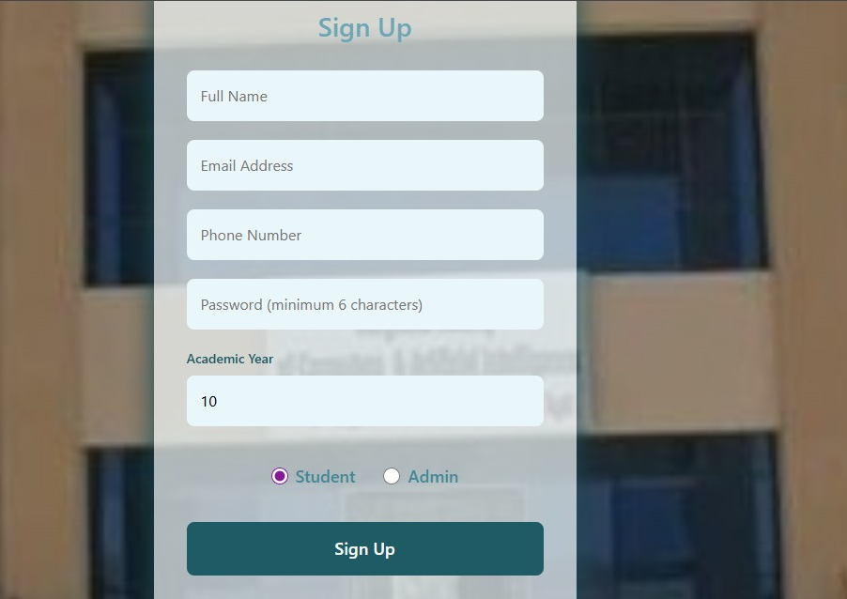
Student
Sign up

Slide 25
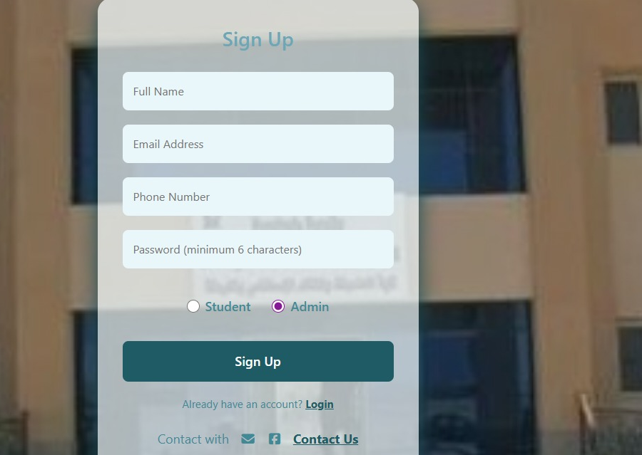
Admin
Sign Up

Slide 26
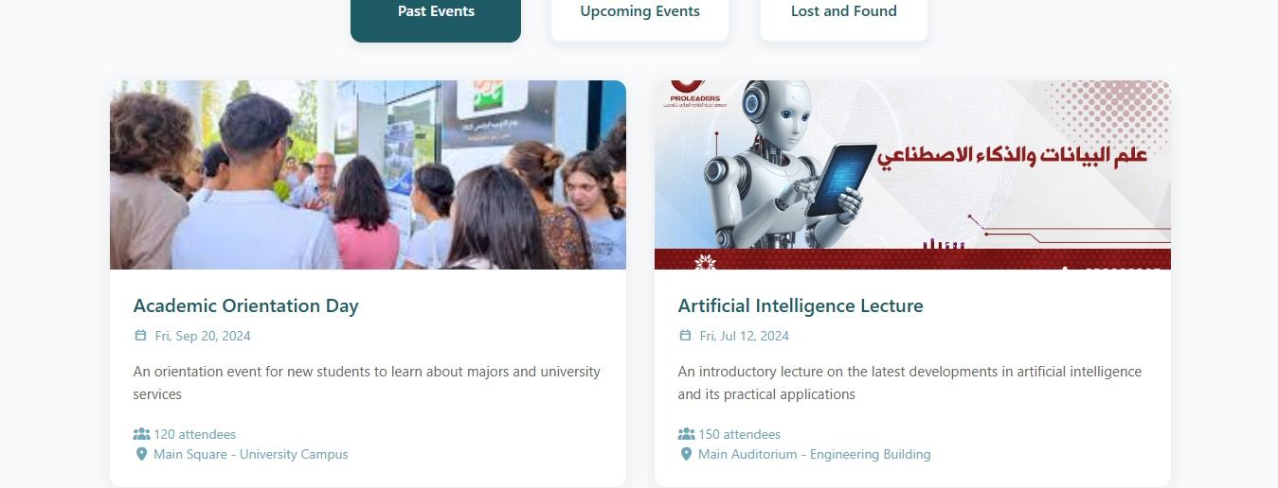
Past Events
Admin can convert event to past, then add photos

Slide 27
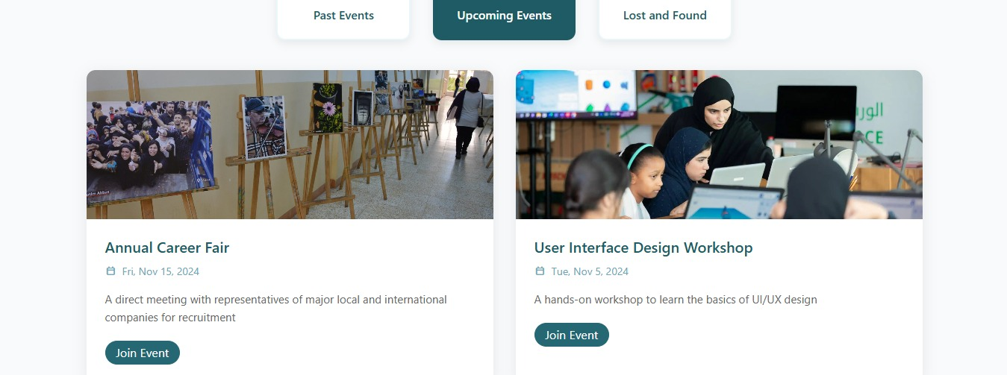
Upcoming Events
Event displayed on public / student home page as " Upcoming"

Slide 28
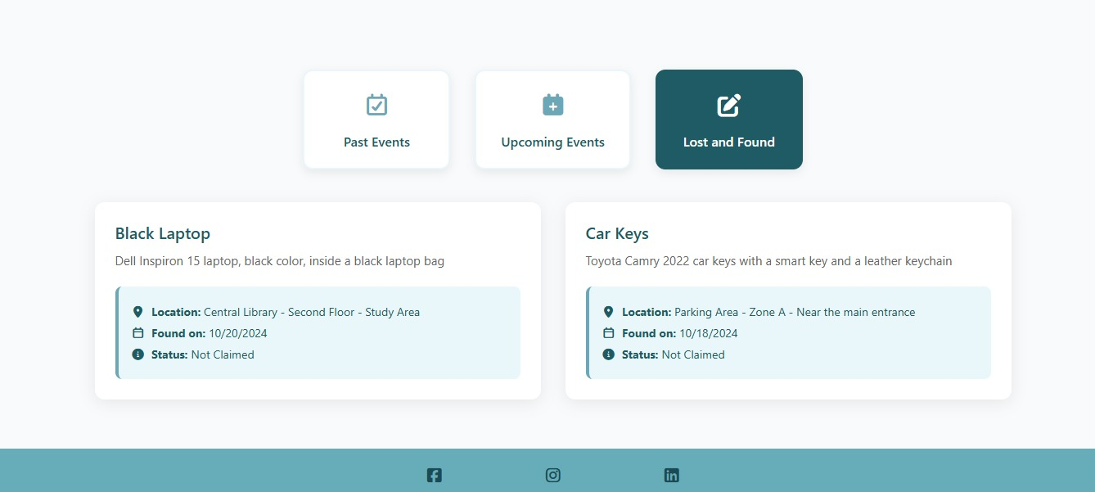
Lost & Found items uploaded

Slide 29
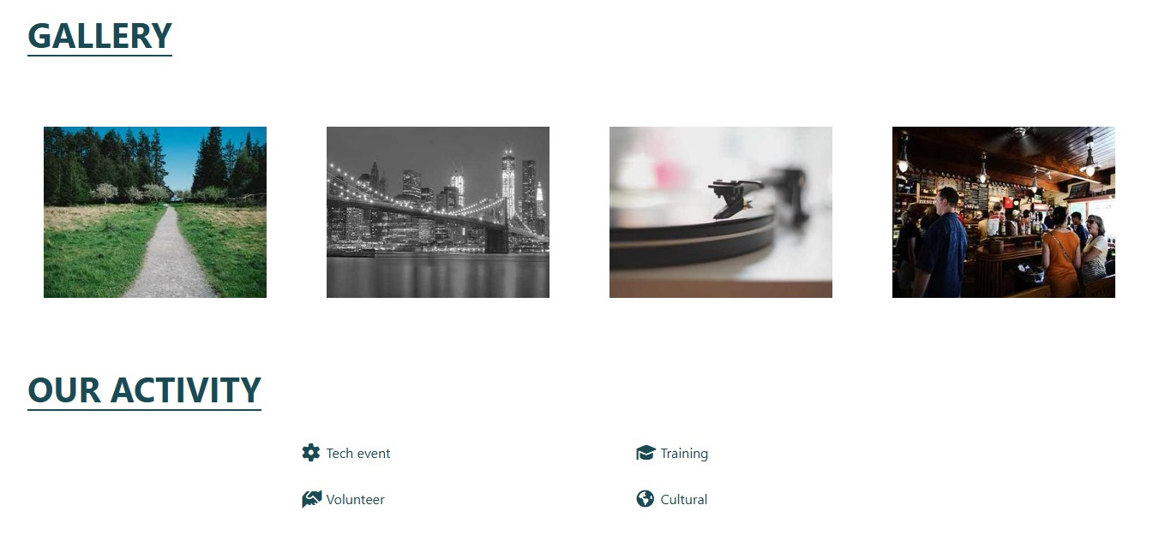

Slide 30
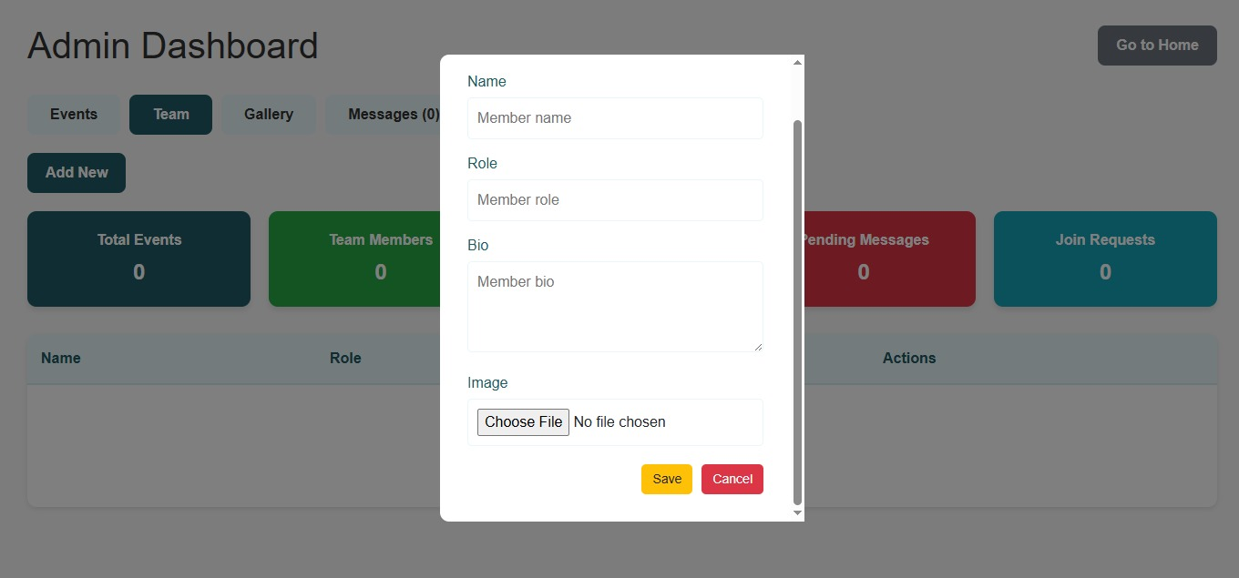
Admin add a new team member

Slide 31
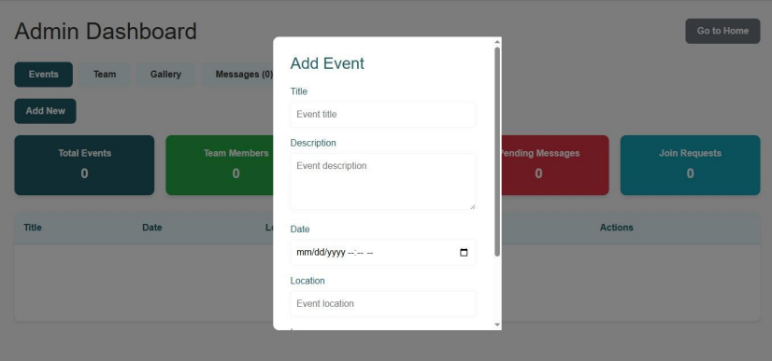
Admin uploading an upcoming Event

Slide 32
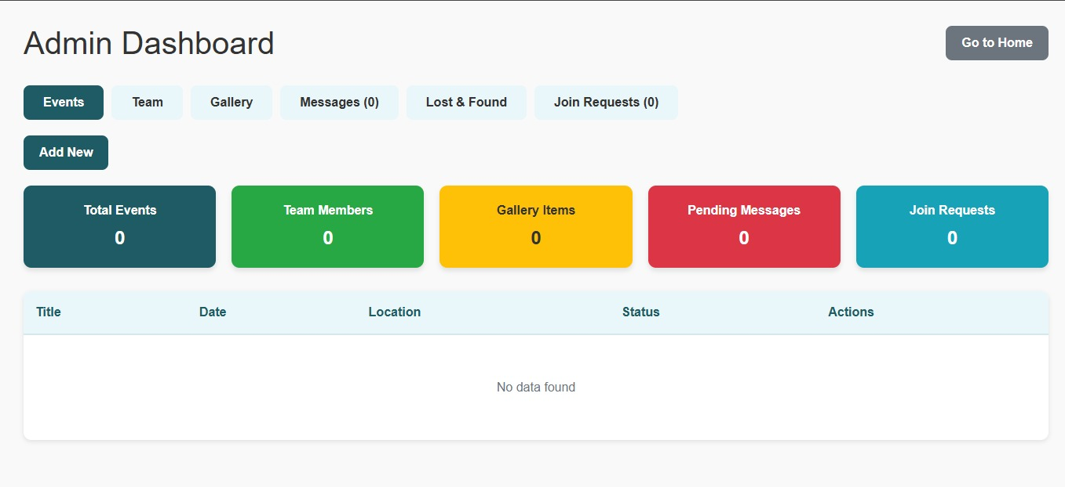
Admin Dashboard

Slide 33
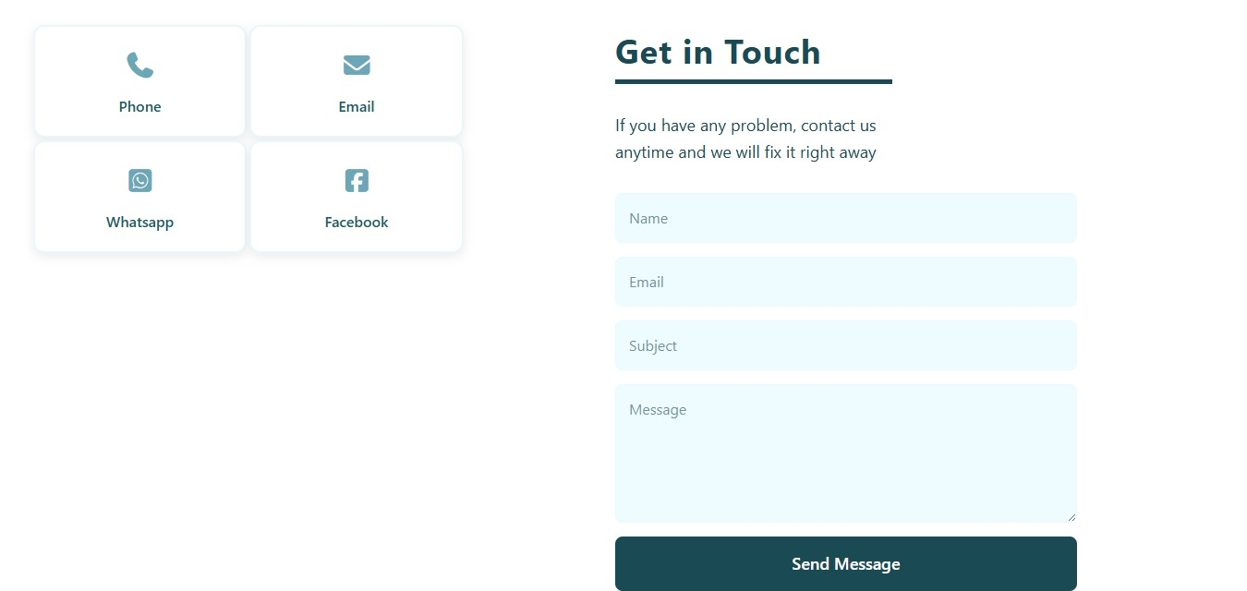

Slide 34
Admin management flow
Report Entry: Only Admins can add lost/found items (description, photo, location).
Public Listing: Items displayed for Students/Visitors to browse.
Claim Process: Student initiates a claim request on an item.
Admin Arbitration: Admin receives request, verifies ownership, updates item status.

Slide 35
Installation Requirements
Device: Laptop or Computer or a tablet (Windows, Linux, macOS)
Browser: Chrome
Internet: Stable connection
No installation needed: just open the website in the web browser

Slide 36
Future Work:
Mobile Application: React Native version for better accessibility.
Advanced Features: Live chat, event calendars, push notifications.
Analytics Dashboard: For admins to track engagement metrics.
Payment Integration: For event tickets or club merchandise.

Slide 37
Conclusion:
Successfully developed a full-stack, secure, and functional club management system.
Met all core SRS requirements: User management, Event cycle, Lost & Found, Announcements.
Implemented formal design models into a working application.

Slide 38
Thank you

