Slide 1

ANALYZING RESTAURANT OPERATIONS AND
ORDER TRENDS WITH SQL

Slide 2

Overview
This project uses SQL to analyze restaurant data with the goal of understanding order trends, optimizing delivery performance, and evaluating operational efficiency.

Slide 3
Objectives
Evaluate Operational Efficiency
Analyze Order Trends
Assess Delivery Performance
Improve Resource Planning
Support Data-Driven Decision Making

Slide 4
Dataset
This dataset is in csv format, includes 45,000 row where each row represents an order, 20 columns which are:
ID
Delivery_Person_ID
Delivery_Person_Age
Restaurant_Latitude
Restaurant_Longitude
Delivery_Location_Latitude
Delivery_Location_Longitude
Order_Date
Time_Orderd
Time_Order_Picked
Weather_Conditions
Road_Traffic_Density
Vehicle_Condition
Type_Of_Order
Type_Of_Vehicle
Multiple_Deliveries
Festival
City
Time_Taken(min)

Slide 5
1-Import the Data

Slide 6
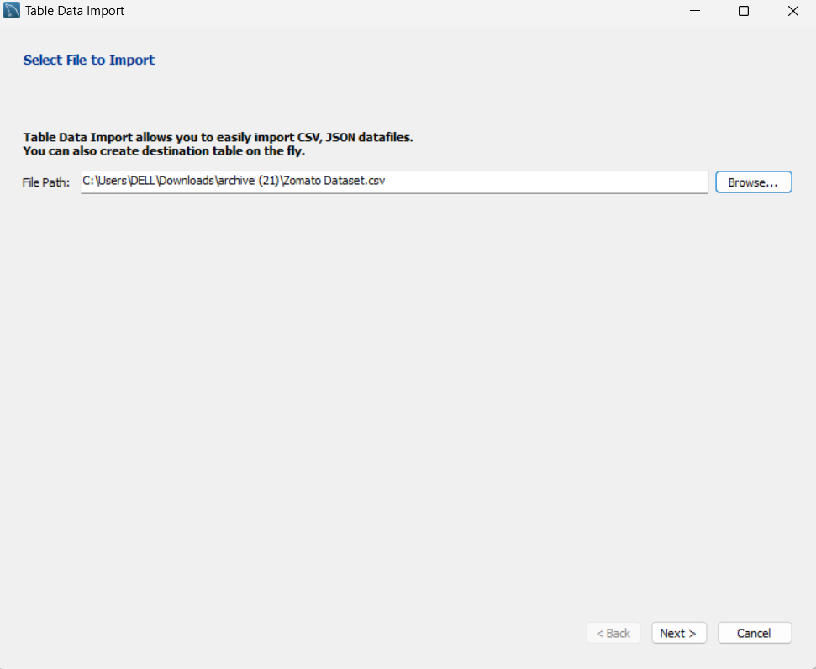
Utilize the Data Table Import Wizard to Import the csv file.

Slide 7
2-Data Profiling

Slide 8
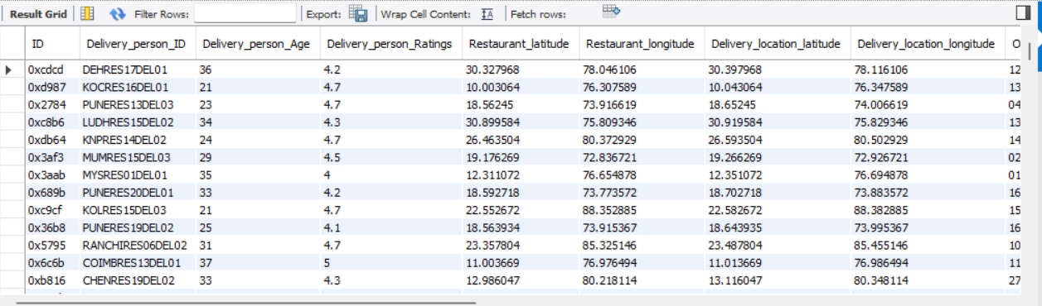
Getting familiar with the data:
SQL Statement
select * from orders;
Output

Slide 9
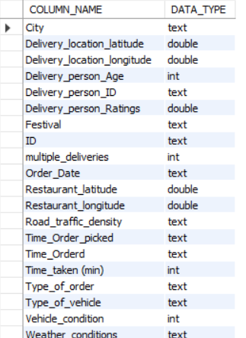
Checking the Data Types of each column:
SQL Statement
SELECT COLUMN_NAME, DATA_TYPE FROM INFORMATION_SCHEMA.COLUMNS WHERE TABLE_SCHEMA = 'zomato' AND TABLE_NAME = 'orders';
Output

Slide 10
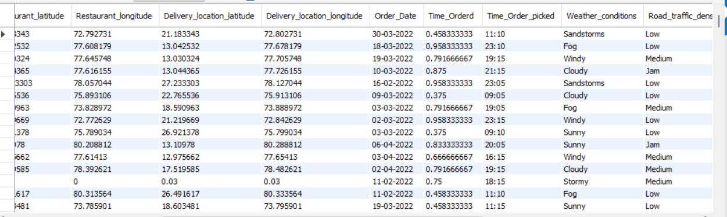
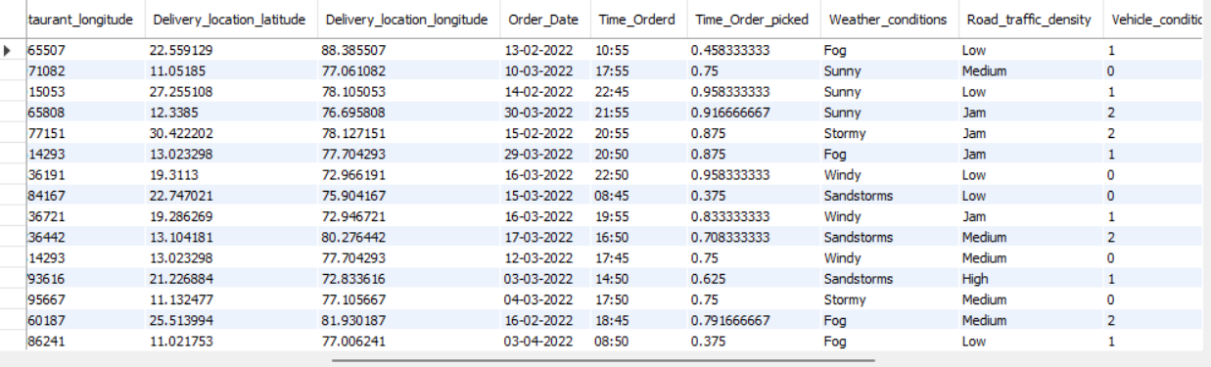
Some Inconsistencies are noticed in the Time_Orderd and Time_Order_Picked field, so let’s have a closer look:
SQL Statement
select * from orders where time_orderd like "%.%";
select * from orders where time_order_picked like "%.%";
Output

Slide 11
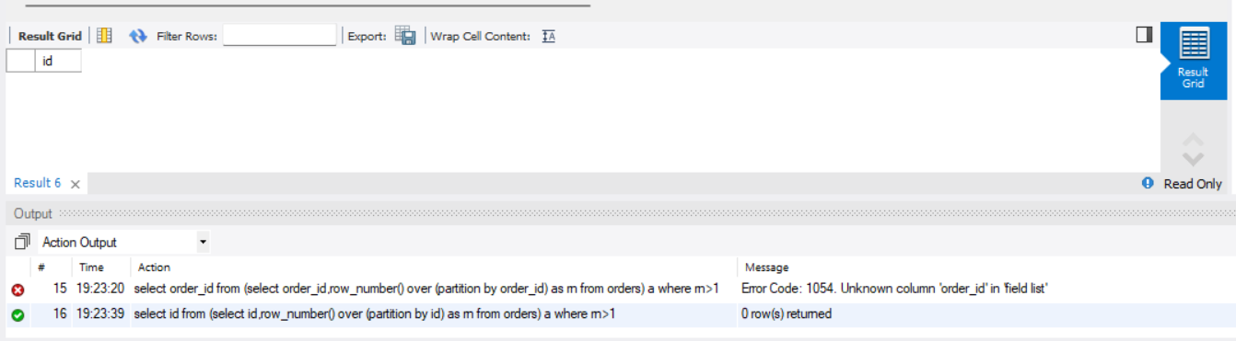
Check if there are any Duplicate Orders:
SQL Statement
select id from (select id,row_number() over (partition by id) as rn from orders) a where rn>1;
Output

Slide 12
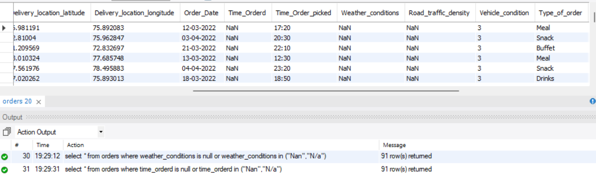
Check for Missing Values:
SQL Statement
select * from orders where time_orderd is null or time_orderd in ("Nan","N/a");
Output

Slide 13
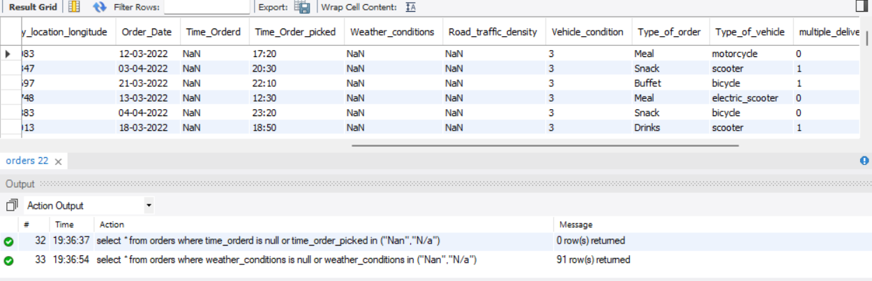
Check for Missing Values:
SQL Statement
select * from orders where weather_conditions is null or weather_conditions in ("Nan","N/a");
Output

Slide 14
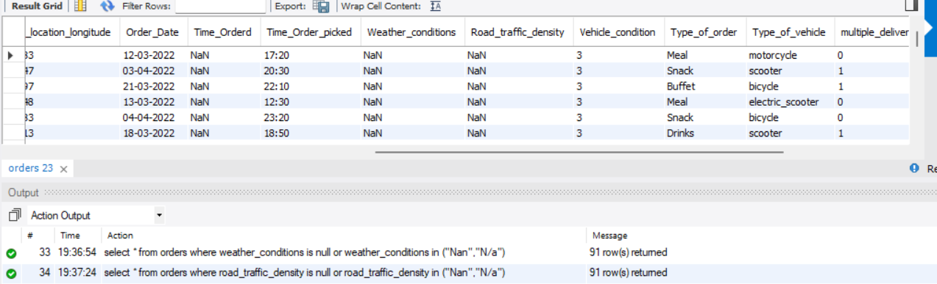
Check for Missing Values:
SQL Statement
select * from orders where road_traffic_density is null or road_traffic_density in ("Nan","N/a");
Output

Slide 15
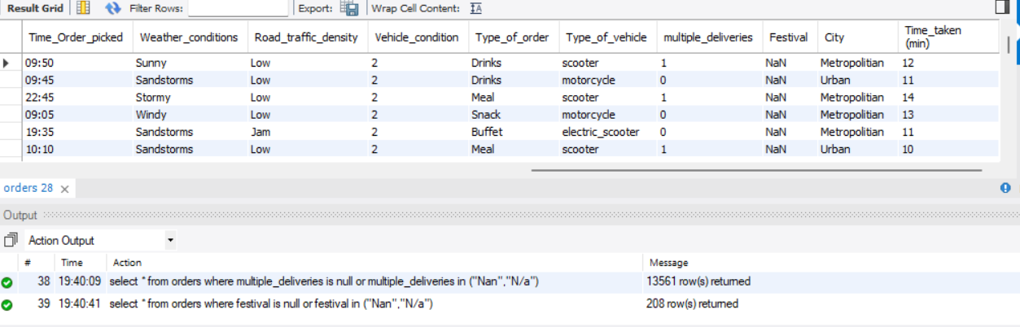
Check for Missing Values:
SQL Statement
select * from orders where festival is null or festival in ("Nan","N/a");
Output

Slide 16
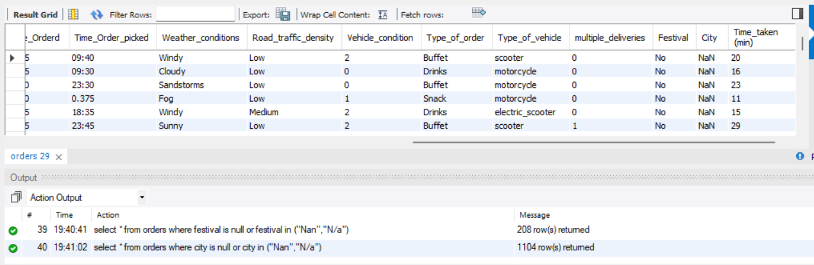
Check for Missing Values:
SQL Statement
select * from orders where city is null or city in ("Nan","N/a");
Output

Slide 17
3-Data Wrangling

Slide 18
3.1-Data Cleaning

Slide 19
Deleting rows with inconsistencies:
SQL Statement
delete from orders where time_orderd like "%.%";
delete from orders where time_order_picked like "%.%";

Slide 20
Deleting rows where Time_Orderd is null:
SQL Statement
delete from orders where time_orderd is null or time_orderd in ("Nan","N/a");

Slide 21
Replace null values in Festival field by the mode:
SQL Statement
select festival, count(*) as festival_count from orders group by festival order by festival_count desc limit 1;
update orders set festival ="No" where festival ="Nan";

Slide 22
Replace null values in City field by the mode:
SQL Statement
select city, count(*) as city_count from orders group by city order by city_count desc limit 1;
update orders set city='Metropolitian' where city ="Nan";

Slide 23
Change the data types of the columns Order_Date, Time_Orderd,Time_Order_Picked:
SQL Statement
update orders set order_date=str_to_date(order_date,"%d-%m-%Y");
alter table orders modify column order_date date;
alter table orders modify column time_orderd time;
alter table orders modify column time_order_picked time;

Slide 24
Fix Time_Order_Picked where time is more then 23:59:59:
SQL Statement
UPDATE orders SET time_order_picked = SUBTIME(time_order_picked, '24:00:00') WHERE time_order_picked > '23:59:59';

Slide 25
3.2-Add New Columns

Slide 26
Add new column Preparation time:
SQL Statement
alter table orders add column Preparation_time time;
update orders set preparation_time=timediff(time_order_picked,time_orderd);
update orders set preparation_time=addtime(preparation_time,"24:00:00") where preparation_time<0;

Slide 27
3.3-Binning

Slide 28
Binning for column Delivery_Person_Age:
SQL Statement
select min(delivery_person_age),max(delivery_person_age) from orders;
alter table orders add column delivery_age_bins text;
update orders set delivery_age_bins=case when delivery_person_age between 20 and 24 then '20-24'
when delivery_person_age between 25 and 29 then '25-29'
when delivery_person_age between 30 and 34 then '30-34'
when delivery_person_age between 35 and 39 then '35-39'
end ;

Slide 29
4-Analysis

Slide 30
4.1 Delivery Performance Analysis

Slide 31
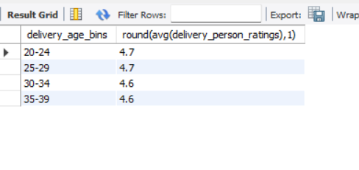
Finding Average Rating by Age bins:
SQL Statement
select delivery_age_bins,round(avg(delivery_person_ratings),1) from orders group by delivery_age_bins order by delivery_age_bins;
Output

Slide 32
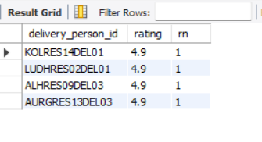
Finding Top Performing Delivery People:
SQL Statement
with cte as(
select delivery_person_id,round(avg(delivery_person_ratings),1) as rating from orders group by delivery_person_id order by rating desc),
ranked as(
select * ,rank() over (order by rating desc) as rn from cte)
SELECT * FROM ranked WHERE rn = 1;
Output

Slide 33
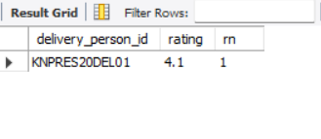
Finding Low Performing Delivery People:
SQL Statement
with cte as(
select delivery_person_id,round(avg(delivery_person_ratings),1) as rating from orders group by delivery_person_id order by rating ),
ranked as(
select * ,rank() over (order by rating ) as rn from cte)
SELECT * FROM ranked WHERE rn = 1;
Output

Slide 34
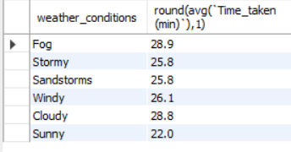
Finding Average Delivery Time by Weather Condition:
SQL Statement
select weather_conditions,round(avg(`Time_taken (min)`),1) from orders group by weather_conditions;
Output

Slide 35
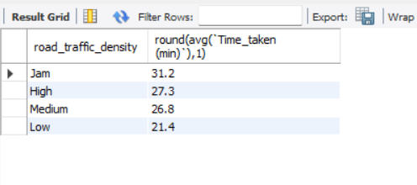
Finding Average Delivery Time by Road Traffic:
SQL Statement
select road_traffic_density,round(avg(`Time_taken (min)`),1) from orders group by road_traffic_density;
Output

Slide 36
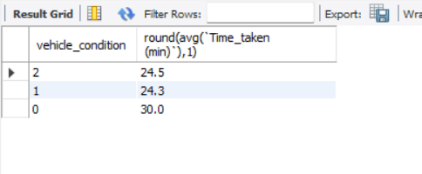
Finding Average Delivery Time by Vehicle Condition:
SQL Statement
select vehicle_condition,round(avg(`Time_taken (min)`),1) from orders group by vehicle_condition;
Output

Slide 37
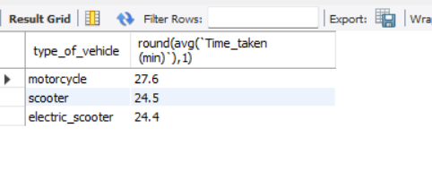
Finding Average Delivery Time by Type of Vehicle:
SQL Statement
select type_of_vehicle,round(avg(`Time_taken (min)`),1) from orders group by type_of_vehicle;
Output

Slide 38
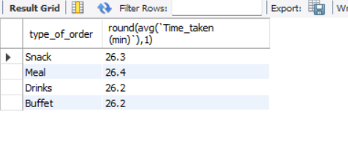
Finding Average Delivery Time by Type of Order:
SQL Statement
select type_of_order,round(avg(`Time_taken (min)`),1) from orders group by type_of_order;
Output

Slide 39
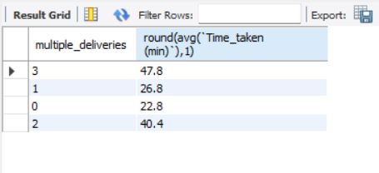
Finding Average Delivery Time by Multiple Deliveries:
SQL Statement
select multiple_deliveries,round(avg(`Time_taken (min)`),1) from orders group by multiple_deliveries;
Output

Slide 40
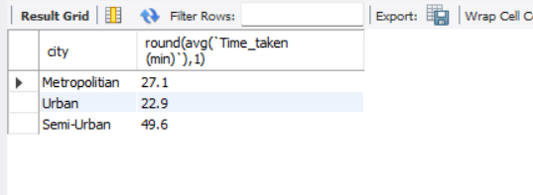
Finding Average Delivery Time by City:
SQL Statement
select city,round(avg(`Time_taken (min)`),1) from orders group by city;
Output

Slide 41
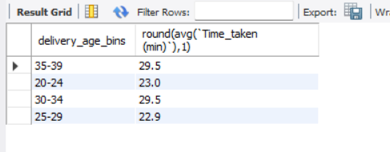
Finding Average Delivery Time by Delivery Person Age:
SQL Statement
select delivery_age_bins,round(avg(`Time_taken (min)`),1) from orders group by delivery_age_bins;
Output

Slide 42
4.2 Operations Analysis

Slide 43
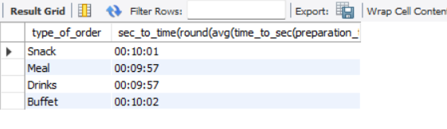
Finding Average Order Preparation Time by Order Type:
SQL Statement
select type_of_order,sec_to_time(round(avg(time_to_sec(preparation_time)))) from orders group by type_of_order;
Output

Slide 44
4.3 Order Trend Analysis

Slide 45
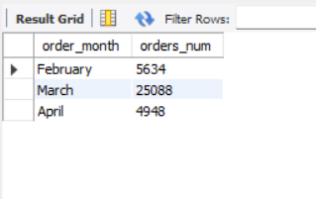
Finding Number of Orders by Month:
SQL Statement
select monthname(order_date) as order_month,count(*) as orders_num from orders group by monthname(order_date);
Output

Slide 46
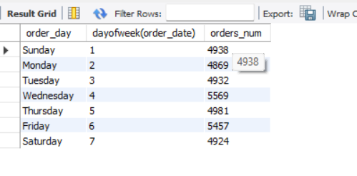
Finding Number of Orders by Day of Week:
SQL Statement
select dayname(order_date) as order_day,dayofweek(order_date),count(*) as orders_num from orders group by dayname(order_date),dayofweek(order_date) order by dayofweek(order_date);
Output

Slide 47
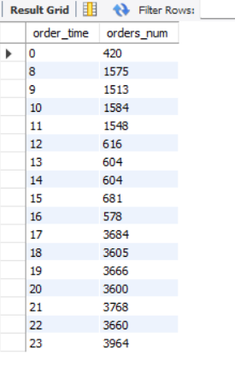
Finding Number of Orders by Hour:
SQL Statement
select hour(time_orderd) as order_time,count(*) as orders_num from orders group by hour(time_orderd) order by hour(time_orderd);
Output

Slide 48
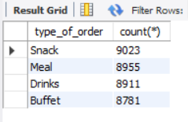
Finding Distribution of Orders by Order Type:
SQL Statement
select type_of_order,count(*) from orders group by type_of_order;
Output

Slide 49
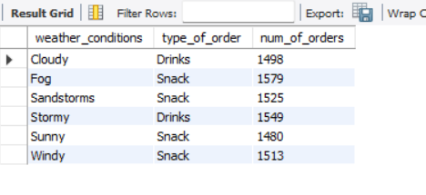
Finding out most common Type of Orders by Weather Condition:
SQL Statement
with cte as (select weather_conditions,type_of_order,count(type_of_order) as num_of_orders from orders group by weather_conditions,type_of_order),
ranking as(select *,rank() over (partition by weather_conditions order by num_of_orders desc) as rn from cte)
select weather_conditions,type_of_order,num_of_orders from ranking where rn=1;
Output

Slide 50
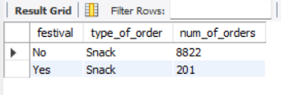
Finding out most common Type of Orders by Festival:
SQL Statement
with cte as (select festival,type_of_order,count(type_of_order) as num_of_orders from orders group by festival,type_of_order),
ranking as(select *,rank() over (partition by festival order by num_of_orders desc) as rn from cte)
select festival,type_of_order,num_of_orders from ranking where rn=1;
Output

Slide 51
Insights
Delivery Agents in their 20's tend to have slightly higher ratings than those in their 30's.
Average Delivery time in Cloudy/Foggy weather is the longest (28.8-28.9) mins., slightly shorter in Stormy/Windy (25.8,26.1) mins. and the shortest Average delivery time is usually in the sunny weather (22) mins..
Average Delivery time for Vehicles with condition 0 is around 30 mins. which is 6 minutes longer than condition 1,2.

Slide 52
Delivery using motorcycles has the longest average delivery time 27.6 mins. which is aroud 3 minutes longer than scooters and electric scooters.
Semiurban cities have the longest average delivery time 49 mins, Metropolitan 27.1 mins and the shortest is in urban cities 23 mins.
Average delivery times for agents in their 30's is around 29 mins. which is 6 mins. longer than average delivery times for agents in their 20's.

Slide 53
March was the month of highest number of orders around 5x the number of orders in February or April.
Wednesdays and Fridays are the busiest days of the week.
Hours from 5pm-11pm are the busiest hours of the day.

Slide 54
THANK YOU

