Slide 1
MASTER'S THESIS · DEFENCE
Playground Activity Detection using Deep Learning
A CPU-only system that detects activity and verifies booked pitch usage.
Fady Khazaka
Supervisor: Dr. Mohammad Khalil

Slide 2
SUMMARY
The abstract
I developed this project after noticing that most AI solutions for football pitches focus on athletes, not business owners. Our system uses deep learning to automatically verify whether booked pitches were actually used, giving owners greater trust and peace of mind without relying on human monitoring. The system takes the CCTV camera stream and analyzes one picture every minute. Each picture is classified as Active Play, Empty, Maintenance, or Not Playing, so the owner doesn’t need to constantly check the cameras to know what is happening on the pitch.
It runs on a CPU-only server, so it is affordable and deployable in the real world.
The owner’s problem
For example: Seven pitches, one person, and no way to watch them all. Checking by eye is a sample, not an audit.
The market
~1,200 football playgrounds in Lebanon — the same problem, multiplied.
Booking ≠ attendance
An online booking says a slot was sold. It does not say anyone came.
Affordable by design
CPU servers rather than GPUs or cloud inference. The constraint is what makes it deployable, not a limitation to work around.
1

Slide 3
SUMMARY
The study in numbers
1692
3
7
0
labelled frames
classes
venue folds
GPUs — and no cloud services either
2

Slide 4
SUMMARY
Three findings
A high score does not always mean the model understands the pitch
For example, the model learned that dark images mean playing and bright images mean empty. So, it learned the lighting instead of the real activity.
When we tested a new video, we found a bigger problem.
The original dataset did not contain enough different situations. So the model could work well on the original data, but not always on new data.
Data augmentation did not always improve the model
One experiment gave us 85.5%, but when repeated the same experiment, the results dropped to 34.8%–41.4%. This showed us that the high score was not stable, it was a random result.
3

Slide 5
PLAN
How this report is organised
Eight parts: a summary, this plan, an introduction, four chapters, and a conclusion.

Slide 6
PLAN
The eight parts
1
Summary
The abstract, the scale of the study, and the three findings.
2
Plan
This page.
3
Introduction
The problem in general, who has worked on it, and how we resolve it.
4
Chapter 1 — State of the art
Playgrounds: how facilities are monitored today and why each alternative fails. Deep learning: what the field has established, and the gap.
4

Slide 7
PLAN
The eight parts
5
Chapter 2 — Deep learning methods and our model
The families considered, why the backbones are frozen, the architecture, and how it is evaluated.
Chapter 3 — YOLOv8
Why a detector at all, the candidates tested, the bake-off that chose one, what it cannot see, and how it is wired to the classifier of Chapter 2: a motion check between two frames and a head count inside the pitch boundary, each able to overturn a match-in-progress verdict but never to create one.
6
7
Chapter 4 — Applications and data augmentation
The deployed application, preprocessing, the augmentation presets, the retraction, and the data generated with AI.
8
Conclusion and perspectives
What was achieved, what it cannot claim, and what would change that.
5

Slide 8
THE MAIN IDEA OF THE PROJECT IS:
The booking says an hour was sold. Only the camera knows if anyone came.
What is really being sold here is trust, and today this information can depend on a paper or a manual record made by employees. The problem is that nobody can check this information all the time.

Slide 9
INTRODUCTION
Our system tries to answer simple questions:
Was this hour booked?
The system shows the booking, but not what actually happened on the pitch.
Did they actually come?
A customer may book the pitch but never show up.
Did they actually play?
People may be on the pitch without actually playing a game.
Is the pitch empty right now?
The owner cannot know unless someone checks the pitch or the camera.
Did someone play without booking?
Someone may use the pitch without a booking, so the owner could lose money.
Did staff record it correctly?
Manual records can be entered incorrectly or forgotten.
The CCTV camera gives us real visual evidence.
6

Slide 10
CHAPTER 1 — STATE OF THE ART
Playgrounds, and deep learning
There are already different ways to monitor activity. But each solution has limitations.

Slide 11
CHAPTER 1 — STATE OF THE ART
Playgrounds — how occupancy is measured today
APPROACH | COST PER PITCH | WHAT IT MEASURES | HOW IT FAILS
PIR / motion sensor | ~€20 | Detect movements | Gave us false alarm, Rain, wind-blown netting, foxes, staff crossing — and no evidence trail
Door counter / turnstile | €300–2,000 | Count people entering | Cannot tell us if they actually played, nobody counts out
Floodlight power draw | ~€60 | Lights on | Daylight slots invisible; lights left on; shared circuits
Mobile App check-in | ~€0 | ask customers to check in | It depends on the customer, and they may not do it
Manual logging | Staff time | What staff wrote down | It is one of the three records being audited
This system | Reuses existing CCTV | Give us real images using CCTV, with evidence | Needs a camera view; classification error
7

Slide 12
CHAPTER 1 — STATE OF THE ART
Deep learning — what the field must establish
§2.1 Occupancy and activity recognition from fixed cameras
That classifying scene state from a fixed viewpoint is a solved problem class, and what accuracy the field considers ordinary.
§2.2 Frozen features and linear probes
That a frozen backbone with a small trained head is a legitimate method rather than a shortcut.
§2.3 Dataset leakage and evaluation protocol
That near-duplicate leakage is a known, recurring problem, with prior cases where a benchmark was found to be measuring memorisation.
§2.4 Trivial baselines and benchmark validity
That checking a benchmark against a baseline which ignores the input is established practice.
§2.5 Edge and CPU-constrained inference
What is achievable without a GPU, and at what accuracy cost.
§2.6 Calibration and uncertainty for deployed classifiers
That a confidence score is an operational quantity once it routes work to a person, and how calibration is normally assessed.
§2.7 Facility management, audit and record reconciliation
That cross-checking a sensor against an administrative record is a recognised problem, in this domain or an adjacent one.
§2.8 Prior art — who already does this
Whether a commercial or academic system already audits facility occupancy, and what it does not do.
§2.9 Selective prediction and learning to defer
That abstaining and handing a case to a human is a studied design with its own metrics — so the REVIEW band is literature-backed, not an engineering convenience.
8

Slide 13
CHAPTER 2 — DEEP LEARNING METHODS
The families considered, and the model we built
Three frozen backbones, a classifier small enough to read on one screen, and the reason it is that way round.

Slide 14
CHAPTER 2 — DEEP LEARNING METHODS
We considered four main AI models
Convolutional networks
ConvNeXtV2 — a modern CNN, supervised and masked-autoencoder pretraining on ImageNet-22k.
Vision transformers
ViT-Base — supervised ImageNet-21k, fine-tuned to 1k.
Self-supervised transformers
DINOv2 — self-supervised on LVD-142M, no labels at all.
Vision-language models
CLIP / OpenCLIP / SigLIP, used zero-shot with written class descriptions.
9

Slide 15
CHAPTER 2 — DEEP LEARNING METHODS
Why the Backbones Are Frozen
Fine-Tuning Needs Variety We Do Not Have
We did not fine-tune all 200 million parameters because we only have ~150 different scenes. With so little data, the model could memorize the pictures instead of learning the game, causing overfitting.
More Data Is Not Easy to Collect
The videos show real people, so collecting footage from new venues requires permission.
Our Numbers Show the Risk
98.5% of frames are very similar, and accuracy dropped when we increased the data from 300 to 671 samples.
Freezing is a defence against overfitting first, and an efficiency win second.
10

Slide 16
CHAPTER 2 — DEEP LEARNING METHODS
DINOv2 — what actually runs
frozen · 86,580,480 parameters · 0 gradients received
trained · 2,307
the frame
224×224, inside
the pitch boundary
patch embedding
14×14 patches
256 tokens + CLS
transformer × 12
12 heads, width 768
every patch sees every other
mean over tokens
one 768-number
description
linear probe
768 × 3 + 3 biases
the only thing trained
37,529 frozen parameters per trained one
EMPTY
ACTIVE PLAY
MAINTENANCE
DINOv2 is pretrained on LVD-142M with no labels at all, so it has no notion of the three classes and no classifier: what comes out is a description of the image. Everything inside the dashed region is used exactly as downloaded and receives no gradient at any point in this project. The whole of what is fitted is the box on the right.
11

Slide 17
CHAPTER 2 — DEEP LEARNING METHODS
The full model comparison
MODEL | Random split macro-F1, frames shuffled — the leaky protocol ↑ higher is better | Grouped split macro-F1, no venue in both train and test ↑ higher is better | Cross-venue recall playing frames found at an unseen venue ↑ higher is better | Worst fold the lowest single fold behind that recall ↑ higher is better | False-play held-out empty pitches called a match ↓ lower is better | Balanced recall minus false-play ↑ higher is better | ms/frame time to score one frame ↓ lower is better
DINOv2 self-supervised, no labels in pretraining | 0.988 | 0.579 | 0.956 | 0.806 | 0.309 | 0.647 | 219
ConvNeXtV2 self-supervised convnet, smallest and fastest | 0.988 | 0.497 | — | — | 0.992 | — | 101
ViT supervised on ImageNet labels | 0.994 | 0.497 | — | — | 0.835 | — | 169
Clock rule reads the clock, never the pixels | 0.991 | 0.497 | 0.984 | 0.923 | 0.021 | 0.964 | —
A dash is a result that has not been measured, not a zero. Cross-venue recall is measured on folds that are 100% ACTIVE_PLAY, so it can be earned by answering “playing” to everything — which is what the false-play column is there to catch, and why the ranking it gives is not the ranking the grouped split gives.
12

Slide 18
CHAPTER 3 — YOLOV8
Counting what stands on the pitch
The classifier says what a scene looks like. The detector says how many people are on it, whether there is a ball, and whether anything moved — and those counts can overrule the classifier.

Slide 19
CHAPTER 3 — YOLOV8
The architecture — one forward pass
one forward pass · COCO weights, nothing trained here · yolov8n
boxes out
the frame
long edge 1280
one per camera-minute
backbone (Features & layers)
CSPDarknet (architecture),
C2f blocks
(features representation)
features at 3 scales (s,m,l)
neck
PAN-FPN
small objects keep detail
head
anchor-free (location),
decoupled
(where is it?, what is it?)
box + class, no anchors
NMS
person ≥ 0.25
ball ≥ 0.1
then the rules: foot inside the boundary, 4 or fewer is not a game, 5+ with a moving ball is
The detector ends at boxes. It is asked for two COCO classes only — person and sports ball — and it is never asked whether a match is happening: that is decided afterwards by counting, which is why a verdict can be shown to a manager as the objects it was made from.
13

Slide 20
CHAPTER 3 — YOLOV8
The three cases
People — How many people are on the pitch
We count the people inside the pitch.
0 people = empty
A few people may be staff or non-playing people.
Many people usually means a game is happening.
1
Motion — Is something moving?
We compare the current frame with the previous frame.
It tells us if something is moving.
It does not tell us who is moving.
2
Ball — Is there a ball being played?
The ball must appear in at least 2 of 3 frames.
This helps avoid false detections.
The ball must also be moving.
A ball that is just lying on the pitch does not mean a game is happening.
3
14

Slide 21
CHAPTER 3 — YOLOV8
From boxes to a verdict — the rule table
# | CONDITION | VERDICT
1 | Detector unavailable | Uncertain — a missing detector is not an empty pitch
2 | No pitch boundary | Uncertain — mandatory on the deployed path
3 | Nobody, nothing moving | EMPTY
4 | Nobody, but something moved | Uncertain
5 | 1–4 people | Not a game — too few, ball or no ball
6 | 5+ people, and a ball in play, and motion | ACTIVE PLAY — the only way in
7 | 5+ people, otherwise | Not a game — a crowd that is not playing
5 and 4 are the facility’s numbers, not fitted ones: five make a game, four or fewer do not. Every threshold that was fitted is recorded in configs/rules.json with the camera it was fitted on, and a cue that cannot be measured is reported as unmeasured, never assumed.
15

Slide 22
CHAPTER 4 — APPLICATIONS AND DATA AUGMENTATION
What it does in practice, and what we did about the data
The preprocessing path and the augmentation argument, in pictures.

Slide 23
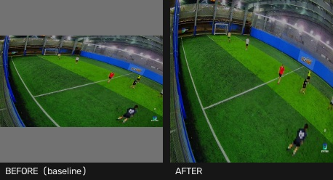
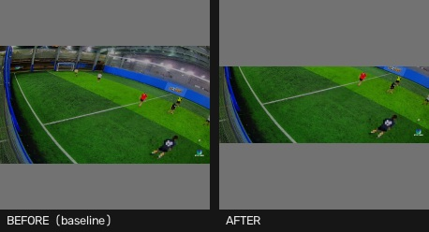
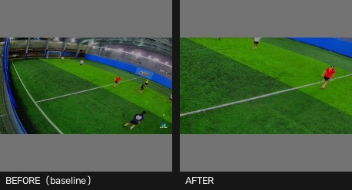
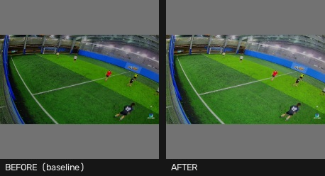
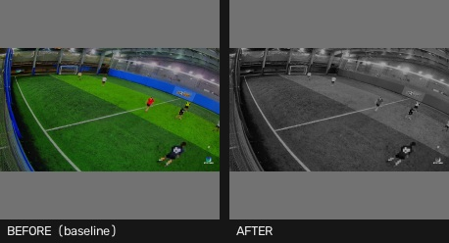
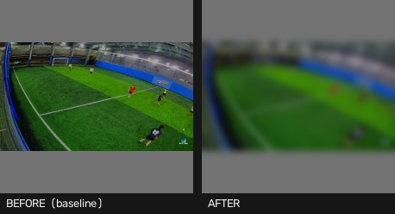
CHAPTER 4 — APPLICATIONS AND DATA AUGMENTATION
Preprocessing — six switches, before and after
letterbox=False
Pad to a square instead of squashing.
39.1/255 moved · 98% of pixels
top_crop=0.35
Cut the sky and stands off the top.
21.4/255 moved · 56% of pixels · 65% kept
centre_crop=0.5
Keep the middle, discard the border.
16.1/255 moved · 56% of pixels · 25% kept
gamma=0.7
Brightness curve.
14.6/255 moved · 56% of pixels
saturation=0.0
Colour strength — 0.0 is grayscale.
14.4/255 moved · 55% of pixels
blur_sigma=4.0
Blur — destroys fine detail, including people.
7.5/255 moved · 60% of pixels
16

Slide 24
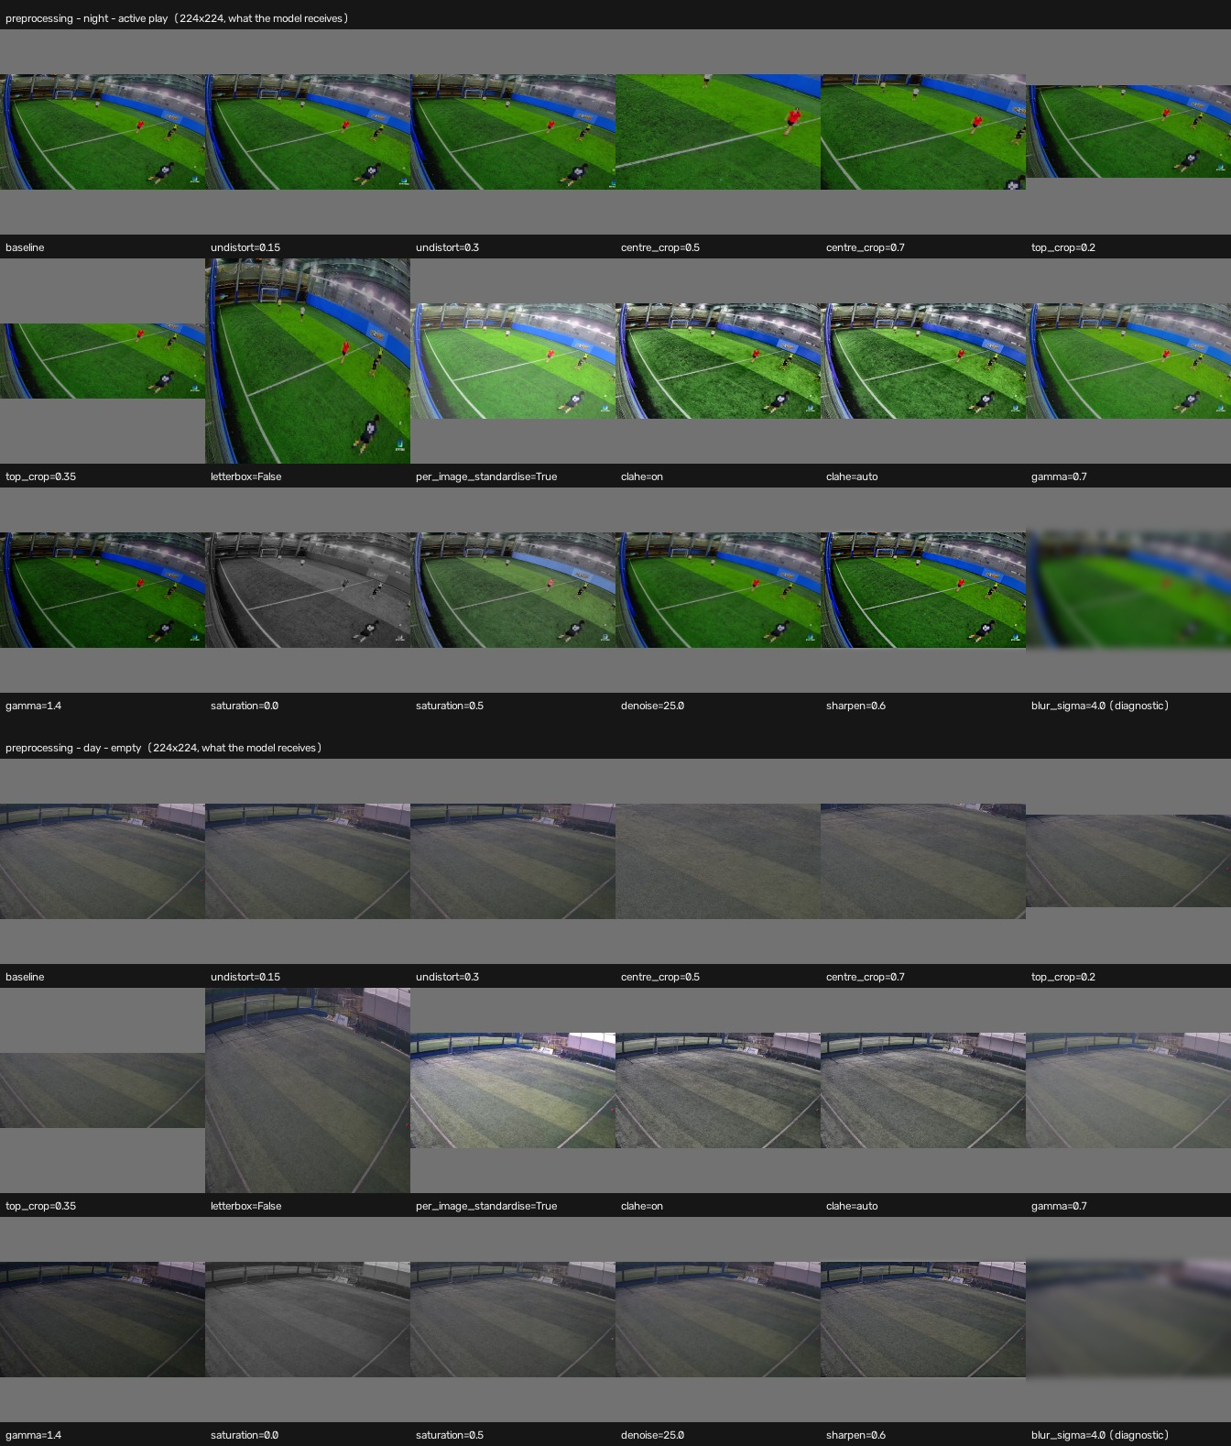
CHAPTER 4 — APPLICATIONS AND DATA AUGMENTATION
What removal looks like
Preprocessing removes information permanently; augmentation varies it and keeps every pixel at inference. That is why both exist, and why removal has a floor that variation cannot cross.
Every preprocessing switch the search tries, at the real 224×224 the backbone receives. Grey bands are letterbox padding. blur_sigma=4.0 has removed the people and centre_crop=0.5 the goalmouth. roi is absent: no pitch polygon drawn yet. Left: the night active-play frame. Right: the day empty frame.
17

Slide 25
CHAPTER 4 — APPLICATIONS AND DATA AUGMENTATION
The augmentation argument
preprocessing — one way, and it has a floor
source frame
everything
grayscale
+0.022 · fp 0.02
gray + crop50
−0.061 · fp 0.99
below the untouched
baseline — the floor
augmentation — varies the input, discards nothing
view 1
source frame
everything
view 2
probe training
sees all three
inference
the source frame, unchanged
view 3
nothing was discarded, so nothing is missing here
Each box carries recall and the false-play rate (fp): grayscale gains on both axes, the crop’s larger apparent gain is a variant answering PLAY more often. Augmentation’s fan exists only in training, so there is no floor to cross.
18

Slide 26
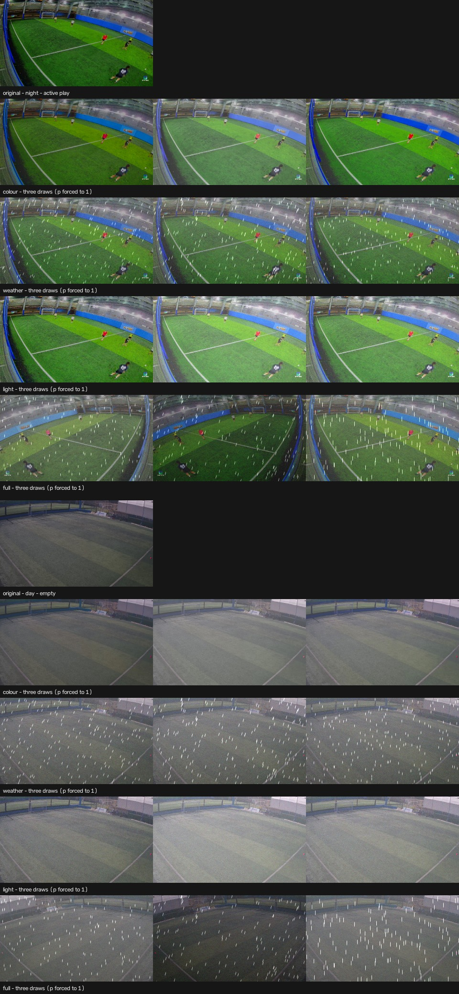
CHAPTER 4 — APPLICATIONS AND DATA AUGMENTATION
The preset sheets — every preset, three draws each
Every preset, three draws each, on a night play frame and a day empty frame. Probability forced to 1, so the sheet shows the effect and not the coin flip. Left: the night active-play frame. Right: the day empty frame — the two halves of the one sheet.
19

Slide 27
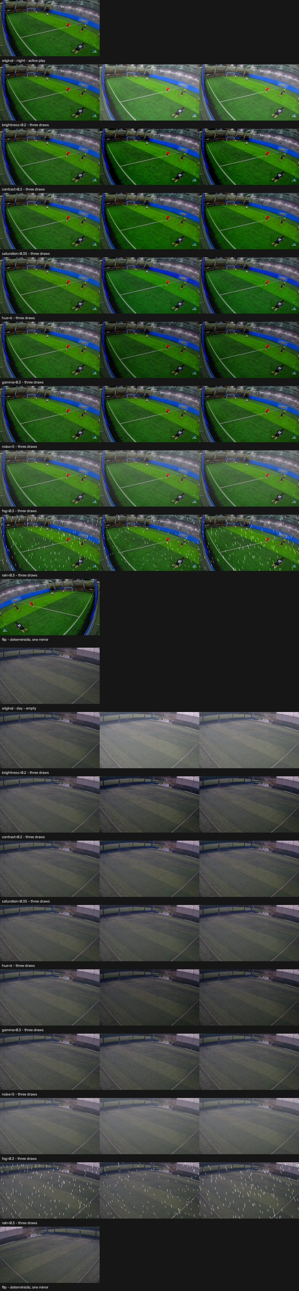
CHAPTER 4 — APPLICATIONS AND DATA AUGMENTATION
One effect at a time
One effect at a time, at the magnitude full uses — brightness 0.2, contrast 0.2, saturation 0.35, hue 6°, gamma 0.3, noise σ=5, fog 0.3, rain 0.3, flip. Magnitudes are read off the preset. flip is shown once; every other row is three draws. The sheet is read left to right: four pieces of five bands, in the order they appear on it.
20

Slide 28
CHAPTER 4 — APPLICATIONS AND DATA AUGMENTATION
The preprocessing search — change from the untouched baseline
Best on DINOv2, all frames: clahe=auto at 0.9881 recall, worst fold 0.905. 43 evaluations · 1599 frames
Cross-venue play recall. Bars run right when a switch helped and left when it hurt; the number on the right is the absolute recall. Baseline 0.831.
clahe=auto · r2
0.988
saturation=0.5 · r2
0.977
clahe=on · r2
0.976
letterbox=False · r2
0.975
gamma=1.4 · r3
0.962
saturation=0.5 · r3
0.986
gamma=0.7 · r2
0.974
centre_crop=0.7 · r1
0.964
per_image_standardise=True · r3
0.960
sharpen=0.6 · r3
0.979
saturation=0.0 · r2
0.924
denoise=25.0 · r2
0.986
undistort=0.3 · r1
0.912
saturation=0.0 · r1
0.819
worse
baseline
better
improved
worse
gained recall but also raised false alarms
Every cross-venue test set is entirely active play, so recall can be bought by predicting “playing” more often. Amber bars did exactly that and are not improvements. Top 14 of 43 by balanced = recall − false-play; the untouched baseline ranks 21, which is why it is not on the chart. Three backbones over two frame counts: each finished run is saved under results/search_runs/, so the six can be compared without re-running any of them.
21

Slide 29
QUESTIONS
Ask anything.
And then, rather than another slide: the model, running.
Now we would like to show you the system — the model on real footage, how a frame becomes a verdict, and what the operator actually sees.

