Slide 1







AIR QUALITY
ANALYSIS
Mariam Tarek

Slide 2


INTRODUCTION
Imagine we placed a set of devices across a large city to monitor air quality throughout the day. These devices record things like Carbon Monoxide (CO), Benzene (C6H6), Nitrogen Oxides (NO, NO₂), and Ozone (O₃). They also measure temperature, humidity, and air pressure.
Then when we look at this dataset, we are essentially reading a diary of how the air changed over time. It contains daily measurements of different pollutants, weather conditions, and environmental factors. Let me walk you through the key points.
Introduction
Sources of Air Pollution
Strategies to Reduce Air Pollution
Pollution Prevention Technology
Benefits of a City Free of Air Pollution
Conclusion

Slide 3


DATASET FEATURES
Date → Date of measurement (March 2004 – April 2005).
Time → Time of measurement (hour and minute).
Temperature (T) → Air temperature in °C.
Relative Humidity(RH) → Relative humidity (%)
Absolute Humidity(AH) → Absolute humidity (g/m³)
CO(GT) → Carbon Monoxide concentration (mg/m³)
PT08.S1(CO) → Sensor signal related to CO levels
NMHC(GT) → Non-Methane Hydrocarbons (µg/m³)
C6H6(GT) → Benzene concentration (µg/m³)
PT08.S2(NMHC) → Sensor signals related to hydrocarbons
NOx(GT) → Nitrogen Oxides (ppb), group of gases mainly from traffic
PT08.S3(NOx) → Sensor signal related to NOx
NO₂(GT) → Nitrogen Dioxide concentration (µg/m³)
PT08.S4(NO₂) → Sensor signal related to NO₂
PT08.S5(O₃) → Sensor signal related to Ozone

Slide 4




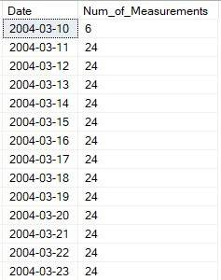
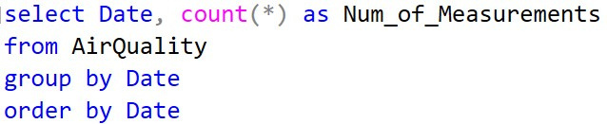
SQL QUERIES
1. How many total records exist in the dataset?
2. What is the time period covered by the dataset (first and last date)?
3. How many measurements were recorded each day?

Slide 5
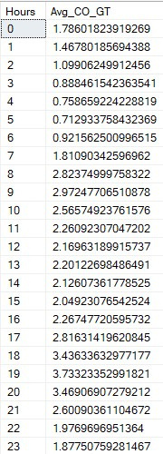

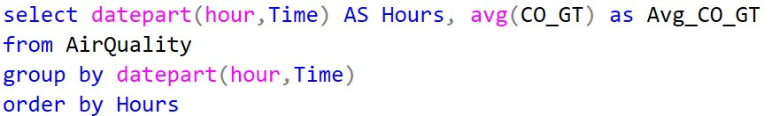
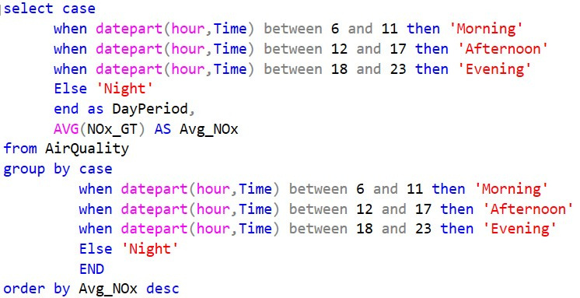
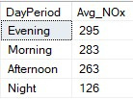
SQL QUERIES
4. What is the average carbon monoxide (CO) level by hour of the day?
High level between 8:20 due to traffic
5. What is the average nitrogen oxides (NOx) level by day period (morning, afternoon, evening, night)?
High level in Evening and Morning

Slide 6


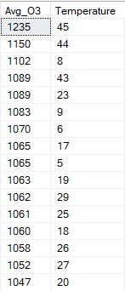
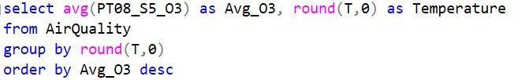
SQL QUERIES
6. At what hour of the day is nitrogen dioxide (NO₂) at its highest?
The highest time is 4 PM, which is when people usually leave work.
7. What is the average ozone (O₃) level at different temperature ranges?
The highest level is usually associated with a rise in temperature.

Slide 7
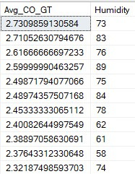
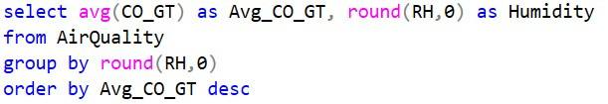
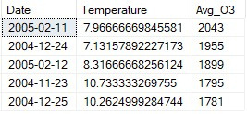
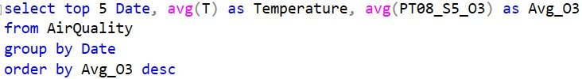
SQL QUERIES
8. What is the average carbon monoxide (CO) level at different humidity levels?
High humidity is associated with higher CO, showing that moist air traps pollutants
9. Which 5 days had the highest average temperature, and what was the average ozone on those days?
On the hottest days, ozone levels were also among the highest

Slide 8
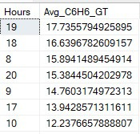
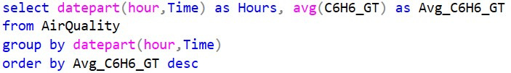
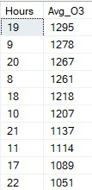
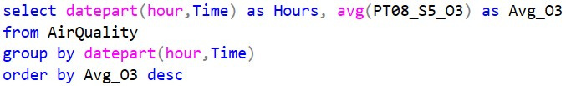
SQL QUERIES
10. What are the average benzene (C6H6) levels across the hours of the day?
Benzene is higher in the morning and evening, reflecting its link to traffic activity.
11. What are the average ozone (O₃) levels across the hours of the day?
Ozone is lowest in the morning, rises during midday with sunlight, and drops again at night.
The highest level is usually associated with a rise in temperature.

Slide 9

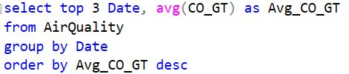

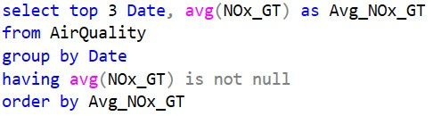
SQL QUERIES
12. Which 3 days had the highest average CO levels?
These days were likely cold, calm winter days when pollution accumulates due to low wind.
13. Which 3 days had the lowest average NOx levels?
These days were warmer with higher wind, which helped disperse pollutants.

Slide 10

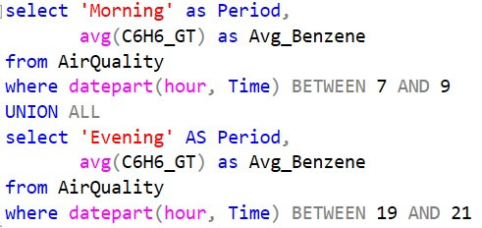
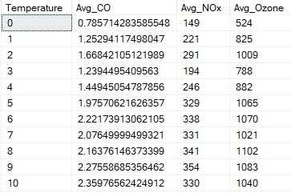
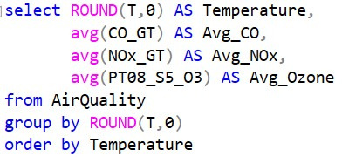
SQL QUERIES
14. How do benzene (C6H6) levels in the morning (7–9 AM) compare to the evening (7–9 PM)?
15. What is the relationship between temperature and the main pollutants (CO, NOx, O₃)?
Higher temperatures reduce CO and NOx but increase ozone.

Slide 11

KEY INSIGHTS
Time of day: Pollution peaks in mornings and evenings (traffic hours)
Seasons: Winter has higher pollution due to air stagnation, summer shows cleaner air but higher ozone
Weather:
Hot days → more ozone
Humid days → slower pollutant dispersion
Traffic impact: CO, NO₂, and Benzene strongly linked to road activity
Best time outdoors: Late night and early dawn

Slide 12



SUGGESTED SOLUTIONS
Improve traffic management to reduce congestion
Expand green spaces to absorb pollutants
Install real-time monitoring stations for better control
Promote clean energy and electric vehicles
Raise public awareness about avoiding outdoor
activity during polluted hours

Slide 13





THANK YOU

