Slide 1

Let’s Play with Traffic
Mariam Khader
Mariam.S.Khader@gmail.com
Sincere thanks to: Dr. Ali Hadi
For providing the material.
ali@ashemery.com

Slide 2
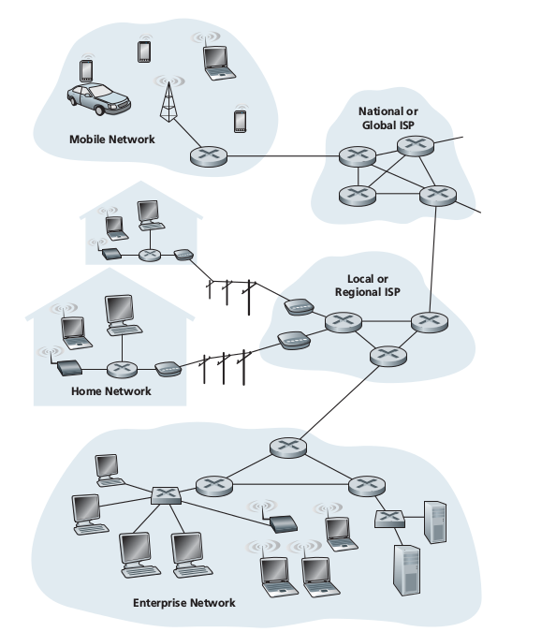


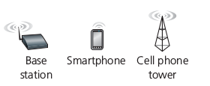
Computer Networks
Notes:
Systems connected together

Slide 3

Computer Networks And The Internet
The Internet:
→ Infrastructure provides services to applications, include electronic mail, Web surfing, social networks, instant messaging, Voice-over-IP (VoIP), peer-to-peer (P2P) file sharing, remote login, and much, much more.
Notes:
Internet is interconnected networks

Slide 4
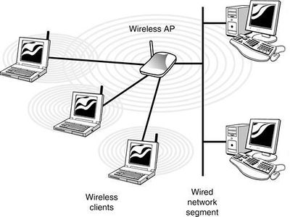
Networks Devices Communication
Each Packet has IP and Port number
Traffic is Broadcast, Unicast, Multicast

Slide 5
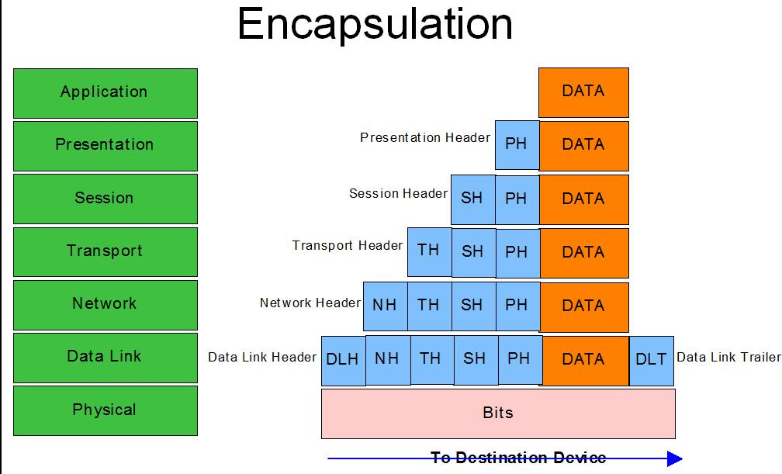
Communication over The Internet
[OSI Specification]

Slide 6
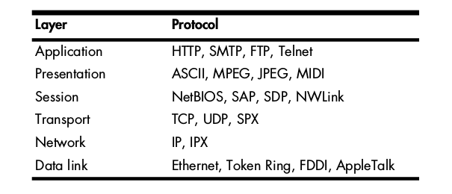
Communication over The Internet
[OSI Specification]

Slide 7

Networks Devices Communication
One’s understanding of network protocols is by seeing them in action and by playing around with them.
Well-known Protocols:
20 & 21: File Transfer Protocol (FTP)
22: Secure Shell (SSH)
23: Telnet remote login service
25: Simple Mail Transfer Protocol (SMTP)
53: Domain Name System (DNS) service
80: Hypertext Transfer Protocol (HTTP) used in the World Wide Web
443: HTTP Secure (HTTPS)

Slide 8
What Protocols do
Connection initiation: Is it the client or server initiating the connection? What information must be exchanged prior to communication?
Negotiation of connection characteristics: Is the communication of the protocol encrypted? How are encryption keys transmitted between communicating hosts?
Data formatting: How is the data contained in the packet ordered? In what order is the data processed by the devices receiving it?

Slide 9
What Protocols do
Error detection and correction: What happens in the event that a packet takes too long to reach its destination? How does a client recover if it cannot establish communication with a server for a short duration?
Connection termination: How does one host signify to the other that communication has ended? What final information must be transmitted in order to gracefully terminate communication?

Slide 10
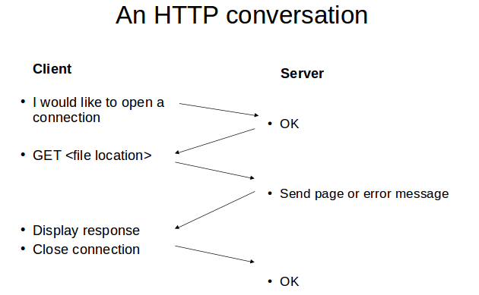
Hypertext Transfer Protocol (HTTP)
A protocol that govern the conversation between a Web client and a Web server, and responsible for the transfer of various data formats between the server and client, including: Plaintext, Hypertext, Images, Video and Sound

Slide 11
HTTP
Uniform Resource Locator (URL)
- protocol (http, ftp, news)
- host name (name.domain name)
- port (usually 80 but many on 8080)
- directory path to the resource
- resource name
ex: http://www.examplee.com/dir/index.html
Methods
- GET - HEAD
- POST - PUT
- DELETE

Slide 12
HTTP
HTTP Request Packets: consists of HTTP header
- content type / mime type
- content length
- user agent - browser issuing request
- content types user agent can handle and a URL
- Accept-Encoding - Accept Language
Response Packets
Status Header “HTTP/1.0 sp code”
1xx - reserved for future use
2xx - successful, understood and accepted
3xx - further action needed to complete
4xx - bad syntax in client request
5xx - server can’t fulfill good request

Slide 13
HTTP
HTTP Response Headers
-Status Header
-Entities
-Content-Encoding
-Content-Length
-Content-Type
-Expires
-Last-Modified
-extension-header
-Body – content (usually html)

Slide 14

Networks Under Attack!
Many Organizations and individuals rely on the Internet
for their activities.
But behind this utility and excitement, is a dark side, where “bad guys” who never stop trying To damage our Internet-connected computers, violating our privacy, preventing us to benefit from Internet services.

Slide 15

Networks Security (Attacks)
Much of the malware out
there today is self-replicating:
Viruses
Worms
The bad guys can masquerade as someone you trust
IP spoofing: inject
packets into the Internet with a false source address

Slide 16

Networks Security (Malwares)
The bad guys can put malware into your host via the Internet
Malwares could delete our files, install spyware that collects our private information or compromise our host to be enrolled in a network of thousands of similarly compromised devices, collectively known as a botnet,

Slide 17
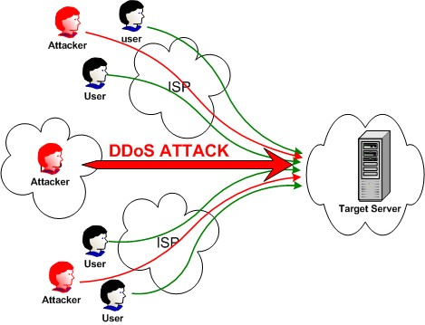
Attacks (DoS)
The bad guys can attack servers and network infrastructure, for example: DoS attacks render a network, host, or other piece of infrastructure unusable by legitimate
users.

Slide 18
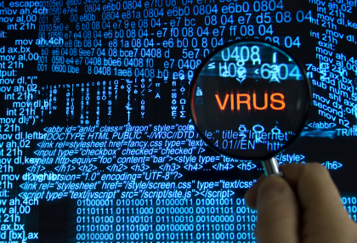
Networks Security
Understand how the bad guys can attack computer networks and how we (by being experts in computer networking), can defend against those attacks, or better yet, design new architectures that are immune to such attacks in the first place.

Slide 19
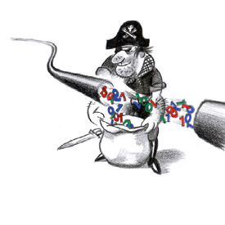
Sniffing
Capturing and interpreting live data as it flows across a network in order to better understand what is happening on that network.
Sniffing steps:
Collection: Promiscuous mode
Conversion
Analysis: According to extracted features

Slide 20
Capture Packets ??
Why capture packets when nothing wrong on the network ???
There is always something wrong on the network!
There doesn’t need to be something wrong in order for you to perform packet analysis

Slide 21
Packet analysis can help in
Understanding network characteristics
Learning who is on a network
Determining who or what is utilizing available bandwidth
Identifying peak network usage times
Identifying possible attacks or malicious activity
Finding unsecured and bloated applications

Slide 22

Why Wireshark??
Supported protocols, > 850 & it is open system
User-friendliness ☺
Cost … NONE
Program support … Large supporting community
O.S support … Windows, Mac OS X, and Linux
Let’s install it …. https://www.wireshark.org/download.html

Slide 23
Let’s Capture Packets!
Go to Capture menu, and choose Interfaces
You will see a dialog listing the various interfaces on your device to capture packets, along with their IP addresses
Choose the interface you wish to use, and then click Start.
Wait a minute and from the Capture menu choose Stop

Slide 24
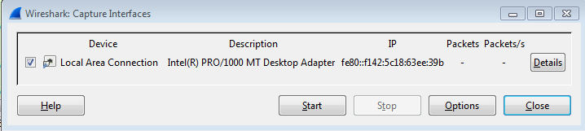
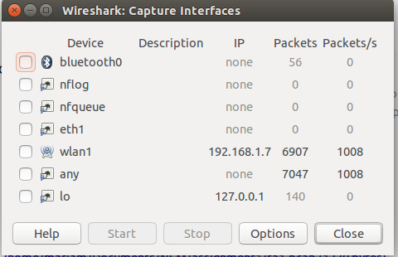
Let’s Capture Packets!

Slide 25
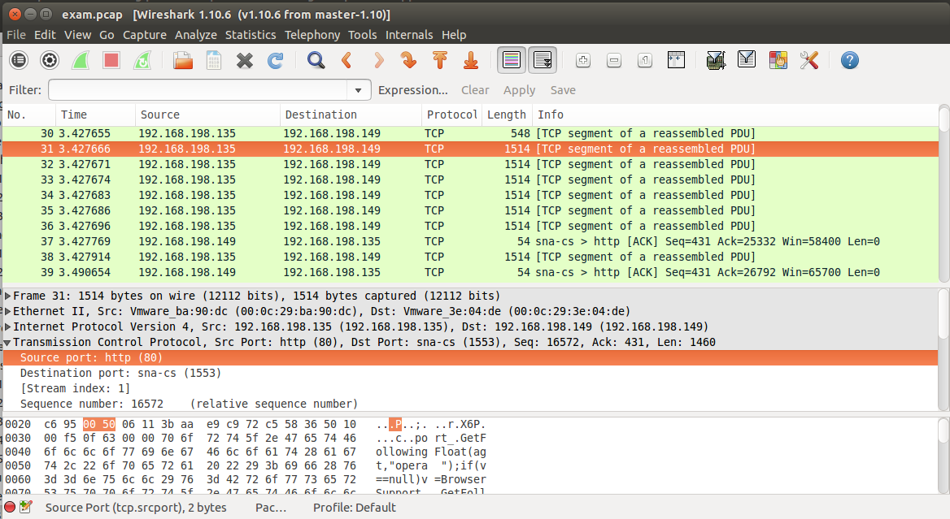
Wireshark
Command
menus
Listing of
captured
packets
Details of Packet Header
Packet
Contents
(Bytes)

Slide 26
Working with Capture Files!
Saving and exporting capture files: to save a packet capture, select File, Save As. Default is .pcap
To open a packet capture, select File, open.

Slide 27
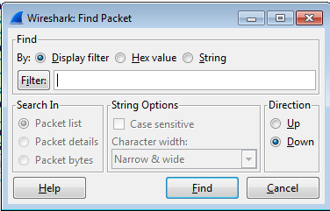
Working with Packets
Number packets grows into the thousands and even
millions, so you need to navigate through packets more efficiently.
Go to Edit, Find Packet

Slide 28
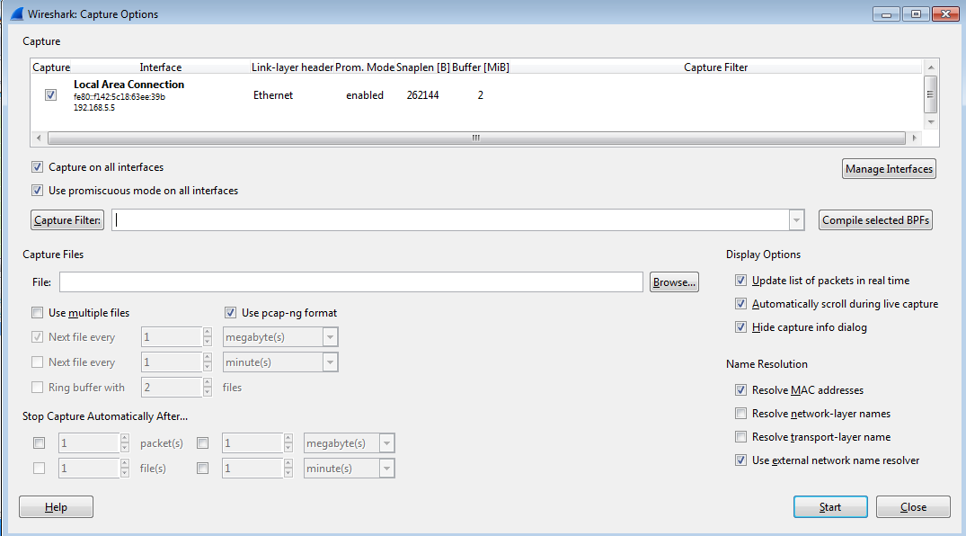
Setting Capture Options
Go to Capture, Options

Slide 29
Using Filters
Capture Filters
Display Filters
Wireshark Filter Expressions
You will often find that the success or failure of your analysis depends on your ability to create filters appropriate for your current situation

Slide 30
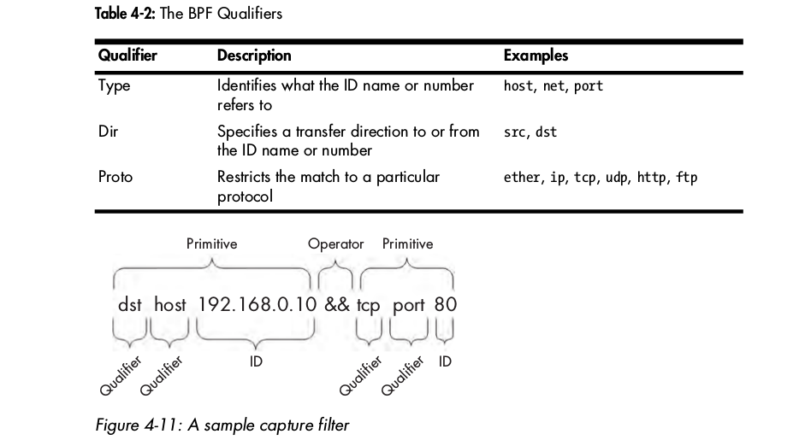
Berkeley packet Filtering (BPF)

Slide 31
Berkeley packet Filtering (BPF)
Hostname and Addressing Filters
src 192.168.0.10 && port 80
host 172.16.16.149
host 2001:db8:85a3::8a2e:370:7334
host testserver2
ether host 00-1a-a0-52-e2-a0
src host 172.16.16.149
dst host 172.16.16.149
dst 172.16.16.149 → host is default

Slide 32
Berkeley packet Filtering (BPF)
Port and Protocol Filters
port 8080
!port 8080
dst port 80
Protocol Filters
icmp
!ip6
Protocol Field Filters
icmp[0] == 3 → destination unreachable
icmp[0] == 8 || icmp[0] == 0 → request or replay

Slide 33
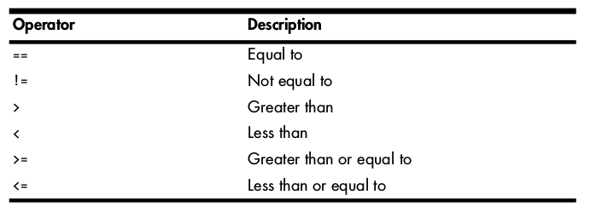
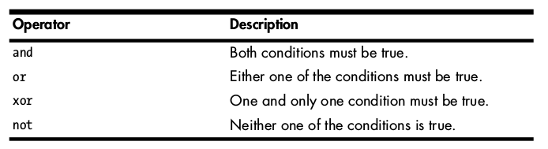
BPF Examples

Slide 34
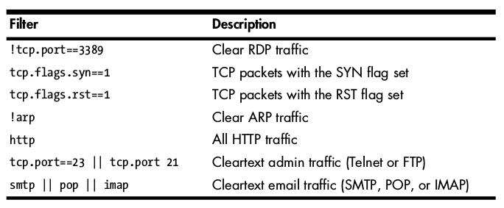
BPF examples

Slide 35
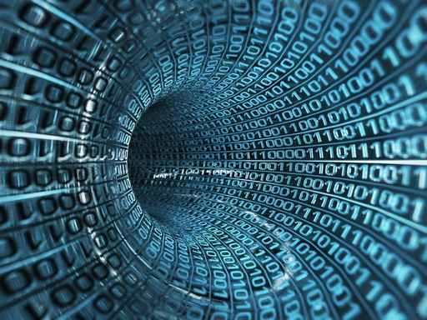
Go to Labs
Know your IP address: On windows (ipconfig)

Slide 36
References
Computer Networking, A Top-down Approach 6th Edition, James F. Kurose & Keith W. Ross
Practical Packet Analysis - Using Wireshark to Solve Real-World Network Problems, 2nd Edition, Chris Sanders
https://www.iana.org/assignments/service-names-port-numbers/service-names-port-numbers.xhtml
https://www.wireshark.org/download.html
Protocols numbers in IP protocol field: http://www.iana.org/assignments/protocol-numbers/protocol-numbers.xhtml

Slide 37
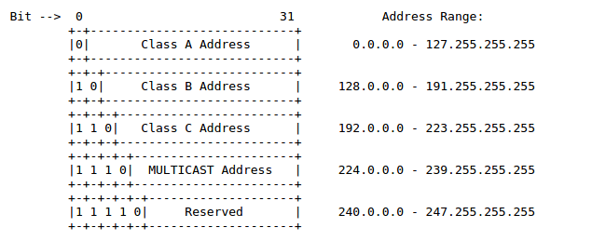
IP Addressing Schema

Slide 38
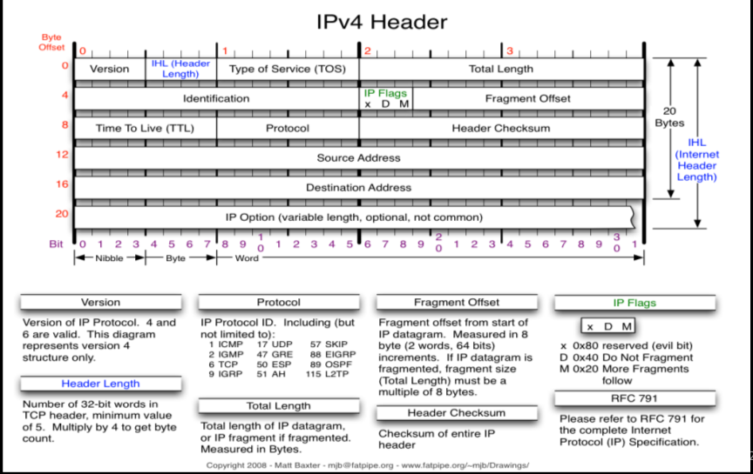

Slide 39
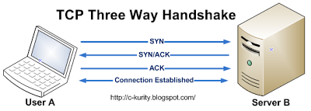

Slide 40
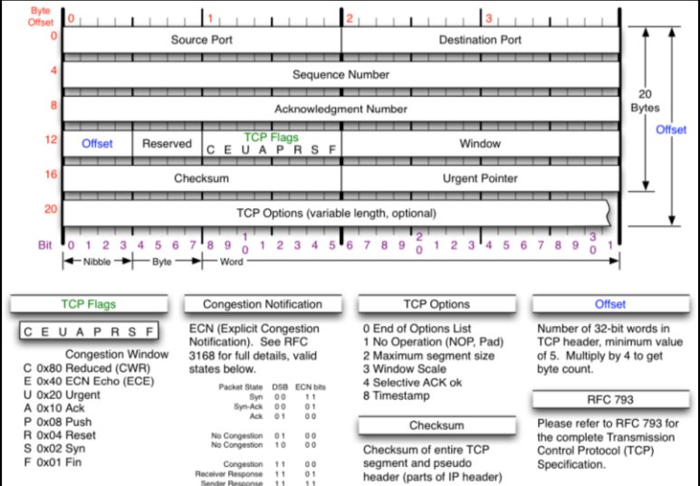
TCP Header

Slide 41
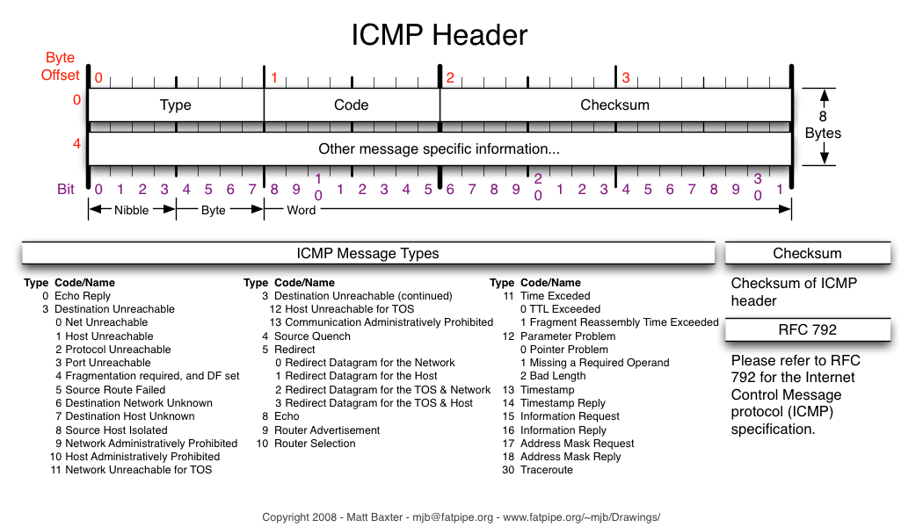
ICMP Header

Slide 42
