Slide 1


PULSE PHARMACY
Smart Pharmacy Management System
PLATFORM
ITI Graduation Project · 2026
PRESENTED BY
ServiceNow PDI Scoped Application
Mariam Mohammed
SERVICENOW SMART PHARMACY MANAGEMENT SYSTEM
01

Slide 2
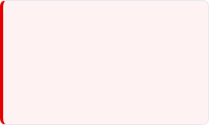
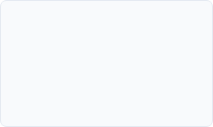
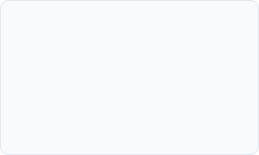
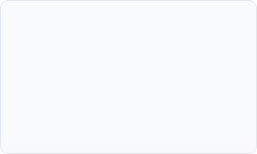
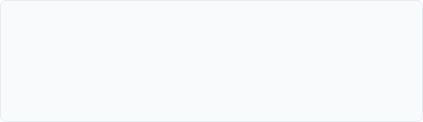
TABLE OF CONTENTS
01
02
03
04
Problem & Objectives
Solution Architecture
Core Automation
Safety & Alerts
Why Pulse Pharmacy exists & manual operation challenges
Data model, role-based controls & custom portal
Flow designer, client/server logic & SLAs
Daily safety checking systems & low stock alerts
05
06
07
Dashboards & Reports
Live Demo Journey
Challenges, Learnings & ITSM
Operational reports for admins & pharmacists
Complete walk-through of the medicine workflow
Resolved barriers, cross-scope enablement & Incident workflows
SERVICENOW SMART PHARMACY MANAGEMENT SYSTEM
02

Slide 3
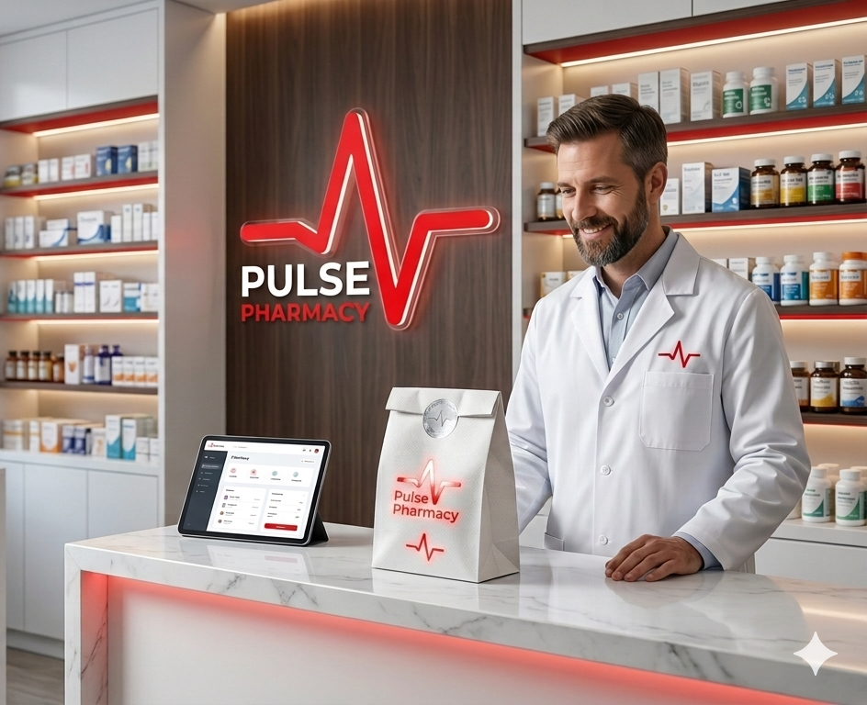

PROBLEM STATEMENT
Manual Operations Create Critical Patient Risks
Stock Blindness: No automated alerts when medicines run low. Staff discover critical shortages only when a customer requests.
Expiry Risks: Expired stock checked manually. Missed entries cause compliance and patient safety violations.
Paper Requests: Customers must call or visit physically to request medicines. No automated tracking or status visibility.
No SLA Visibility: Complaints and requests sit without defined deadlines. No alert mechanisms when service levels breach.
PROBLEM STATEMENT
03

Slide 4
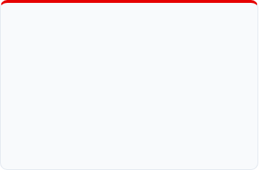
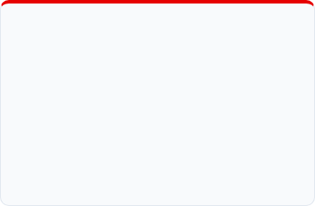
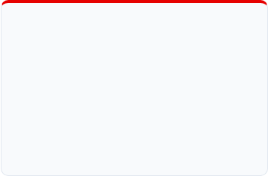




PROJECT OBJECTIVES
What the Pulse Pharmacy Scoped ServiceNow Application Delivers
Digitized Inventory
Service Portal
Automated Workflows
Track medicine inventory in real-time with automatic status checking and expiration date controls.
Enable customers to request medicines 24/7 directly via a modern, highly responsive self-service portal.
Automate Approval → Preparation → Handover lifecycle processes utilizing ServiceNow Flow Designer.
Proactive Alerts
SLA Enforcement
Operational Visibility
Trigger instant automated low-stock notifications and expiry alerts to prevent pharmaceutical service failures.
Enforce strict operational SLAs on patient requests and complaints with dynamic visual breach alerts.
Provide centralized interactive Dashboards for real-time overview to Administrators and Pharmacists.
04

Slide 5




SOLUTION OVERVIEW
System Architecture on ServiceNow Personal Developer Instance (PDI)
PRESENTATION LAYER
Service Portal for customers, interactive reporting Dashboards, and native backend Admin Console workspaces.
APPLICATION CONFIGURATION
100%
LOGIC LAYER
Flow Designer processes, Client & Server Business Rules, Scheduled Jobs, and GlideAjax Script Includes.
Scoped Application
Built inside a private container ensuring zero interference with global platform operations.
DATA LAYER
Custom scoped Medicine Inventory tables, Service Catalog tables (sc_req_item / sc_task), and native ITSM Incident tables.
SYSTEM ARCHITECTURE
05

Slide 6
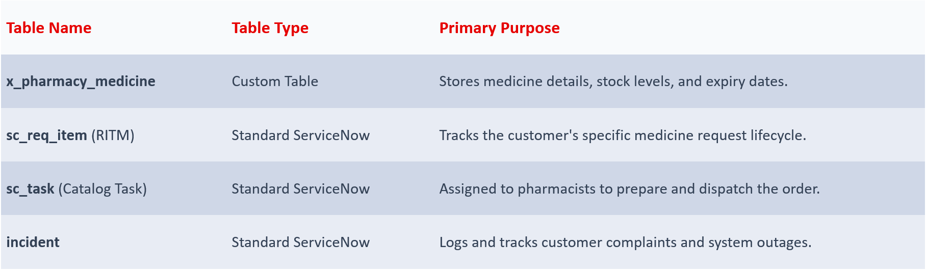
DATA MODEL
Table Schema Definitions & Relationships
DATA MODEL SCHEMA
06

Slide 7



ROLES & SECURITY
Fine-Grained Access Control Lists (ACLs) Supporting Patient Isolation
CUSTOMER
PHARMACIST
ADMINISTRATOR
medicine requests via portal
Manage inventory (stock, expiry)
Approve/reject requests
Track request status
Prepare approved orders
Receive low-stock & expiry alerts
Report complaints
Complete handover tasks
monitor dashboard
Isolation: Sees only his own
requests and incidents
Access: Full read/write on inventory,
RITMs, and tasks
Access: Full CRUD across all tables
and application configuration
ROLES & SECURITY ACLS
07

Slide 8






CORE AUTOMATION
Low-Code Medicine Request Approval Flow
End-to-End automated lifecycle mapping with transactional decision boundaries
Submission
Under Review
Admin Approval
Preparation
Ready / Pickup
Completion
Branching Condition:
Approved → Prepare tasks + Stock deduction (prevents double selling)
Rejected → Stage = Rejected + refusal email
Fulfiller Tasks:
- Two sequential Catalog Tasks for Pharmacist
- Timeout: 2 business days → auto-cancel + stock restore
Automatic Emails:
• Customer: Request submitted, Ready for pickup, Rejection
• Pharmacist: Dynamic medicine name & quantity (via Mail Script from RITM)
FLOW DESIGNER AUTOMATION
11

Slide 9
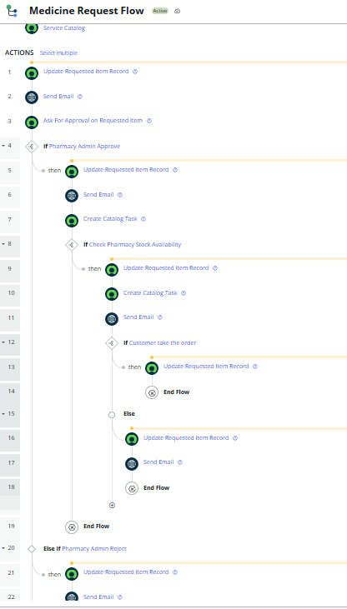
PULSE PHARMACY
CORE AUTOMATION
Customer logs into portal → submits medicine request
System creates RITM → Stage = Under Review
Admin receives email → approves request
Stock deducted immediately → Catalog Task created for Pharmacist
Customer logs into portal → submits medicine request
Pharmacist receives email with medicine details → prepares order
Stage = Ready for Pickup → customer gets pickup email
If no pickup → auto-cancel + stock restore
Pharmacist completes handover → Stage = Completed
FLOW DESIGNER AUTOMATION
11

Slide 10
DEMO
DEMO

Slide 11
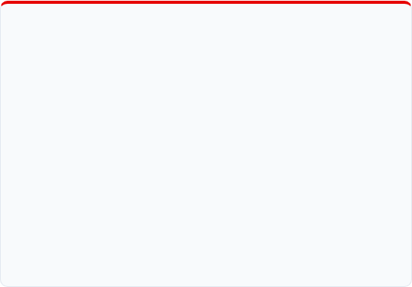
SAFETY & MONITORING
Proactive Patient Safety Controls - Zero Manual Checking Required
EXPIRY MONITORING ENGINE
EXPIRED DISPOSAL FLOW
Scheduled Job Execution: Evaluates database daily at exact 06:00 system hour. Scans active inventory.
Auto‑Incident: When medicine becomes expired → Incident created, assigned to Pharmacist.
State Escalation: Sets medicine status to expired if date passed. Sets status to near_expiry if date occurs within exactly 30 days.
Pharmacist Email: Contains medicine name, batch, quantity, storage location.
On Incident Resolve: quantity = 0, status = Disposed.
System Restrictions: Expired medicines instantly blocked from catalogs. Form UI policies force expired medication records to read-only views for system safety.
Admin Email: Notification that disposal is complete and stock is zero.
.
EXPIRY & INVENTORY SAFETY
12

Slide 12
SAFETY & MONITORING
Proactive Patient Safety Controls - Zero Manual Checking Required
EXPIRY MONITORING ENGINE
EXPIRED DISPOSAL FLOW
Scheduled Job Execution: Evaluates database daily at exact 06:00 system hour. Scans active inventory.
Auto‑Incident: When medicine becomes expired → Incident created, assigned to Pharmacist.
State Escalation: Sets medicine status to expired if date passed. Sets status to near_expiry if date occurs within exactly 30 days.
Pharmacist Email: Contains medicine name, batch, quantity, storage location.
On Incident Resolve: quantity = 0, status = Disposed.
System Restrictions: Expired medicines instantly blocked from catalogs. Form UI policies force expired medication records to read-only views for system safety.
Admin Email: Notification that disposal is complete and stock is zero.
.
EXPIRY & INVENTORY SAFETY
12

Slide 13
SAFETY & MONITORING
Proactive Patient Safety Controls - Zero Manual Checking Required
LOW STOCK ALERTS
EXPIRED DISPOSAL FLOW
Trigger Event: Executed immediately upon transaction modifications on quantities if value matches threshold conditions: qty ≤ reorder_level.
Auto‑Incident: When medicine becomes expired → Incident created, assigned to Pharmacist.
Pharmacist Email: Contains medicine name, batch, quantity, storage location.
Admin Dispatches: Fires a system notification containing detail arrays: drug name, current count, and predetermined restock margins.
On Incident Resolve: quantity = 0, status = Disposed.
Admin Email: Notification that disposal is complete and stock is zero.
Dashboard Score Integration: Renders visual critical alert indicator tiles in admin workspaces for high-level awareness.
.
EXPIRY & INVENTORY SAFETY
12

Slide 14
SAFETY & MONITORING
Proactive Patient Safety Controls - Zero Manual Checking Required
LOW STOCK INCIDENT AUTOMATION
• Trigger: quantity ≤ reorder_level
• Auto‑check: If an open incident already exists for the same medicine → skip
• Create Incident with: Category: Low Stock
- Reference field: u_medicine (links to medicine record)
• Email notification sent to Admin (medicine name, current qty, suggested reorder)
• Dashboard: Low Stock Count widget (Single Score) updates in real time.
EXPIRY & INVENTORY SAFETY
12

Slide 15
DEMO
DEMO

Slide 16
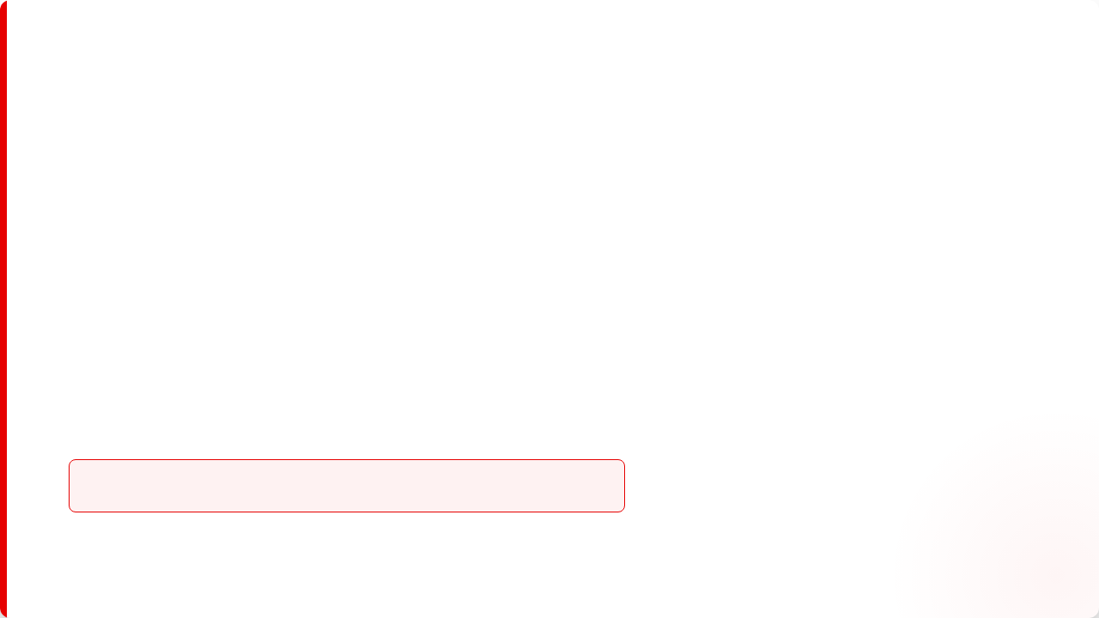
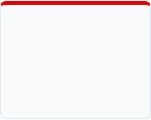

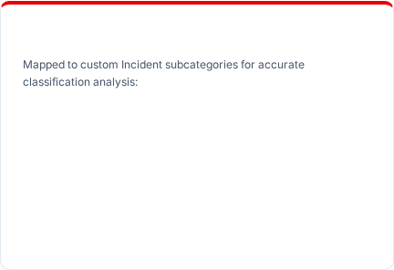
ITSM COMPLAINTS
ITSM Incident & Complaint Management Integration
Providing a standardized platform roadmap for patient issues, escalations, and tracking
1. NEW
2. IN WORK
3. RESOLVED
4. CLOSED
Complaint Classifications
Auto-assigned directly to Admin fulfiller group on record insert transaction.
Admin initiates root investigation, updating journal activity logs.
Resolution details marked mandatory. Stamps resolve timers.
Logs locked automatically after validation confirmation.
Wrong Medicine: Raised when received items mismatch requests.
Delay: Triggered on collection/processing SLA breach complaints.
Other: Generic category capturing custom patient comments.
Complaint Resolution Target: Exactly 2 Hours SLA limit. Alarms alert administrators immediately at 75% threshold and when 100% boundary breach events occur.
COMPLAINT INCIDENT LIFECYCLE
16

Slide 17
DEMO
DEMO

Slide 18









CHALLENGES & LEARNINGS
Platform Obstacles Encountered & Scoped Application Architecture Solutions
Medicine Dropdown Hidden
Cross-Scope Actions Blocked
GlideAjax Calls Failing
Root Cause: Reference field dropdown calls require default table privileges not granted to base Customer roles, making search components completely invisible.
Root Cause: Scoped application container restricted from executing writes to default catalog tables (sc_req_item) out of container box.
Root Cause: Client scripts failed to fetch pricing information dynamically because script includes lacked standard callable permissions.
Solution:
Solution:
Solution:
client_callable = true
query_range
CHALLENGES & RESOLUTIONS
17

Slide 19
Conclusion & Achievements
Project Impact
100%
•
Successfully delivered all 10 user stories across 3 distinct personas.
•
Transformed manual, paper-based work into a scalable, auditable digital platform.
•
Enforced strict SLAs to vastly improve the customer experience and response times.
Automated Workflow
•
Guaranteed patient safety by systematically preventing the sale of expired stock.
17

Slide 20
Questions?
Thank you for your time.
Pulse Pharmacy System

