Slide 1
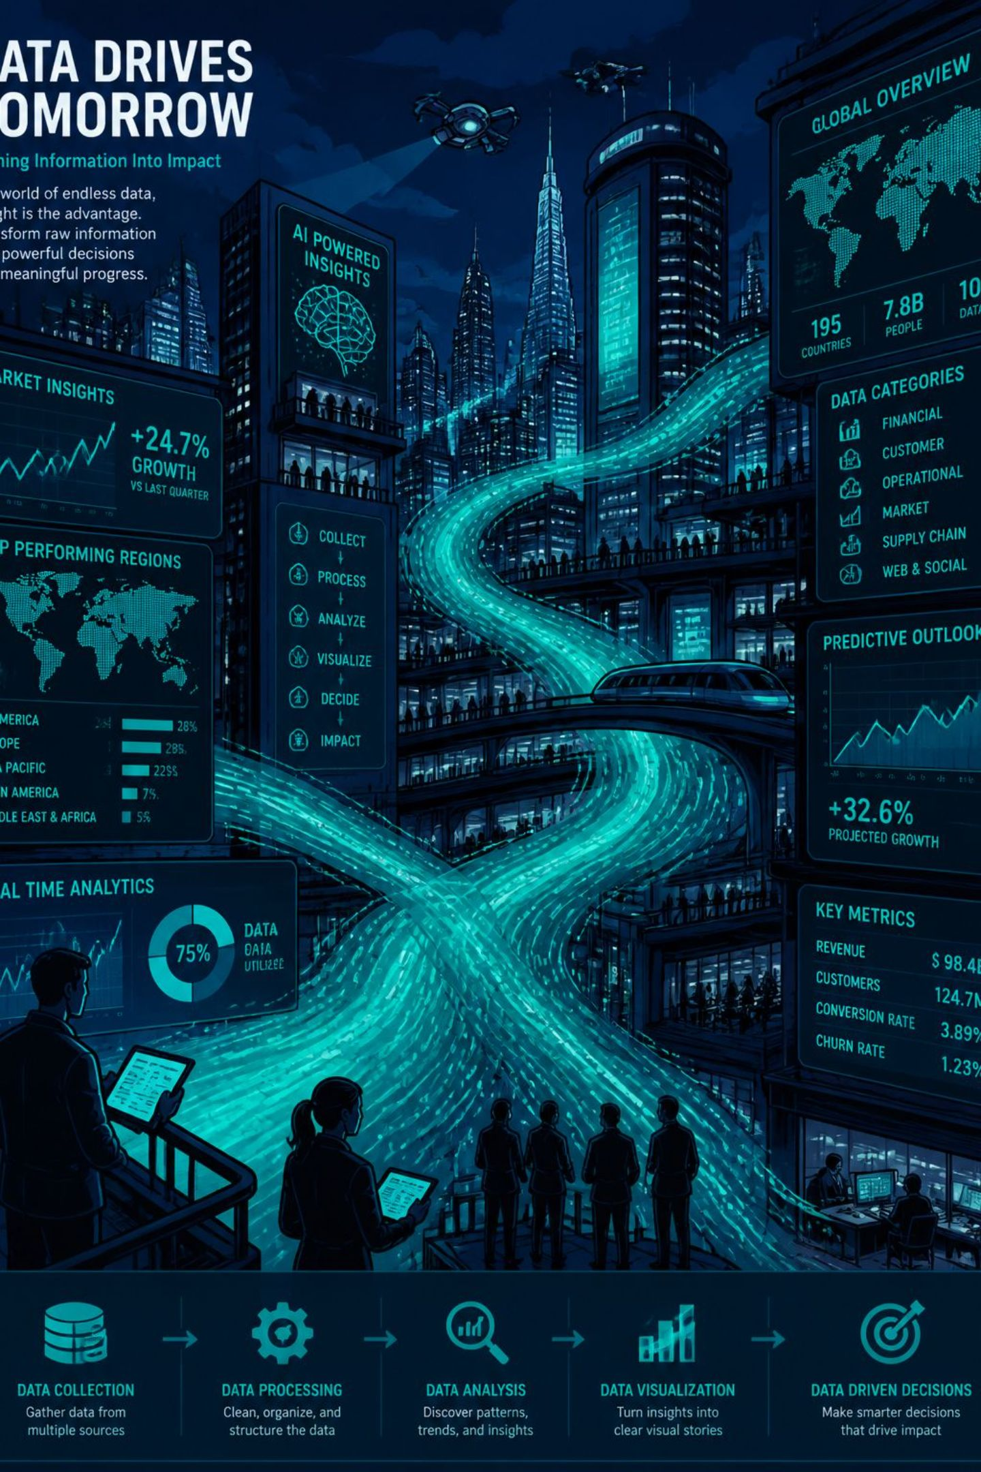
Data Storytelling
Turning Data into Insight and Action
Combining data + visuals + narrative to transform numbers into clear, actionable messages that drive decisions.

Slide 2

What Is Data Storytelling?
The Problem
The Solution
Companies collect huge amounts of data, but raw numbers alone are too technical and meaningless without context.
Data storytelling explains the "why," not just the "what" — making insights understandable and memorable.
The Goal
Drive faster decisions and action by turning data into a clear recommendation.

Slide 3
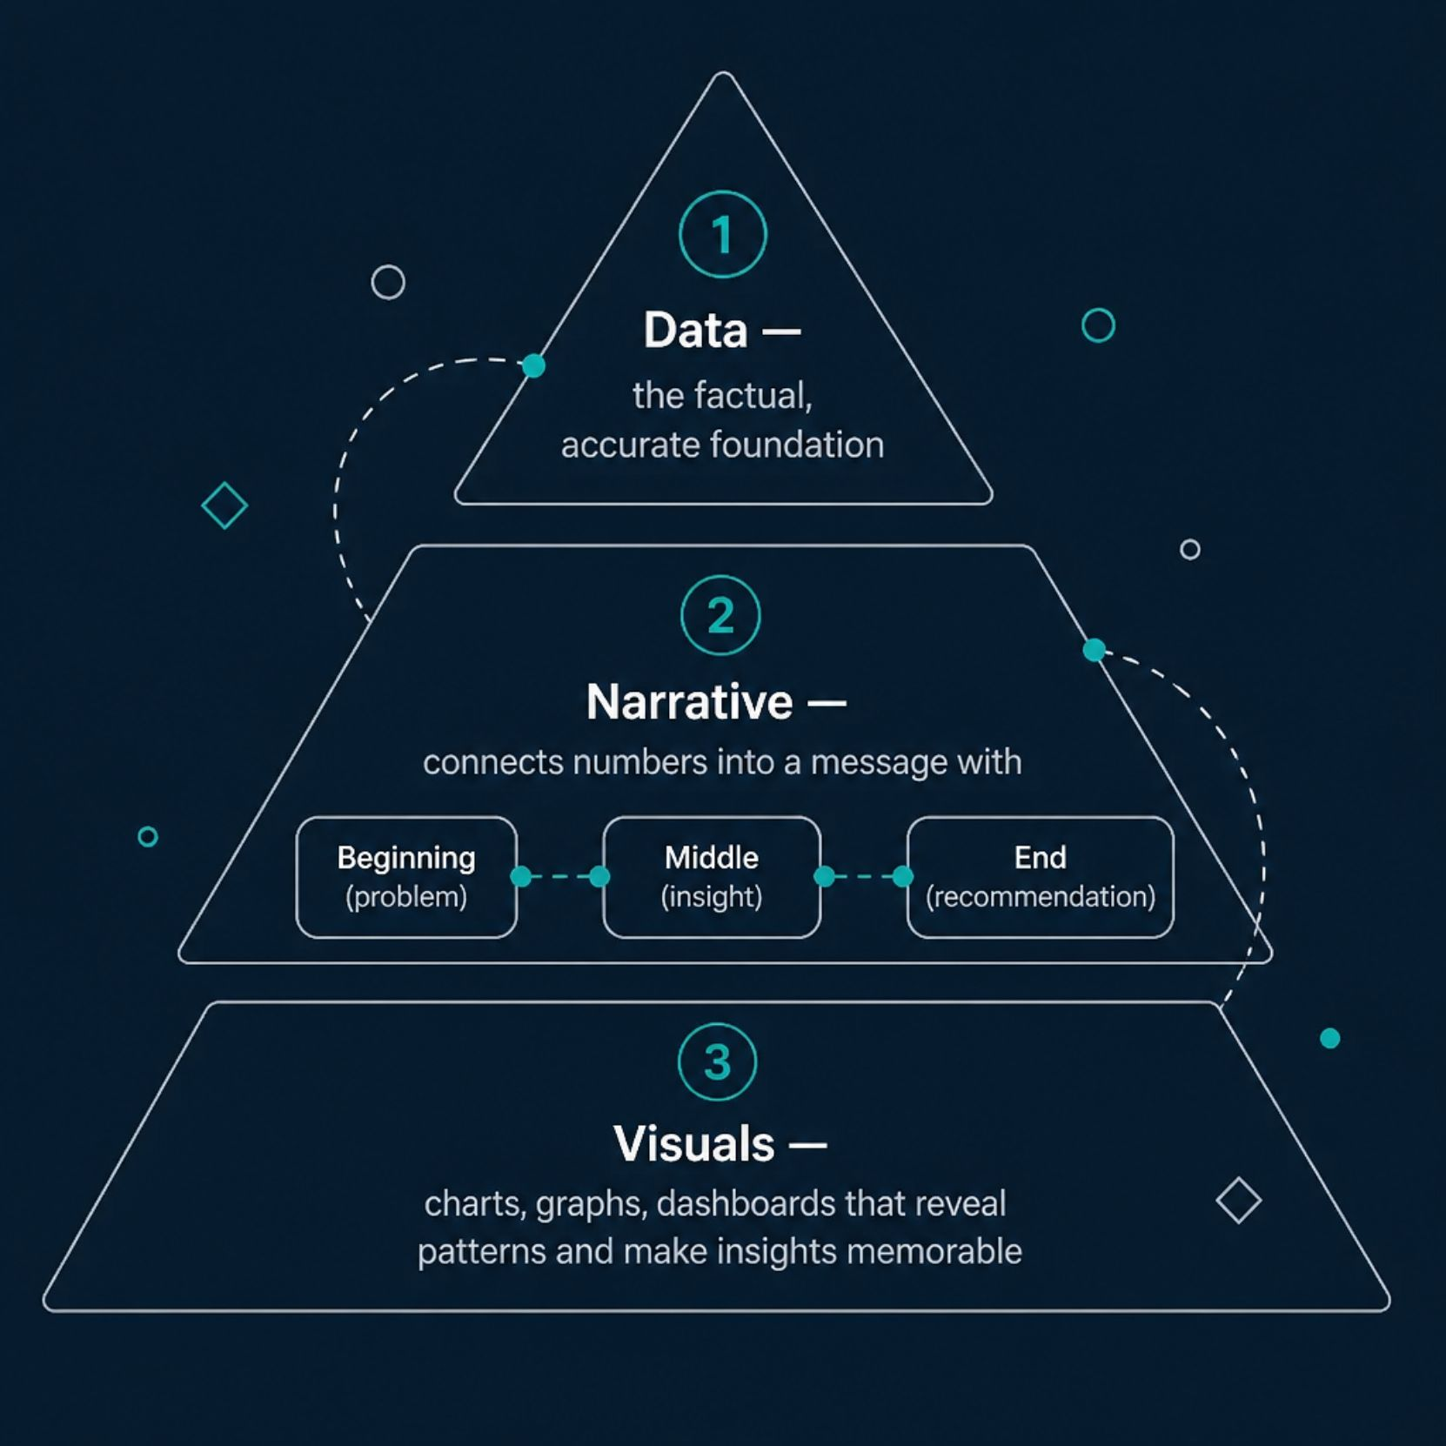

The Three Core Elements
Data storytelling combines three essential elements:
Data — The factual foundation. Must be accurate and reliable.
Narrative — Connects numbers into a message: problem → insight → recommendation.
Visuals — Charts, graphs, and dashboards that reveal patterns and make insights memorable.
Data Storytelling = Data + Narrative + Visualization

Slide 4

How the Elements Work Together
Analysis
Visuals
Data
Narrative
Each element builds on the last — accurate data is analyzed, shaped into a narrative, visualized for clarity, and understood by the
audience, ultimately driving better decisions.
❌ Weak
✅ Strong
"Sales decreased by 15%."
"Sales dropped 15% in the southern region after a competitor launched a discount campaign. The company should review its pricing strategy."

Slide 5

Why Visualization Matters
Reveal Patterns
Charts and graphs expose trends and relationships hidden in raw numbers.
Faster Understanding
Visuals help audiences grasp complex information more quickly and effectively.
Drive Action
Good visualizations answer: What happened? Why does it matter? What should we do next?

Slide 6
Chart Types at a Glance
What Makes a Good Visualization?
Chart Type
Best Used For
Be clear and simple — avoid clutter
Use the appropriate chart type for your data
Highlight the key insight, not everything
Use color intentionally, not excessively
Never mislead with distorted scales
Bar Chart
Comparing categories
Line Chart
Showing trends over time
Pie Chart
Displaying proportions (4–5 categories)
Scatter Plot
Showing relationships
Heat Map
Highlighting intensity or patterns
Dashboard
Combining multiple insights

Slide 7
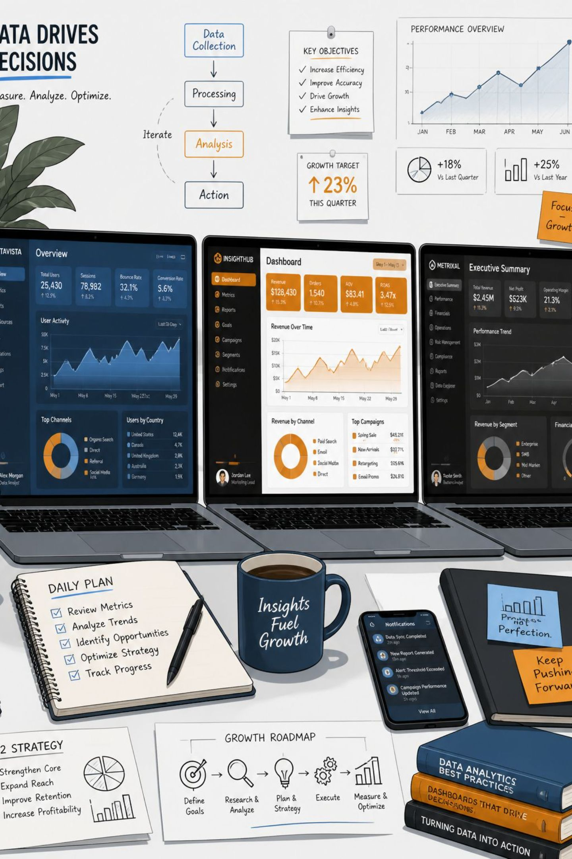
Top Data Storytelling Tools
Tableau
Drag-and-drop interface for interactive dashboards. Best for business analytics, sales analysis, and performance dashboards.
Microsoft Power BI
Connects to Excel, databases, and cloud services with AI-powered insights. Best for business reporting and financial analysis.
Looker Studio
Free tool integrating with Google Analytics and Sheets. Best for marketing analytics and digital campaigns.

Slide 8
Storytelling Techniques
1
Adapt to Your Audience
2
Focus on One Key Message
CEO: "Revenue up 15%." Marketing: "Campaign X drove 15% growth — invest more."
Don't overwhelm — highlight the single most important insight and build around it.
3
Use the Right Visuals
4
Keep It Simple
Match chart type to data: line for trends, bar for comparisons, pie for proportions.
Show only data that supports your main message. A clear presentation beats a crowded one.

Slide 9

Case Study: Amazon's Recommendation Engine
The Story (Data & Insight)
Amazon analyzed browsing history, purchases, and search behavior — discovering that personalized recommendations significantly increase purchases.
The Action
Built a recommendation engine suggesting products based on each customer's interests and activity.
The Result
Improved customer experience and generated ~35% of Amazon's total sales.

Slide 10


Real-World Case Studies
📱 Tech Startup: App Feature Redesign
🚚 Logistics Company: Route Optimization
Heat maps and word clouds revealed users abandoning a confusing feature. After redesigning the UI and adding tooltips: +30% ratings, +12% retention.
GPS and fuel data exposed inefficient routes. Dynamic route optimization and fuel-efficient vehicles achieved: –20% delivery costs, +15% on-time deliveries in 3 months.
"Data visualization transforms data into understanding, while storytelling transforms understanding into action."

