Slide 1
Which Vehicle Characteristics Drive CO2 Emissions?
A data-driven look at Canadian passenger vehicle emissions
Sharon · Mariam · Eric

Slide 2
Our Question
RESEARCH QUESTION
Which vehicle characteristics are linked to higher levels of CO2 emissions?
IDEAL OUTCOME
Identify which characteristics are linked to higher CO2 emissions, so we can suggest vehicle design changes that would lower Canada's vehicle carbon footprint.
Supervised regression problem — CO2 emissions is a known, continuous target
Goal is actionable insight: a lever a vehicle designer could change
Builds on EDA and modelling work from earlier in the course

Slide 3
Data Source & Reliability
7,385
Vehicles in the raw dataset
0
Missing values across all columns
12
Variables describing each vehicle
SOURCE
CO2 Emissions Canada dataset, sourced from Kaggle — detailed, descriptive, and includes numerous vehicle and engine attributes
No missing values, which makes the dataset reliable and straightforward to work with directly
Sample selection caveat: the dataset excludes buses and heavy-duty trucks, so our conclusions apply to passenger and light vehicles only

Slide 4
Our Modelling Approach
1
Supervised, not unsupervised
Our data includes a known target — CO2 emissions — so we can train a model to predict it directly.
2
Regression, not classification
CO2 emissions is a continuous numerical value (g/km), not a category, so this is a regression problem.
3
Two models, compared head-to-head
Linear Regression as an interpretable baseline, and Random Forest to capture non-linear relationships.
4
K-Means as an independent check
Unsupervised clustering, used afterward to verify our supervised findings are a real pattern, not an artifact.

Slide 5
Data Snapshot
CLEANING
Found 1,103 duplicate rows — removed before analysis so they don't inflate sample size or bias results toward over-represented vehicles
6,282 unique vehicle records remain after cleaning
WHY THIS MATTERS
CO2 emissions range widely — from 96 to 522 g/km — relative to a mean of 250.6. That spread is large enough to suggest it's driven by real differences in vehicle characteristics, which is exactly what our model sets out to explain.
WHAT A TYPICAL VEHICLE LOOKS LIKE
3.16L
Average engine size
250.6
Average CO2, g/km
96–522
CO2 range, g/km

Slide 6
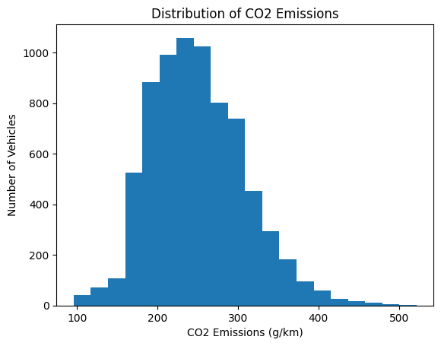
Distribution of CO2 Emissions
WHAT WE SEE
Roughly bell-shaped, with a slight right skew
Most vehicles cluster between 180–320 g/km
A smaller number of high-emission vehicles — large SUVs, vans — pull the tail upward

Slide 7
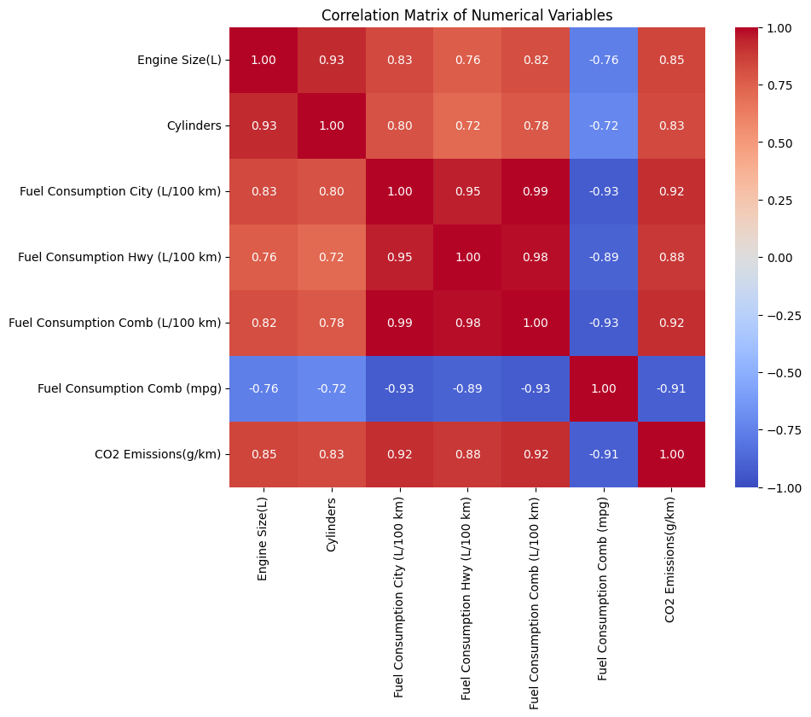
What's Correlated with Emissions?
Fuel consumption (L/100km): r ≈ 0.9–0.99 with CO2
Fuel Comb (mpg): r ≈ –0.9 — the inverse measure
Engine Size & Cylinders: r ≈ 0.7–0.85 with CO2, and ≈ 0.8 with each other
Fuel consumption is tied to CO2 almost by physical necessity — burning more fuel per km directly produces more CO2.

Slide 8
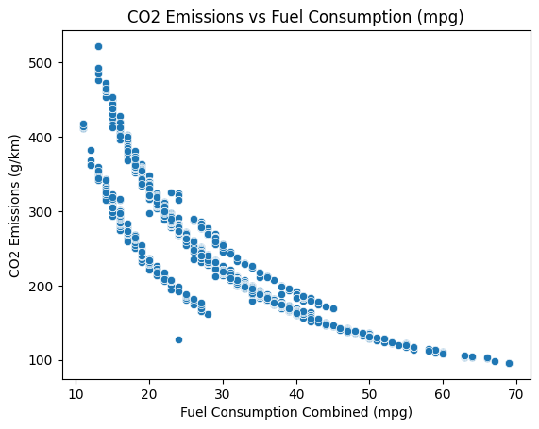
Fuel Efficiency vs. Emissions
WHAT WE SEE
CO2 drops sharply as fuel efficiency (mpg) rises — a curved, non-linear relationship
Steepest drop between roughly 15–30 mpg, flattening out at higher mpg
A single-feature regression on mpg alone already explains R² = 0.81 of the variance

Slide 9
Preprocessing & Feature Selection
STEPS TAKEN
Removed 1,103 duplicate rows before any analysis
Confirmed zero missing values across all columns
Label-encoded categorical text columns (Vehicle Class, Fuel Type, Transmission) into integers for scikit-learn
Excluded Model (2,000+ unique values) — effectively a unique identifier, not a meaningful predictor
Excluded Make for the same reason, to a lesser degree
Excluded all four fuel consumption columns (incl. mpg) — these are outcomes of vehicle design, not design characteristics a team could change
FINAL FEATURE SET
Engine Size (L)
Cylinders
Vehicle Class
Transmission
Fuel Type
Design characteristics only — nothing a reader could mistake for a restated version of the target.

Slide 10
Model Comparison
 | Test R² | Train R² | Test MAE | Test RMSE
Linear Regression | 0.7715 | 0.7789 | 21.18 g/km | 28.08 g/km
Random Forest | 0.9318 | 0.9515 | 11.06 g/km | 15.34 g/km
TAKEAWAY
Random Forest outperforms Linear Regression on every metric — the relationship between vehicle characteristics and CO2 is not purely linear
Both models' train and test scores are close, so neither is overfitting — results generalize well to unseen vehicles

Slide 11
What Drives Emissions?
PERMUTATION IMPORTANCE (RANDOM FOREST)
LINEAR REGRESSION COEFFICIENTS (G/KM PER UNIT)
Feature | Importance
Engine Size (L) | 1.33
Vehicle Class | 0.21
Transmission | 0.11
Fuel Type | 0.07
Cylinders | 0.04
Feature | Coefficient
Engine Size (L) | +23.44
Cylinders | +9.51
Fuel Type | +3.10
Vehicle Class | +2.25
Transmission | −0.41
Engine Size is overwhelmingly the strongest, most reliable lever: each additional litre of displacement is associated with an estimated +23.4 g/km of CO2, holding other variables constant — and both methods agree on the ranking.

Slide 12
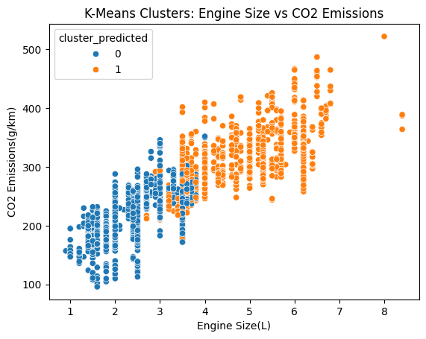
Independent Check: Clustering
WHY WE DID THIS
K-Means is unsupervised — it never sees CO2 emissions. If it still separates vehicles into groups with distinct average CO2, that's independent evidence of a real pattern, not a modelling artifact.
219.4
Cluster 0 avg CO2, g/km
309.8
Cluster 1 avg CO2, g/km
The two groups split cleanly along Engine Size — confirming the same relationship our models found.

Slide 13
Engine Size Is the Clearest Lever for Lowering Emissions
Our Random Forest model explains 93.18% of the variance in CO2 emissions (MAE = 11.06 g/km) using only Engine Size, Vehicle Class, Cylinders, Transmission, and Fuel Type.
We achieved our desired outcome: Engine Size and Cylinders are the two strongest, mos actionable design characteristics behind CO2 emissions
A shift toward smaller-displacement engines would have the largest direct impact on emissions, more so than changes to Vehicle Class or Transmission alone

Slide 14
Next Steps
1
2
3
Add vehicle weight
Weight is a known driver of fuel use and isn't in this dataset — likely explains additional variance.
Add powertrain type
Explicitly flagging hybrid / EV / ICE vehicles would sharpen the design recommendation further.
Validate with a holdout make/year
Test generalization to a model year or make the training data hasn't seen at all.

Slide 15
Thank you!
Any questions?

