Slide 1
Student Academic Performance
Mariam Adekanye, Bushra Fatima, Sagar Gupta, and Qahir Ramji

Slide 2
Our Data
https://archive.ics.uci.edu/dataset/320/student+performance
The data was collected using school reports and questionnaires.
Information on demographics, family background, study habits, social activities, lifestyle, educational circumstances, and academic information.
Final course grades were examined across both Mathematics and Portuguese courses.
DATA 602 | Student Academic Performance
2

Slide 3
Why?
May help educators and schools identify students who may benefit from additional academic support.
Provide insights into how students’ study habits, family background, social activities, and attendance effect and contribute to their final grades.
DATA 602 | Student Academic Performance
3

Slide 4
Variables of Interest
Final grade in Mathematics and Portuguese courses.
Predictors:
School
Sex
Address
Parental Cohabitation Status
Mother's job
Father's job
Study time
Internet Access
Absences
First Period Grade
Second Period Grade
DATA 602 | Student Academic Performance
4

Slide 5
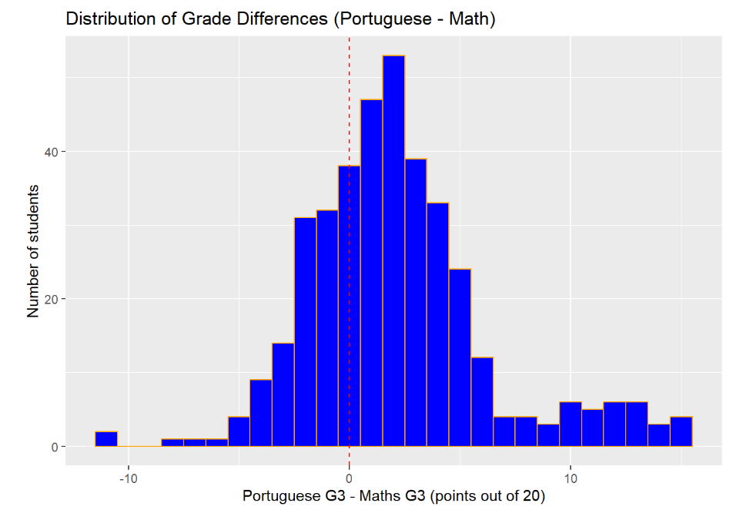
Most students score higher in Portuguese
Long right tail to about 15, so the distribution is right-skewed
Most students fall between −4 and +6, it is roughly bell-shaped.
DATA 602 | Student Academic Performance
5

Slide 6
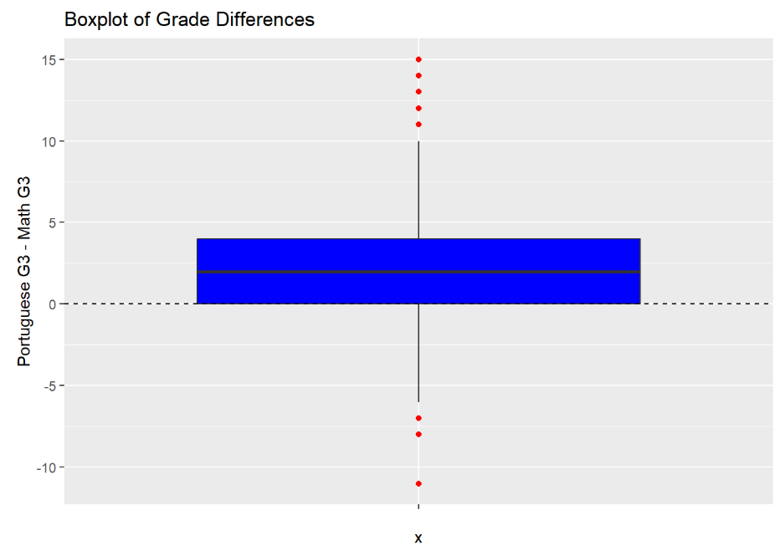
Boxplot Of Grade Differences
2
median grade difference
0 to 4
middle 50% of students (IQR = 4)
DATA 602 | Student Academic Performance
6

Slide 7
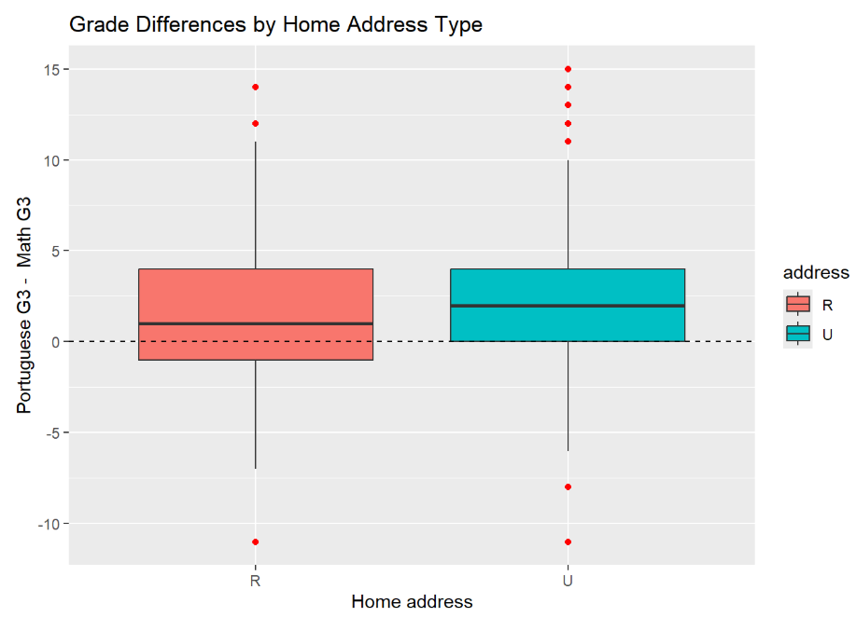
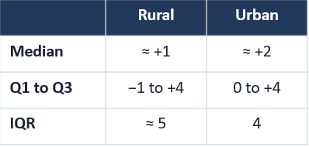
Grade Differences by Home Address Type
Urban students have a slightly higher median grade difference than rural students, suggesting rural students have a somewhat smaller gap between their Portuguese and Mathematics grades.
DATA 602 | Student Academic Performance
7

Slide 8
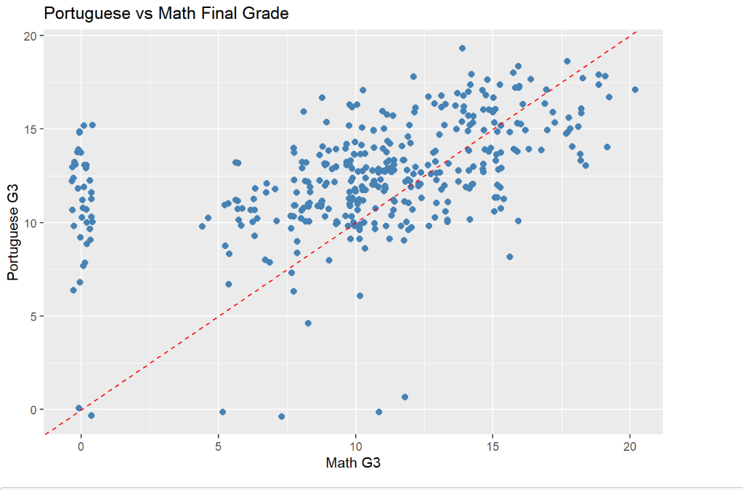
Strong students tend to be strong in both subjects
There is a positive relationship between Portuguese and Mathematics final grades (r = [ 0.48])
Some points lie below the line of equal grades, consistent with students scoring lower in Mathematics
DATA 602 | Student Academic Performance
8

Slide 9
Condition Checking
Method 1: Paired t-Test and Confidence Interval (Conventional and Bootstrap) for the Grade Difference
Paired t-Test!
First what are our population parameters?
The average final mark in Portuguese of all students (secondary school) aged 15-22 in Portugal : μ_{G3Portuguese}
The average final mark in Mathematics of all students (secondary school) aged 15-22 in Portugal : μ_{G3Math}
DATA 602 | Student Academic Performance
9

Slide 10
Condition Checking : The Assumptions
The conditions for a matched paired t-Test require the assumption that the underlying differences in the population means follow a Normal distribution / can be modeled by the Normal probability model, meaning that μ_{G3Portuguese} - μ_{G3Math} is assumed to be Normally distributed.
How do we carry this into the sample parameters? : X_{G3Portuguese} - X_{G3Math}
Plot the differences in value of each pair X_{i,G3Portuguese} - X_{i,G3Math} against a Normal Probability QQ Line!
DATA 602 | Student Academic Performance
10

Slide 11
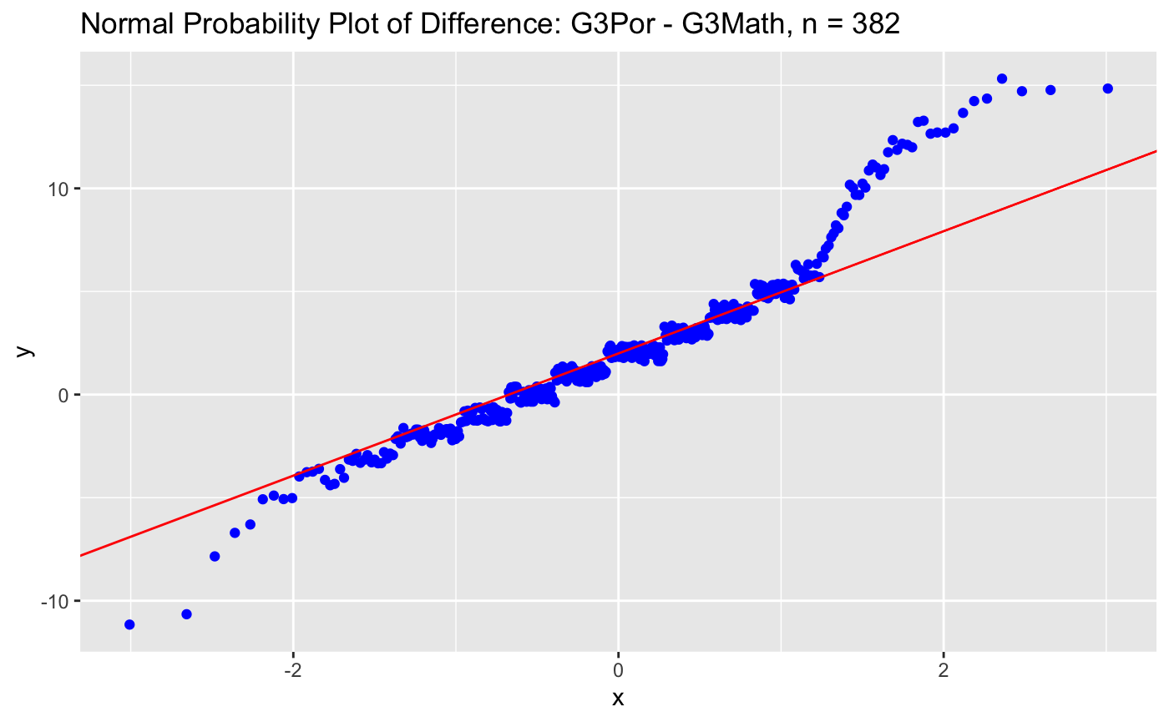
Condition Checking : Approximation of Normality
On average these data points cluster around the mid-section of the y = x Normal probability line, approximately conforming to Normality.
The sample size is also n ≥ 25, 382 ≥ 25. So the robustness of the Central Limit Theorem (CLT) holds!
DATA 602 | Student Academic Performance
11

Slide 12
Condition Checking : Matched-Pairs Experimental Design
If the study and data collection method adheres to a Matched-Pairs Experimental Design, then:
  Paired Observations : These data must correspond to the same student (same person) for each X_{i,G3Portuguese} and X_{i,G3Math} , that is the Final Grade of the Portuguese class must come from the same student that also has a Final Grade in the Mathematics class.
  Independence of Pairs from other Pairs: A student’s paired Final Grades should not influence or predict another student’s paired Final Grades
  Random Sampling: Each of the n = 382 pairs should be randomly selected out of the population
  The adherence of the data collected during the 2005–2006 school year by P. Cortez & A. M. G. Silva. to a Matched-Pairs Experimental Design was proven in their academic paper published on April 1st , 2008.
DATA 602 | Student Academic Performance
12

Slide 13
Statistical Method #1
Paired t-Test to Compare the Difference in Portuguese and Mathematics Final Grades Along with a Confidence Interval (Conventional and Bootstrap) for the Grade Difference

Slide 14
Statistical Hypothesis
Does the data suggest that out of the students who take both final exams, are the average final grades higher in Portuguese class than Mathematics class?
Let μ_{G3Portuguese} be the average Portuguese Class Final Exam Grade
Let μ_{G3Math} be the average Math Class Final Exam Grade
Let μ_{d} be the average difference in Language and Math final exam grades
H₀: μ_{G3Portugese} ≤ μ_{G3Math} ; μ_{G3Portugese} - μ_{G3Math} ≤ 0 ; μ_{d} ≤ 0
H_{A}: μ_{G3Portugese} > μ_{G3Math} ; μ_{G3Portugese} - μ_{G3Math} > 0, μ_{d} > 0
DATA 602 | Student Academic Performance
14

Slide 15
Test Statistic
T_{Obs} = (X_{d} - μ_{d}) /(S_{d}/√n)
X_{d} is the observed average difference in Language and Math final exam grades
μ_{d} is the value of the average difference in Language and Math final exam grades if the null hypothesis is true.
S_{d} is the standard deviation of the difference in Language and Math Final exam grades.
n is the number of observations.
X_{d} = 2.128272
μ_{d} = 0
S_{d} = 4.169227
n = 382
T_{Obs} = 9.977077
DATA 602 | Student Academic Performance
15

Slide 16
P-Value
This is a right-tailed test
P-Value = P(T₃₈₁ > 9.977077)
= 1 - P(T₃₈₁ < 9.977077)
≈ 0
DATA 602 | Student Academic Performance
16

Slide 17
95% Confidence Intervals
T-Test 95% Confidence Interval
1.708848 ≤ μ_{d} ≤ 2.547697
Bootstrap 95% Confidence Interval
1.706806 ≤ μ_{d} ≤ 2.534162
DATA 602 | Student Academic Performance
17

Slide 18
Statistical Method #2
Parametric Test to Compare the Difference in Final Grades Between Urban and Rural Area Students for both Portuguese and Mathematics Courses Along with a Lower Confidence Bound (Conventional and Bootstrap)

Slide 19
Statistical Hypothesis
Does the data suggest that secondary school students in urban regions perform better, on average, than secondary school students in rural regions?
Let μ_{G3Urban} be the average Urban Student Final Exam Grade
Let μ_{G3Rural} be the average Rural Student Final Exam Grade
H₀: μ_{G3Urban} ≤ μ_{G3Rural} ; μ_{G3Urban}- μ_{G3Rural} ≤ 0
H_{A}: μ_{G3Urban} > μ_{G3Rural} ; μ_{G3Urban} - μ_{G3Rural} > 0
DATA 602 | Student Academic Performance
19

Slide 20
Mathematics - Parametric Approach
Test Statistic:
T_{Obs} = 1.8347
P-Value:
P-Value = 0.03443
95% Lower Confidence Bounds:
T-Test 95% Lower Confidence Bound: 0.1023915 ≤ μ_{G3Urban}- μ_{G3Rural} < ∞
95% Bootstrap Lower Confidence Bound: 0.1022702 ≤ μ_{G3Urban}- μ_{G3Rural} < ∞
DATA 602 | Student Academic Performance
20

Slide 21
Portuguese - Parametric Approach
Test Statistic:
T_{Obs} = 3.172
P-Value:
P-Value = 0.0009927
95% Lower Confidence Bounds:
T-Test 95% Lower Confidence Bound: 0.6482747 ≤ μ_{G3Urban}- μ_{G3Rural}< ∞
95% Bootstrap Lower Confidence Bound: 0.6453734 ≤ μ_{G3Urban}- μ_{G3Rural} ≤ ∞
DATA 602 | Student Academic Performance
21

Slide 22
Conclusion: Method 1 (Paired t-Test)
Do students score higher in Portuguese than in Mathematics?
The average difference (Portuguese − Math) is +2.13 points out of 20. Since it is positive, students scored higher in Portuguese
Since the P-value (≈ 0) is less than 0.05, we reject H₀ in favour of Hₐ. The data suggest that, on average, students score higher in Portuguese than in Mathematics
We are 95% confident that, on average, students score between 1.71 and 2.55 points higher in Portuguese than in Mathematics (Bootstrap: 1.71 to 2.53)
DATA 602 | Student Academic Performance
22

Slide 23
Conclusion: Method 2 (Urban vs Rural)
Do urban students score higher than rural students?
Portuguese: Since the P-value (0.001) is less than 0.05, we reject H₀ in favour of Hₐ. The data suggest that, on average, urban students score higher in Portuguese than rural students
  We are 95% confident that urban students score at least 0.65 points higher in Portuguese, on average
Mathematics: Since the P-value (0.034) is less than 0.05, we reject H₀ in favour of Hₐ. The data suggest that, on average, urban students score higher in Mathematics than rural students
  We are 95% confident that urban students score at least 0.10 points higher in Mathematics, on average, which is a small difference
DATA 602 | Student Academic Performance
23

Slide 24
What We Cannot Conclude
We cannot conclude cause and effect
  This is observational data, not an experiment, so we cannot say Mathematics is harder or that living in an urban area causes higher grades
  Other factors, such as family income or parental education, may explain these differences
DATA 602 | Student Academic Performance
24

Slide 25
Limitations
Math grades of 0 were not removed
  These students most likely missed the final exam; a difference such as 13 − 0 = +13 may inflate the average of 2.13
Urban students may simply be stronger students, or rural students may simply be stronger students
  Method 2 compares different students, so higher urban grades may reflect stronger students rather than where they live
Students were matched by background details, not a student ID
  Two students with identical details could be mismatched, so a pair may not represent the same student
DATA 602 | Student Academic Performance
25

Slide 26
Questions?

Slide 27
References
https://archive.ics.uci.edu/dataset/320/student+performance
DATA 602 | Student Academic Performance
27

