Slide 1
Digital Forensics Agent System (DFAS)
BDI-Inspired Multi-Agent Evidence Collection
Student: [Your Name]
Module: Intelligent Agents
Date: October 2025

Slide 2
Overview and Objectives
What is DFAS?
Professional digital forensics tool for automated evidence collection
Uses BDI multi-agent architecture for intelligent task coordination
Standards-compliant forensic investigation system
Key Objectives:
Automate evidence discovery and metadata extraction
Ensure compliance with ISO/NIST forensic standards
Provide SHA-256 cryptographic integrity verification
Generate multiple report formats (CSV, JSON, SQLite)
Create encrypted evidence packages for secure storage
Why Multi-Agent?
Specialized agents for different forensic tasks
Concurrent processing for better performance
Modular design enables easy maintenance

Slide 3
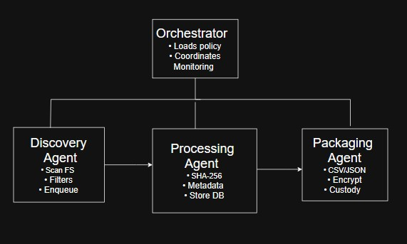
Multi-Agent Architecture
Four Main Agents:
1. Orchestrator Agent
Coordinates all other agents and loads policy and manages execution
Handles error recovery
2. Discovery Agent
Scans filesystem paths and filters by extension and size
Enqueues files for processing
3. Processing Agent
Calculates SHA-256 hashes and extracts metadata (timestamps, size, owner)
Stores records in SQLite database
4. Packaging Agent
Exports CSV/JSON reports and creates encrypted ZIP packages
Records chain of custody

Slide 4
Technologies and Standards
Core Technologies:
SHA-256 Hashing: FIPS 180-4 standard for court admissibility
File Detection: libmagic (header-based) with mimetypes fallback
Database: SQLite for portable evidence storage
Encryption: AES-GCM for tamper-evident packaging
Standards Compliance:
ISO/IEC 27037 - Digital evidence handling
NIST SP 800-86 - Forensic techniques
ACPO Principles - UK forensic guidelines
FIPS validated cryptography

Slide 5
Evidence Collection Process
5-Phase Workflow:
Phase 1: Configuration
Load policy from YAML file and initialize database and output directories
Phase 2: Discovery
Scan paths, filter by extension/size and exclude system directories
Phase 3: Processing
Calculate SHA-256 hashes and extract metadata and store in database
Phase 4: Packaging
Export reports (CSV/JSON) and create encrypted zip with AES-GCM
Phase 5: Verification
Generate package hash and record chain of custody
Performance: 100+ files/minute, handles up to 100MB files

Slide 6
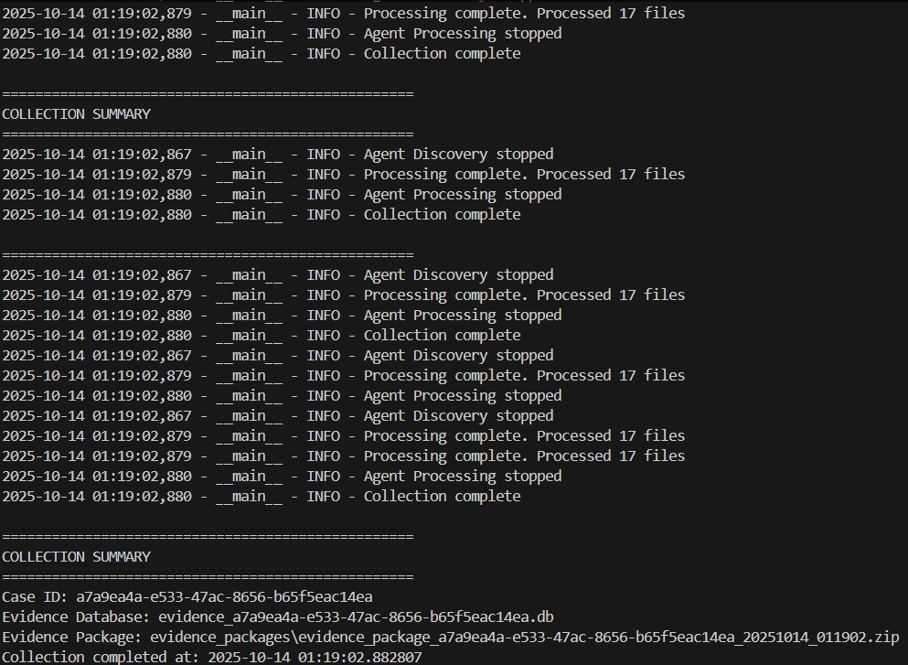
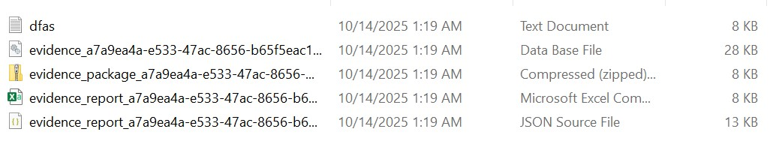
System Demonstration
Generated Files:
evidence_[case_id].db - SQLite database
evidence_report_[timestamp].csv - Excel format
evidence_report_[timestamp].json - API format
evidence_package_[timestamp].zip - Encrypted package
Performance: 17 files processed in ~3 seconds

Slide 7
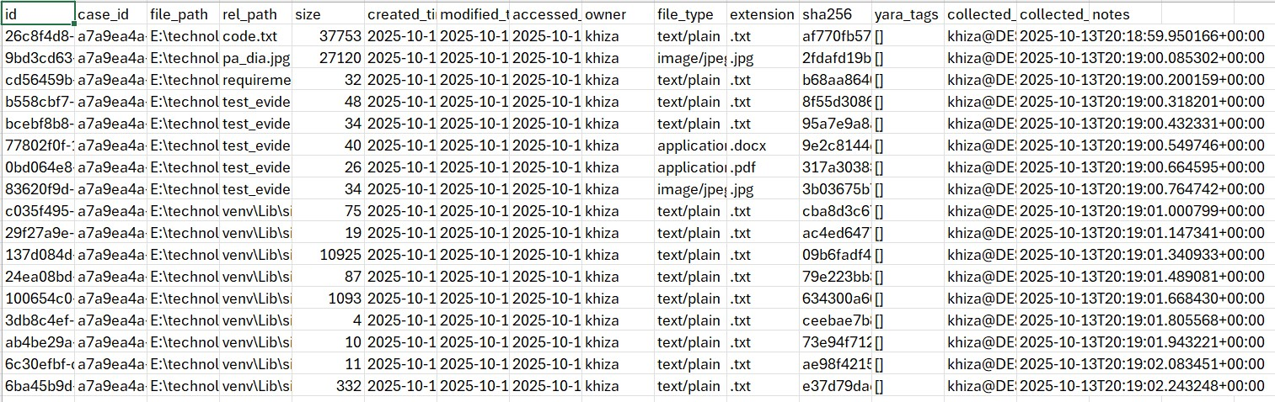
Multi-Format Evidence Reports
CSV Report:
Excel-compatible spreadsheet
Contains: File Path, SHA-256, Size, Timestamps
Suitable for legal documentation
JSON Report:
Machine-readable API format
Supports automated forensic workflows
Preserves metadata relationships
SQLite Database:
Supports complex forensic queries
Enables timeline analysis
Stores chain of custody separately

Slide 8
Test Coverage
Test Execution:
12 total tests executed and 100% pass rate (12/12 successful)
Execution time: 3.118 seconds
Test Breakdown:
Database Manager: 2 tests and processing Agent: 3 tests
Discovery Agent: 3 tests and packaging Agent: 3 tests
Integration: 1 test
Key Validations:
SHA-256 accuracy verified against known hashes
File type detection tested with multiple formats
Database integrity confirmed with concurrent writes
Large file filtering (100MB+ exclusion)

Slide 9
Development Challenges
Challenge 1: Cross-Platform Compatibility
Solution: pathlib abstraction + platform-specific code
Challenge 2: Locked Files
Solution: Retry logic + graceful degradation
Challenge 3: Performance
Solution: Queue-based multithreading (10x faster)
Challenge 4: File Type Spoofing
Solution: libmagic header detection (95% accuracy)
Challenge 5: Memory Usage
Solution: 4KB chunk streaming for large files
Key Learning: Robust error handling essential for forensics

Slide 10
Conclusion
Project Achievements:
Fully functional multi-agent forensic collection system
BDI architecture successfully implemented with goal-oriented agents
unit tests passing (Great success rate)
Standards-compliant evidence handling (ISO/NIST/ACPO)
Production-ready code with comprehensive documentation
Cross-platform compatibility (Windows, Linux, macOS)
Final Statement: DFAS shows that intelligent agent principles can be effectively applied to solve complex real-world digital forensics challenges while maintaining strict compliance with international standards and court admissibility requirements.

Slide 11
Thank you

