Slide 1
16S analysis: from OTU to ASVs
Dr. Brigida Rusconi
Department of Pediatrics, Washington University School of Medicine

Slide 2
How to start R Studio on RIS
>mkdir -p $HOME/usr/lib
>cat <<EOF > $HOME/.Rprofile
vals <- paste('$HOME/usr/lib/R',paste(R.version$major,R.version$minor,sep="."),sep="")
for (devlib in vals) {
if (!file.exists(devlib))
dir.create(devlib)
x <- .libPaths()
x <- .libPaths(c(devlib,x))
}
rm(x,vals)
EOF
>LSF_DOCKER_VOLUMES='/storage1/fs1/ ${wustlkey}/Active:/storage1/fs1/ ${wustlkey}/Active /scratch1/fs1/ ${wustlkey}:/scratch1/fs1/ ${wustlkey} /home/ ${wustlkey}:/home/ ${wustlkey}' PATH=/home/ ${wustlkey}:$PATH LSF_DOCKER_PORTS='8000:8787' bsub -Is –G –n 16 –M 16GB -compute- ${wustlkey} -q general-interactive -R 'select[port8000=1]' -a 'docker(koetjen/rstudio:4.0.3)' /bin/bash
>rstudio-server start

Slide 3
Strengths of 16S Sequencing
Cheap
Can accommodate many samples on the same run
Ideal to study conditions that change bacterial community patterns
Multiple tutorials and tools available to analyze the data
Can compare datasets to previous publications (if you reanalyze the data with same parameters and if it’s the same sequencing technology)
Not as computationally intense as shot gun sequencing

Slide 4
Common Issues with 16S
Imperfect recall (not all sequences or taxa are detected)
Bias in extraction (universal)
Inefficiency of universal primers to hybridize all the templates
V4 sub-region has complete overlap of paired-end sequences
16S rRNA genes that do not differ in their amplified sequence cannot be resolved
Can only resolve on the family or genus level (Bukin et al, 2019, Scientific Data)
Enterobacteriaceae and the Clostridiales order are known to be poorly resolved using V4 amplicons
V2-V3 is better at resolving beyond the Genus level

Slide 5
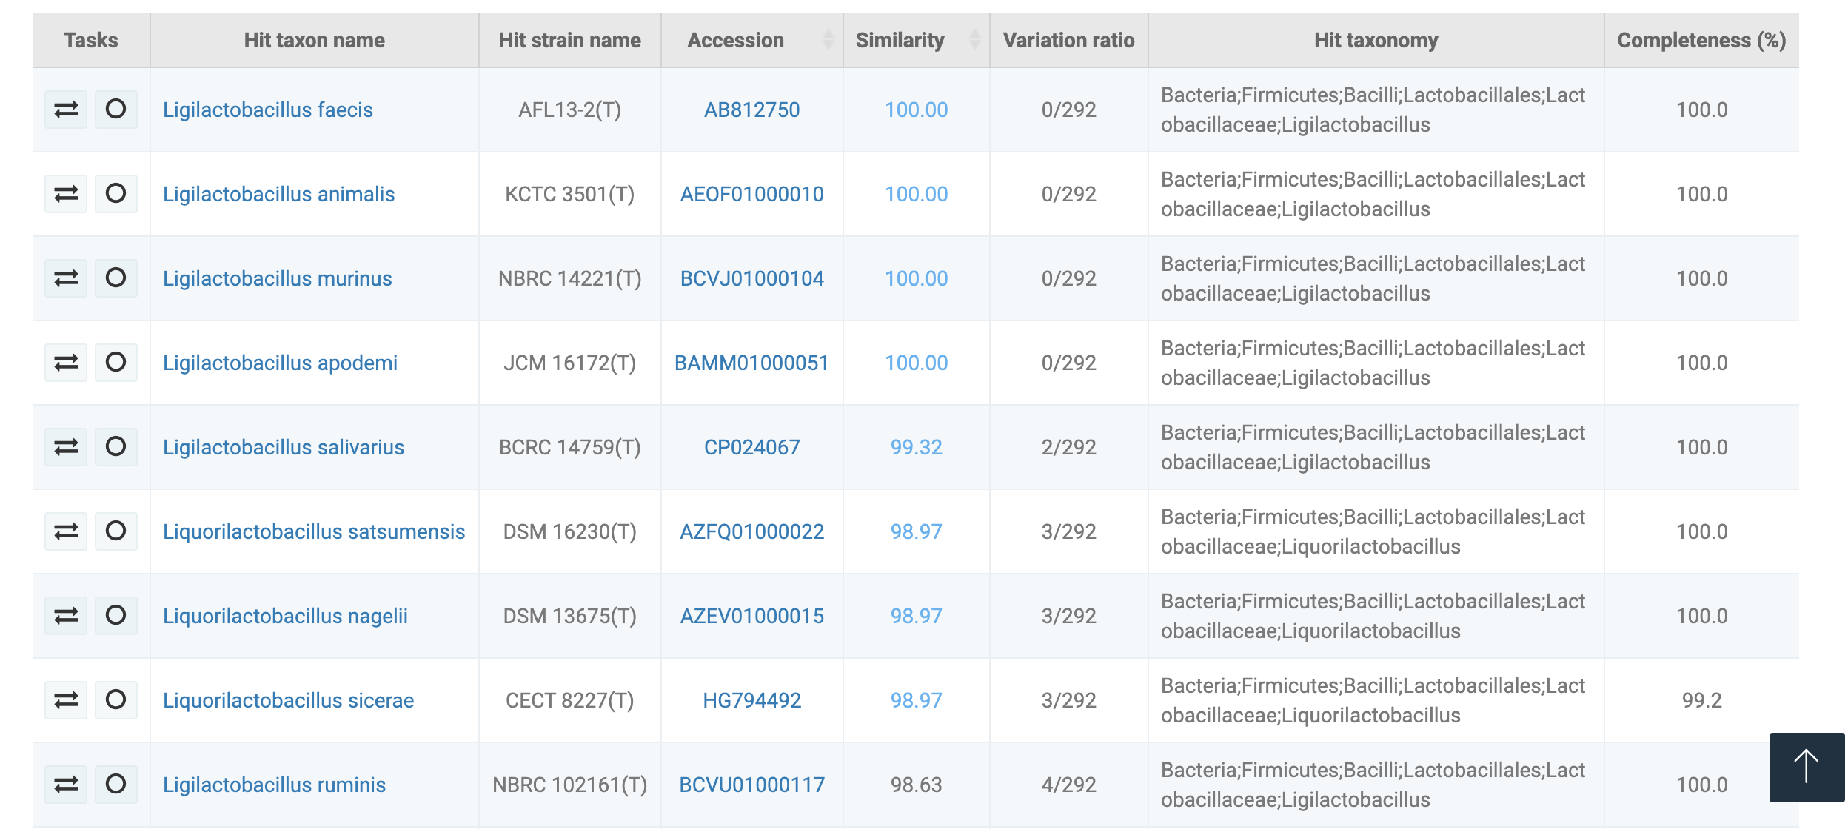

Slide 6
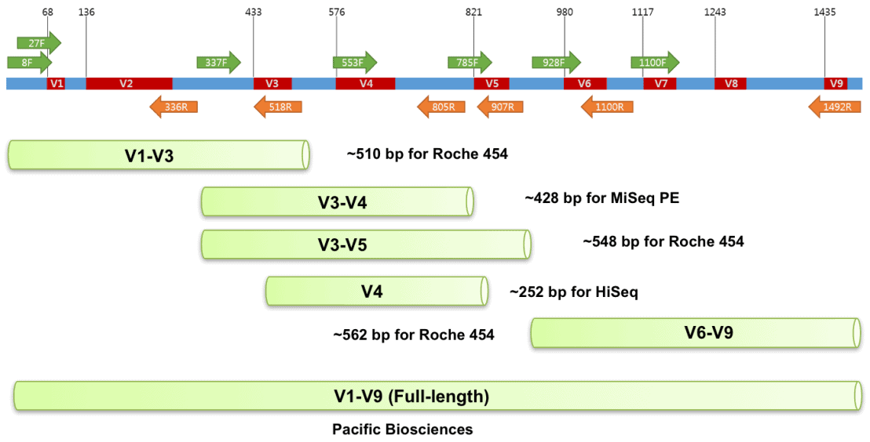
Which Variable Region should I Sequence?
EZ BioCloud

Slide 7
Which Variable Region should I Sequence?
Depends on the source of your sample
Most cohort studies of the past have used V4 for profiling
515f/806r primer pair (V4) originally described by Caporaso et al, 2011 has been used in almost 2000 publications

Slide 8
Download packages needed
Open workshop_16S_1.Rmd file in RStudio

Slide 9
16S or Shotgun Sequencing?
Depends on the budget and the scientific question
Do you want to assess changes to community structure or potential function?
Are you interested in rare or low abundance species?
What is the source of your specimens (host or environment contaminants)?
Do you need species or strain level resolution?
If you are interested in function shotgun sequencing will provide better resolution
For functional information you will need higher read depth
Less samples per run
Intermediate approach is to do shallow shotgun sequencing (500k/sample)
Increased taxonomic resolution
Computationally more demanding
Shallow shotgun sequencing cannot be used for novel gene and genome assembly

Slide 10
Low Abundance Samples
What can I do to improve analysis of low abundance samples?
Enrich target DNA by degrading free DNA prior to DNA extraction (Stinson et al, 2019, Lett Appl Microbiol., Li et al., 2017, Scientific Reports)
Include an extraction control to get background amplification
This can then be used to remove background with package “decontam” (Davis et al,2018, Microbiome)

Slide 11
Approaches to Analyze 16S
Clustering of sequencing reads to obtain operational taxonomic units (OTUs) (USEARCH)
≥97% is often used as a cutoff to cluster reads
Generation of amplicon sequence variants (ASVs) using error-corrected reads (DADA2, Deblur)
Direct taxonomic classification of raw reads (Kraken, Bracken)
Classifies sequencing reads into taxonomic bins
Bracken extension now also offers read count
Read that has identical matches to two species will be classified at the genus level
Multiple reads that can only be assigned at the genus level will be combined
Alignment-free algorithm makes it really fast (Lu et al, 2020, Mirobiome)

Slide 12
Why I prefer ASV to OTU
Clustering sequences masks biological variation and produces artifacts
ASVs that are generally considered to be a more detailed view of OTUs
DADA2 is considered to provide the best compromise of specificity and sensitivity
But don’t just take my word

Slide 13
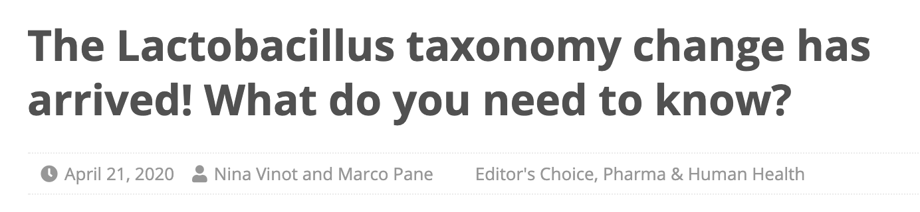

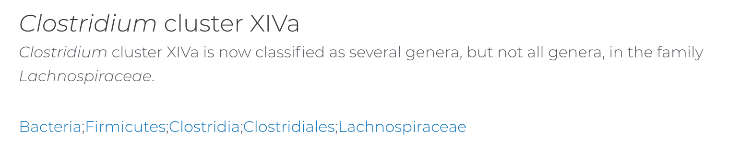

Slide 14
16S data structure
More features (ASV) than samples (high dimensional)
Many features with 0 (sparse)
Number of reads between samples can vary
Compositional (we only get a snapshot of the whole community)
Unless we use spike ins

Slide 15
Pre-requisites for DADA2 analysis
Samples have been demultiplexed, i.e. split into individual per-sample fastq files
Non-biological nucleotides have been removed, e.g. primers, adapters, linkers, etc
If paired-end sequencing data, the forward and reverse fastq files contain reads in matched order
Most sequencing services and cores will provide data in this format
Have access to R either on own machine or through interactive job on RIS
“dada2” and “phyloseq” R packages

Slide 16
Common Steps in Amplicon Denoising Pipelines
Filter Low Quality Reads
Alignment and Dereplication
Error Correction
Chimera Removal
Taxonomic Classification
dada2::filterAndTrim
dada2::nwalign and dada2::derepFastq
dada2::learnErrors and dada2::dada
dada2::removeBimeraDenovo
dada2:assignTaxonomy and dada2::addSpecies

Slide 17
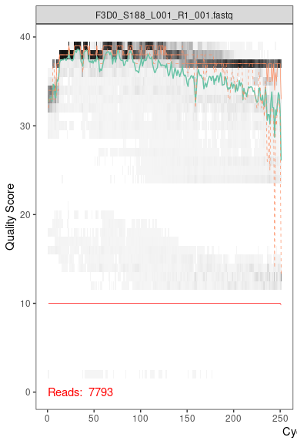
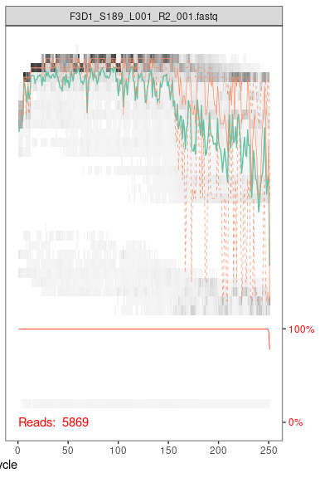

Slide 18
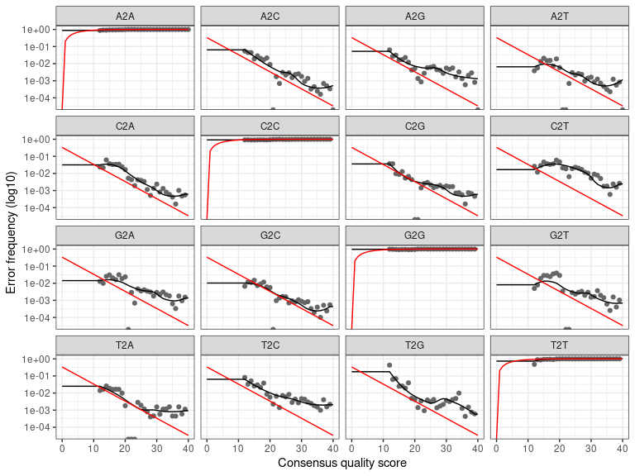

Slide 19
Overview DADA2 output
 | input | filtered | denoisedF | denoisedR | merged
F3D0 | 7793 | 7113 | 6976 | 6979 | 6540
F3D1 | 5869 | 5299 | 5227 | 5239 | 5028
F3D141 | 5958 | 5463 | 5331 | 5357 | 4986
F3D142 | 3183 | 2914 | 2799 | 2830 | 2595
F3D143 | 3178 | 2941 | 2822 | 2868 | 2553
F3D144 | 4827 | 4312 | 4151 | 4228 | 3646

Slide 20
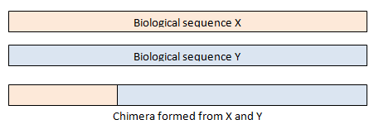
Chimeric Sequences
Chimeras are sequences formed from two (or more) biological sequences joined together
Typically form during PCR when:
Extension of an amplicon is aborted
Serves as a primer in the next PCR cycle
Aborted product anneals to the wrong template
Makes a new sequence from two different template
Typically small fraction of reads are chimeric
However a large fraction of ASVs/OTUs are often chimeric

Slide 21
Taxonomy
Switch to Rstudio
wget https://zenodo.org/record/3986799/files/silva_nr99_v138_train_set.fa.gz
wget https://zenodo.org/record/3986799/files/silva_species_assignment_v138.fa.gz

Slide 22
When Should I Use Rarefaction?
Library size normalization
Read depth can affect diversity measurements
Rarefaction curves represent diversity as a function of library size
Used to define the cutoff for downsampling
Do not use random cutoffs as it differs between experiments and sample types
Issue: Random subsampling that results in loss of data and generation of artificial variation
There are now new approaches for diversity metrics that do not require rarefaction
For differential abundance do not use rarefied data as most approaches have their own normalization techniques that take library size into account

Slide 23
Beta Diversity Measures
Visualize differences between sample diversity
Bray-Curtis is a quantitative measure
1 – (2 x the lesser count of the intersection of taxa) / total taxa both sites
Values range from 0 to 1
BC = 0 if sites share all the same taxa; BC = 1 if they don’t share any
Unweighted UniFrac distance is a qualitative measure
Ignores relative abundances but takes phylogenetic distances into account
The more closely related the sequences between the samples the smaller the distance
Sum unshared branch lengths / sum all branches

Slide 24
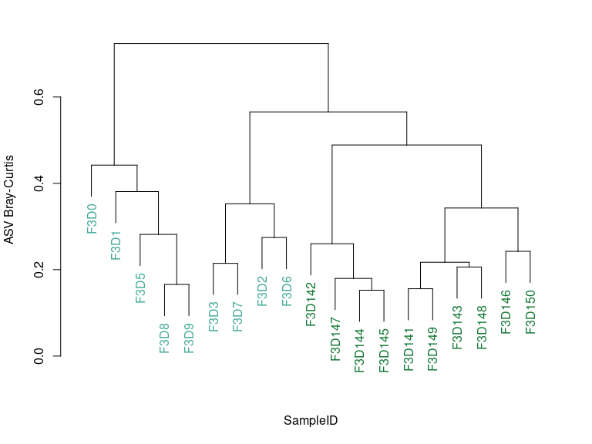
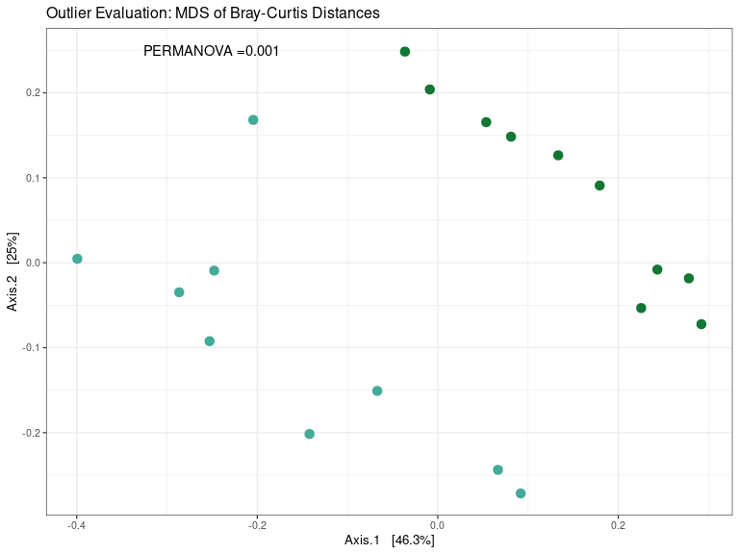

Slide 25
Alpha Diversity Measures
Focus on within sample diversity
Measure of richness and evenness
Shannon Diversity
Relatively insensitive to low abundant features as it is a quantitative measure
Summation of prob. x ln(prob.) of observing each taxon multiplied by -1
Chao1 diversity index relies on singleton and can therefore not be used with data that has been denoised
Unless you use the pool option in DADA2 to allow for singletons
Pielou Evenness
A measure of how evenly the distribution of the features is

Slide 26
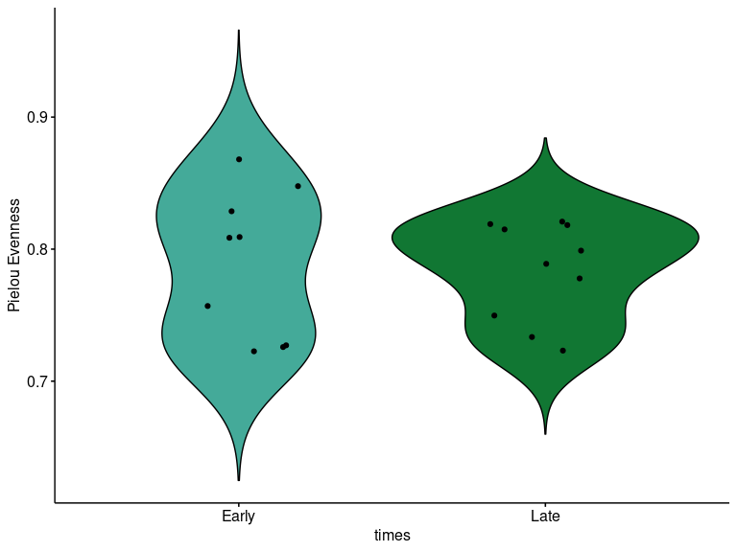
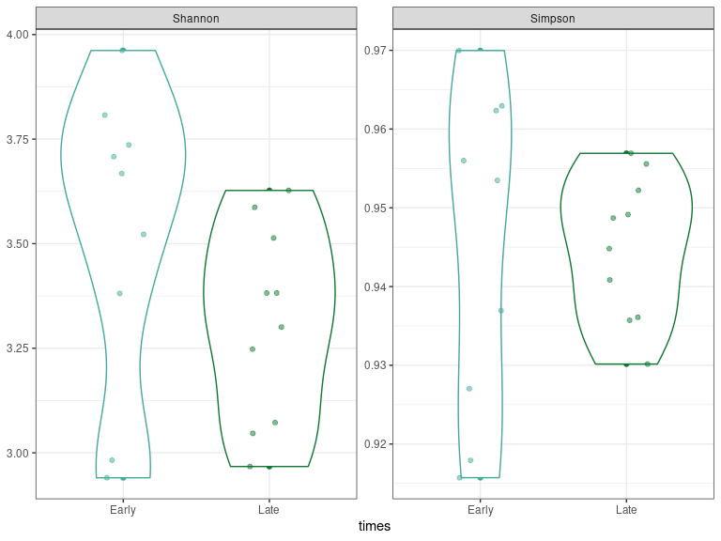

Slide 27
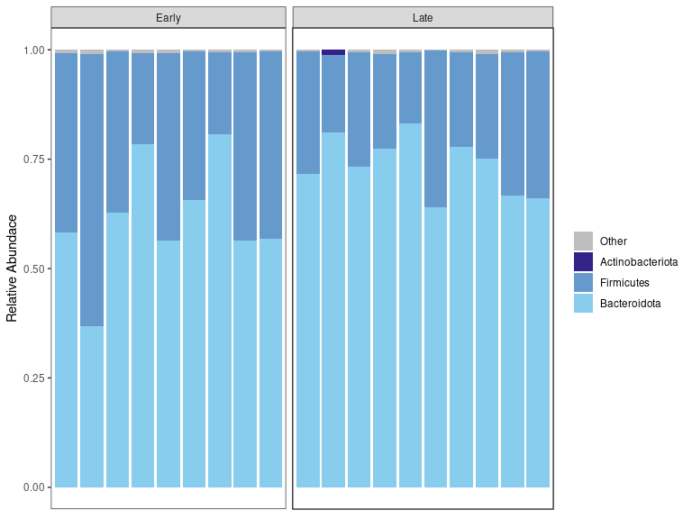

Slide 28
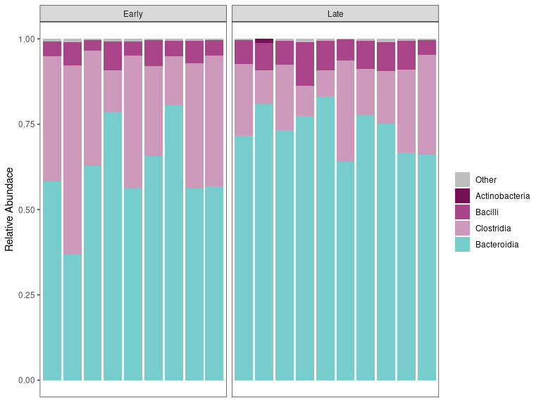

Slide 29
DESeq2
If each ASV has the same chance of being selected for sequencing, and selected independently, then the number of read counts for a given ASV should follow a Poisson distribution
In most experiments the assumption of independence fails so we have to use a different type of model
Taxa and samples can be correlated which can lead to overdispersion
In DESeq library size for each sample is accounted for with the size factor
Used to transform the counts to a common scale
DESeq2 assumes that ASVs of similar average count have a similar dispersion and fits the ASV-specific dispersion towards the average dispersion
ASVs are transformed to logarithmic fold change
Wald tests for differential expression with multiple testing correction
You can add additional factors to correct for interactions (batch effect, etc)

Slide 30
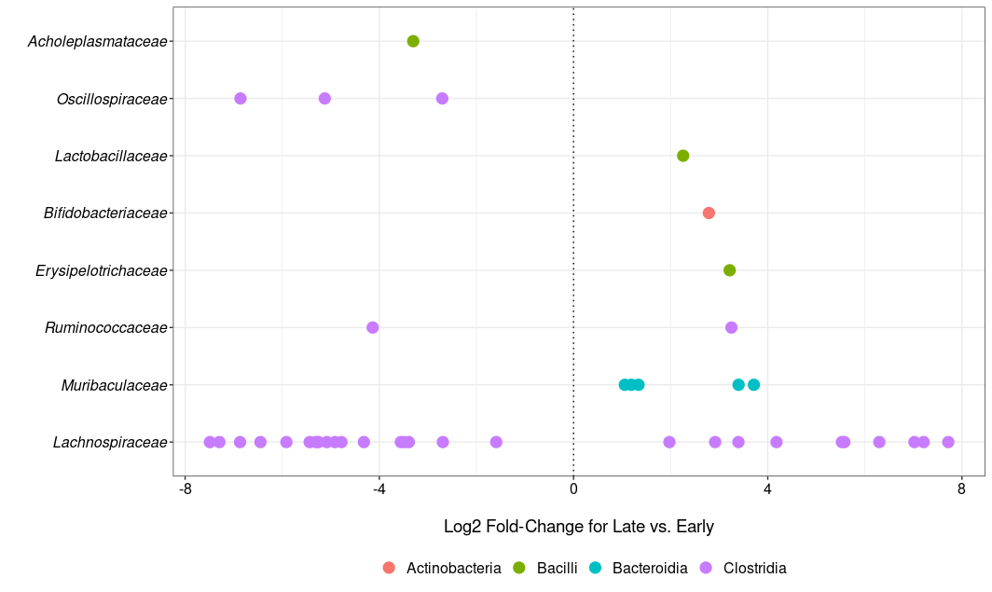

Slide 31
Zero-inflation
Zero inflated models should be considered for differential abundance:
If you compare samples from very different sourcing sites
If you do a treatment or intervention that would cause the depletion of given taxa
This is important if you think that one of the groups will lack taxa not because you didn’t sequence deeply enough, but because they are truly gone
More information on https://www.nicholas-ollberding.com/post/observation-weights-for-differential-abundance-of-zero-inflated-microbiome-data-with-deseq2/
Calgaro et al, 2020, Genome Biology

Slide 32
Future Developments
Moving away from 16S to shallow shotgun or Pacbio
PacBio sequencing of the whole 16S gene will increase taxonomic resolution
Use a spike-in DNA to determine absolute quantification
This approach can be used in high abundance samples too
Synthetic 16S (Venkataraman et al, 2018, BioTechniques)
Can be DNA or whole bacterium (Salinibacter ruber, Rhizobium radiobacter and Alicyclobacillus acidophilus) (Stämmler et al, 2016, Microbiome)
Should not take more than 1% of the reads per sample
Changes the statistics as now we move away from compositional data
Read counts are converted to absolute 16S rRNA gene copy numbers

Slide 33

Longitudinal studies
https://biostatistics.wustl.edu/research/seminars/

