Slide 1
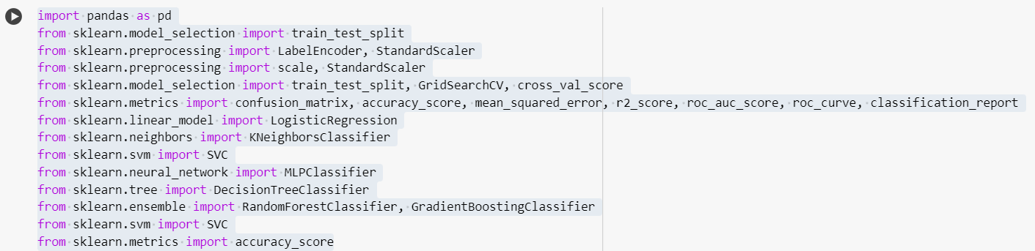
The code imports various modules and classes from the scikit-learn (sklearn) and pandas libraries, setting up an environment for machine learning tasks. Here's a summary of the documentation for each import statement:
pandas:import pandas as pd: Imports the pandas library with the alias pd.

Slide 2
import pandas as pd: Imports the pandas library with the alias pd.
scikit-learn (sklearn):
from sklearn.model_selection import train_test_split: Provides the train_test_split function for splitting datasets into training and testing subsets.
from sklearn.preprocessing import LabelEncoder, StandardScaler: Imports LabelEncoder for encoding categorical integer features and StandardScaler for standardizing features.
from sklearn.preprocessing import scale, StandardScaler: Redundantly imports scale and StandardScaler.
from sklearn.model_selection import train_test_split, GridSearchCV, cross_val_score: Imports various functions for model selection, such as train_test_split, GridSearchCV for hyperparameter tuning, and cross_val_score for cross-validation.
from sklearn.metrics import confusion_matrix, accuracy_score, mean_squared_error, r2_score, roc_auc_score, roc_curve, classification_report: Imports various evaluation metrics including confusion matrix, accuracy score, mean squared error, ROC AUC score, ROC curve, and classification report.

Slide 3
from sklearn.linear_model import LogisticRegression: Imports the LogisticRegression class for logistic regression.
from sklearn.neighbors import KNeighborsClassifier: Imports the KNeighborsClassifier class for k-nearest neighbors classification.
from sklearn.svm import SVC: Imports the SVC class for Support Vector Classifier (SVC).
from sklearn.neural_network import MLPClassifier: Imports the MLPClassifier class for Multi-layer Perceptron (MLP) classification.
from sklearn.tree import DecisionTreeClassifier: Imports the DecisionTreeClassifier class for decision tree classification.
from sklearn.ensemble import RandomForestClassifier, GradientBoostingClassifier: Imports the RandomForestClassifier and GradientBoostingClassifier classes for ensemble classification methods.

Slide 4
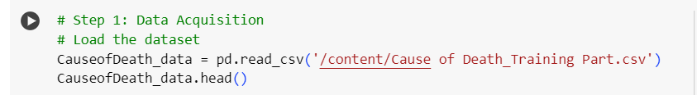
Step 1: Data Acquisition:
Purpose: This step involves acquiring the dataset to be used for analysis or training machine learning models.
Explanation:
pd.read_csv('/content/Cause of Death_Training Part.csv'): This line reads the CSV file named 'Cause of Death_Training Part.csv' and loads it into a pandas DataFrame named CauseofDeath_data.
CauseofDeath_data.head(): This line displays the first few rows of the DataFrame CauseofDeath_data, providing a quick view of the dataset.

Slide 5
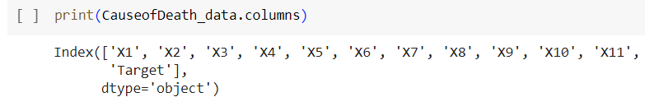
Printing column names
CauseofDeath_data.head(): This prints the first few rows of the DataFrame to the console.
print(CauseofDeath_data.columns): This line prints the names of all columns in the DataFrame to the console.
So, the code essentially loads a CSV file into a Pandas DataFrame and then prints the column names of that DataFrame.

Slide 6
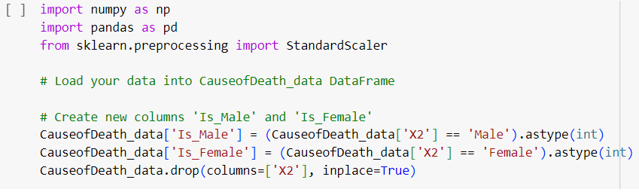
This code snippet seems to be preprocessing data, specifically adding two new columns 'Is_Male' and 'Is_Female' to the DataFrame CauseofDeath_data
1- Importing Libraries:
import numpy as np: Imports the NumPy library under the alias np.
import pandas as pd: Imports the Pandas library under the alias pd.
from sklearn.preprocessing import StandardScaler: Imports the StandardScaler class from the preprocessing module of the scikit-learn library.

Slide 7
Data Preprocessing:
Creating New Columns:
CauseofDeath_data['Is_Male'] = (CauseofDeath_data['X2'] == 'Male').astype(int): This line creates a new column named 'Is_Male' in the CauseofDeath_data DataFrame. The column is filled with 1s where the corresponding value in the 'X2' column is 'Male', and 0s otherwise.
CauseofDeath_data['Is_Female'] = (CauseofDeath_data['X2'] == 'Female').astype(int): Similarly, this line creates a new column named 'Is_Female' in the CauseofDeath_data DataFrame. The column is filled with 1s where the corresponding value in the 'X2' column is 'Female', and 0s otherwise.
Dropping a Column:
CauseofDeath_data.drop(columns=['X2'], inplace=True): This line removes the column named 'X2' from the CauseofDeath_data DataFrame. The inplace=True argument ensures that the change is made directly to the DataFrame.
This code essentially preprocesses the data by creating binary indicator columns for gender ('Is_Male' and 'Is_Female') based on the values in the 'X2' column and then drops the original 'X2' column from the DataFrame.

Slide 8
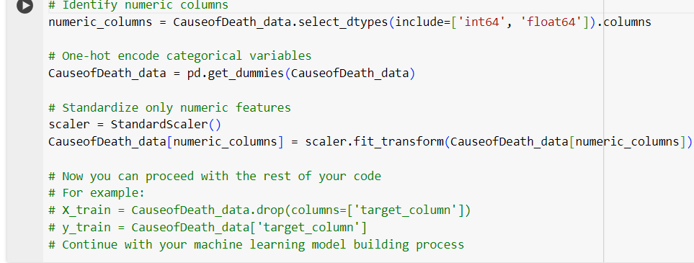
Identify Numeric Columns:
numeric_columns = CauseofDeath_data.select_dtypes(include=['int64', 'float64']).columns: This line identifies the numeric columns in the CauseofDeath_data DataFrame by selecting columns with data types 'int64' and 'float64'. The column names are stored in the variable numeric_columns.
One-Hot Encode Categorical Variables:
CauseofDeath_data = pd.get_dummies(CauseofDeath_data): This line performs one-hot encoding on the categorical variables in the CauseofDeath_data DataFrame. It creates binary columns for each categorical value, effectively converting categorical variables into a numerical format suitable for machine learning algorithms.

Slide 9
Standardize Numeric Features:
scaler = StandardScaler(): This line creates an instance of the StandardScaler class, which is used for standardizing features by removing the mean and scaling to unit variance.
CauseofDeath_data[numeric_columns] = scaler.fit_transform(CauseofDeath_data[numeric_columns]): This line standardizes only the numeric features identified earlier (numeric_columns) using the fit_transform method of the StandardScaler instance. This ensures that each numeric feature has a mean of 0 and a standard deviation of 1.
Proceeding with Machine Learning Model Building:
After preprocessing the data, the code suggests that you can proceed with the rest of your machine learning model building process.

Slide 10
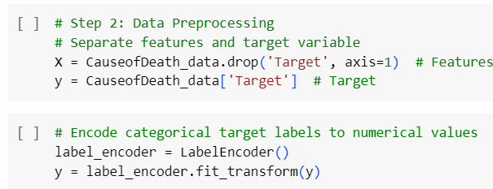
Step 2: Data Preprocessing:
This section represents the preprocessing step in the machine learning pipeline.
Separate Features and Target Variable:
X = CauseofDeath_data.drop('Target', axis=1): This line separates the features from the target variable in the CauseofDeath_data DataFrame. It creates a new DataFrame X containing all columns except the 'Target' column.
y = CauseofDeath_data['Target']: This line assigns the 'Target' column to the variable y, representing the target variable.

Slide 11
Encode Categorical Target Labels to Numerical Values:
label_encoder = LabelEncoder(): This line creates an instance of the LabelEncoder class, which is used to encode categorical labels with numerical values.
y = label_encoder.fit_transform(y): This line applies the label encoding transformation to the target variable y.
It assigns a unique numerical value to each unique category in the 'Target' column, effectively converting categorical labels into numerical format suitable for machine learning algorithms.
This code snippet essentially preprocesses the data by separating features and the target variable,
and then encoding the categorical target labels into numerical values, which is often necessary for machine learning algorithms to process the data effectively.

Slide 12
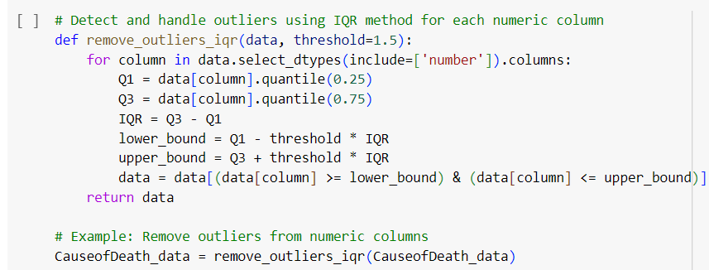
Detect and Handle Outliers using IQR Method:
This function aims to identify and handle outliers in each numeric column of the dataset using the Interquartile Range (IQR) method.
Function Definition:
def remove_outliers_iqr(data, threshold=1.5):: This line defines a function named remove_outliers_iqr that takes two parameters: data, which represents the input DataFrame, and threshold, which specifies the threshold for detecting outliers (default is set to 1.5).

Slide 13
Outlier Detection and Removal:
The function iterates over each numeric column in the DataFrame using a for loop and select_dtypes(include=['number']).columns.
For each numeric column, it calculates the first quartile (Q1), third quartile (Q3), and Interquartile Range (IQR).
Based on these values, it calculates the lower and upper bounds to identify outliers using the formula:
It then filters the data to keep only the rows where the column values fall within the calculated bounds, effectively removing outliers.
Return Value:
The function returns the modified DataFrame with outliers removed.
Example Usage:
CauseofDeath_data = remove_outliers_iqr(CauseofDeath_data): This line demonstrates how to use the remove_outliers_iqr function by applying it to the CauseofDeath_data DataFrame to remove outliers from its numeric columns.
This code snippet provides a convenient way to detect and handle outliers in a dataset using the IQR method, which is a robust method for outlier detection.

Slide 14
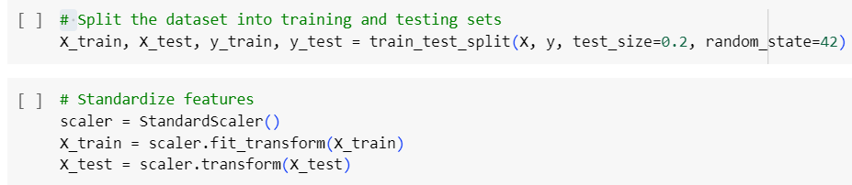
Splitting the Dataset into Training and Testing Sets:
X_train, X_test, y_train, y_test = train_test_split(X, y, test_size=0.2, random_state=42): This line splits the dataset into training and testing sets for both features (X) and the target variable (y).
X: Represents the feature dataset.
y: Represents the target variable dataset.
test_size=0.2: Specifies that 20% of the data will be used for testing, and 80% will be used for training.
random_state=42: Sets the random seed for reproducibility. It ensures that each time the data is split, the same random indices are chosen for the training and testing sets.

Slide 15
Standardizing Features:
scaler = StandardScaler(): This line creates an instance of the StandardScaler class, which is used for standardizing features by removing the mean and scaling to unit variance.
X_train = scaler.fit_transform(X_train): This line standardizes the training features (X_train) using the fit_transform method of the StandardScaler instance. This step calculates the mean and standard deviation of each feature in the training set and then standardizes the features accordingly.
X_test = scaler.transform(X_test): This line applies the same transformation (standardization) to the testing features (X_test) using the transform method of the StandardScaler instance. It ensures that the testing features are standardized using the parameters (mean and standard deviation) learned from the training set.
Documentation:
The code performs data splitting into training and testing sets using the train_test_split function from scikit-learn. It also standardizes the features using StandardScaler.
These steps are essential in preparing the data for machine learning models, ensuring that the models are trained and tested on comparable scales.

Slide 16
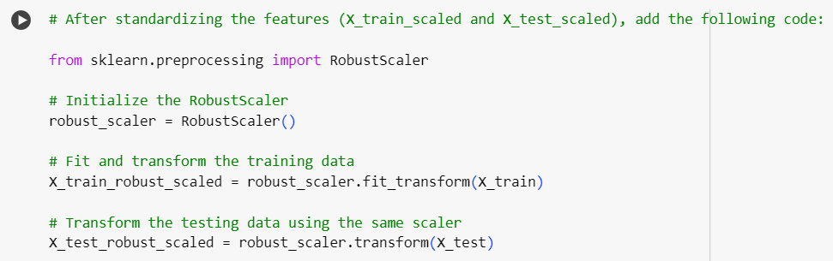
RobustScaler for Feature Scaling:
from sklearn.preprocessing import RobustScaler: This line imports the RobustScaler class from the scikit-learn library. RobustScaler is used for scaling features using statistics that are robust to outliers.
Initialization of RobustScaler:
robust_scaler = RobustScaler(): This line initializes an instance of the RobustScaler class. The RobustScaler is now ready to transform the data.

Slide 17
Fitting and Transforming Training Data:
X_train_robust_scaled = robust_scaler.fit_transform(X_train): This line fits the RobustScaler to the training data (X_train) and then transforms the training data. Fitting the scaler computes the necessary statistics (such as median and interquartile range) from the training data, and transforming applies the scaling.
Transforming Testing Data Using the Same Scaler:
X_test_robust_scaled = robust_scaler.transform(X_test): This line transforms the testing data (X_test) using the same RobustScaler instance that was fitted to the training data. It ensures that the testing data is scaled using the same statistics as the training data, maintaining consistency in scaling.
Documentation:
The provided code snippet demonstrates how to use RobustScaler for feature scaling in a machine learning pipeline.
RobustScaler is particularly useful when dealing with datasets containing outliers, as it scales the data based on statistics that are robust to outliers, such as the median and interquartile range.
The code ensures that both training and testing data are scaled consistently using the same scaler instance, which is a crucial step in data preprocessing for machine learning tasks.

Slide 18

Step 3: Model Selection:
This section represents the step in the machine learning pipeline where a model is selected and trained.
Training the Support Vector Machine (SVM) Model:
svm_model = SVC(kernel='linear', random_state=42): This line initializes a Support Vector Machine (SVM) classifier model with a linear kernel.
SVC is the class for Support Vector Classification in scikit-learn.
kernel='linear' specifies that a linear kernel will be used. A linear kernel computes the dot product of the feature vectors, which is suitable for linearly separable data.
random_state=42 sets the random seed for reproducibility in the model. It ensures that the results are consistent across different runs.

Slide 19
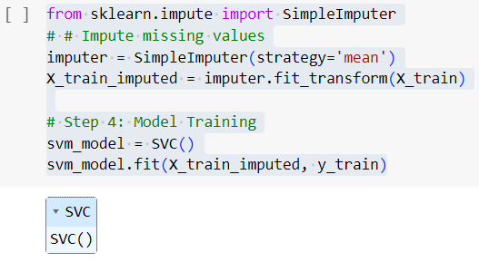
Importing SimpleImputer:
from sklearn.impute import SimpleImputer: This line imports the SimpleImputer class from the scikit-learn library. SimpleImputer is used for imputing missing values in the dataset.
Impute Missing Values:
imputer = SimpleImputer(strategy='mean'): This line initializes a SimpleImputer instance with the strategy of imputing missing values with the mean of the non-missing values for each feature.
X_train_imputed = imputer.fit_transform(X_train): This line fits the imputer to the training data (X_train) and transforms it. The missing values in X_train are replaced with the mean value of each feature.

Slide 20
Model Training (Step 4):
svm_model = SVC(): This line initializes a Support Vector Machine (SVM) classifier model without specifying any hyperparameters. By default, it uses a radial basis function (RBF) kernel.
svm_model.fit(X_train_imputed, y_train): This line trains the SVM model using the imputed training features (X_train_imputed) and the corresponding target labels (y_train).
Documentation Summary:
The code snippet demonstrates the imputation of missing values in the training dataset using the mean imputation strategy.
It then proceeds to train a Support Vector Machine (SVM) classifier model using the imputed training features and corresponding target labels.
The model training step is crucial in supervised learning, as it involves fitting the model to the training data to learn patterns and relationships between features and target variables

Slide 21
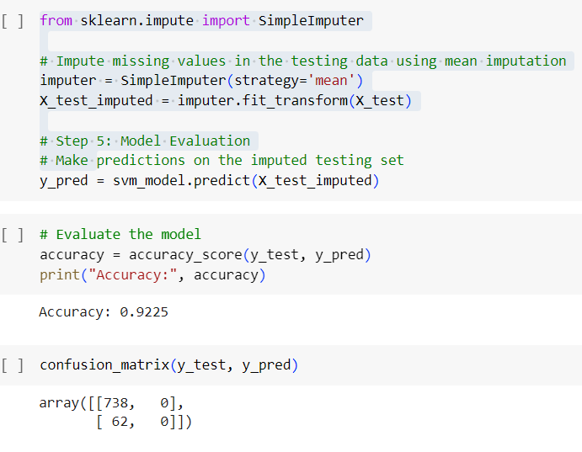
Importing SimpleImputer:
from sklearn.impute import SimpleImputer: This line imports the SimpleImputer class from the scikit-learn library. SimpleImputer is used for imputing missing values in the dataset.
Impute Missing Values in Training Data:
imputer = SimpleImputer(strategy='mean'): This line initializes a SimpleImputer instance with the strategy of imputing missing values with the mean of the non-missing values for each feature.
X_train_imputed = imputer.fit_transform(X_train): This line fits the imputer to the training data (X_train) and transforms it. The missing values in X_train are replaced with the mean value of each feature.

Slide 22
Model Training (Step 4):
svm_model = SVC(): This line initializes a Support Vector Machine (SVM) classifier model without specifying any hyperparameters. By default, it uses a radial basis function (RBF) kernel.
svm_model.fit(X_train_imputed, y_train): This line trains the SVM model using the imputed training features (X_train_imputed) and the corresponding target labels (y_train).
Impute Missing Values in Testing Data:
imputer = SimpleImputer(strategy='mean'): This line initializes another SimpleImputer instance with the same mean imputation strategy for the testing data.
X_test_imputed = imputer.fit_transform(X_test): This line fits the imputer to the testing data (X_test) and transforms it. The missing values in X_test are replaced with the mean value of each feature.
Model Evaluation (Step 5):
y_pred = svm_model.predict(X_test_imputed): This line predicts the target labels (y_pred) for the imputed testing set (X_test_imputed) using the trained SVM model.
accuracy = accuracy_score(y_test, y_pred): This line calculates the accuracy of the model predictions by comparing the predicted labels (y_pred) with the true labels (y_test).
print("Accuracy:", accuracy): This line prints the accuracy score of the model on the testing data.
Confusion Matrix:
confusion_matrix(y_test, y_pred): This line computes the confusion matrix to evaluate the performance of the classification model. It shows the counts of true positive, true negative, false positive, and false negative predictions.

Slide 23
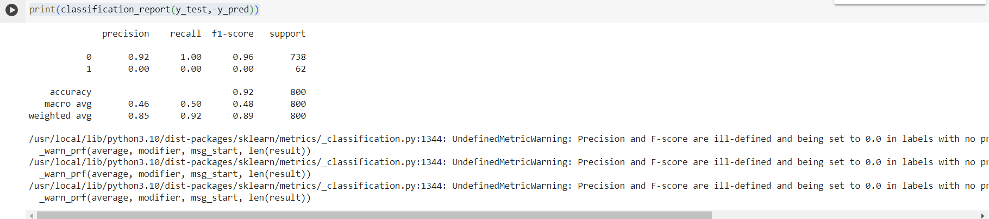
Print Classification Report:
classification_report(y_test, y_pred): This line generates a classification report by comparing the true labels (y_test) with the predicted labels (y_pred) and computes various evaluation metrics for each class in the classification problem.
Output:
The classification report typically includes the following metrics for each class:
Precision: The ratio of true positive predictions to the total number of positive predictions. It measures the accuracy of positive predictions.
Recall: The ratio of true positive predictions to the total number of actual positive instances. It measures the ability of the classifier to find all positive instances.
F1-score: The harmonic mean of precision and recall. It provides a balance between precision and recall.
Support: The number of actual occurrences of each class in the specified dataset.

Slide 24
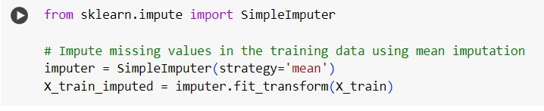
This code utilizes the SimpleImputer class from the sklearn.impute module, which is a part of the scikit-learn library. The purpose of this code is to handle missing values in the testing data (X_test) using mean imputation.

Slide 25
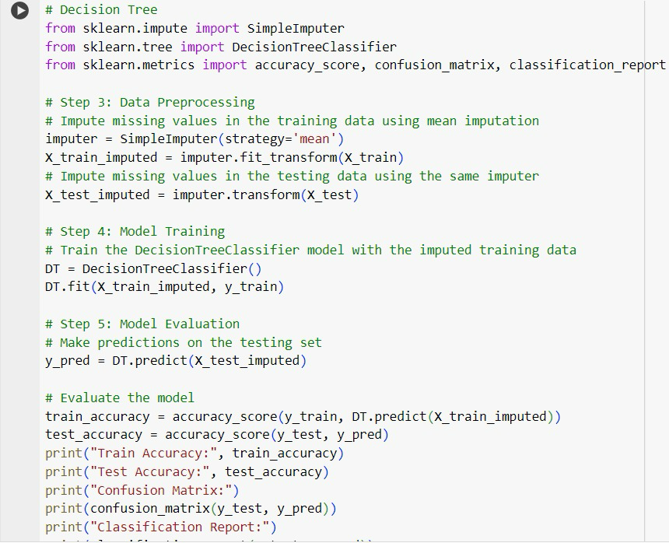

Slide 26
Data Preprocessing (Step 3):Missing values in the training data (X_train) are imputed using mean imputation with SimpleImputer and the strategy set to 'mean'. The imputer is fitted to the training data and transforms it, resulting in X_train_imputed.Missing values in the testing data (X_test) are imputed using the same imputer instance fitted on the training data. This ensures consistency in imputation between training and testing sets. The testing data is transformed, resulting in X_test_imputed.Model Training (Step 4):A Decision Tree Classifier (DecisionTreeClassifier) model is instantiated.The Decision Tree model is trained using the imputed training data (X_train_imputed) and corresponding target labels (y_train).Model Evaluation (Step 5):The trained Decision Tree model is used to make predictions on the imputed testing set (X_test_imputed), resulting in y_pred.The accuracy of the model is evaluated using both the training and testing data:The accuracy score is calculated for both the training and testing sets.Confusion matrix and classification report metrics are printed to assess the model's performance on the testing set.In summary, this code snippet demonstrates a typical machine learning workflow, including data preprocessing (imputation of missing values), model training (using a Decision Tree classifier), and model evaluation (assessing accuracy, confusion matrix, and classification report).

Slide 27
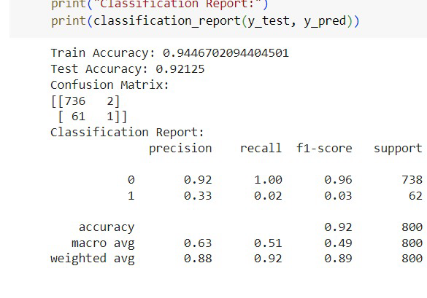

Slide 28
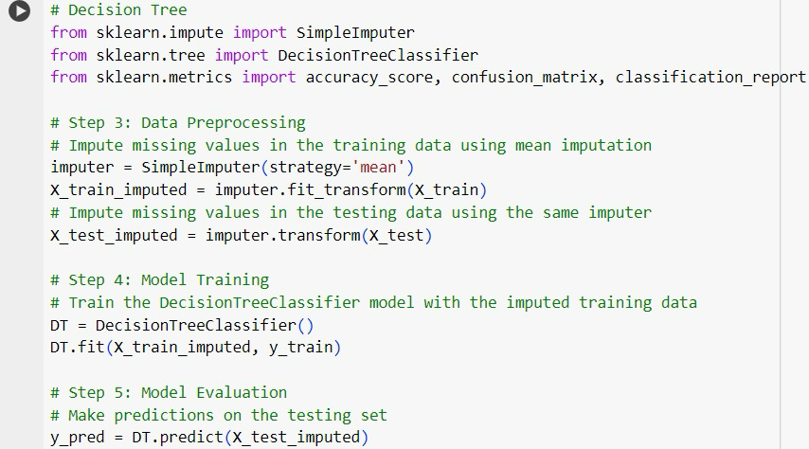

Slide 29
This code performs hyperparameter tuning for a Decision Tree Classifier using Grid Search Cross-Validation (GridSearchCV) to find the best combination of hyperparameters for the model. Here's what each part of the code does:Import Necessary Libraries:The code imports GridSearchCV from sklearn.model_selection and DecisionTreeClassifier from sklearn.tree.Define Grid Search Parameters:grid_param is a dictionary that contains various hyperparameters and their corresponding values. These hyperparameters include:criterion: The function to measure the quality of a split ('gini' or 'entropy').max_depth: The maximum depth of the tree.splitter: The strategy used to choose the split at each node ('best' or 'random').min_samples_leaf: The minimum number of samples required to be at a leaf node.min_samples_split: The minimum number of samples required to split an internal node.max_features: The number of features to consider when looking for the best split.Create Grid Search:grid_search_dt is initialized as a GridSearchCV object. It takes the following arguments:DecisionTreeClassifier(): The estimator to be optimized, which is a Decision Tree Classifier in this case.grid_param: The parameter grid to search.cv: The number of folds for cross-validation.n_jobs: Number of jobs to run in parallel.verbose: Controls the verbosity.Perform Grid Search:grid_search_dt.fit(X_train_imputed, y_train) fits the grid search to the training data (X_train_imputed) and target labels (y_train).Get Best Hyperparameters:best_params = grid_search_dt.best_params_ retrieves the best hyperparameters found during the grid search.The best hyperparameters are then printed with the message "Best Hyperparameters:".In summary, this code uses Grid Search Cross-Validation to search through a specified grid of hyperparameters for a Decision Tree Classifier, aiming to find the combination that yields the best performance on the training data.

Slide 30
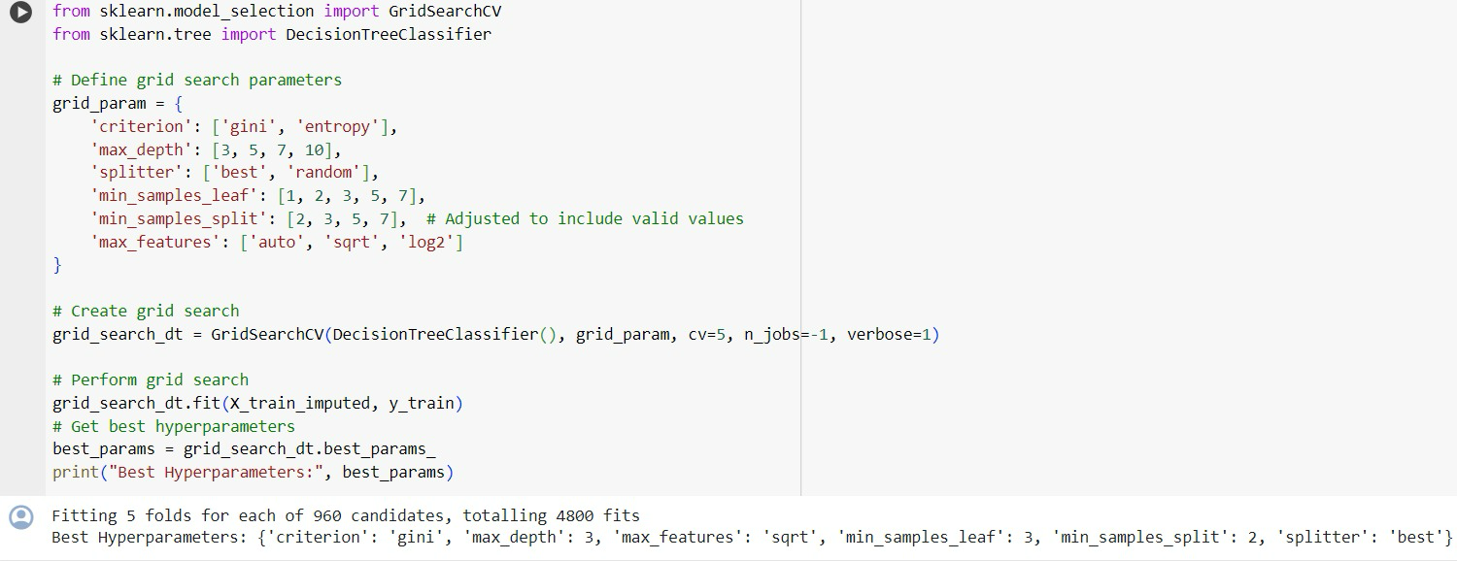

Slide 31
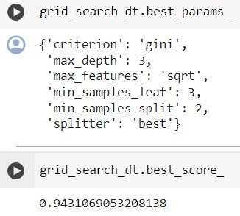

Slide 32
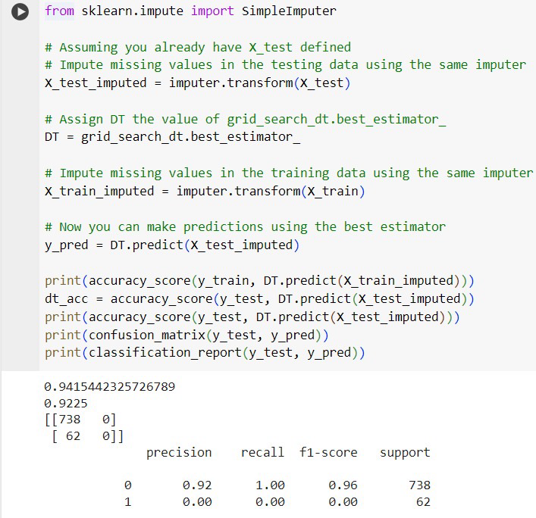

Slide 33
Impute Missing Values in Testing Data:It imputes missing values in the testing data (X_test) using the same imputer (imputer) that was previously fitted to the training data. The transformed data is stored in X_test_imputed.Assign Best Estimator to Decision Tree:It assigns the best estimator found during the grid search (grid_search_dt.best_estimator_) to the variable DT.Impute Missing Values in Training Data:It imputes missing values in the training data (X_train) using the same imputer (imputer). This ensures consistency in data preprocessing between training and testing sets. The transformed data is stored in X_train_imputed.Make Predictions Using Best Estimator:It makes predictions on the imputed testing set (X_test_imputed) using the best estimator (DT), storing the predictions in y_pred.Print Evaluation Metrics:It prints various evaluation metrics, including accuracy scores, confusion matrix, and classification report:accuracy_score(y_train, DT.predict(X_train_imputed)): Accuracy score on the training set.accuracy_score(y_test, DT.predict(X_test_imputed)): Accuracy score on the testing set.confusion_matrix(y_test, y_pred): Confusion matrix on the testing set.classification_report(y_test, y_pred): Classification report on the testing set, including precision, recall, F1-score, and support for each class.In summary, this code performs data imputation on both the training and testing data, utilizes the best estimator obtained from grid search, and evaluates the performance of the model on the testing set using various metrics.

Slide 34
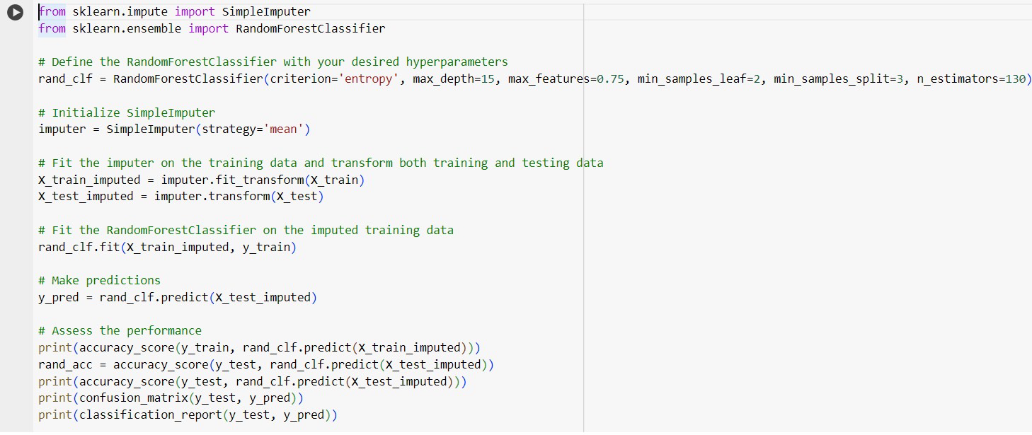

Slide 35
Define and Configure Random Forest Classifier:A RandomForestClassifier is defined with specific hyperparameters:criterion='entropy': The function to measure the quality of a split is entropy.max_depth=15: The maximum depth of the trees in the forest is set to 15.max_features=0.75: The maximum number of features to consider for splitting at each node is 75% of the total features.min_samples_leaf=2: The minimum number of samples required to be at a leaf node is set to 2.min_samples_split=3: The minimum number of samples required to split an internal node is set to 3.n_estimators=130: The number of trees in the forest is set to 130.Initialize Imputer and Perform Data Imputation:A SimpleImputer is initialized with the strategy set to 'mean'.The imputer is fitted to the training data (X_train) and then used to transform both the training and testing data (X_train_imputed and X_test_imputed, respectively). This handles missing values by replacing them with the mean of each feature.Fit Random Forest Classifier to Training Data:The RandomForestClassifier (rand_clf) is trained on the imputed training data (X_train_imputed) along with the corresponding target labels (y_train).Make Predictions:Predictions are made on the imputed testing data (X_test_imputed) using the trained random forest classifier, and the predicted labels are stored in y_pred.Evaluate Model Performance:The accuracy of the model is calculated and printed on both the training and testing sets.Additionally, the confusion matrix and classification report metrics are printed to assess the model's performance on the testing set.In summary, this code trains a Random Forest Classifier with specified hyperparameters, handles missing values in the dataset using mean imputation, makes predictions, and evaluates the model's performance on both the training and testing sets.

Slide 36
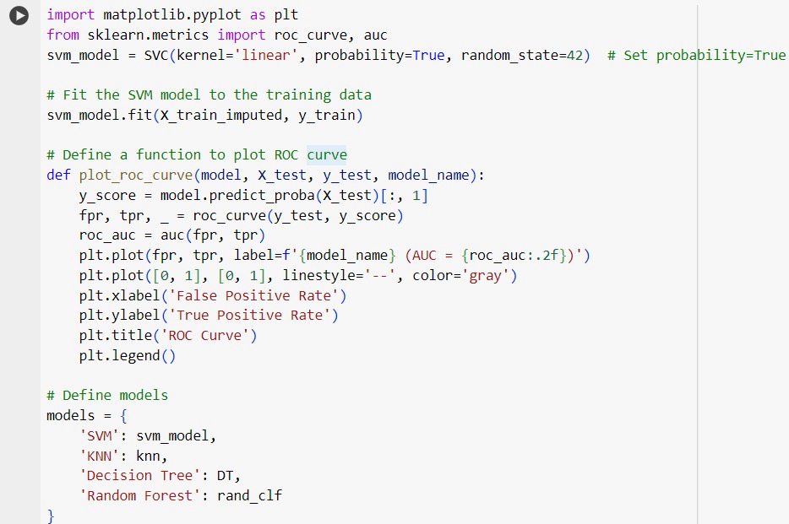

Slide 37
The code provided conducts a complete machine learning workflow using a Random Forest Classifier. Here's a breakdown of what each part of the code does:Define and Configure Random Forest Classifier:Initializes a RandomForestClassifier with specific hyperparameters:criterion='entropy': Uses entropy as the criterion for splitting.max_depth=15: Sets the maximum depth of trees in the forest to 15.max_features=0.75: Considers 75% of the total features for splitting at each node.min_samples_leaf=2: Sets the minimum number of samples required to be at a leaf node to 2.min_samples_split=3: Sets the minimum number of samples required to split an internal node to 3.n_estimators=130: Sets the number of trees in the forest to 130.Initialize Imputer and Perform Data Imputation:Initializes a SimpleImputer with the strategy set to 'mean'.Fits the imputer to the training data (X_train) and then transforms both the training and testing data (X_train_imputed and X_test_imputed, respectively), handling missing values by replacing them with the mean of each feature.Fit Random Forest Classifier to Training Data:Trains the RandomForestClassifier (rand_clf) on the imputed training data (X_train_imputed) along with the corresponding target labels (y_train).Make Predictions:Uses the trained random forest classifier to make predictions on the imputed testing data (X_test_imputed), storing the predicted labels in y_pred.Evaluate Model Performance:Calculates and prints the accuracy of the model on both the training and testing sets.Additionally, prints the confusion matrix and classification report metrics to assess the model's performance on the testing set.In summary, this code effectively implements a Random Forest Classifier, handles missing values through imputation, trains the model, makes predictions, and evaluates its performance on unseen data.

Slide 38
