Slide 1
GIT
www.InstigateMobile.com

Slide 2
Git History
Came out of Linux development community
Linus Torvalds, 2005
Initial goals:
  Speed
  Support for non-linear development (thousands of parallel branches)
  Fully distributed
  Able to handle large projects like Linux efficiently

Slide 3
First-Time Git Setup
Git comes with a tool called git config that lets you get and set configuration variables that control all aspects of how Git looks and operates. These variables can be stored in three different places:
  /etc/gitconfig file:
  ~/.gitconfig file:
  config file in the Git directory (that is, .git/config)
If you want to check your settings, you can use the git config --list command to list all the settings Git can find at that point:
  user.name=Username
  user.email=username@example.com
  …...

Slide 4


Git uses a distributed model
Centralized Model
Distributed Model
(Git, Mercurial)
(CVS, Subversion, Perforce)
Result: Many operations are local

Slide 5

A Local Git project has three areas
Basic Workflow
Basic Git workflow:
Modify files in your working directory.
Stage files, adding snapshots of them to your staging area.
Do a commit, which takes the files as they are in the staging area and stores that snapshot permanently to your Git directory.
.
Unmodified/modified
Files
Staged
Files
Committed
Files
Note: working directory sometimes called the “working tree”, staging area sometimes called the “index”.

Slide 6

Git file lifecycle

Slide 7
Tagging
Like most VCSs, Git has the ability to tag specific points in history as being important. Generally, people use this
functionality to mark release points (v1.0, and so on).
Git uses two main types of tags: lightweight and annotated. A lightweight tag is very much like a branch that doesn’t change — it’s just a pointer to a specific commit. Annotated tags, however, are stored as full objects in the Git database.

Slide 8
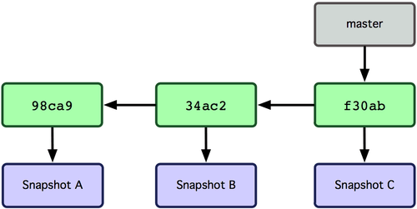
Git Branching
Nearly every VCS has some form of branching support. Branching means you diverge from the main line of development and continue to do work without messing with that main line.
A branch in Git is simply a lightweight movable pointer to one of these commits. The default branch name in Git is master.

Slide 9
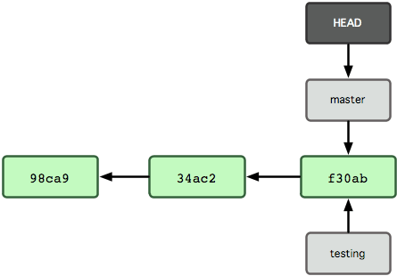
How does Git know what branch you’re currently on?
It keeps a special pointer called HEAD. Note that this is a lot different than the concept of HEAD in other VCSs you may be used to, such as Subversion or CVS. In Git, this is a pointer to the local branch you’re currently on. In this case, you’re still on master. The git branch command only created a new branch — it didn’t switch to that branch.

Slide 10
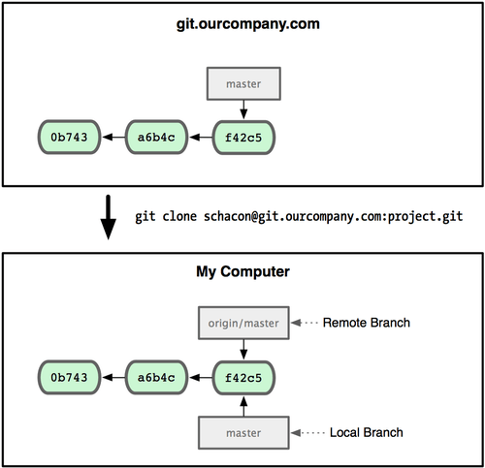
Remote Branches
Remote branches are references to the state of branches on your remote repositories. Remote branches act as bookmarks to remind you where the branches on your remote repositories were the last time you connected to them.

Slide 11
Git on the Server - The Protocols
Local Protocol
The SSH Protocol
Git can use four major network protocols to transfer data: Local, Secure Shell (SSH), Git, and HTTP.
The most basic is the Local protocol, in which the remote repository is in another directory on disk.
Probably the most common transport protocol for Git is SSH. This is because SSH access to servers is already set up in most places. SSH is also the only network-based protocol that you can easily read from and write to.

Slide 12
The Git Protocol
The HTTP/S Protocol
Next is the Git protocol. This is a special daemon that comes packaged with Git; it listens on a dedicated port (9418) that provides a service similar to the SSH protocol, but with absolutely no authentication.
Last we have the HTTP protocol. The beauty of the HTTP or HTTPS protocol is the simplicity of setting it up. Basically, all you have to do is put the bare Git repository under your HTTP document root and set up a specific post-update hook, and you’re done.

Slide 13
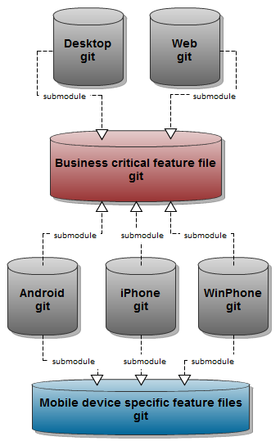
Git Submodules
It often happens that while working on one project, you need to use another project from within it. Perhaps it’s a library that a third party developed or that you’re developing separately and using in multiple parent projects. Submodules allow you to keep a Git repository as a subdirectory of another Git repository. This lets you clone another repository into your project and keep your commits separate.

Slide 14
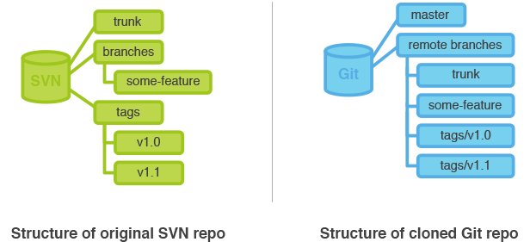
Git and Subversion
One of Git’s great features is a bidirectional bridge to Subversion called git svn. This tool allows you to use Git as a valid client to a Subversion server, so you can use all the local features of Git and then push to a Subversion server as if you were using Subversion locally. This means you can do local branching and merging, use the staging area, use rebasing and so on.

Slide 15
Git Resources
At the command line: (where verb = config, add, commit, etc.)
$ git help <verb>
$ git <verb> --help
$ man git-<verb>
Online books:
http://git-scm.com/book/en/Git-Basics
https://speakerdeck.com/schacon/wrangling-git

Slide 16
Instigate Mobile CJSC
58/1 K. Ulnetsu, Yerevan 0069, Armenia
www.instigatemobile.com
Armenia +374 60 464700
USA (VoIP) +1 408 625 7509
Germany (VoIP) +49 893 8157 1771

