Slide 1
Git Introduction
Git repository's path:
https://github.com/

Slide 2
Git History
Came out of Linux development community
Linus Torvalds, 2005
Initial goals:
  Speed
  Support for non-linear development (thousands of parallel branches)
  Fully distributed
  Able to handle large projects like Linux efficiently

Slide 3
First-Time Git Setup
Git comes with a tool called git config that lets you get and set configuration variables that control all aspects of how Git looks and operates. These variables can be stored in three different places:
  /etc/gitconfig file:
  ~/.gitconfig file:
  config file in the Git directory (that is, .git/config)

Slide 4
Checking Your Settings
If you want to check your settings, you can use the git config --list command to list all the settings Git can find at that point:
  $ git config --list
  user.name=Username
  user.email=username@example.com
  color.status=auto
  color.branch=auto
  color.interactive=auto
  color.diff=auto

Slide 5


Git uses a distributed model
Centralized Model
Distributed Model
(CVS, Subversion, Perforce)
(Git, Mercurial)
Result: Many operations are local

Slide 6


Git takes snapshots
Subversion
Git

Slide 7
Creating Git Repository
You can clone an existing repository by calling command $ git clone <repo_url> [working copy], where <repo_url> is the repository path
You can create repository by doing the following steps:
$ git init
$ git add <file1>
$ git commit -m “- Initial commit”

Slide 8

A Local Git project has three areas
Unmodified/modified
Files
Staged
Files
Committed
Files
Note: working directory sometimes called the “working tree”, staging area sometimes called the “index”.

Slide 9
Basic Workflow
Basic Git workflow:
Modify files in your working directory.
Stage files, adding snapshots of them to your staging area.
Do a commit, which takes the files as they are in the staging area and stores that snapshot permanently to your Git directory.
Notes:
If a particular version of a file is in the git directory, it’s considered committed.
If it’s modified but has been added to the staging area, it is staged.
If it was changed since it was checked out but has not been staged, it is modified.

Slide 10

Git file lifecycle

Slide 11
Viewing the Commit History
After you have created several commits, or if you have cloned a repository with an existing commit history, you’ll probably want to look back to see what has happened. The most basic and powerful tool to do this is the git log command.
  $ git log
  commit ca82a6dff817ec66f44342007202690a93763949
  Author: <Author(s) name(s)> <author@example.com>
  Date: <Date of commit>
    <Something is done.>

Slide 12
Showing Your Remotes
To see which remote servers you have configured, you can run the git remote command. It lists the shortnames of each remote handle you’ve specified. If you’ve cloned your repository, you should at least see origin — that is the default name Git gives to the server you cloned from.You can also specify -v, which shows you the URL that Git has stored for the shortname to be expanded to:
  $ git remote -v
  origin git://github.com/something.git (fetch)
  origin git://github.com/something.git (push)

Slide 13
Adding Remote Repositories
To add a new remote Git repository as a shortname you can reference easily, run git remote add [shortname] [url]:
  $ git remote
  origin
  $ git remote add pb git://github.com/something.git
  $ git remote -v
  origin git://github.com/something.git
  pb git://github.com/something_else.git

Slide 14
Removing and Renaming Remotes
If you want to rename a reference, in newer versions of Git you can run git remote rename to change a remote’s shortname. For instance, if you want to rename pb to paul, you can do so with git remote rename:
  $ git remote rename pb paul
  $ git remote
  origin
  paul
If you want to remove a reference for some reason — you’ve moved the server or are no longer using a particular mirror, or perhaps a contributor isn’t contributing anymore — you can use git remote rm:
  $ git remote rm paul
  $ git remote
  origin

Slide 15
Tagging
Like most VCSs, Git has the ability to tag specific points in history as being important. Generally, people use this functionality to mark release points (v1.0, and so on).

Slide 16
Creating Tags
Git uses two main types of tags: lightweight and annotated. A lightweight tag is very much like a branch that doesn’t change — it’s just a pointer to a specific commit. Annotated tags, however, are stored as full objects in the Git database. They’re checksummed; contain the tagger name, e-mail, and date; have a tagging message; and can be signed and verified with GNU Privacy Guard (GPG).

Slide 17
Annotated Tags
Creating an annotated tag in Git is simple. The easiest way is to specify -a when you run the tag command:
  $ git tag -a v1.4 -m 'my version 1.4'
  $ git tag
  v0.1
  v1.3
  V1.4
The -m specifies a tagging message, which is stored with the tag. If you don’t specify a message for an annotated tag, Git launches your editor so you can type it in.

Slide 18
Lightweight Tags
Another way to tag commits is with a lightweight tag. This is basically the commit checksum stored in a file — no other information is kept. To create a lightweight tag, don’t supply the -a, -s, or -m option:
  $ git tag v1.4-lw
  $ git tag
  v0.1
  v1.3
  v1.4
  v1.4-lw
  v1.5

Slide 19
Git Branching
Nearly every VCS has some form of branching support. Branching means you diverge from the main line of development and continue to do work without messing with that main line.
A branch in Git is simply a lightweight movable pointer to one of these commits. The default branch name in Git is master. As you initially make commits, you’re given a master branch that points to the last commit you made. Every time you commit, it moves forward automatically.

Slide 20
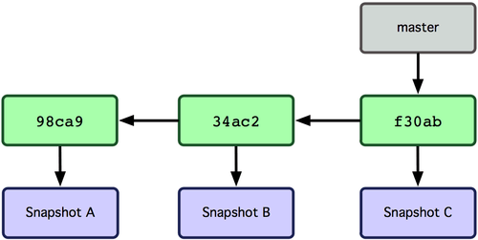

Slide 21
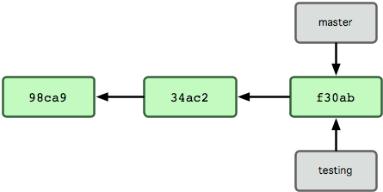
What happens if you create a new branch?
Well, doing so creates a new pointer for you to move around. Let’s say you create a new branch called testing. You do this with the git branch command:
  $ git branch testing
This creates a new pointer at the same commit you’re currently on.

Slide 22
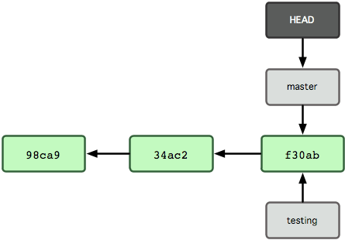
How does Git know what branch you’re currently on?
It keeps a special pointer called HEAD. Note that this is a lot different than the concept of HEAD in other VCSs you may be used to, such as Subversion or CVS. In Git, this is a pointer to the local branch you’re currently on. In this case, you’re still on master. The git branch command only created a new branch — it didn’t switch to that branch.

Slide 23
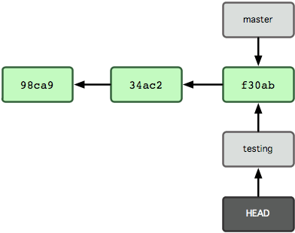
To switch to an existing branch, you run the git checkout command. Let’s switch to the new testing branch:
  $ git checkout testing
This moves HEAD to point to the testing branch.

Slide 24
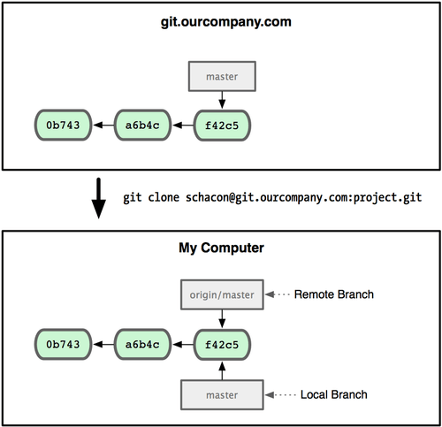
Remote Branches
Remote branches are references to the state of branches on your remote repositories. Remote branches act as bookmarks to remind you where the branches on your remote repositories were the last time you connected to them.

Slide 25
Git on the Server - The Protocols
Git can use four major network protocols to transfer data: Local, Secure Shell (SSH), Git, and HTTP.
Local Protocol
The most basic is the Local protocol, in which the remote repository is in another directory on disk.

Slide 26
The SSH Protocol
Probably the most common transport protocol for Git is SSH. This is because SSH access to servers is already set up in most places. SSH is also the only network-based protocol that you can easily read from and write to.

Slide 27
The Git Protocol
Next is the Git protocol. This is a special daemon that comes packaged with Git; it listens on a dedicated port (9418) that provides a service similar to the SSH protocol, but with absolutely no authentication.

Slide 28
The HTTP/S Protocol
Last we have the HTTP protocol. The beauty of the HTTP or HTTPS protocol is the simplicity of setting it up. Basically, all you have to do is put the bare Git repository under your HTTP document root and set up a specific post-update hook, and you’re done.

Slide 29
Git Submodules
It often happens that while working on one project, you need to use another project from within it. Perhaps it’s a library that a third party developed or that you’re developing separately and using in multiple parent projects. Submodules allow you to keep a Git repository as a subdirectory of another Git repository. This lets you clone another repository into your project and keep your commits separate.

Slide 30
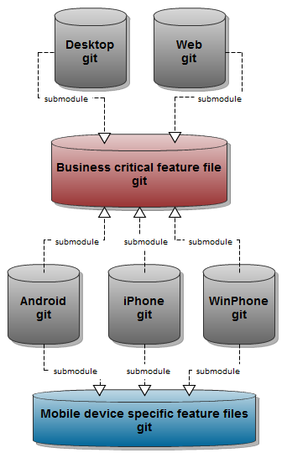

Slide 31
Git and Subversion
One of Git’s great features is a bidirectional bridge to Subversion called git svn. This tool allows you to use Git as a valid client to a Subversion server, so you can use all the local features of Git and then push to a Subversion server as if you were using Subversion locally. This means you can do local branching and merging, use the staging area, use rebasing and so on.

Slide 32
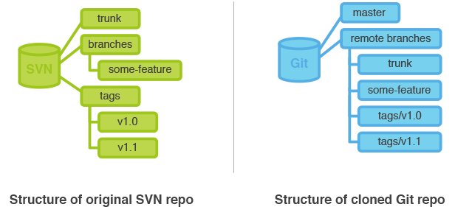

Slide 33
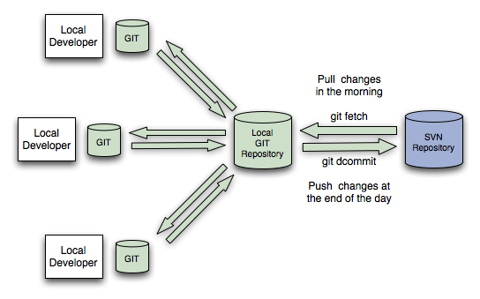
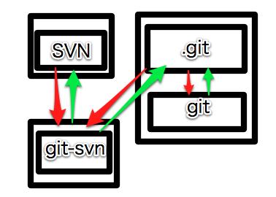

Slide 34
Git Resources
At the command line: (where verb = config, add, commit, etc.)
$ git help <verb>
$ git <verb> --help
$ man git-<verb>
Online books:
http://git-scm.com/book/en/Git-Basics
https://speakerdeck.com/schacon/wrangling-git

