Slide 1
Profiling FHE Schemes and Frameworks
Cory Brynds

Slide 2
Outline
1 FHE Libraries and Frameworks
2 Scheme profiling

Slide 3
FHE Frameworks
HE Libraries
HElib
SEAL
OpenFHE
Higher-level frameworks
IBM HELayers
Zama Concrete

Slide 4
HELib
Supports the following schemes:
BGV with bootstrapping
CKKS

Slide 5
Microsoft SEAL
Supported schemes:
BFV
BGV
CKKS

Slide 6
OpenFHE
Supports the following schemes:
BFV
BGV with bootstrapping
CKKS
TFHE
FHEW
Succeeded PALISADE in 2022
Integrated aspects of HELib and HEAAN

Slide 7
HE Frameworks: HE Layers and Concrete
Frameworks for building user applications with FHE
Examples: machine learning inferencing, data analytics
Abstracts many of the crypto parameters and scheme implementations

Slide 8


Concrete: FHE Compiler
Open-source framework implementing TFHE
TFHE compiler (LLVM based) for building user applications
FHE programs can be written with simple Python code
CPU and GPU support

Slide 9
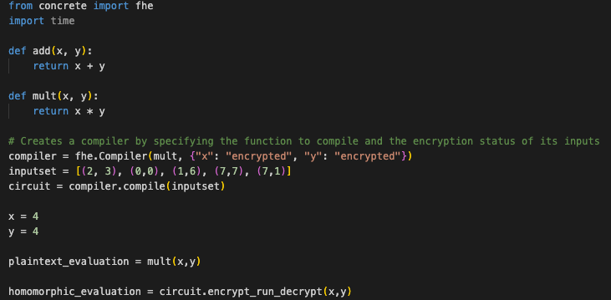
Concrete: Multiplication Example
Notes:
Input set is used to help the compiler determine the bit widths and shapes of the variables within the function

Slide 10



Concrete: Homomorphic Multiplication Performance

Slide 11
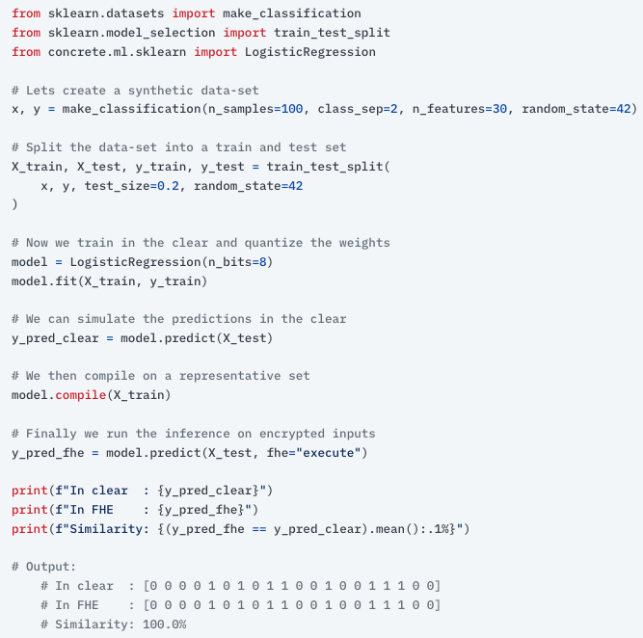
End-User Application: Concrete ML
Open-source ML inference framework
Can turn ML models into FHE equivalents
i.e. Pytorch model to FHE model
Useful for data scientists without cryptographic background
<- Example from Zama.ai: classification on encrypted data using logistic regression

Slide 12
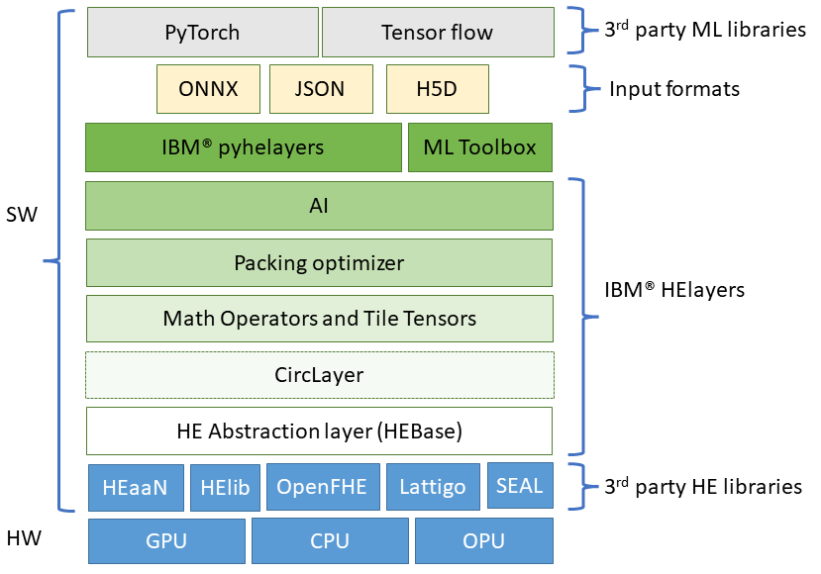
IBM HElayers
Adds functionality to lower-level HE libraries such as OpenFHE, SEAL, and HElib
CPU and GPU support
Available under a community license for non-commercial use, not open-source

Slide 13
HE Frameworks: Relevance to our Research
For the application phase (testing optimized NTT architecture for ML/GEMM operations)
Comparing the speedup of our architecture for a given scheme against an end-user ML framework (Concrete or HE Layers)
Could compare our custom architecture against CPU and GPU implementations
Need to determine which library (OpenFHE, likely) and framework to use for comparing and profiling performance

Slide 14
What Else I’ve Been Working On
Writing programs in C++ to understand modular multiplication, reduction, NTT, and butterfly algorithms
Reading papers about profiling different schemes for performance and security

Slide 15

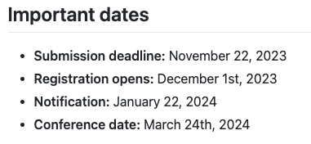
3rd Annual FHE.org Conference
3rd annual FHE.org conference in Toronto, Canada on March 24th, 2024
Accepting presentation proposals

Slide 16
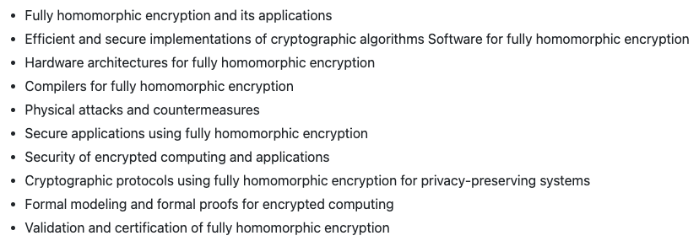
Submission Topics of Interest

Slide 17
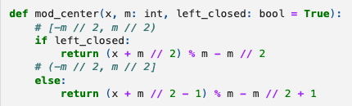
Side note from last week: Modulus Centering
Modulus centering used to change integer coefficient space from [0, q - 1] to [-q/2, q/2)
Symmetric range can be used to simplify certain calculations and is implemented in most HE schemes

Slide 18
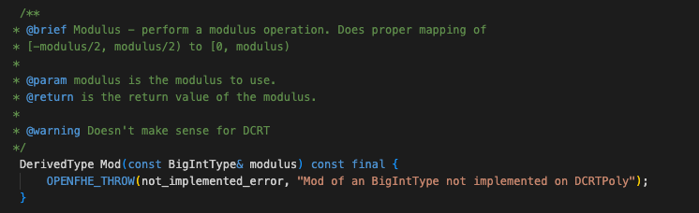
Side note from last week: Modulus Centering

