Slide 1
The Cory Update: Execution Time and Performance Counters
11/3/2023

Slide 2
Outline
1 Profiling Levels
2 Execution time of FHE operations
3 Stack tracing with Linux perf counter and FlameGraph

Slide 3
Profiling Levels
Higher-Level Applications (Helayers)
GEMM for DL, data analytics, other end-use cases
Profile memory accesses at a higher level application
Identify any performance bottlenecks
FHE Operations
Encryption/decryption, key generation, addition, multiplication
Scheme-Specific Operations
Bootstrapping, relinearization, rotation, rescaling, scheme switching
Modular Arithmetic
(Add, mult, inverse)
Polynomial Operations (NTT, iNTT, precompute)
Modular Arithmetic
(Add, mult, inverse)
Polynomial Operations (NTT, iNTT, precompute)
Determine which operations are being called most frequently

Slide 4
Profiling Tools
Within OpenFHE
Google benchmark
Google test
Google performance tools
Linux perf tool
Intel performance counter monitor (PCM)
FlameGraph to visual stack trace

Slide 5
Performance Graphs
Integer Arithmetics
NTT Operations
Polynomial Operations
BGV vs CKKS operations
*All of the following evaluations were performed on my personal computer, so performance may vary. Will use Unary Lab computer in the future until we have access to an AMD server

Slide 6
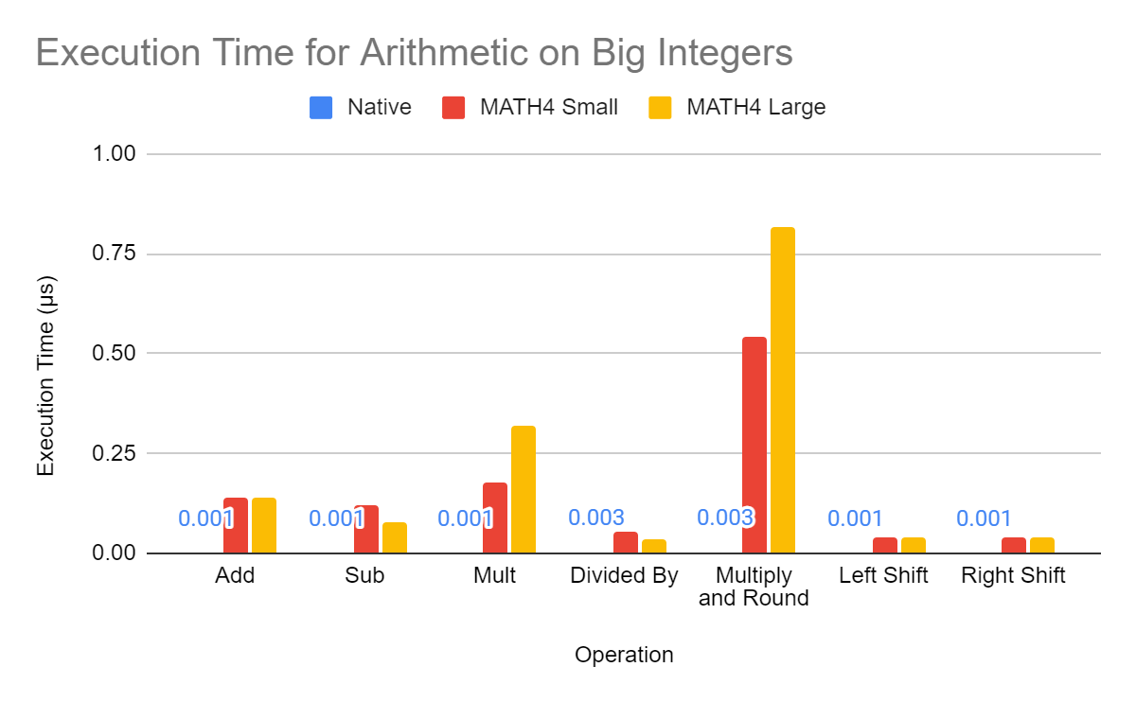
Integer Arithmetic
From openfhe-development\benchmark\src\IntegerMath.cpp
Representation | Operand 1 | Operand 2 | Modulus
64-Bit Integer | 10403 | 103 | 101101
BigInteger (small) | 10403 | 103 | 101101
BigInteger (large) | 18446744073709551616 | 18446744073709551617 | 1844674407370955471617

Slide 7
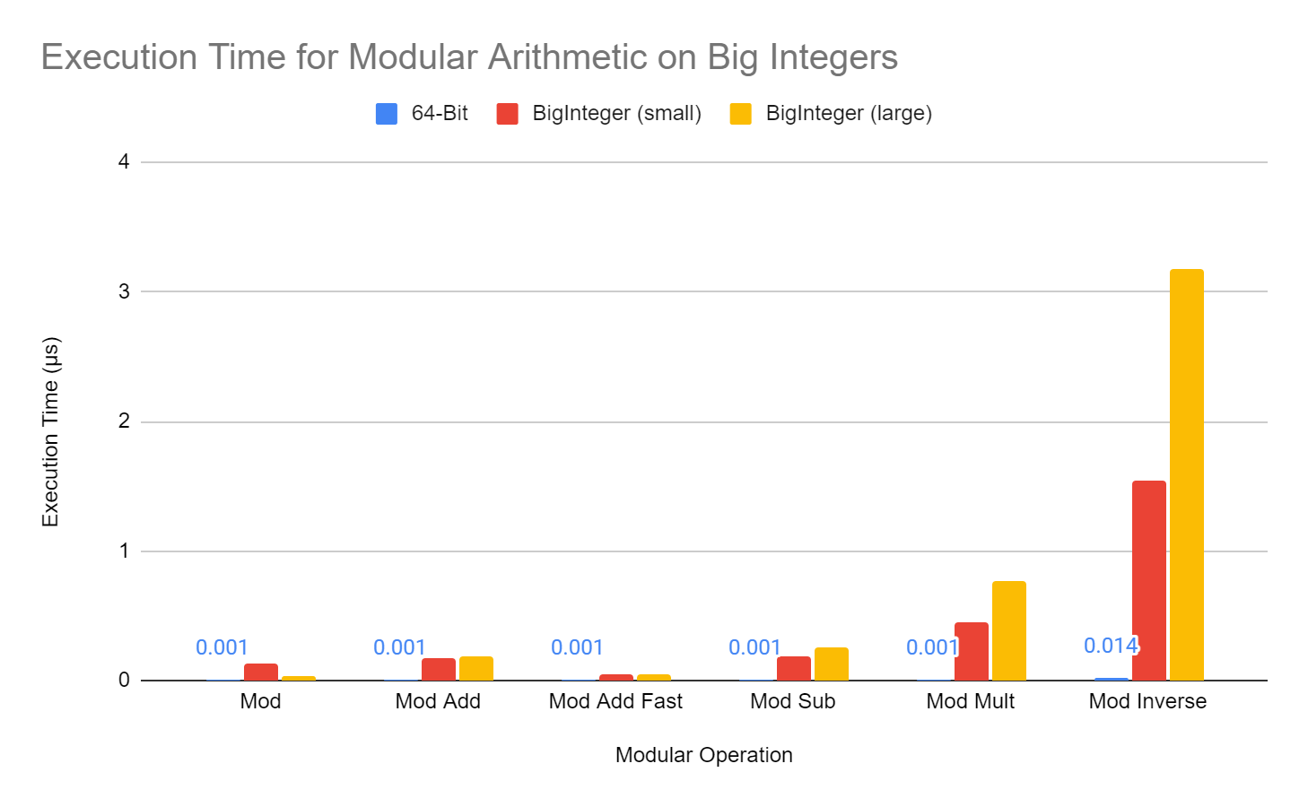
Integer Modular Arithmetic
From openfhe-development\benchmark\src\IntegerMath.cpp

Slide 8
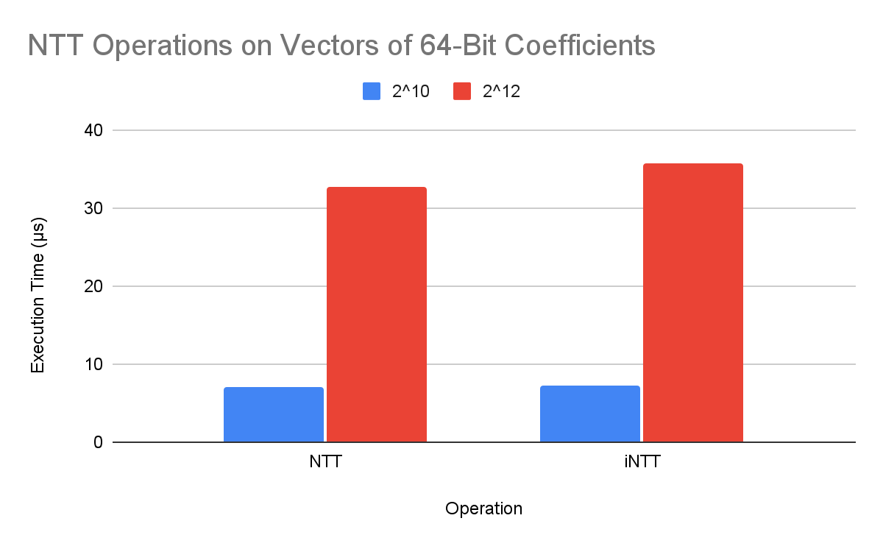
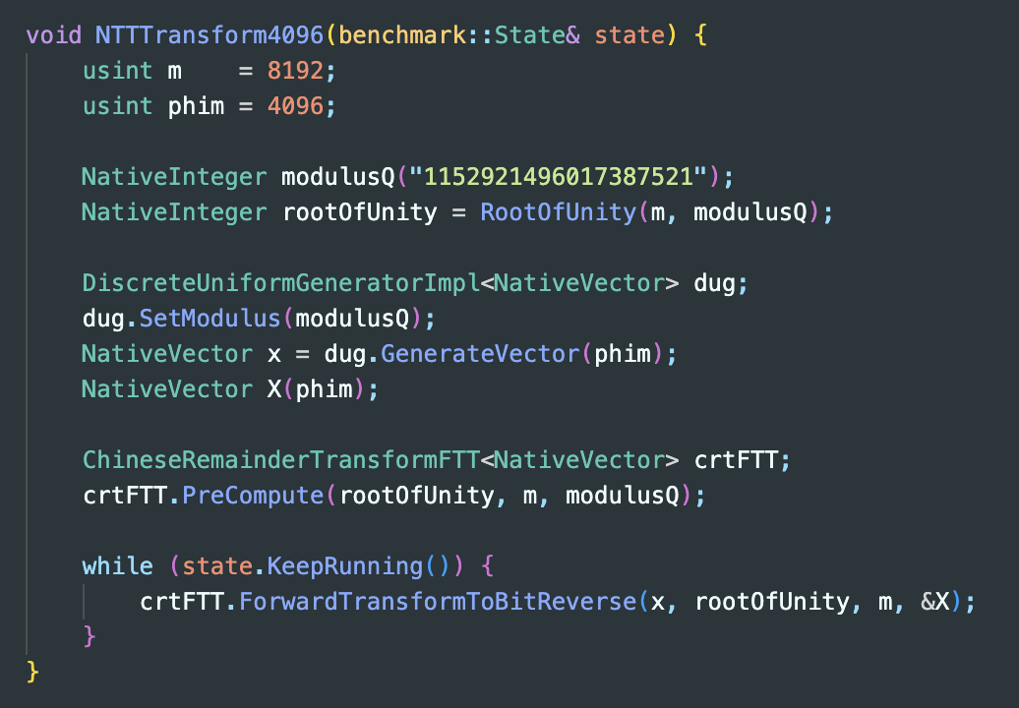
NTT Performance
Degree of 2^10: Modulus = 288230376151748609
Degree of 2^12: Modulus = 1152921496017387521
From openfhe-development\benchmark\src\lib-benchmark.cpp

Slide 9
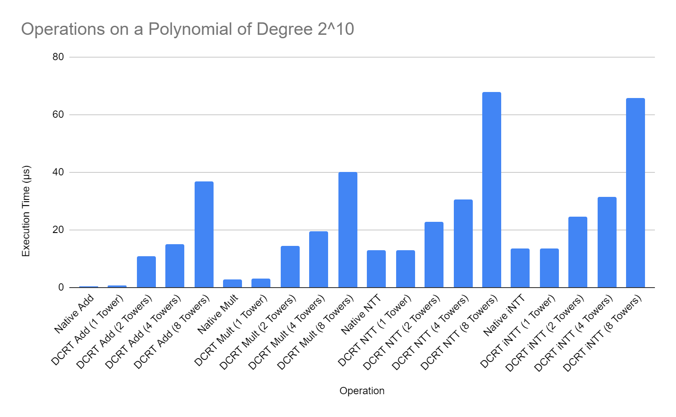
Polynomial Operations for n = 2^10
From openfhe-development\benchmark\src\poly-benchmark-1k.cpp
Maximum modulus size is 2^60 (60 bits)
Coefficients are generated using a discrete uniform generator

Slide 10
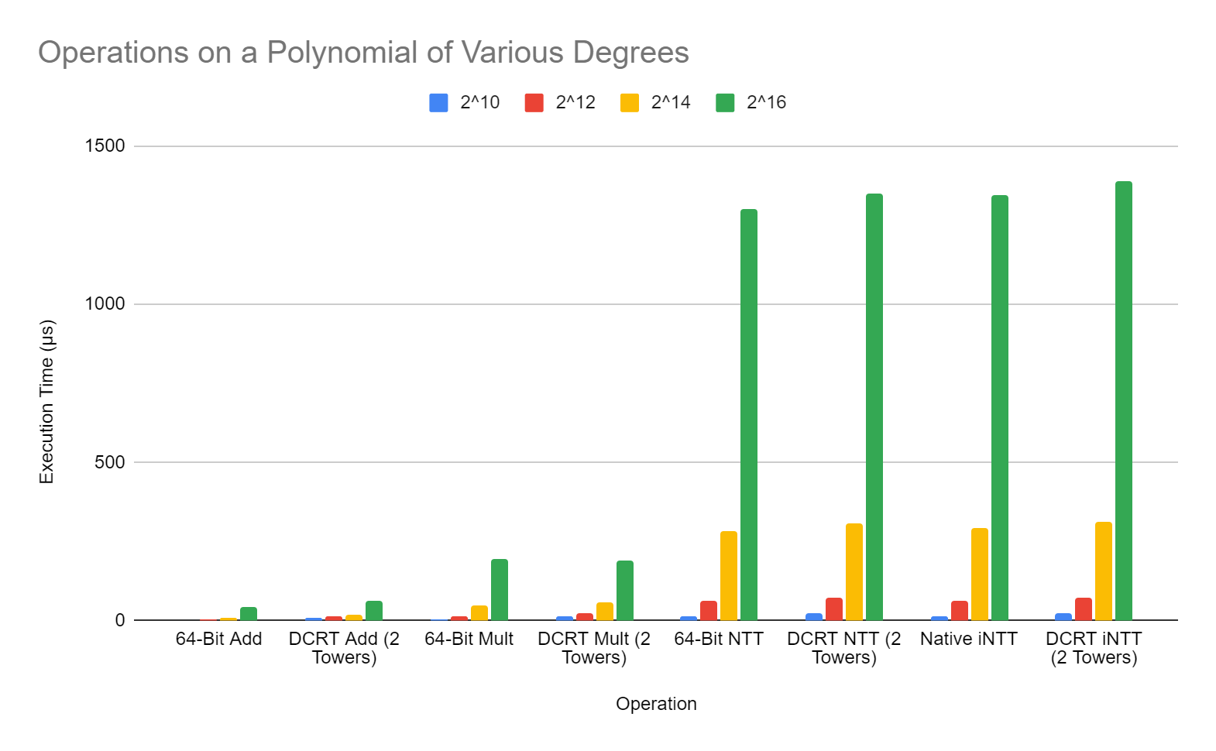
Polynomial Operations
From openfhe-development\benchmark\src
Maximum modulus size is 2^60 (60 bits)
Coefficients are generated using a discrete uniform generator

Slide 11
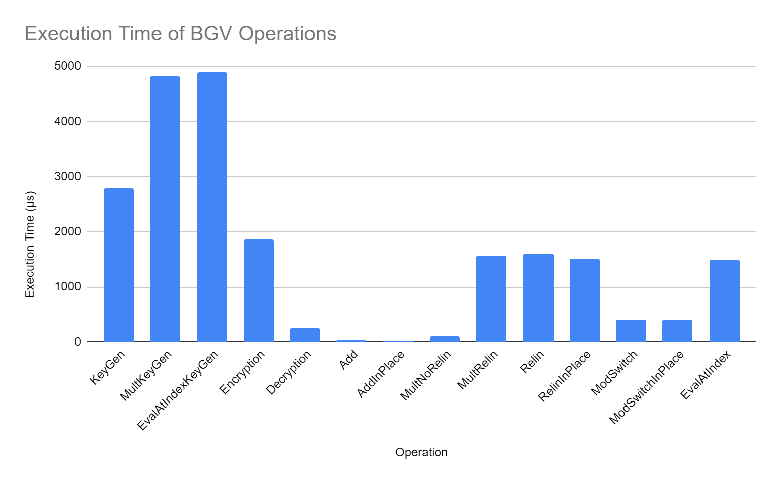
BGV Performance
From openfhe-development\benchmark\src\lib-benchmark.cpp

Slide 12
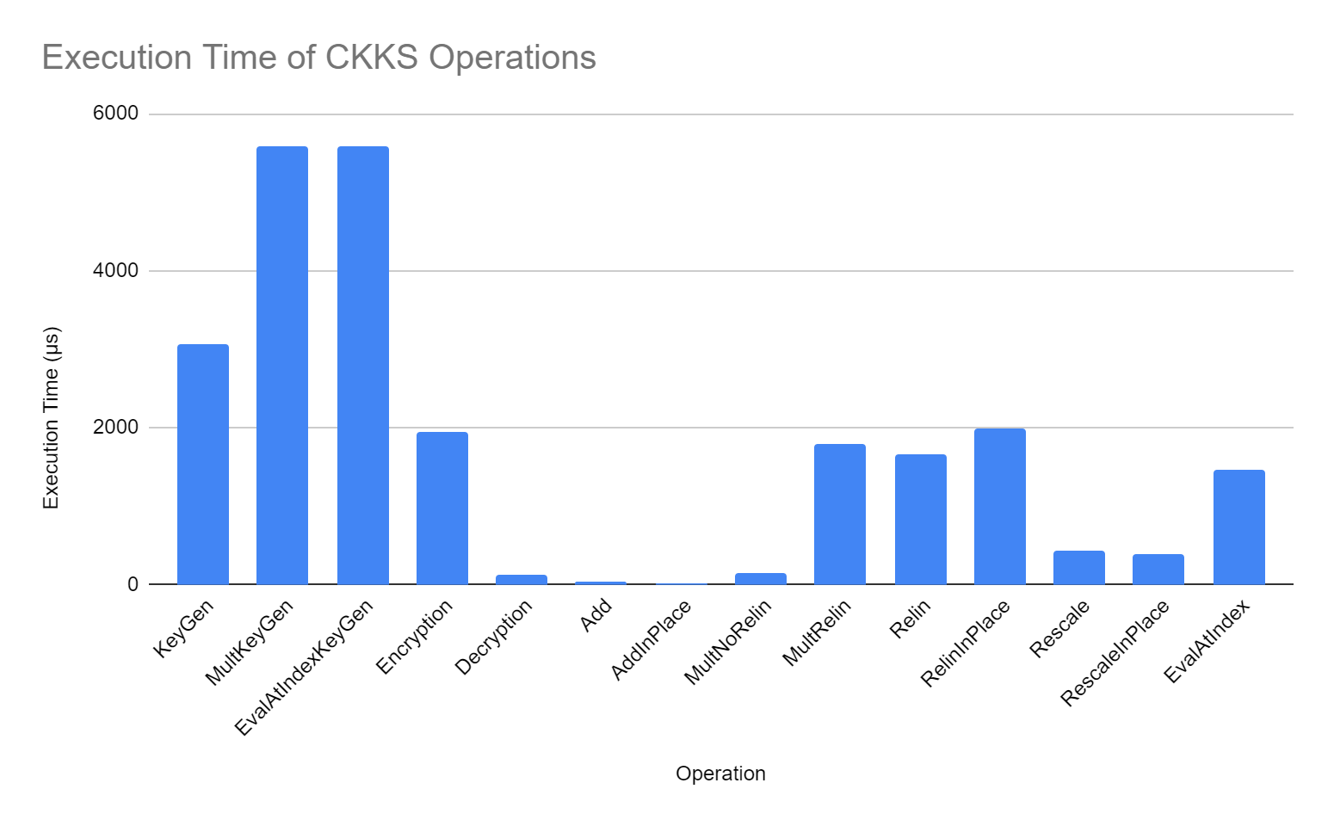
CKKS Performance
From openfhe-development\benchmark\src\lib-benchmark.cpp

Slide 13
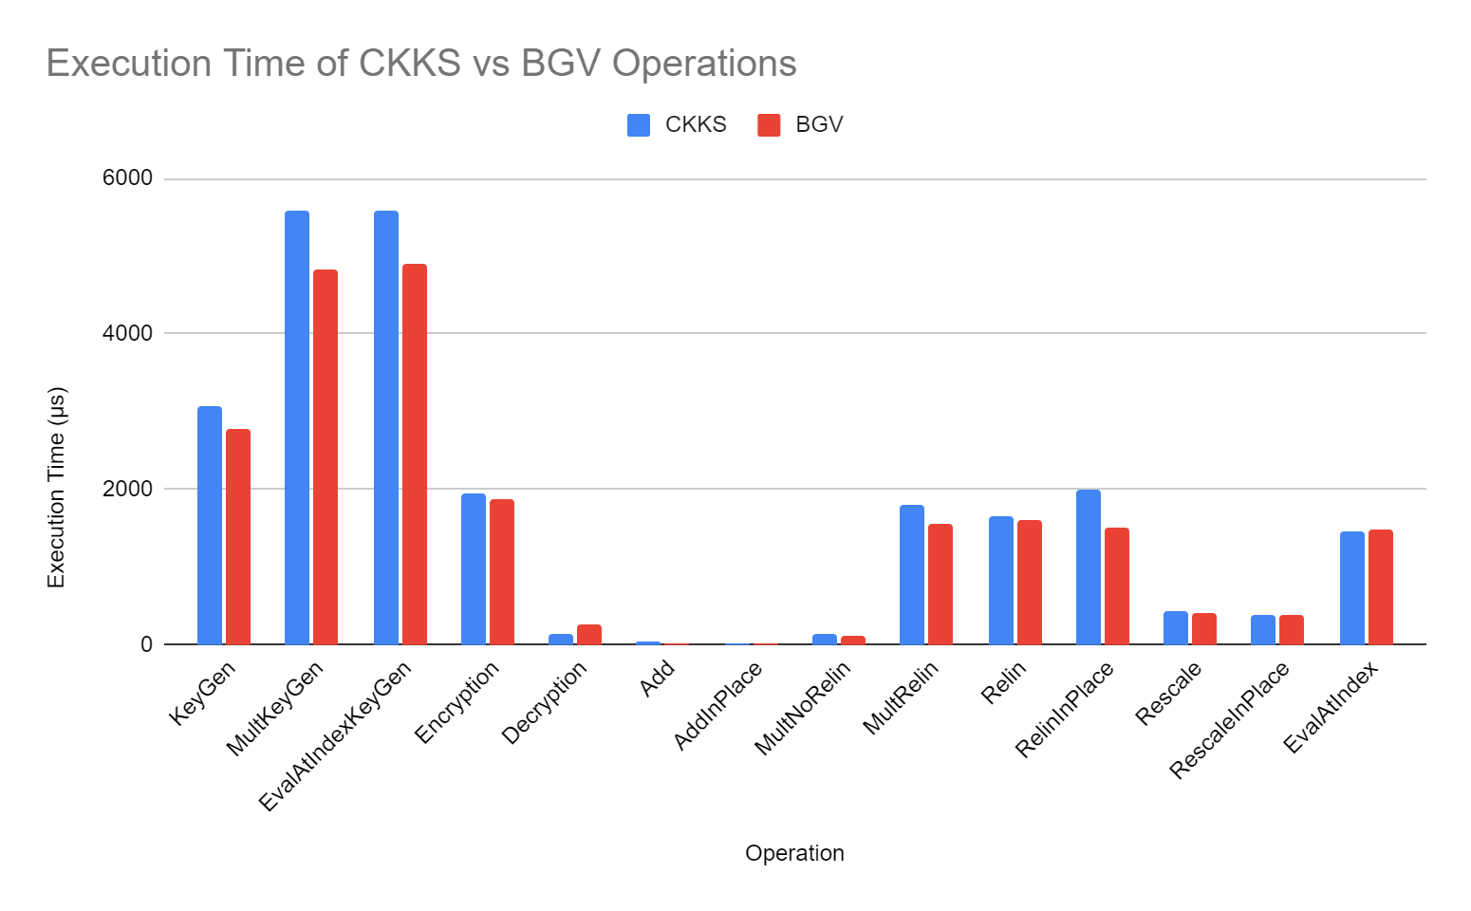
BGV vs CKKS Performance
From openfhe-development\benchmark\src\lib-benchmark.cpp

Slide 14
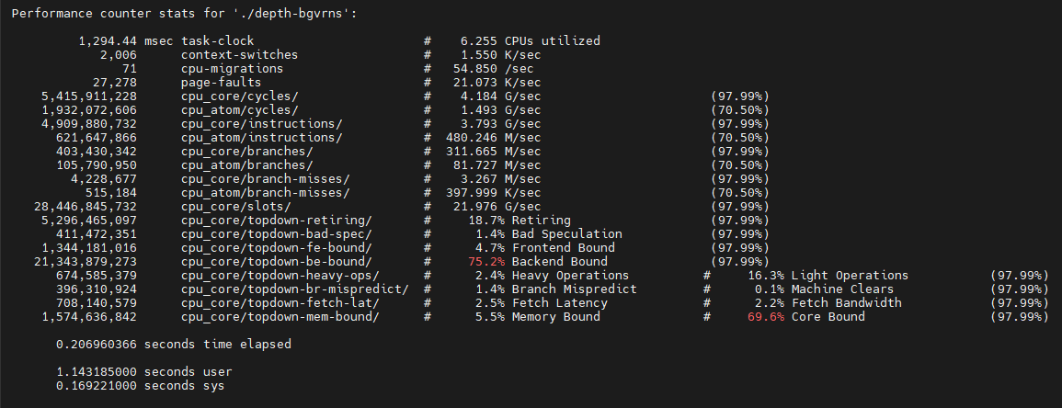
Linux Perf Counter for depth-bgvrns.cpp
*Ran on the Unary Lab remote server

Slide 15
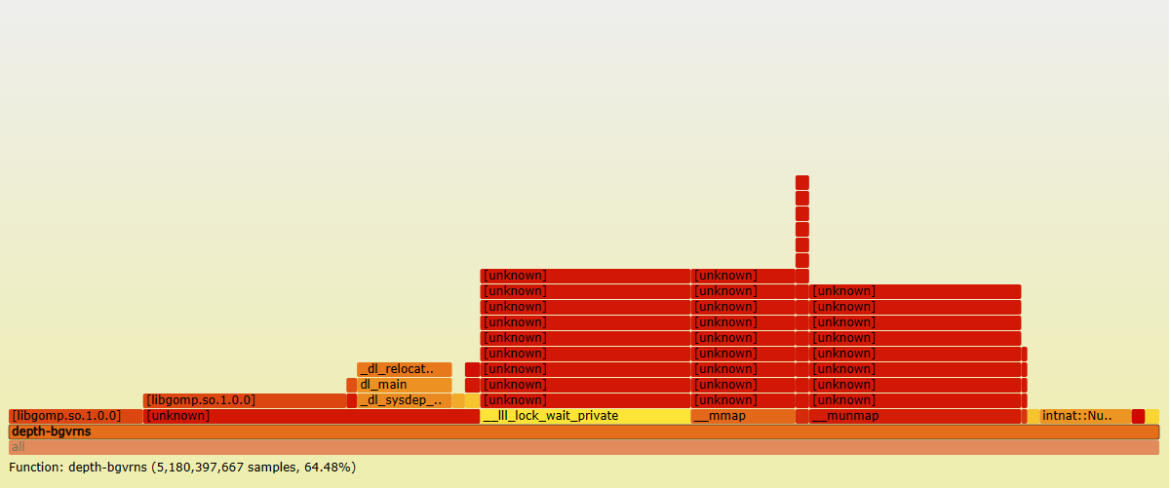
Function Call Visualization with FlameGraph

Slide 16
Next Week’s Goals
Profile and plot memory usage and other performance metrics for HE operations (KeyGen, Add and Mult)
Create FlameGraphs to visualize function calls
Identify any performance bottlenecks at each profiling level
Perform future profiling on Unary Lab computer until AMD server becomes available
Set up Helayers to profile higher-level applications

