Slide 1
Weather Forecast App
By: Mariam Safwat

Slide 2
Introduction
This project is a weather forecast that detect user's geographical location using ipinfo.io API then show a summary of the current weather using worldweatheronline API.
The user can also enter any city name to show a summary of the current weather of the selected city.
Github repo link: https://github.com/MariamSafwat/WeatherForecastApp

Slide 3
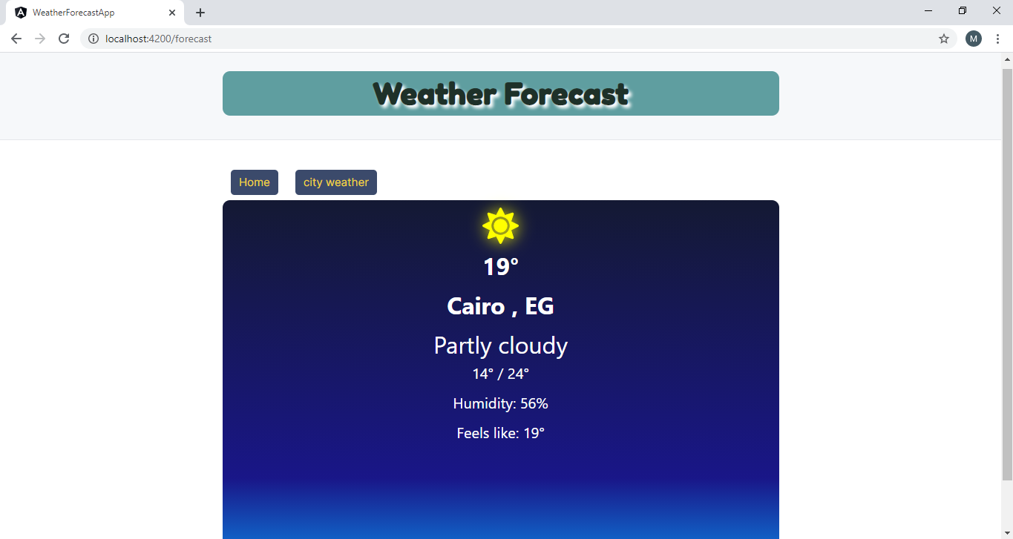
Output
Landing Display:
Detects user’s geographical location and show a summary of the current weather

Slide 4
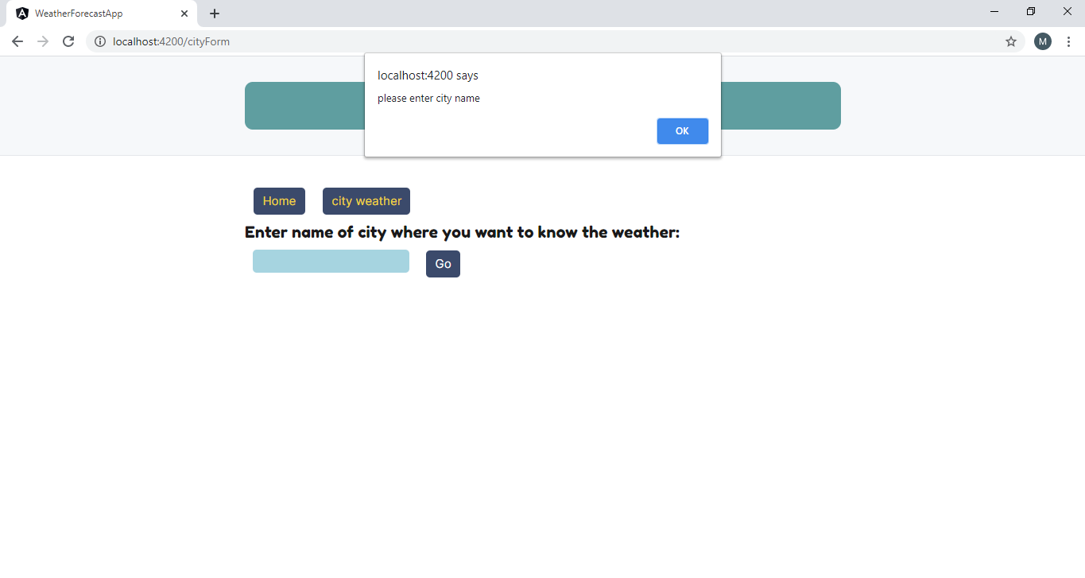
City weather Display:
User can write any city name to display the weather there, if they didn’t provide a name the app will alert an error.

Slide 5
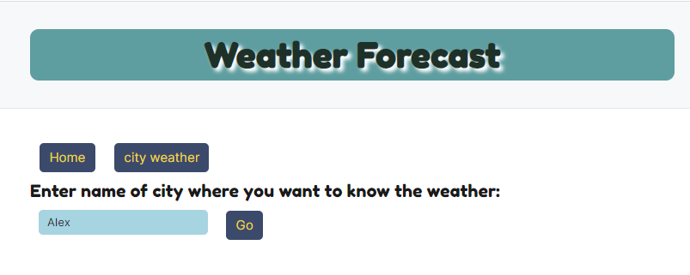
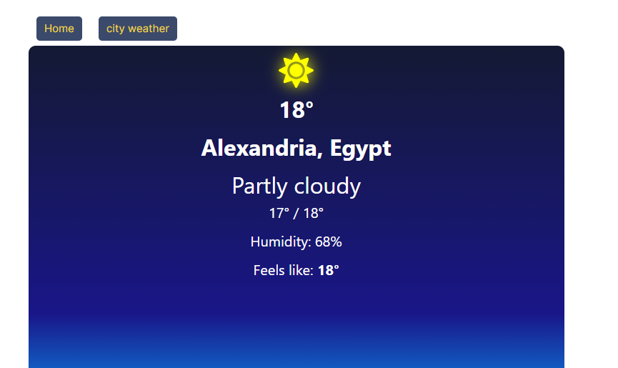
User can enter any city from any country then hit Go

Slide 6
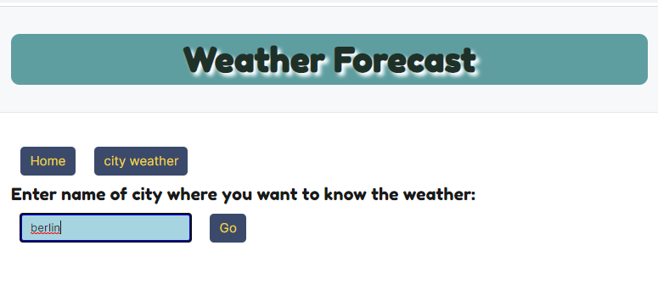


Slide 7
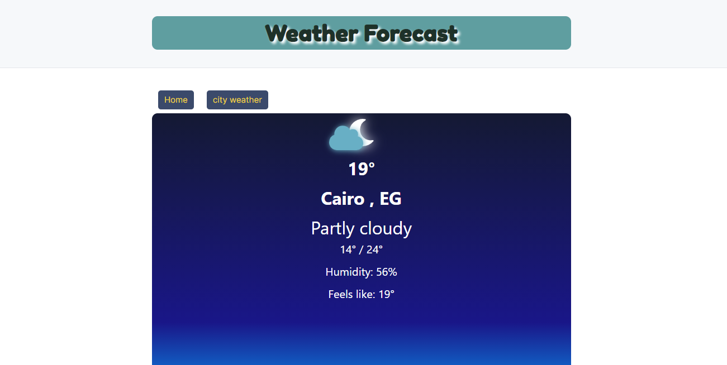
The display changes depending on time; if it is day time sun icon will be displayed, while at night moon and moving cloud will be displayed

Slide 8
Thank you

