Slide 1
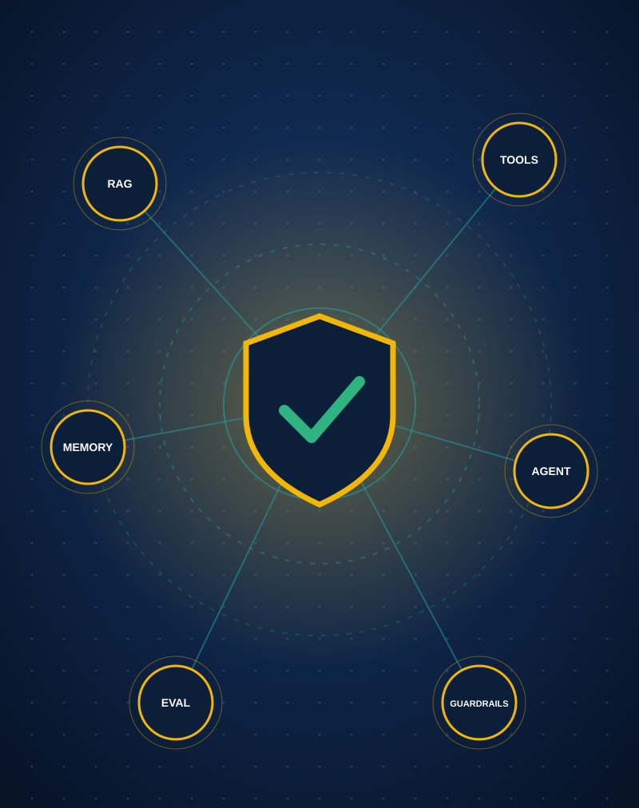
Centenary Bank AI Agentic Help Desk
GROUP B – EVE | BSE4104 AI-NATIVE & AGENTIC ENGINEERING CAPSTONE
A bounded helpdesk agent for customer support using a model, retrieval, tools, memory, and guardrails.
Group Members
Wambui Mariam : 23/U/18494/PS
Mugoya Yusuf : 23/U/11615/EVE
Ssenoga Herman : 23/U/17648/EVE
Walusimbi Ashraf : 23/U/18466/EVE
Makerere University | College of Computing and Information Sciences
Notes:
[Opening - ~30 seconds]
Good day everyone. We are Group B, and this is the Centenary Bank AI Agentic Helpdesk.
This project is not a generic chatbot. It is a bounded support system built to help a bank customer with safe, grounded, traceable support tasks, using a model, retrieval, tools, memory and guardrails.
Over the next 12 to 15 minutes we will cover the problem, our architecture, a live workflow, our evidence, a real failure, and our guardrails.

Slide 2




Problem, target user and why AI is justified
Problem
Target user
Why AI is justified
Bank customers present high daily volumes of repetitive support questions. Because existing channels lack instant automated resolution, they face long response delays, while support officers are overwhelmed by manual queries.
A Centenary Bank customer seeking help with a service issue through a safe digital support channel. A support officer receives the cases the agent cannot safely complete.
AI understands the message, classifies the intent, retrieves the right information from a trusted knowledge base and routes the request to the right approved action, reducing repetitive support work.
Why deterministic software still matters
The model does not decide high-impact actions. Ownership checks, authorization, scope boundaries and approval control stay rule-based.
Key boundary
Support and case handling only. No unauthorised financial actions, loan approvals, transfers, account data changes or revealing credentials.
Notes:
[Problem, target user, why AI - ~1.5 minutes]
Bank customers often need quick help with account questions, ticket status, branch information, mobile banking issues or service issues. These requests may arrive with incomplete context, ambiguity, or safety concerns.
Our target user is a Centenary Bank customer seeking help with a service issue through a safe digital support channel. A second user is the support officer, who receives the cases the agent cannot safely complete.
Why is AI justified? AI is useful for understanding the user message, classifying the intent, retrieving the correct information from a trusted knowledge base, and routing the request to the right approved action. It helps reduce repetitive support work and speeds up response time.
But deterministic software still matters. The system does not allow the model to decide high-impact actions on its own. Ownership checks, authorization, scope boundaries and approval control are rule-based.
Our key boundary: the agent may help with support and case handling, but it cannot perform unauthorised financial actions, approve loans, transfer money, change account data, or reveal credentials.

Slide 3



System architecture
6
Guardrails: action and tool allow-lists, scope checks, prompt-injection detection, iteration limit
Customer
asks, gets a reply
5
Memory and state
customer context and prior cases; not authorization
4
Bounded agent controller
1 Load memory
2 Classify intent
3 Select approved action
Support officer
human approval and hand-over
4 Execute tool
5 Observe result
6 Stop and respond
6
Trace log and evaluation
7 logged events per run; Week 7 harness with 30 scenarios
1
2
3
Model layer
RAG / context
Approved tools
Support tickets
simulated with test accounts and sample data
Scripted planner in the demo; live Gemini variant in the README
Controlled knowledge corpus; grounded answers
create_support_ticket, get_ticket_status, knowledge retrieval
Notes:
[Architecture - ~2 minutes. Walk the diagram left to right, then top to bottom; the numbers match the six layers]
Our architecture follows a bounded progression from model to evaluation.
The customer's request enters the bounded agent controller, layer four. The controller manages the request lifecycle: load memory, classify intent, select an approved action, execute the tool, observe the result, and stop safely. Requests it cannot safely complete, or that need approval, are handed to a human support officer.
Layer one, the model layer, interprets the request and proposes an action. For reproducibility the demo uses a scripted planner, while the README also documents a live Gemini-based variant.
Layer two, the RAG and context layer, retrieves support information from a controlled knowledge corpus, so the agent stays grounded in approved content instead of relying only on the model's memory.
Layer three, the tool layer, uses explicit, approved tools for ticket creation, ticket status lookup and knowledge retrieval. It does not expose arbitrary actions.
Layer five, memory and state, stores customer context and prior case information. It gives continuity for returning customers, but memory does not grant approval or override guardrails.
Layer six, evaluation and guardrails. The dashed boundary around the controller shows the guardrails: action and tool allow-lists, scope enforcement, prompt-injection detection and iteration limits. Alongside it, the trace log and the Week 7 evaluation harness make the agent inspectable.

Slide 4

Live workflow: creating a support ticket
Customer says
“My mobile banking app keeps crashing every time I try to log in.”
Week 6 demo output
[CLASSIFY_REQUEST]
intent='create_ticket' action=create_support_ticket
[EXECUTE_TOOL]
calling create_support_ticket
[OBSERVE_RESULT]
tool=create_support_ticket status=success code=OK
Final outcome: TICKET_CREATED
1
Loads the session; checks for prior customer memory
2
Classifies the request as creating a support ticket
3
Selects the approved action: create_support_ticket
4
Calls the ticket creation tool
Final response
“Your support ticket has been created: CS-10246.”
A real support workflow, completed in a bounded and controlled way.
5
Observes success
6
Writes a memory record and responds with a ticket number
Notes:
[Live end-to-end workflow, part 1 - ~2 minutes. Run the Week 6 demo here]
Here is the successful workflow from our Week 6 demo. A customer says: "My mobile banking app keeps crashing every time I try to log in."
Watch what the system does. It loads the session and checks whether the customer has prior memory. It classifies the request as creating a support ticket, and selects the approved action, create_support_ticket. It then calls the ticket creation tool and observes success. Finally it writes a memory record for the customer and responds with a support ticket number.
In the output you can see the CLASSIFY_REQUEST step with intent create_ticket, the EXECUTE_TOOL step, and OBSERVE_RESULT with status success and code OK. The final outcome is TICKET_CREATED, and the customer is told: "Your support ticket has been created: CS-10246."
This shows the system can complete a real support workflow in a bounded and controlled way.

Slide 5





Live workflow: memory and continuity
Returning customer says: “What is the update on my issue?”
1
2
3
4
Loads prior case information from memory
Finds the existing ticket associated with the customer
Uses the stored ticket ID without asking the user to repeat it
Checks ticket status
Week 6 demo output
Memory is not authorization
[MEMORY_LOADED]
1 prior case(s) found for this customer
ticket=CS-10245 status=in_progress category=mobile_banking
Final outcome: TICKET_STATUS_RETURNED
“Ticket CS-10245 — Status: in_progress.”
Memory improves continuity for a returning customer without creating authorization by itself.
Notes:
[Live end-to-end workflow, part 2 - ~2 minutes. Run the second Week 6 demo scenario]
Now a second scenario, showing memory. A returning customer says: "What is the update on my issue?"
The system loads prior customer case information from memory and finds the existing ticket associated with the customer. It uses the stored ticket ID without asking the user to repeat it, and checks the ticket status.
You can see MEMORY_LOADED reporting one prior case found, and the ticket CS-10245 with status in_progress and category mobile_banking. The final outcome is TICKET_STATUS_RETURNED, and the response reads "Ticket CS-10245, Status: in_progress."
This shows that memory can improve continuity for a returning support customer without creating authorization by itself.

Slide 6



Engineering evidence: inspectable traces
1
›
2
›
3
›
4
›
5
›
6
›
7
MEMORY_LOADED
CLASSIFY_REQUEST
SELECT_ACTION
EXECUTE_TOOL
OBSERVE_RESULT
RESPOND
MEMORY_WRITE
Example from the live demo
What the agent saw
[MEMORY_LOADED]
no prior cases — fresh customer session
[CLASSIFY_REQUEST]
intent='create_ticket' action=create_support_ticket
[EXECUTE_TOOL]
calling create_support_ticket
[OBSERVE_RESULT]
tool=create_support_ticket status=success
What it decided
Which tool it used
What result it obtained
The assignment emphasises evidence, traceability and explainability rather than a “black box” AI result.
Notes:
[Engineering evidence view - ~1 minute. Optionally show the trace live]
The project records structured trace evidence that makes the agent inspectable. Each run produces this log sequence: MEMORY_LOADED, CLASSIFY_REQUEST, SELECT_ACTION, EXECUTE_TOOL, OBSERVE_RESULT, RESPOND and MEMORY_WRITE.
This gives us visibility into what the agent saw, what it decided, which tool it used, and what result it obtained. Here is an example from the live demo: a fresh customer session, the intent classified as create_ticket, the call to create_support_ticket, and the observed success.
This matters because the assignment emphasises evidence, traceability and explainability rather than a black box AI result.

Slide 7






Evaluation evidence: the 30-scenario final set
30
Normal cases
Edge cases
Incorrect-information cases
scenarios in the final evaluation harness
Adversarial cases
Tool-failure cases
Unauthorized-action cases
Evidence in the repo
docs/evaluation/week7/Week_7_AI_Agent_Evaluation_Simple_Test_Cases.md
evidence/demo/centenary-agent-week6/week7_evaluation_harness.py
tests/week7/test_week7_evaluation_harness.py — asserts the configured scenarios total 30
Notes:
[Evaluation evidence - ~1 minute]
The assignment requires evaluation beyond a single happy path demo. The project includes a final evaluation harness designed to test the helpdesk agent across 30 scenarios.
These cover six categories: normal cases, edge cases, incorrect-information cases, adversarial cases, tool-failure cases, and unauthorized-action cases.
The evaluation set is defined in the Week 7 evaluation package and the harness script. In the repo you can find the Week 7 test cases document, the evaluation harness script, and a test that asserts the configured scenarios total 30.

Slide 8


Controlled failure: cross-customer access
CUST-HACKER
asks for the status of ticket CS-10245
Ownership check
trusted session identity
Ticket CS-10245
belongs to CUST-88213
What the system does
Week 6 demo output
1
Reads the customer identity from the trusted session context
[OBSERVE_RESULT]
tool=get_ticket_status status=success code=UNAUTHORIZED
Final outcome: AUTHORIZATION_DENIED
2
Calls the tool with the active customer identity
3
Detects the ticket does not belong to this customer
“I can only access tickets that belong to your account.”
4
Refuses access
Notes:
[Real failure / controlled recovery - ~2 minutes. Run this scenario in the Week 6 demo]
Now a real failure case from our Week 6 demo: cross-customer access control.
A customer with ID CUST-HACKER asks for the status of ticket CS-10245, which actually belongs to another customer, CUST-88213.
The system reads the session customer identity from the trusted session context, calls the tool with the active customer identity, detects that the ticket does not belong to this customer, and refuses access.
In the output, the tool returns code UNAUTHORIZED, the final outcome is AUTHORIZATION_DENIED, and the customer is told: "I can only access tickets that belong to your account."
This is important because the system does not simply trust the user's request. It enforces customer ownership and the human-safe boundaries of access.

Slide 9





Guardrails and human approval boundaries
Action allow-list
Tool allow-list
Scope boundary checks
27 PASS / 0 FAIL
in the guardrail demo
Evidence grounding checks
Prompt-injection detection
Credential non-disclosure
Blocked or refused
Transfer funds or approve a loan: blocked by scope
Memory-not-authorization
Escalation approval gate
Iteration limit
Passwords, OTPs or secrets: refused
Prompt-injection attempt: blocked
Human approval boundary: even when a case exists in memory, the escalation approval gate still runs before escalation is granted.
Notes:
[Guardrails, human approval boundaries and lessons - ~1.5 minutes]
The guardrails implemented in the project are: an action allow-list, a tool allow-list, scope boundary checks, evidence grounding checks, prompt-injection detection, credential non-disclosure, memory-not-authorization, an escalation approval gate, and an iteration limit.
From the repo, the guardrail demo reports 27 PASS and 0 FAIL. A request to transfer funds or approve a loan is blocked by scope. A request for passwords, OTPs or secrets is refused. A prompt-injection attempt is blocked.
On the human approval boundary: memory is not authorization. Even when a case exists in memory, the escalation approval gate still runs before escalation is granted. This is a key design principle in our project.
Key lesson: AI is valuable for support workflows when bounded by rules, evidence and human oversight. The model may help, but deterministic software and human review remain in control for high-risk decisions.

Slide 10
A bounded, evidence-driven prototype
What it does well
What it does not do
Classifies user intent
Automate financial transfers
Retrieves grounded information
Approve loans or account changes
Creates or checks support tickets
Uses state and memory sensibly
Claim private account data without an authorized path
Logs decisions and evidence
Operate as an unsupervised autonomous bank system
Blocks unsafe actions
Key lesson Useful AI support works best when it is bounded, inspectable, and controlled by deterministic software and human approval.
Questions?
Notes:
[Closing - ~30 seconds]
To close, this system should be presented as a bounded, evidence-driven AI helpdesk prototype, not as a production banking platform.
What it does well: it classifies user intent, retrieves grounded information, creates or checks support tickets, uses state and memory sensibly, logs decisions and evidence, and blocks unsafe actions.
What it does not do: it does not automate financial transfers, it does not approve loans or account changes, it does not claim private account data without an authorized path, and it does not operate as an unsupervised autonomous bank system.
The core lesson is that useful AI support works best when it is bounded, inspectable, and controlled by deterministic software and human approval. Thank you. We are happy to take your questions.

