Slide 1
Maternal Health
Risk Prediction
Using Machine Learning to Identify At-Risk Pregnancies
Presented By: Mariam Wambui
April 30, 2026
Introduction · Problem · Solution · Methodology · Dataset · Results · Limitations · Conclusions

Slide 2
INTRODUCTION
Background & Motivation
Global Burden
Maternal mortality remains a critical public health challenge worldwide. Many deaths are preventable when risk is identified early and managed proactively.
The Opportunity
Structured clinical data — vitals, lab results, medical history — contains strong predictive signals that traditional triage may overlook.
Our Approach
Apply supervised machine learning to a labelled maternal health dataset to build a binary risk classifier, then package results in an interactive dashboard.

Slide 3
PROBLEM STATEMENT
What Problem Are We Solving?
Core Problem
Maternal complications can develop rapidly and are not always apparent from a single vital sign. Clinicians need a data-driven tool to flag high-risk patients early.
Multi-factor Risk
Uneven Consequences
Accessibility
No single indicator is sufficient. Age, BP, blood sugar, BMI, and history must all be considered together.
Missing a high-risk patient (false negative) is far more costly than an unnecessary follow-up (false positive).
Prediction tools must be usable by non-technical healthcare staff, not just data scientists.

Slide 4
SOLUTION
Our Proposed Solution
A machine learning pipeline that classifies patients as High Risk or Low Risk — with an interactive dashboard that presents results in plain clinical language.
01
Data-Driven Classification
02
Multi-Feature Analysis
Two ML models trained on 1,205 patient records to produce a binary risk score.
11 clinical inputs — vitals, lab values, and medical history — considered simultaneously.
03
Explainable Output
04
Interactive Interface
Risk score, identified risk factors, and clinical summary generated for each prediction.
Gradio dashboard lets staff enter patient data and receive immediate risk assessment.

Slide 5
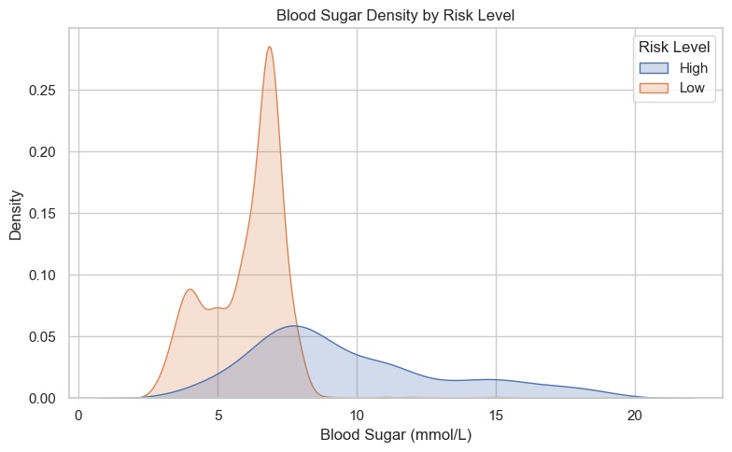
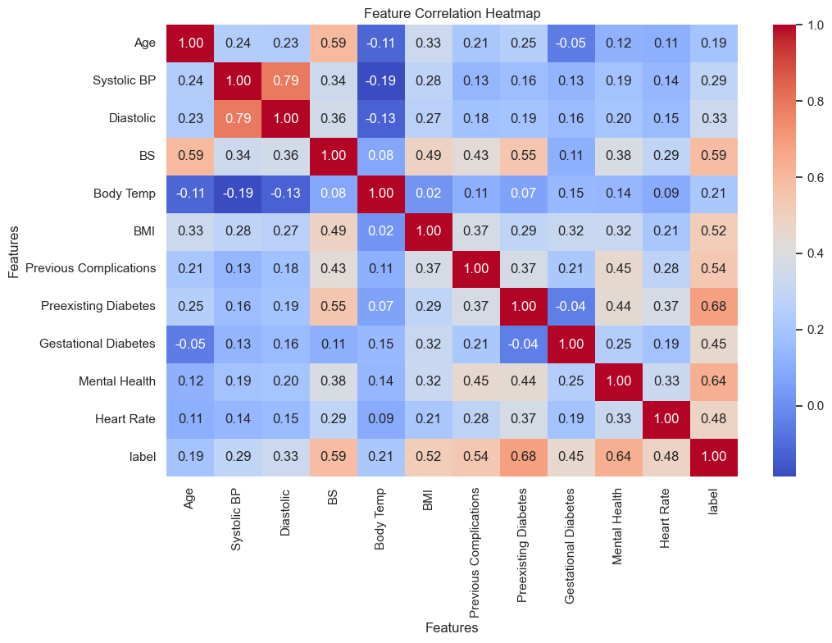
METHODOLOGY / SYSTEM ARCHITECTURE
Pipeline & System Architecture
Raw Data
Preprocessing
Model Training
Evaluation
Dashboard
1,205 records
11 features
Clean · Impute
Encode · Scale
Random Forest
Neural Network
Accuracy · AUC
F1 · Recall
Gradio UI
Risk Output

Slide 6
DATASET DESCRIPTION
About the Data (https://data.mendeley.com/datasets/p5w98dvbbk/1)
1,205
2
11
Patient Records
Risk Classes
Clinical Features
Features & Target
Age (years)
Systolic BP (mmHg)
Diastolic BP (mmHg)
Blood Sugar (mmol/L)
Body Temperature (°F)
BMI
Previous Complications
Preexisting Diabetes
Gestational Diabetes
Mental Health Flag
Heart Rate (bpm)
Target: Risk Level

Slide 7
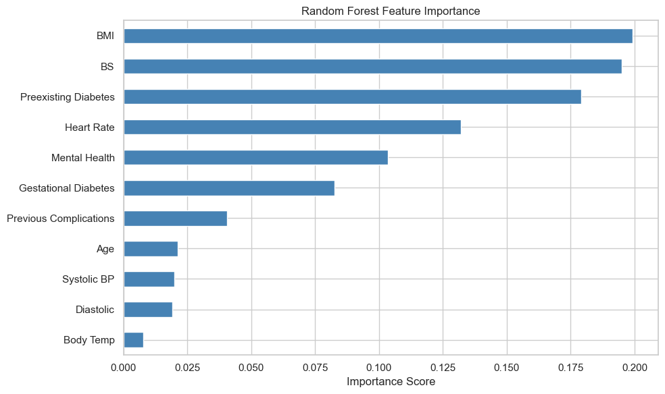
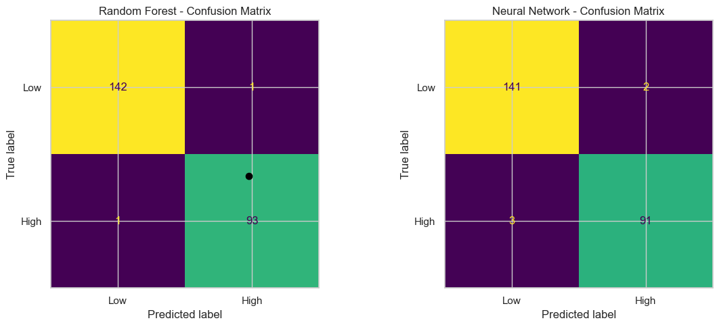
RESULTS
Random Forest — Evaluation
99.15%
98.94%
98.94%
98.94%
99.91%
Accuracy
Precision
Recall
F1 Score
ROC-AUC
Top Predictive Features
Confusion matrix
Pred Low
Pred High
Act High

Slide 8
RESULTS
Neural Network — Evaluation
97.89%
97.85%
96.81%
97.26%
99.90%
Accuracy
Precision
Recall
F1 Score
ROC-AUC
Model Architecture
Near-Perfect Discrimination
Keras Multilayer Perceptron (MLP)
ROC-AUC: 99.90%
Dense layers with Batch Normalisation
Dropout regularisation to reduce overfitting
A score above 0.99 indicates the model can almost perfectly distinguish high-risk from low-risk patients across all classification thresholds.
Early stopping based on validation loss
Trained on same 80/20 stratified split

Slide 9
RESULTS
Head-to-Head Comparison
Metric
Random Forest
Neural Network
Winner
Accuracy
99.15%
97.89%
RF
Precision
98.94%
97.85%
RF
Recall
98.94%
96.81%
RF
F1 Score
98.94%
97.26%
RF
ROC-AUC
99.91%
99.90%
≈ Tie
Key Takeaway
Random Forest outperforms Neural Network on every metric. Both models achieve near-perfect ROC-AUC (>99.9%), confirming strong discriminative ability. The gap is most significant in Recall (98.94% vs 96.81%) — critical in healthcare where missing a high-risk case carries the highest cost.

Slide 10
RESULTS
Why We Chose Random Forest
✓ Selected Model: Random Forest
Higher Accuracy
Superior Recall
99.15% vs 97.89% — a meaningful difference in a clinical triage context.
98.94% vs 96.81%. In maternal health, failing to flag a high-risk patient is the costliest error.
Better F1 Score
Interpretability
98.94% vs 97.26%, confirming stronger balance between precision and recall.
Feature importance scores show exactly which clinical factors drive each prediction — essential for clinical trust.
No Black Box
Robustness & Simplicity
Neural networks are harder to explain to clinicians. Random Forest predictions are traceable to specific features.
Ensemble of 200 trees is robust to outliers and requires no hyperparameter tuning of layers or learning rates.

Slide 11
LIMITATIONS
Known Limitations
Static Predictions
Dataset Size
Training on 1,205 records limits generalisation. A larger, more diverse dataset would improve robustness.
The model makes one-time assessments. It does not track patient vitals over time or adapt to changing conditions.
No External Validation
Feature Scope
The model has only been tested on a hold-out portion of the same dataset. External validation on independent populations is needed.
Several clinically important factors (gravidity, socioeconomic status, genetic risk) are absent from the current feature set.

Slide 12
CONCLUSIONS & FUTURE WORK
Conclusions & Future Work
Conclusions
Future Work
Built a complete ML pipeline from raw data through to an interactive demo (Link: https://youtu.be/Ca4RTIvey0o).
Expand dataset with diverse, multi-site populations for better generalisation.
Random Forest achieved ~85% accuracy — strong for a binary clinical classification task.
Conduct formal external clinical validation with healthcare partners.
Feature importance confirmed clinically meaningful predictors (blood sugar, age, BP).
Integrate SHAP values for deeper, per-patient explainability.
Gradio dashboard makes model output accessible to non-technical users.
Explore longitudinal data to track patient risk over time during pregnancy.
Project demonstrates how data science can support — not replace — clinical decision-making.

Slide 13
Thank You
Questions & Discussion

