Slide 1
ART 277
SECTION 6
GROUP (5) PROJECT

Slide 2
GYM WEBSITE
Project Title
Project Overview
CREATING A FITNESS GYM WEBSITE FOR GOOD HEALTH
My work is a simple body fitness gym
It is BodyZone Fitness & Spy Gym
This website is in Liberia, Monrovia
MARIAMA M. KAMARA the created the website
The website have a Home Page, About Page, Services Page, and ContactUs Page

Slide 3
GYM WEBSITE
Project Constraints
Project Future Scope
This project was completed from December 14, 2021 to December 18, 2021
520 LRD was spent on this project
This project is consider as a fitness gym
A lot of time was spent on this work
The first topic I address was a website called LUCIFER GYM, and the next was BODYZONE FITNESS & SPA GYM which was created

Slide 4
RECOMMENDATION
BodyZone – Fitness & Spa, Liberia is on Facebook
Penn State’s Michael Alley

Slide 5
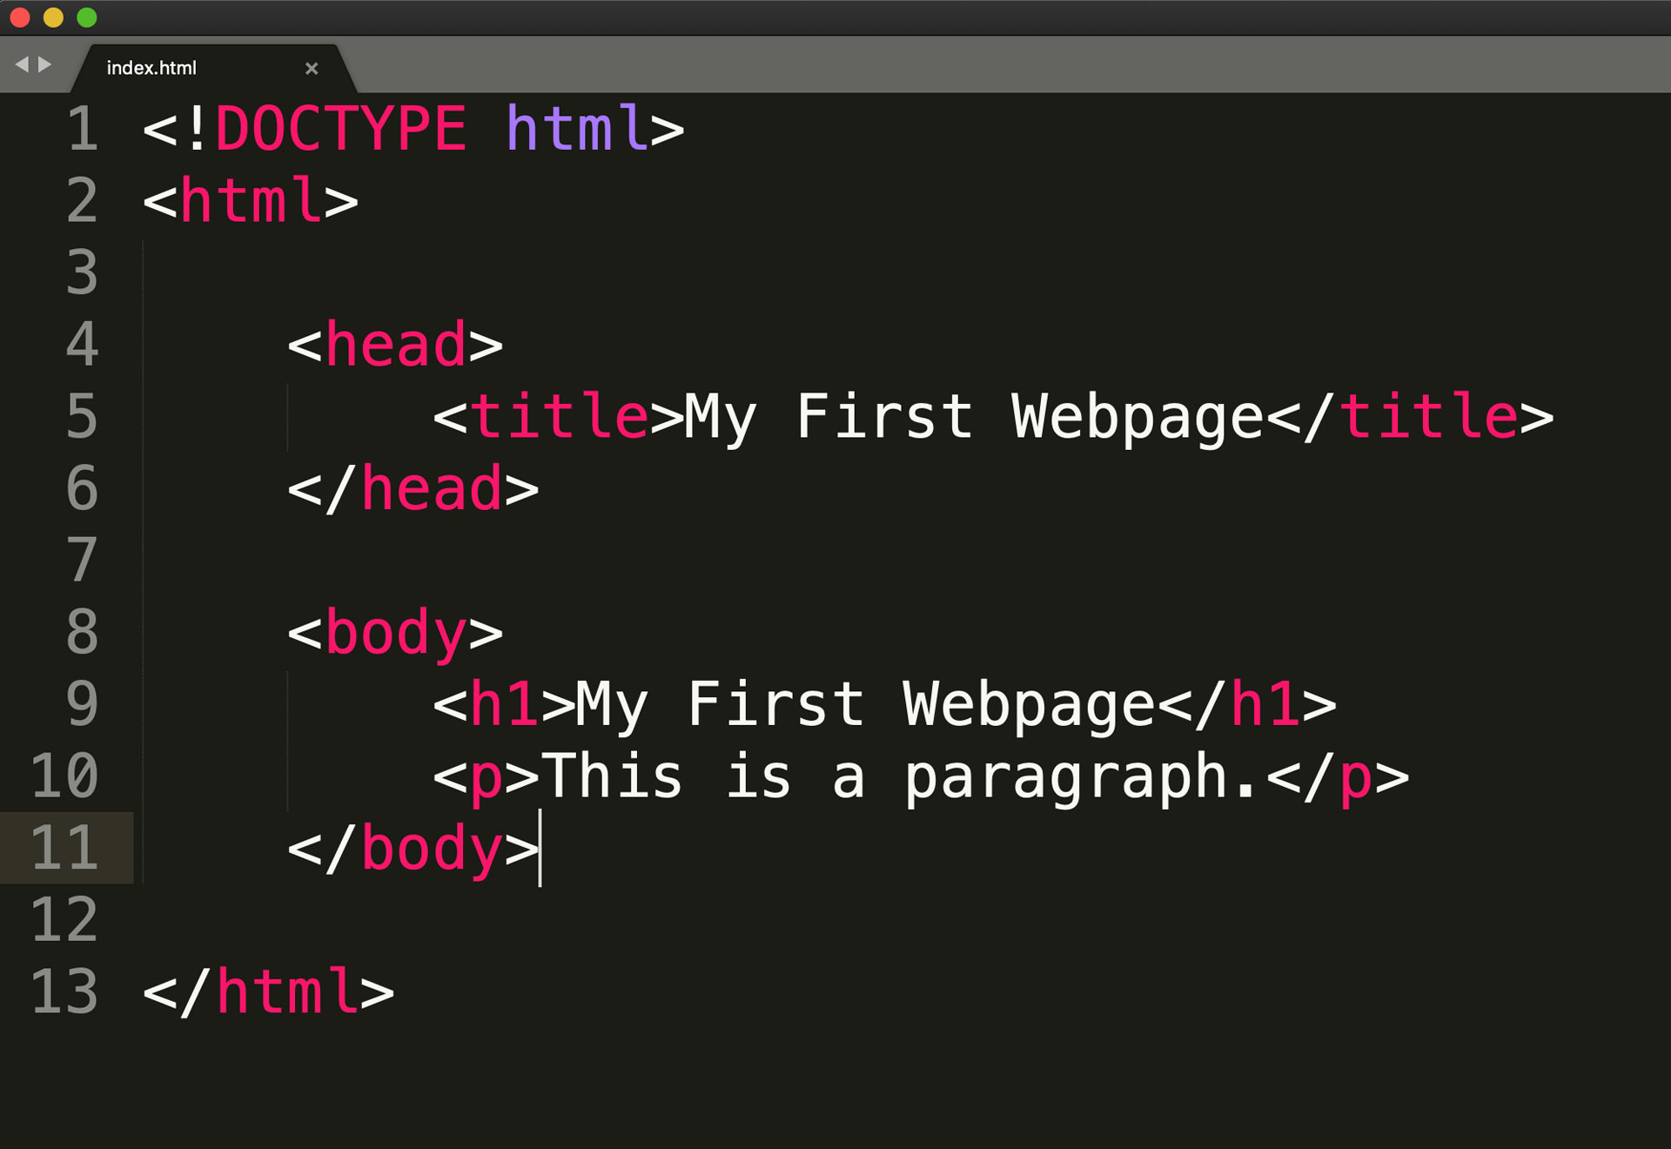

Slide 6
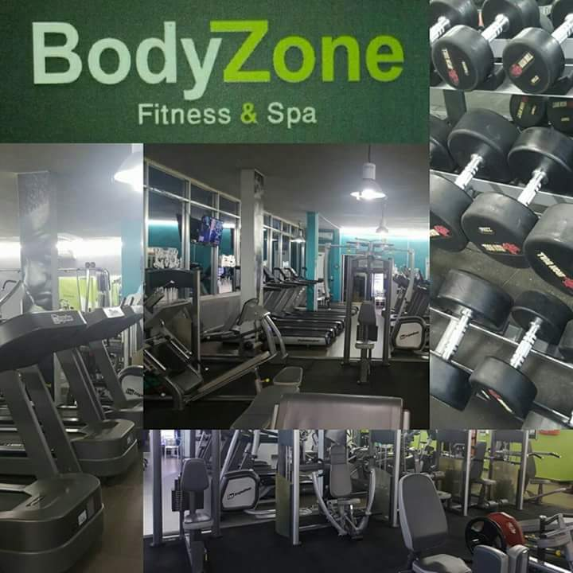

Slide 7
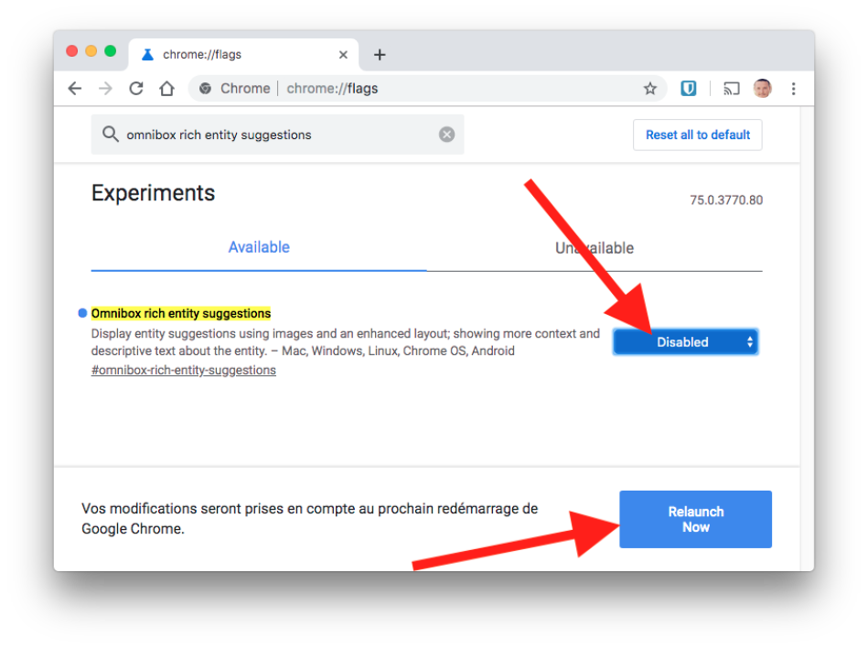

Slide 8
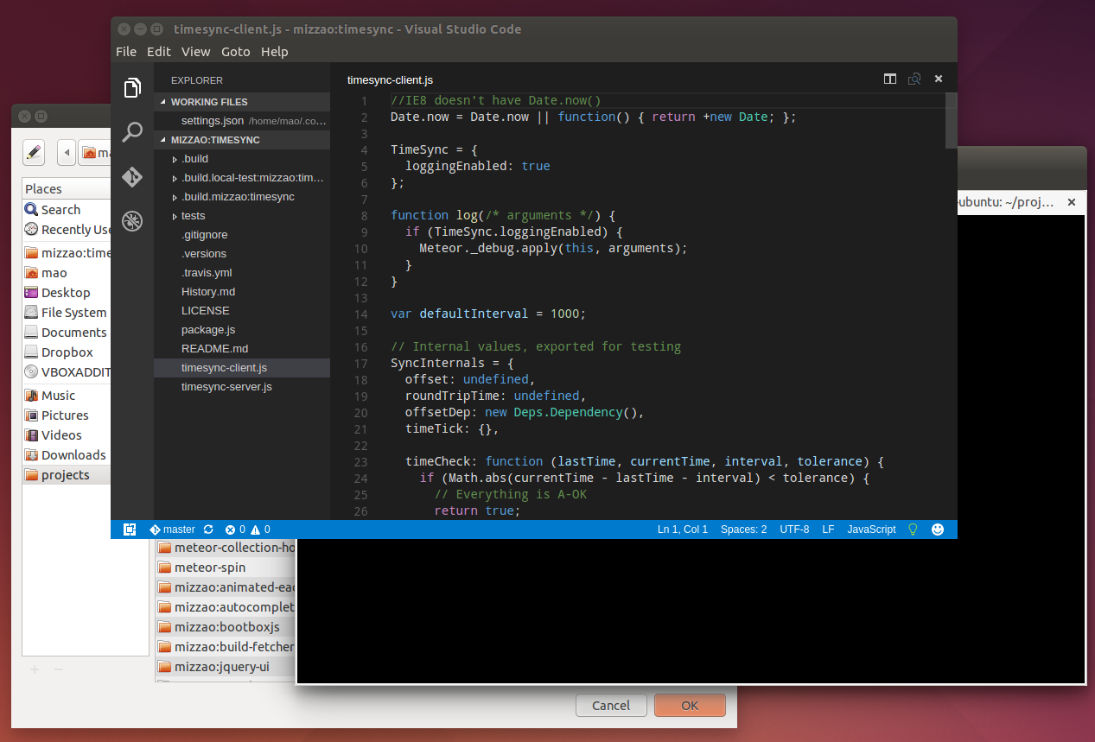

Slide 9
POWERPOINT PRESENTATIO ON BODYZONE FITNESS & SPA GYM WEBSITE

Slide 10
.left li{
padding: 30px 50px;
display: inline;
}
.left li a{
text-decoration: none;
font-size: 20px
color: white
}
.left li a:hover{
color:gray
}
.container{
padding-left: 100px;
margin-top: 200px;
width: 200px;
text-align: center;
color: white;
}

Slide 11
<!DOCTYPE html>
<html lang="en">
<head>
<meta http-equiv="Content-Type" content="text/html; charset=UTF-8">
<meta http-equiv="X-UA-Compatible" content="IE=edge">
<meta name="viewport" content="width=device-width, initial-scale=1.0">
<title>BodyZone Fitness &amp; Spa</title>
<style>
.right{
margin: 0;
padding: 0;
}
body{
background: url(gym.jpg.jpg);
}
img{
margin: 5px 5px;
filter: invert(100%);
height: 50px;
width: 30%;
}

Slide 12
.container input{
margin-top:10px;
padding: 6px;
width: 200px;
border: 2px solid black
border-radius: 8px;
}
.btn{
margin-top: 10px;
margin-left: 220px;
padding: 6px;
border: 6px; solid black
border-radius: 5px;
}
.btn:hover{
color: gray
background-color: hotpink
}
h2{
font-size: 40px;
}
</style>

Slide 13
</head>
<body>
<nav class="right">
<ul>
<img src="img.jpg" alt="img">
<li><a href="a">Home</a></li>
<li><a href="a">About</a></li>
<li><a href="a">Services</a></li>
<li><a href="a">ContactUs</a></li>
</ul>
</nav>
<div class="container">
<h2> Join BodyZone Fitness Spa</h2>
<input type="text" name="number" placeholder="Full name">
<input type="text" name="number" placeholder="Full name">
<input type="text" name="number" placeholder="Full name">
</div>
<button class="btn">submit</button>
</body>
</html>

