Slide 1

RIVERSIDE HEALTH NETWORK
Who Are Our Patients?
Segmenting 150,249 Patients with K-Means Clustering
Turning patient data into targeted strategies for engagement, care coordination, and better outcomes.
Group 1 | Data Analytics · Healthcare Industry · Assignment 6
Presented to the Riverside Health Network leadership team

Slide 2




BUSINESS PROBLEM
One-size-fits-all care is not working
High readmission rates
Patients return to hospital more often than expected
PROJECT OBJECTIVE
Use K-Means clustering to segment 150,249 patients into meaningful groups based on demographics, utilization, clinical complexity, lifestyle, engagement, and cost.
Rising healthcare costs
Resources spread evenly instead of where they matter most
So RHN can:
Missed appointments
Target engagement where it is weakest
Reduce readmissions and length of stay
Allocate resources to the right patients
Support data-driven clinical decisions
Growing no-show rates disrupt treatment plans
Low preventive care uptake
Too few patients join screening and wellness programs

Slide 3
DATASET & PREPROCESSING
A clean, comprehensive patient dataset
Quality checks & preparation
150,249
No duplicates
0 duplicate records or Patient IDs
patient-level records, one per patient, spanning demographics, utilization, clinical history, admissions, costs, engagement, and lifestyle.
Missing values handled honestly
37,704 missing Alcohol_Consumption kept as “Unknown” to avoid imputation bias
All validation checks passed
Example variables
No invalid ages, BMI, dates, or negative costs / admissions
Age, gender, BMI · previous admissions, medications, procedures, ICU, surgery · treatment & out-of-pocket costs · chronic disease, comorbidities, mortality risk · adherence, follow-up compliance · diet, alcohol, smoking, activity
No material outliers
Assessed with the IQR method; no treatment required
Standardized features
StandardScaler so every variable weighs equally in Euclidean distance

Slide 4
FEATURE ENGINEERING
Six features that describe patient behaviour
1
Recency
2
Length of Stay
3
Healthcare Utilization
Days since the patient's last admission. Lower = more recent contact with care.
Discharge date minus admission date. Longer stays signal intensive treatment.
Average of standardized admissions, medications, procedures, ICU, and surgery.
4
Engagement Score
5
Lifestyle Score
6
Clinical Complexity
Mean of medication adherence, follow-up compliance, and diet score (0–100).
Standardized blend of exercise frequency, sleep hours, and diet quality.
Standardized blend of comorbidities, chronic disease, and mortality risk.
Fewer, richer inputs → clearer clusters: related variables were combined so the model sees behaviour, not noise.

Slide 5
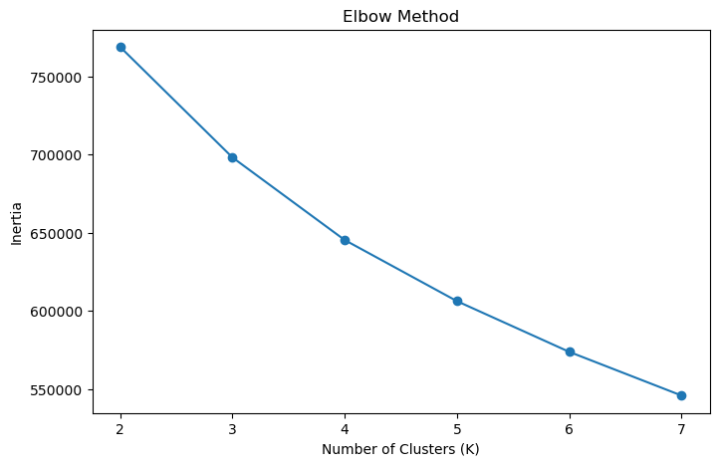
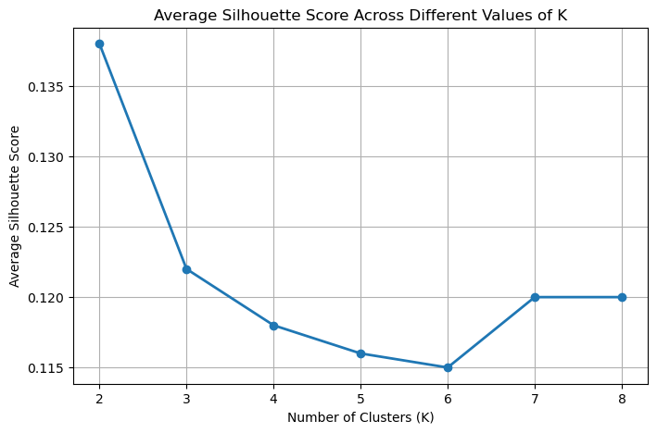
CLUSTERING METHODOLOGY
Why K-Means, and why K = 4
Elbow method
Silhouette analysis
Decision: K = 4
Inertia gains flatten after K = 4, so extra clusters add little.
Best score at K = 2 (0.138); K = 4 close behind (0.118).
Selected because it provides more meaningful patient segments with a silhouette score close to K = 2.

Slide 6
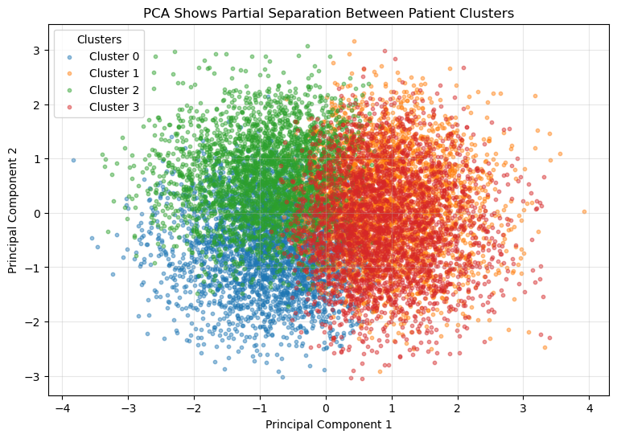
CLUSTER VISUALIZATION 1 OF 2
PCA confirms four distinguishable groups
Six features → two components
PCA compresses the engineered features so 150k patients fit on one plot.
Four distinct regions
Each cluster occupies its own area of the reduced feature space.
Overlap is expected
Real patients don't fall into perfect boxes; boundaries between groups blur in 2D.
Takeaway: the model found real structure, not random noise.

Slide 7
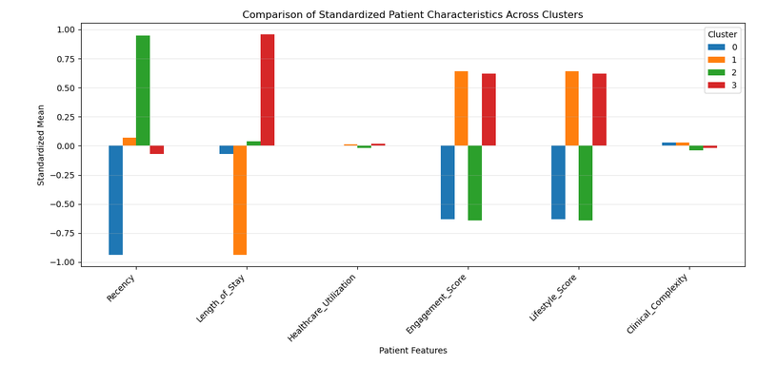
CLUSTER VISUALIZATION 2 OF 2
Four balanced segments, clearly differentiated
What drives the split
Recency of visits
Length of stay
Engagement score
Lifestyle score
Utilization and clinical complexity stay near average for all four groups.
Cluster 0
Cluster 1
Cluster 2
Cluster 3
37,577 patients · 25.0%
37,754 patients · 25.1%
37,208 patients · 24.8%
37,710 patients · 25.1%

Slide 8




CLUSTER PROFILES
Meet the four patient segments
Low Engagement
Healthy
Inactive
Long Stay
37,577 patients
37,754 patients
37,208 patients
37,710 patients
Most recent visits, but weak adherence and less healthy habits. In our care, not following the plan.
Shortest hospital stays, high engagement, healthy lifestyle. Actively self-managing.
Longest gap since last visit, low engagement. May delay care until problems escalate.
Longest hospitalizations despite high engagement. Intensive treatment and recovery needs.
Early-intervention target
Keep them well
Re-activation target
Care-coordination target

Slide 9



HEALTHCARE APPLICATIONS
How RHN can use these segments today
Outreach & engagement
Preventive care
Care coordination & follow-up
Low Engagement
Inactive
Healthy
Long Stay
Automated appointment reminders, personalized education, telehealth follow-ups, digital health tools, and preventive campaigns to bring patients back into care.
Routine screenings, wellness assessments, and lifestyle programs that keep low-risk patients low-risk and reduce future utilization.
Multidisciplinary discharge planning, rehabilitation services, and post-discharge monitoring to shorten stays and prevent readmission.

Slide 10
STRATEGIC RECOMMENDATIONS
Actions tied to measurable outcomes
SEGMENT
RECOMMENDED ACTIONS
EXPECTED IMPACT
Low Engagement
Reminders, patient education, telehealth follow-ups, digital engagement tools
Better adherence · fewer missed appointments · improved follow-up rates
Healthy
Preventive screening, wellness assessments, lifestyle promotion programs
Sustained outcomes · lower future utilization · fewer preventable complications
Inactive
Preventive campaigns, outreach, routine screenings, patient education
Earlier detection · higher engagement · more preventive-care participation
Long Stay
Care coordination, discharge planning, rehab, post-discharge monitoring
Shorter stays · lower readmission risk · more efficient resource use
Net effect: personalized care delivery, better outcomes, and healthcare resources spent where they change results.

Slide 11



ETHICS & LIMITATIONS
Using this model responsibly
Ethical safeguards
Limitations of K-Means here
Privacy first
De-identify records; restrict access to authorized staff under healthcare privacy rules.
Assumes roughly spherical clusters; complex healthcare relationships may not fit that shape.
Moderate silhouette (0.118) and PCA overlap: segments are useful, not perfectly separated.
Other algorithms (hierarchical, DBSCAN, GMM) could group patients differently.
Single organization's data: findings may not generalize to other health systems.
Decision support, not decisions
Clusters inform strategy; clinicians still judge each patient's full history.
Bias monitoring
Demographics, access, and missing data can skew clusters; re-validate regularly for fairness.

Slide 12
CONCLUSION & NEXT STEPS
From 150,249 records to four segments RHN can act on
What we showed
Next steps
K-Means + engineered features found four balanced, interpretable patient segments.
Segments differ most on recency, length of stay, engagement, and lifestyle.
Each segment maps to a concrete strategy: engage, prevent, re-activate, coordinate.
1
Pilot outreach for Low Engagement and Inactive patients; track no-shows and adherence
2
Strengthen discharge planning and rehab pathways for Long Stay patients
3
Re-run and validate clustering quarterly; monitor for drift and bias
4
Test alternative algorithms and enrich data (e.g., social determinants of health)
Thank you · Group 1 · Questions welcome

