Slide 1
Bank management
system

Slide 2
Server state diagram
Server state diagram

Slide 3
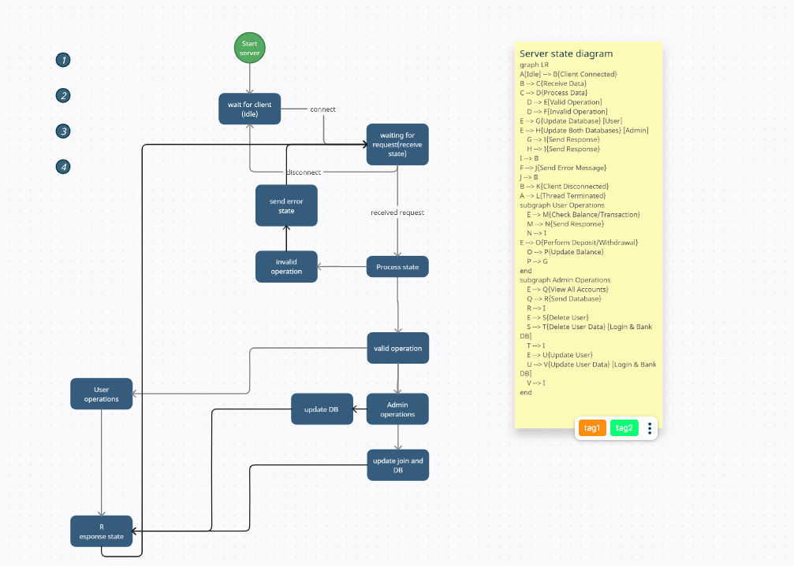

Slide 4
Server state diagram
Client state diagram

Slide 5
