Slide 1
Evaluating Power Purchase Agreements for On-Site Solar Integration
Maria Lyasota

Slide 2
Contents
1.Introduction
2. PPA Options
2.1 Direct contract
2.2 Retail contract with different pricing
3. Key Factors for On-Site Solar Generation (50kW)
3.1 Daily Energy Consumption Patterns
3.2 Available Roof Space
3.3 Optimal Timeline for Installation
4. Feasibility Analysis Across Retail Locations
4.1 Feasibility and legislations across states
4.2 Solar Radiation Variability Across States
4.3 Energy Consumption at Different Locations and potential energy production
5. Renewable Energy Strategy: 50% vs. 100%
5.1 PPA 50%
5.2 PPA 100%
6. Answers to find the best strategy

Slide 3
1. Introduction
This case study examines a multi-site retail client with 350 locations across New South Wales, Australian Capital Territory, Victoria, and Queensland. The client intends to secure a long-term Power Purchase Agreement (PPA) for renewable energy from July 1, 2025, to December 31, 2030, with the goals of enhancing net-zero targets and promoting a sustainable brand image. Given the energy-intensive nature of retail operations, the study explores the feasibility of on-site solar generation to lower energy costs and meet environmental objectives.
The primary aim is to evaluate the most effective approach for solar panel installations and the choice of PPA. This includes analyzing whether the client should pursue the lowest cost option or focus on renewable energy percentages, considering factors such as energy consumption patterns, site feasibility, and solar radiation availability. The study will also assess the potential energy production of a 50 kW system and recommend a strategy between 50% and 100% renewable energy, informing the timeline for installations to align with the client's financial and sustainability goals.

Slide 4
2. PPA Options
Power Purchase Agreements (PPAs)
A Power Purchase Agreement (PPA) is a long-term contract between a power producer and a purchaser for the sale of energy, allowing businesses to secure stable energy prices while supporting sustainability initiatives. On-site PPAs specifically involve energy generated at the purchaser's location, such as solar panels installed on their facility. This setup provides direct access to renewable energy, reduces transmission costs, and enhances energy independence, making it an attractive option for organizations looking to minimize their carbon footprint.
Contract Types Available for On-Site PPAs:
2.1 Direct Contract: A direct contract, or wholesale PPA, involves a business negotiating directly with a renewable energy farm to purchase electricity. This arrangement is typically suited for larger electricity consumers, those using more than 50 GWh annually, allowing them to secure energy at negotiated rates, often resulting in more favorable pricing and direct access to renewable sources.
2.2 Retail Contract with Different Pricing: In a retail contract, a business signs an agreement with an electricity retailer to purchase electricity and/or Large-scale Generation Certificates (LGCs). The retailer acts as an intermediary, managing contract terms and offering various pricing structures, such as fixed, variable, or hybrid rates. This flexibility helps businesses align their energy purchasing strategy with their specific needs and market conditions.
After contacting providers, both contract types are open to on-site PPAs.

Slide 5
The following table resume the three pricing models for PPAs:
Pricing Model | Description | Advantages | Considerations
Fixed Price | A set price per kilowatt-hour (kWh) for the duration of the contract. | Predictable costs, stable budgeting. | May be higher than variable rates if market prices fall.
Variable Price | Prices fluctuate based on market rates or other indices, often linked to wholesale electricity prices. | Potential for lower costs if market prices drop. | Uncertainty in budgeting; costs can rise significantly.
Hybrid Model | A combination of fixed and variable pricing, offering stability and flexibility. | Balances risk and stability; tailored to needs. | Complexity in pricing structure; requires careful management.
From https://news.cityofsydney.nsw.gov.au/

Slide 6
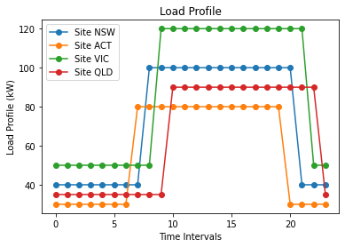
3. Key Factors for On-Site Solar Generation (50kW)
3.1 Energy Consumption Patterns
After evaluating the load profiles across all states, Figure 1 displays the daily energy consumption patterns for each location. In the following, we only account for the average consumption per month calculated from this Load Profile.

Slide 7
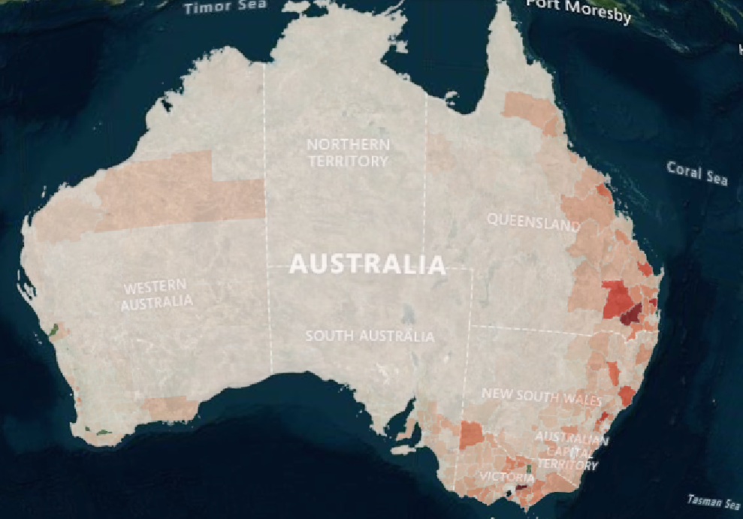
3.2 Available solar space for industrial use
The map illustrates potential industrial roof top solar space (https://nationalmap.gov.au/).
3.3 Optimal Timeline for Installation
The optimal time for rooftop solar energy installation in Australia generally aligns with the country's peak solar production months, which are typically during spring and summer (from October to March). During these months, solar panels can generate more electricity due to increased sunlight availability. When planning rooftop solar installations in Australia, it's vital to consider local regulations and incentives, as these vary by state and territory.

Slide 8
4.1 Feasibility and legislations across states
 | NSW | Vic | QLD | ATC
Planning Approval Requirement | Requires planning approval under EP&A Act; local councils assess necessity. | Requires planning approval under Planning and Environment Act 1987; local councils determine need. | Requires planning approval under Planning Act 2016; local councils assess necessity. | Requires planning approval under Planning and Development Act 2007; ACT Planning Authority assesses need.
Exempt Development | Certain installations may qualify as exempt development under local schemes. | Certain installations may qualify as exempt development under local planning schemes. | Certain installations may qualify as exempt development under local planning schemes. | Certain installations may qualify as exempt development under local provisions.
Tax Discounts | Eligible for tax incentives under the Clean Energy Act; SRECs available. | Eligible for tax incentives under the Clean Energy Act; SRECs available. | Eligible for tax incentives under the Clean Energy Act; SRECs available. | Eligible for tax incentives under the Clean Energy Act; SRECs available.

Slide 9
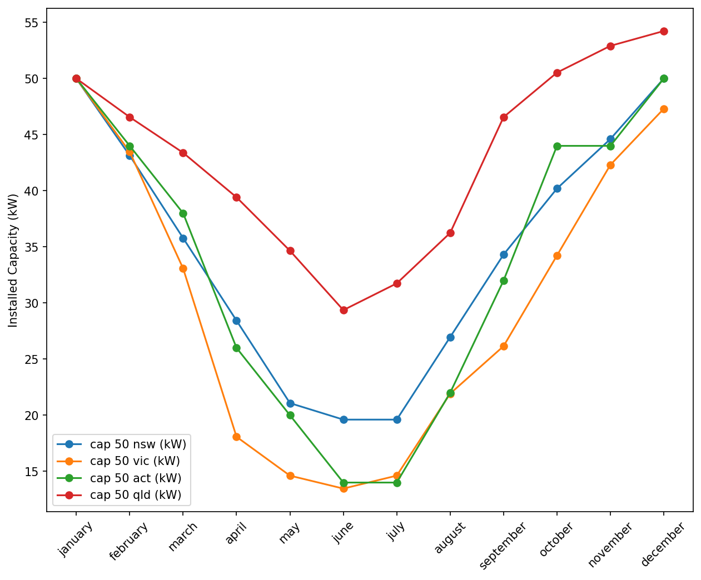
4.2 Solar Radiation Variability Across States
Following the data analysis in Section 4, where solar radiation was measured in MJ/m² across various states, we can estimate the average solar radiation for each state. Details can be found in Attachment 4. This figure illustrates the seasonal variations in the installed capacity assuming 50 kW capacity in January for every state (see legend for reference).
This analysis, based on information provided by Core Market, is essential for optimizing solar power generation strategies by aligning energy production with peak consumption periods.
Figure 2

Slide 10
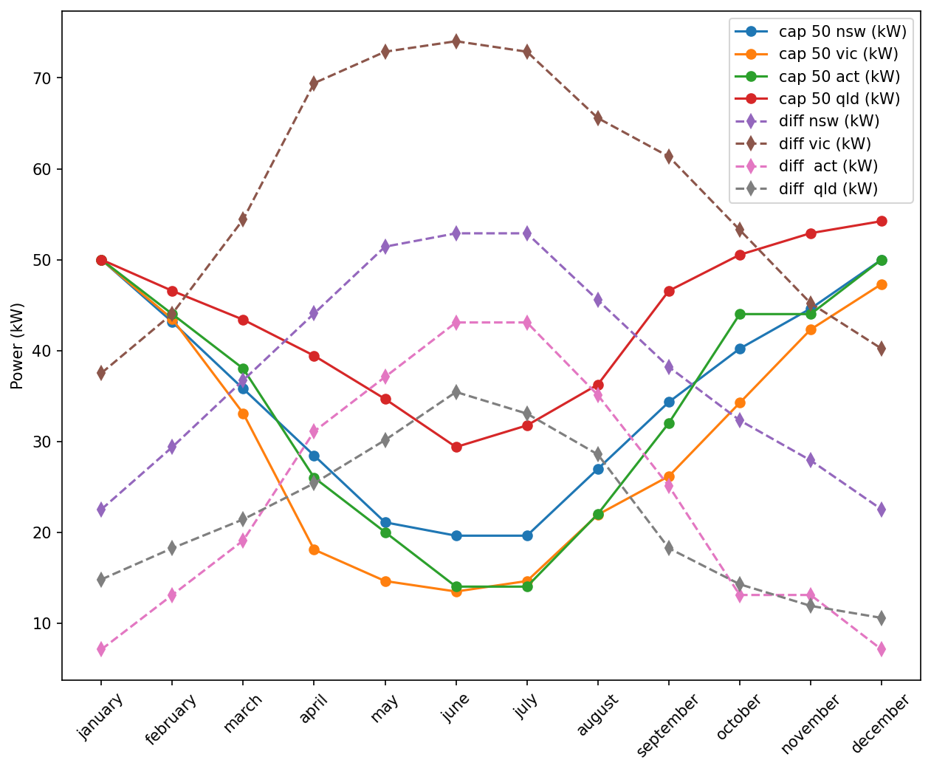
4.3 Energy Consumption at Different Locations and potential energy production
Here, we show the energy production for every state (solid curves) and the difference between the load profile and the energy production (dashed curves) for different months. Variations in energy production result in a large discrepancy in produced and required energy. Here, it was assumed that the load profile did not depend on the month.
Figure 3

Slide 11
5.1 PPA 50%.
In the context of Power Purchase Agreements (PPAs), businesses can opt for either a 50% or a 100% renewable energy commitment. A 50% commitment offers flexibility and requires a lower initial investment, allowing companies to gradually incorporate on-site renewable generation while purchasing Large-scale Generation Certificates (LGCs) to claim their renewable energy usage. However, this option may result in a smaller overall reduction in greenhouse gas emissions.
5.2 PPA 100%
On the other hand, a 100% renewable energy commitment signifies strong corporate sustainability leadership. This strategy typically involves greater upfront costs but leads to long-term savings and significant environmental benefits. By fully transitioning to renewable sources, including on-site generation, and purchasing LGCs, companies can substantially reduce their carbon footprint and enhance their sustainability profile. The decision ultimately hinges on a company's financial capabilities and long-term sustainability goals.
The following figure below illustrate the scenarios in which the non achieved capacity is purchased at spot market price from AEMO.

Slide 12
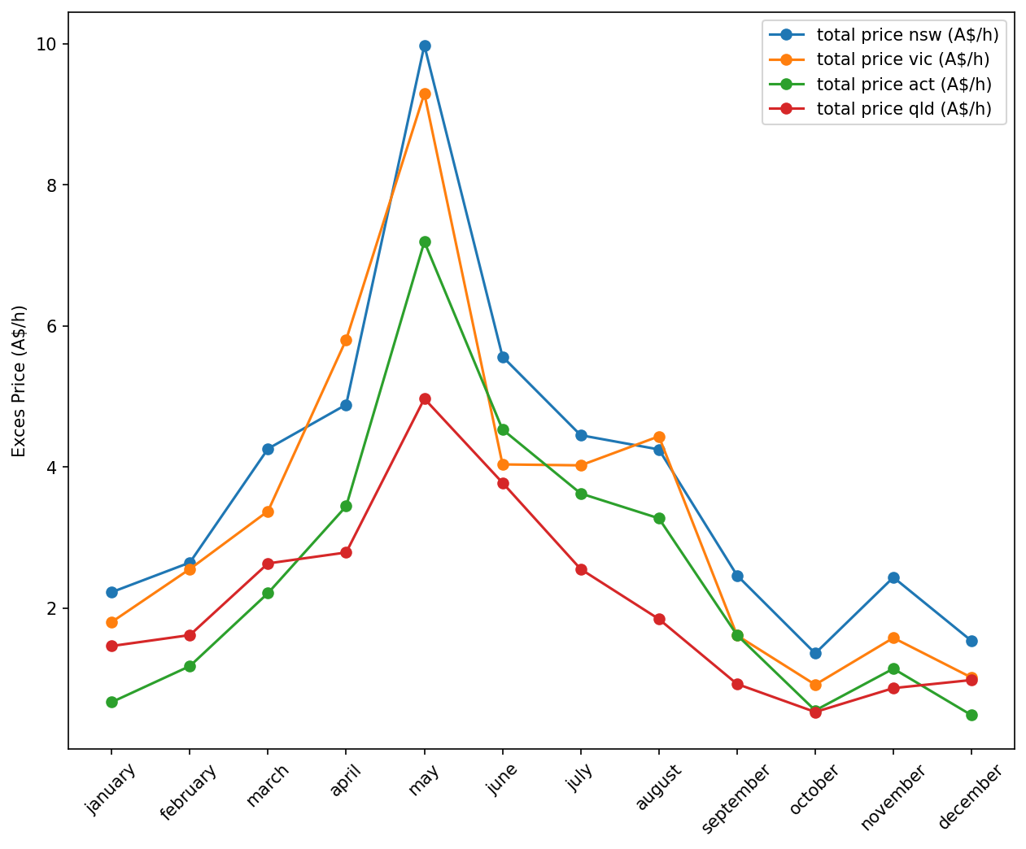
This figure shows the excess price one site will pay for the non achieved capacity assuming spot market price from AEMO. These data were calculated from the difference between the load capacity and the power production for one site shown in Figure 3.
Figure 4

Slide 13
6 Answers

Slide 14
• What option should the client go with for the PPA: lowest cost or renewable energy percentage?
For this answer, we first compare the retail PPA pricing model with fixed and mixed prices on the slide 6.
Fixed price PPA are often more expensive, especially if the client want no upfront installation cost so the energy provider can cover installation and maintenance cost during 5.5 years. The mixed price option is less expensive but can be exposed to higher market prices .
Lower cost and energy percentage in this case 100 and 50% can be achieved under the scenario when the percentage of needed energy noncovered by on-site installation is purchased from another renewables source through LCGs
For instance, businesses seeking to achieve 100% renewable energy in Australia can purchase and surrender Large-scale Generation Certificates (LGCs) to offset any uncovered energy from on-site solar installations. Surrendering LGCs involves handing them over to the Clean Energy Regulator, typically on an annual basis, to meet renewable energy obligations or claim 100% renewable status. Once surrendered, the certificates are no longer tradable.
According to Core markets LCGs, prices forecast LGC spot prices in Australia this year turn around 40$. Prices are expected to decline as the government promotes solar capacity, particularly for installations over 100 kW. Since LGCs are issued until 2030 and the client contract should end in 2030 this could be a good option.

Slide 15
• What factors should the client consider when determining the best strategy for on-site solar power generation (50kW)?
According to the analysis given in Chapters 3 and 4, the key factors are the available solar radiation, and Federal Goverment legislation regarding rewards, such as tax deductions, and restrictions.
According to the table in section 4.1, the solar installation is the least feasible in Victoria due to restrictions for rooftop installations and minimum capacity requirements of 160 MWh for all sites. Furthermore, it has the largest seasonal descripancies between installed capacity and the load profile as shown in section 4.3.
NSW, QLD, and ACT do not have restrictions regarding the rooftop installations and minimum capacity requirements and provide reasonable seasonal variations.

Slide 16
• How feasible is the installation of solar panels at the retail locations across different states, considering the energy consumption, solar radiation, and potential energy production?
For given data, 50 kW solar power installations are the most feasible for the ACT as they cover more then 60% daily requiremenets on peak (see section 3.1) and slightly less feasible for NSW and QLD as they cover around 50% energy consumption. For Victoria, solar installations will cover around 40% of on peak power consumption. Solar installations will cover off peak energy requirements in all four states. Solar energy installations will cover average energy consumption from 16% to 30% for ACT, QLD and NSW, and around 40% for Victoria.
Considering seasonal variations shown in sections 4.2 and 4.3, solar energy installations will cover from 16% to 30% for ACT, QLD and NSW, and around 40% for Victoria at ist maximum capacity during summer. Solar energy installations will cover at least 50% average energy requirements for QLD and ACT, around 45% for NSW, and less than 40% for Victoria during winter. The difference in associated costs increases further when accounting for the price sites will pay to cover the excess energy consumption (see Figure 4), which is the lowest for QLD and ACT, and similar for NSW and Victoria.
In conclusion, solar energy installations are especially feasible for ACT and QLD, feasible for NSW, and moderately feasible for Victoria.

Slide 17
• What is the best strategy for the client in terms of 50% renewable or 100% renewable energy, and when should they start the installations?
Considering a 5.5-year Power Purchase Agreement (PPA) with on-site installations, the client should pursue the 100% renewables option if the goal is to align with the net zero target goals. In this case, the consumption is only sourced from renewables. The client should pursue the 50 percent renewables options if this target is not imminent and the fixed price in the PPA together with spot pricing is more advantageous than the purchase of LGCs.
The optimal time for rooftop solar energy installation in Australia generally aligns with the country's peak solar production months, which are typically during spring and summer (from October to March). During these months, solar panels can generate more electricity due to increased sunlight availability. When planning rooftop solar installations in Australia, it's vital to consider local regulations and incentives, as these vary by state and territory.

