Slide 1
Breast cancer analysis
TA.Yomna Ali

Slide 2
team members
مريم احمد توفيق رمضان
20201700801
احمد مصطفى قنديل السعيد
20201700084
امنيه خالد عبد المجيد محمد
20201700143
عمر طارق فتحي محمد
20201700537
امينه محمد حسين مرزوق
20201700153

Slide 3
AGENDA
Description
Data cleaning
Data Exploration
Data visualization
Dataset preparation
Models

Slide 4
description
This dataset of breast cancer patients was obtained from the 2017 November update of the SEER Program of the NCI, which provides information on population-based cancer statistics. The dataset involved female patients with infiltrating duct and lobular carcinoma breast cancer. 4024 patients were ultimately included.

Slide 5
data cleaning

Slide 6
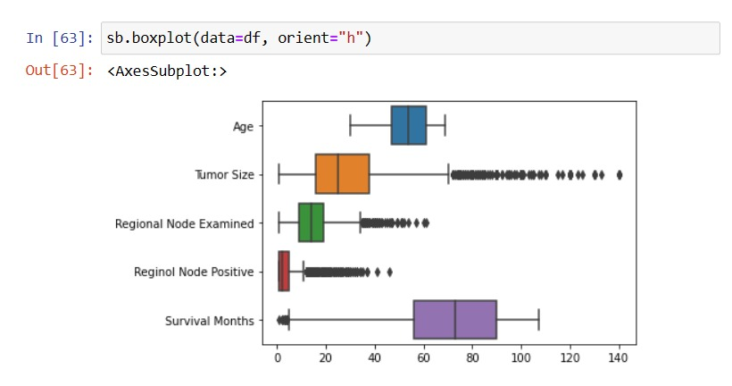
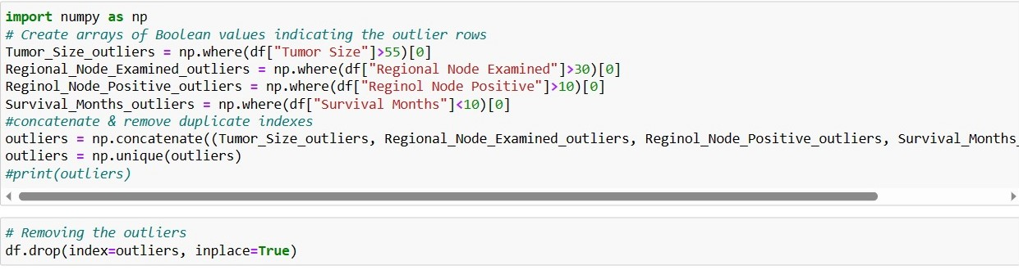
Removing outliers
← Explore the Outliers

Slide 7
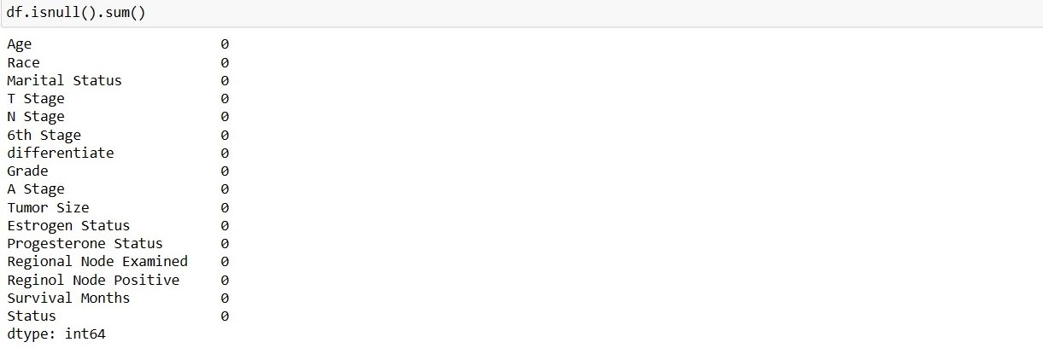
Check nulls

Slide 8
Data visualization & Data Exploration

Slide 9
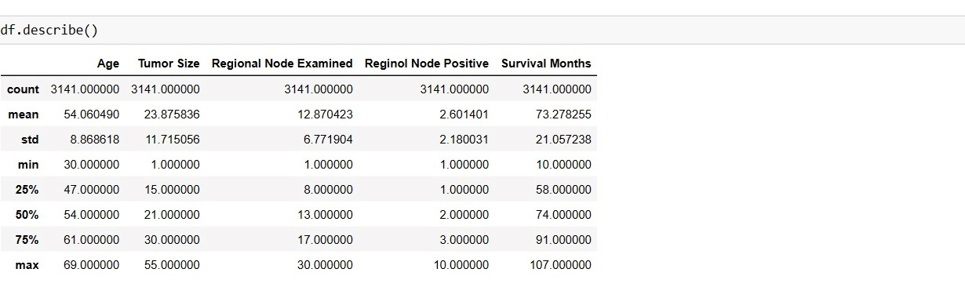
statistics

Slide 10
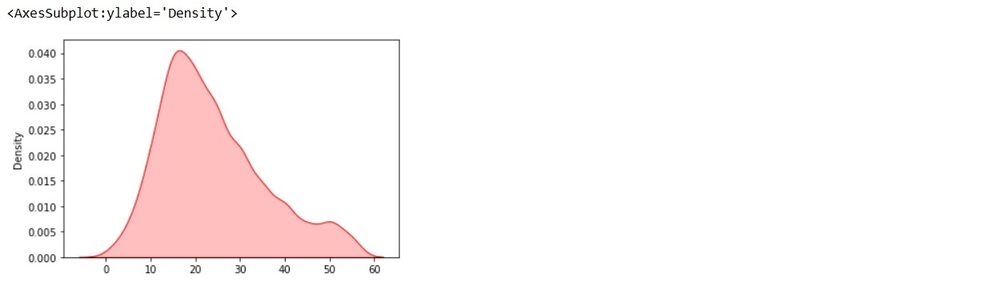
Density plot(tumor size)

Slide 11
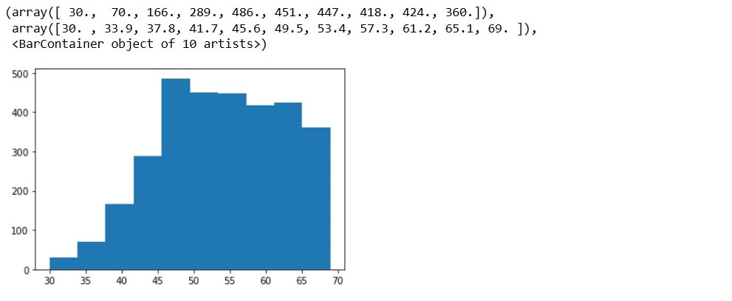
Histogram(Age)

Slide 12

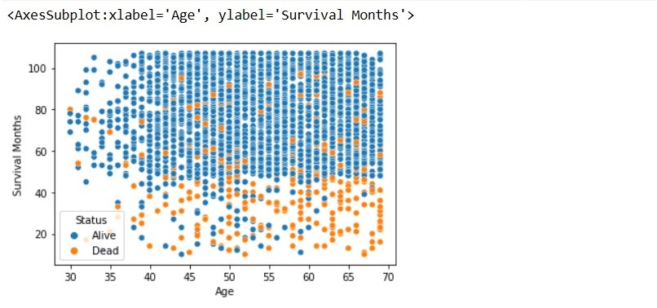
Scatterplot(age,survival)

Slide 13
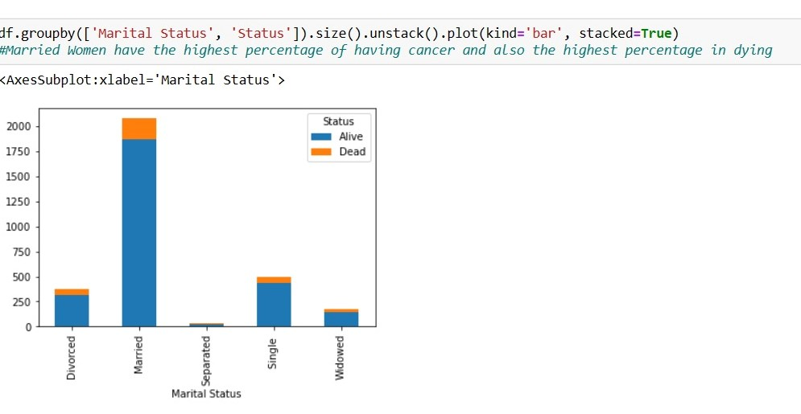
Stacked bar chart(Marital status , status)

Slide 14
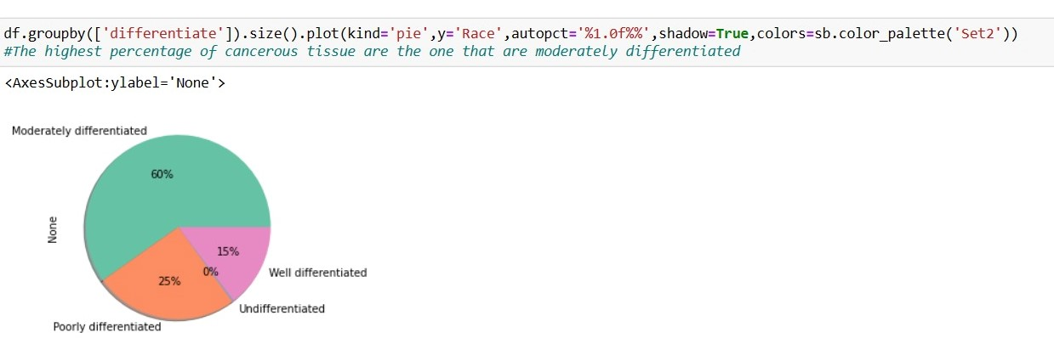
piechart

Slide 15
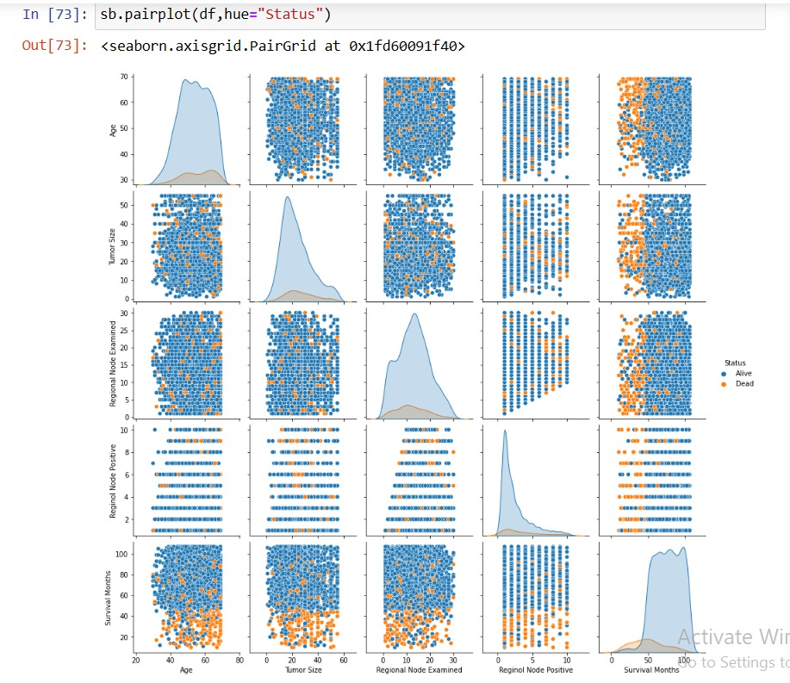
Scatter matrix

Slide 16
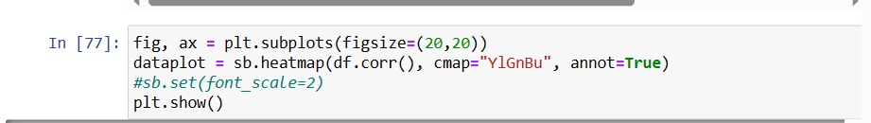
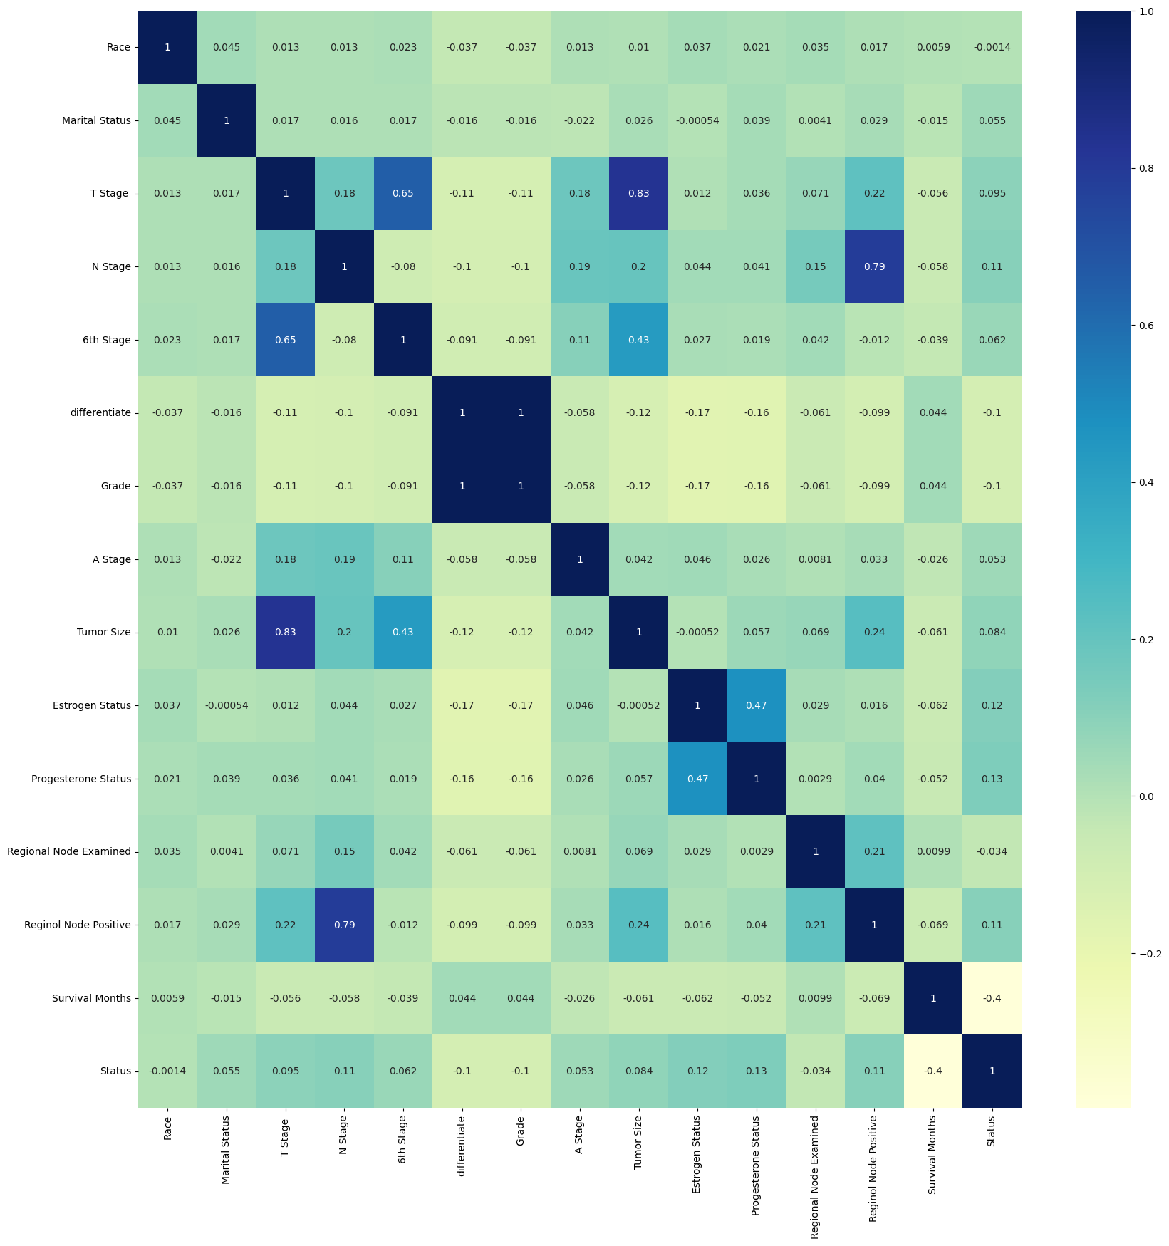
heatmap

Slide 17
dataset preparation

Slide 18
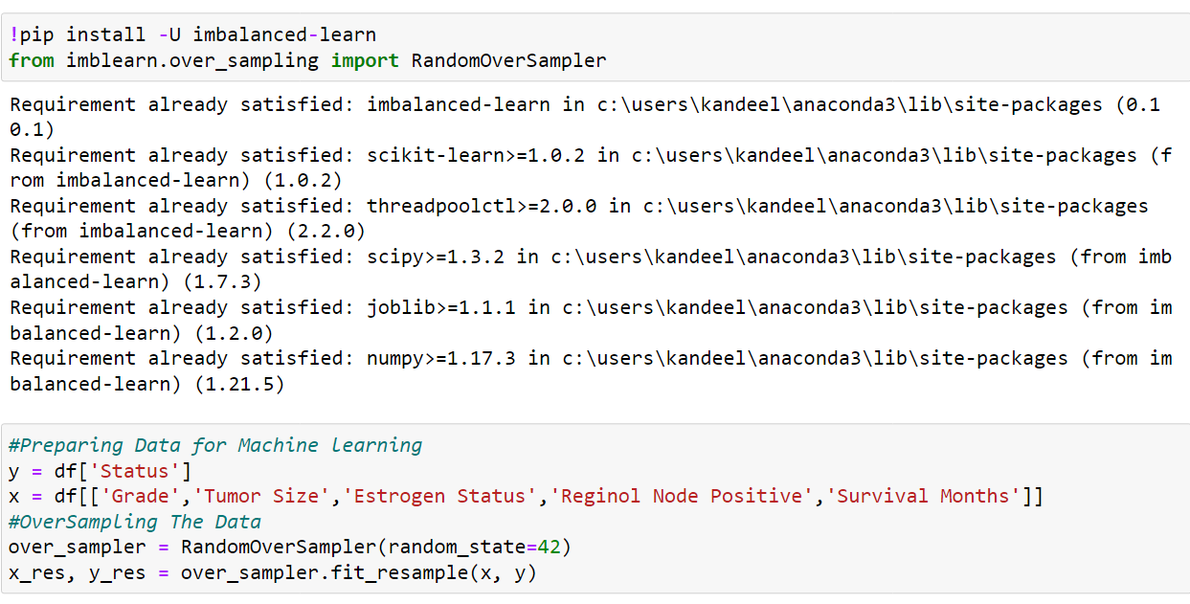
feature extraction & resampling

Slide 19
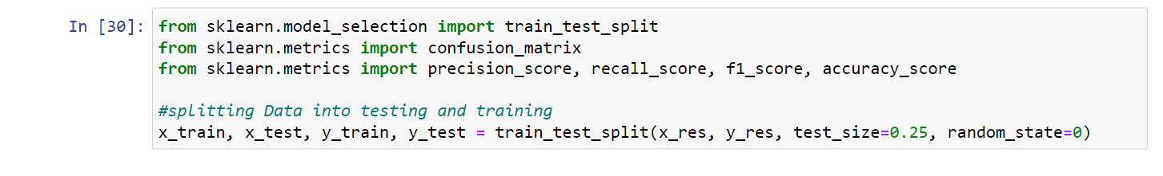
Split the data

Slide 20
Models

Slide 21
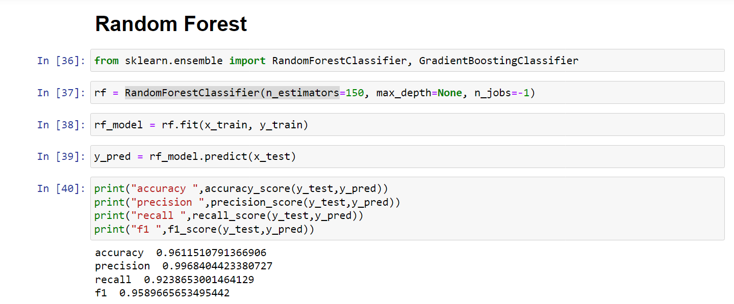
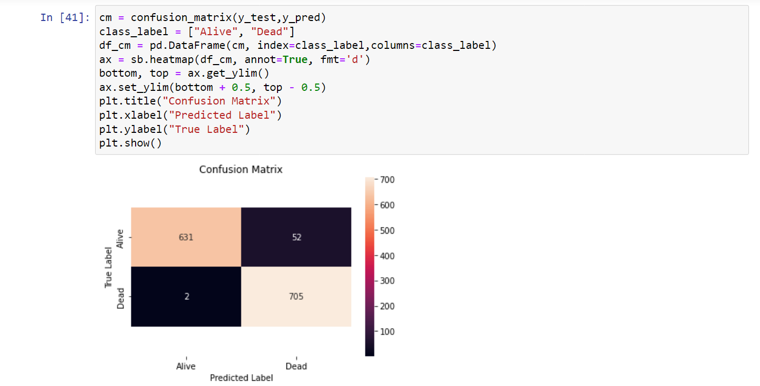

Slide 22
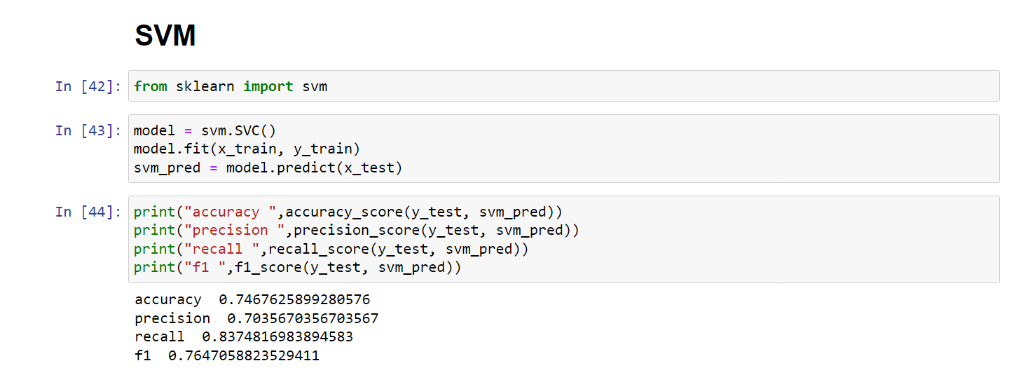
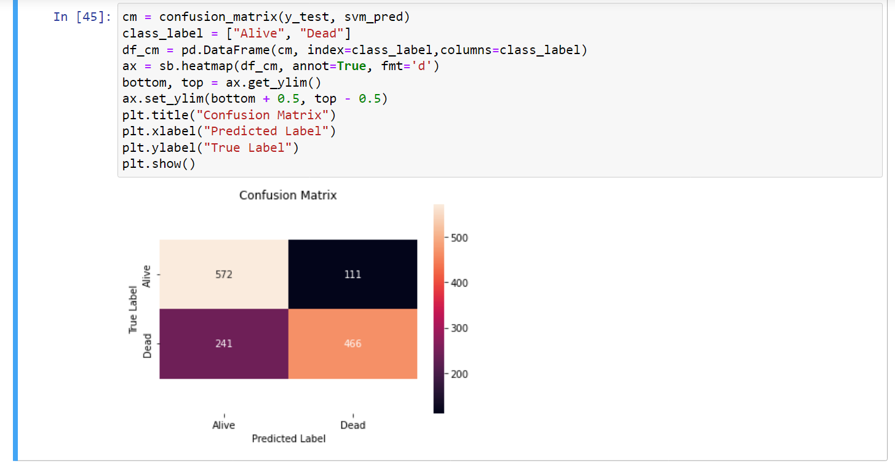

Slide 23
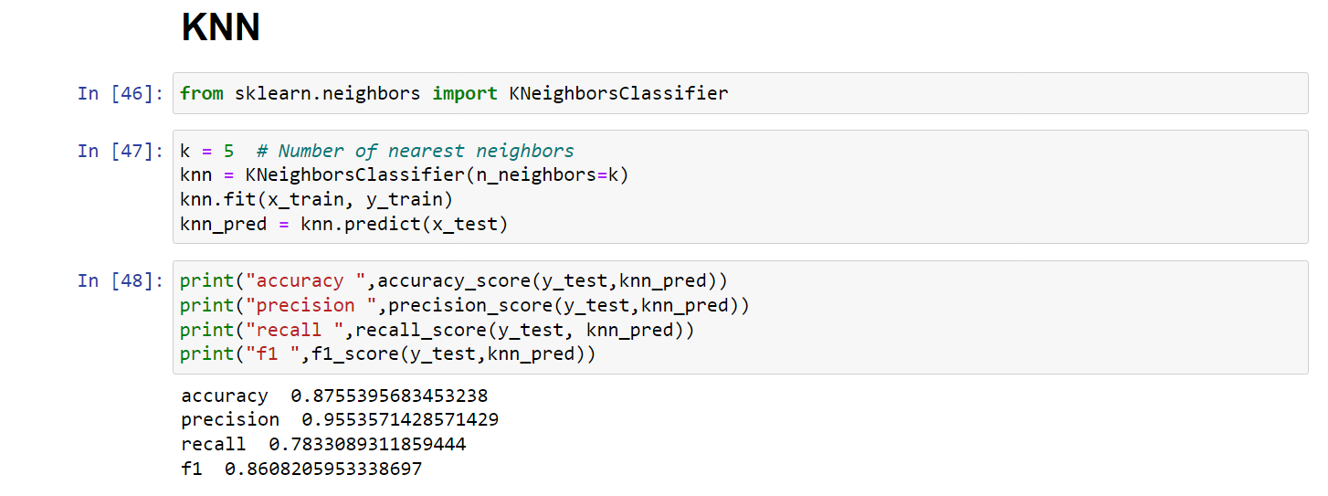
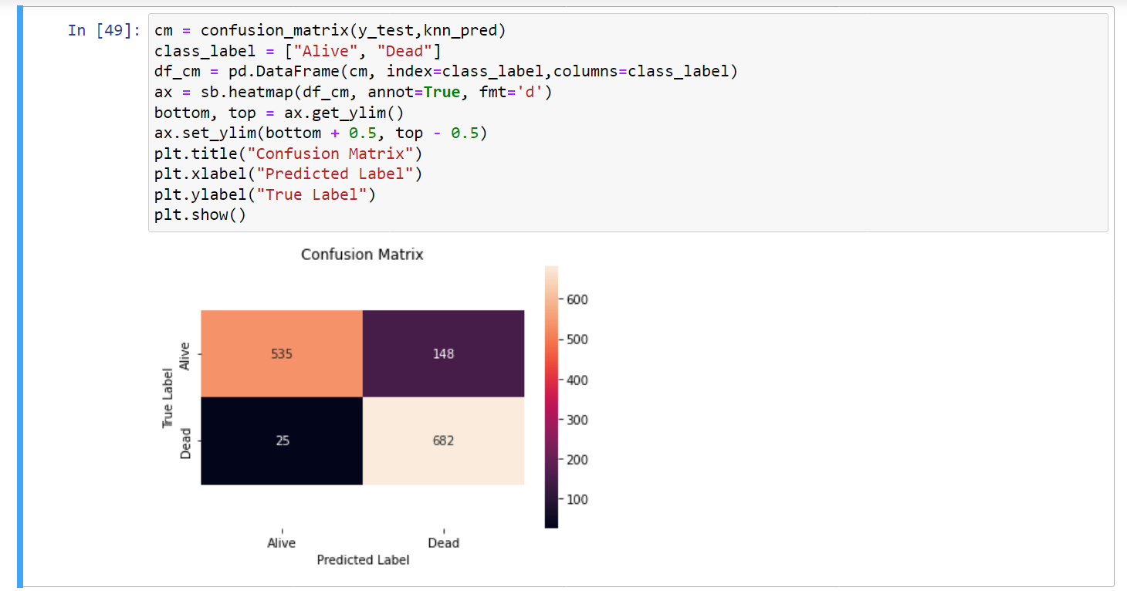

Slide 24
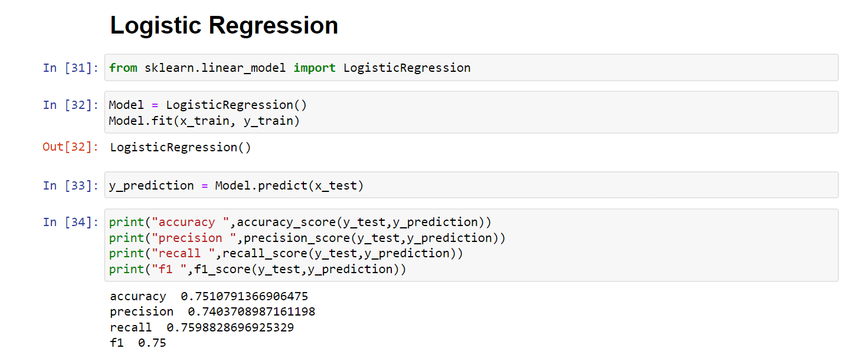
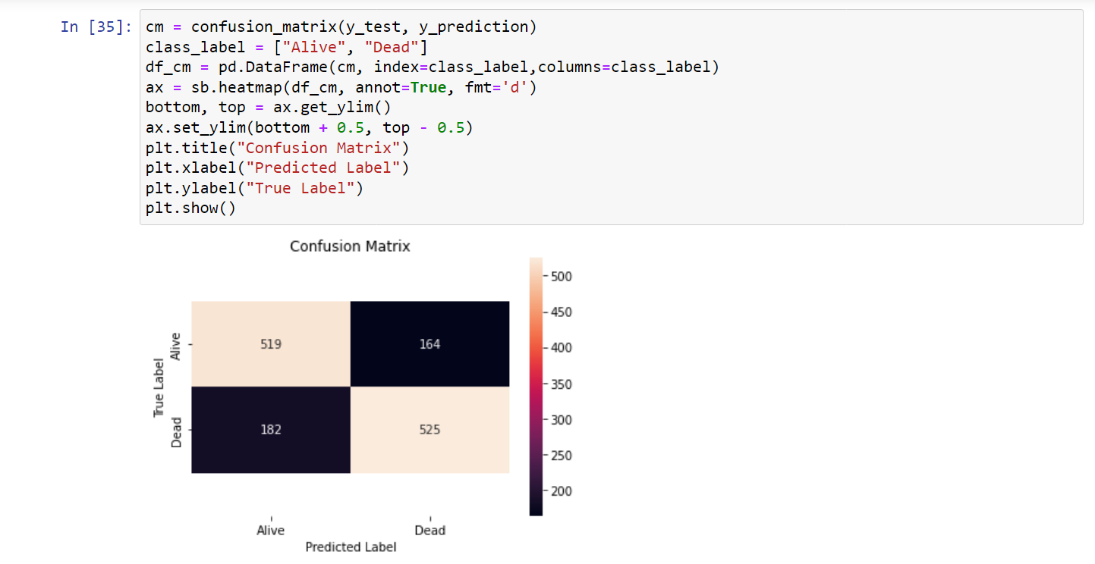

Slide 25
THANK YOU

