Slide 1


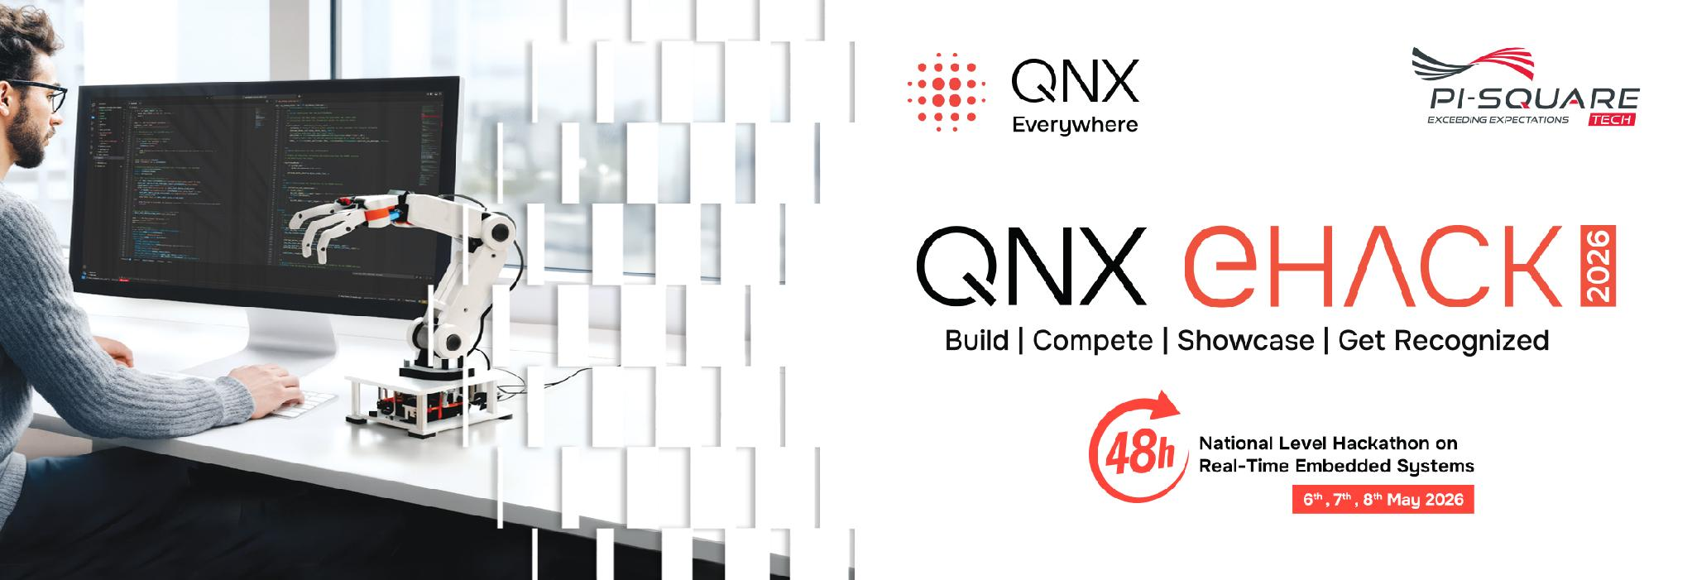
Driver drowsiness and Attention monitoring system
State Level Hackathon
SENTINELS
Deterministic QNX supervision for AI-based driver fatigue detection

Slide 2
Title & Team Identity
Design and Execution
  Project
  DRIVE-X — real-time driver drowsiness and attention monitoring
Team
  Team Sentinels, Chennai | Automotive theme
Value proposition
  A QNX-supervised safety pipeline that turns live driver cues into deterministic drowsiness decisions and alerts.
  Windows supplies camera frames only; the Raspberry Pi 5 performs decoding, ML inference, decision making, and safety response.

Slide 3
Problem Synthesis & Scenario
Design and Execution
Driving scenario
A driver shows sustained eye closure, yawns, or head-pose deviation during a journey.
DRIVE-X detects the cues, enters a drowsy state, and raises an emergency alert with available location data.
Success metrics
• Drowsiness evidence reaches a QNX decision task predictably
• Live ONNX inference executes on the Pi
• Trace capture has zero dropped buffers
Why QNX
Detection → decision → alert needs bounded scheduling.
Independent processes and message passing keep safety functions isolated from video and logging work.

Slide 4
QNX Architectural Approach
Design and Execution
Microkernel pipeline
• Separate QNX processes: video receiver, ONNX inference, decision, alert, GPS, logger, supervisor
• POSIX shared memory carries decoded RGB frames
• QNX message passing carries inference evidence to the decision service
Resource isolation
• CPU affinity isolates time-sensitive services
• FIFO: ingest CPU1, decision CPU2, alert CPU3
• Sporadic: video decode CPU0, ONNX inference CPU3
• Supervisor heartbeats restart failed services
Priority order
1. Alert — FIFO 62
2. Ingest — FIFO 60
3. Decision — FIFO 58
4. ONNX inference — SPORADIC 40/15
5. Video RX — SPORADIC 25/10
6. GPS and logger — background sporadic

Slide 5
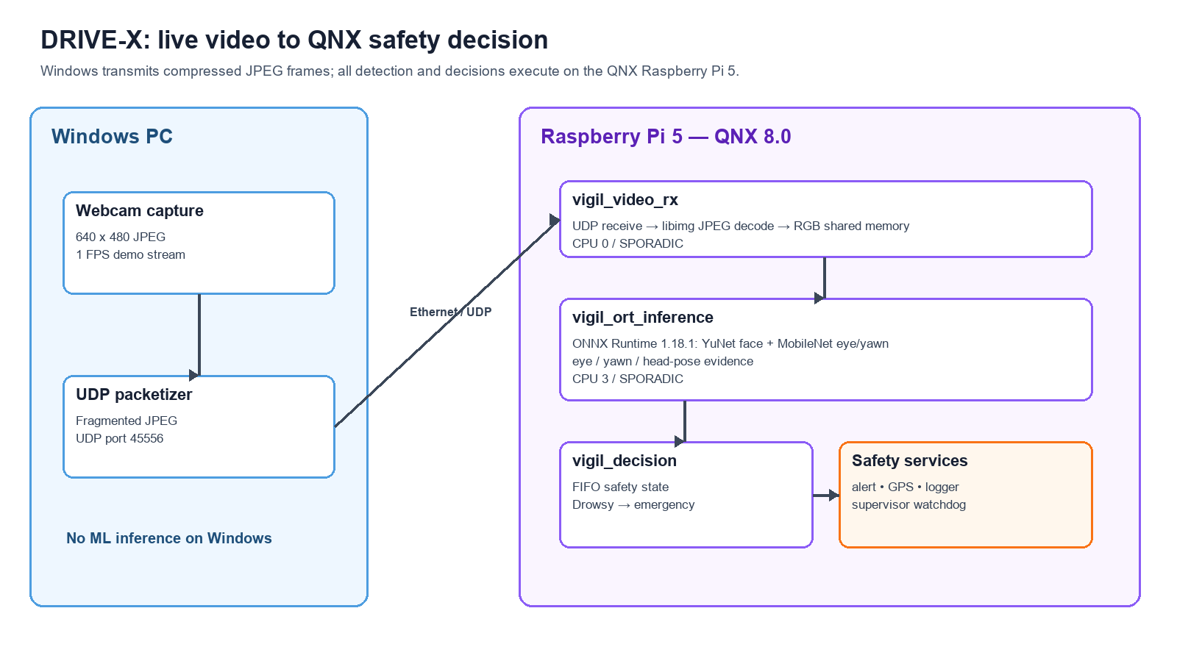
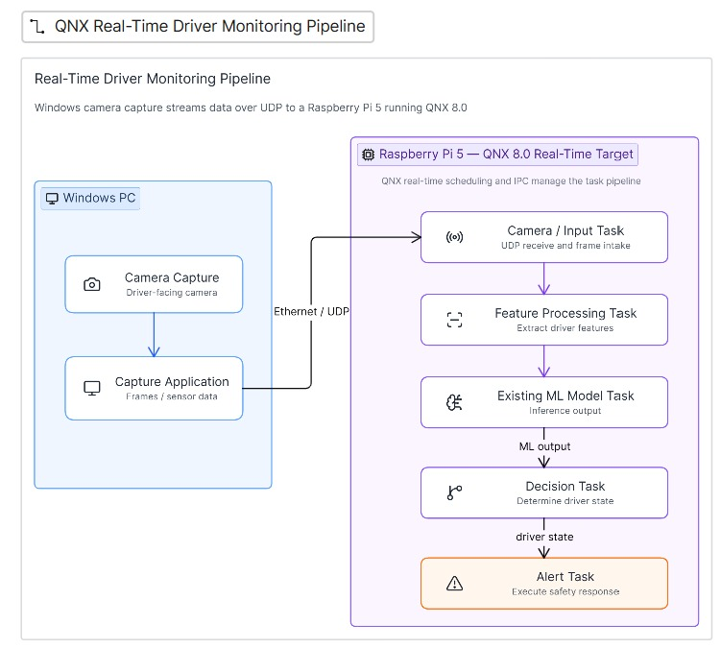
Architectural Diagram
Design and Execution

Slide 6
Technical Execution (Hardware & Logic)
Design and Execution
Hardware
  Raspberry Pi 5, 16 GB RAM, QNX SDP 8.0
  Windows webcam source streams 640×480 JPEG frames over Ethernet/UDP
  Optional NEO-7M GPS interface through UART; alert relay supports emergency notification
Live QNX logic
  vigil_video_rx receives JPEG packets and decodes them with QNX libimg
  vigil_ort_inference runs face detection, eye-state classification, yawn classification, and head-pose tracking
  vigil_decision maps evidence to ALERT, LOW VIGILANCE, CHECKING, or DROWSY
Observed outputs
  faces, eye-closure probability, yawn evidence, yaw, pitch, roll, inference time, and safety state

Slide 7
Resilience & "The Hack" Response
Design and Execution
Failure / stress cases
  Service exits, stale heartbeat, duplicate UDP bind, unavailable GPS device, and delayed decision service
Mitigation
  vigil_supervisor monitors process exits and heartbeat files
  It relaunches individual services and records decision recovery time
  Frame receiver rejects malformed packets; double-buffered shared memory avoids partially written RGB frames
Demonstrated resilience
  The pipeline reported recovery results and continued to process live JPEG frames after supervised service restarts.

Slide 8
Performance Proof (The Profiler Slide)
Demonstration
Live QNX System Profiler evidence
QNX local ONNX inference service
QNX JPEG receiver / decoder service
5.000 s trace • 1,197,822 events • 0 dropped buffers • 4 CPUs
vigil_ort_inference: 1.549 s running time, 33.259 ms ready time
vigil_video_rx: 139.577 ms running time
Live local inference: 237–256 ms/frame; JPEG decode: 7–11 ms
The profiler confirms that the Pi receives video and executes all ML inference under QNX scheduling.

Slide 9
Future Scalability & Conclusion
Demonstration
Next automotive steps
• Connect the safety state to CAN / ECU interfaces for controlled speed reduction
• Use automotive-grade camera, GNSS, power, and communication hardware
• Add night-time robustness, driver calibration, and contextual risk fusion
• Validate with automotive safety, cybersecurity, and real-road test plans
Learning outcome
Built and profiled a complete AI-based driver-monitoring pipeline on QNX.
Separated non-critical video transport from QNX safety decision and alert services.
Validated that the models execute locally on the Raspberry Pi 5.
DRIVE-X turns driver monitoring into a QNX-supervised, real-time safety response.

Slide 10
Thank you

