Slide 1
Developer Testing
Trainers – Cristian Drăgușanu, MarianSpoială

Slide 2
Agenda
Costs of developing software
Why Unit Testing?
What Is A Unit Test?
Unit testing patterns
Testing Frameworks
Mocking
Unit Tests vs Integration Tests
Tips For Writing Great Unit Tests
TDD
Code Coverage
Notes:
Alex

Slide 3
Costs of developing software

Slide 4
Why Unit Testing?
Notes:
Marian

Slide 5
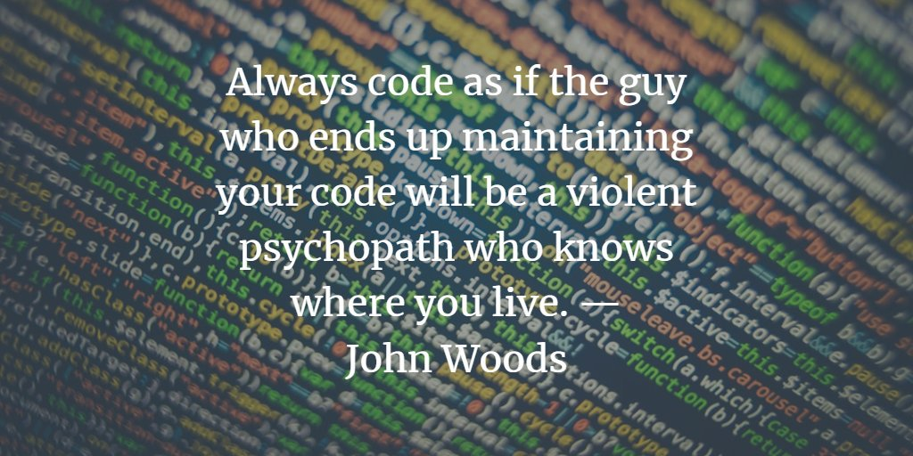
Why Unit Testing?
Notes:
Marian

Slide 6
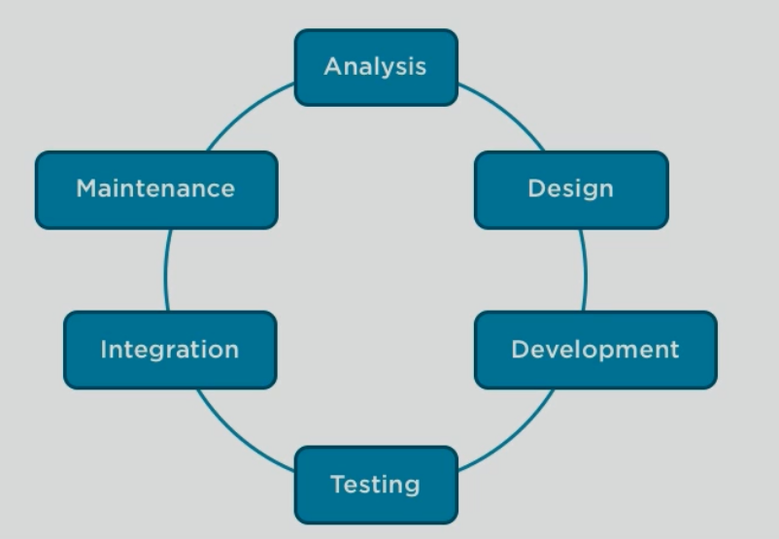
Costs of developing software
Notes:
Marian

Slide 7
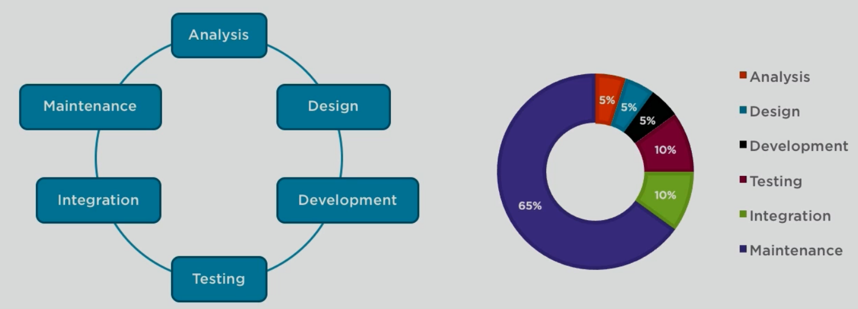
Costs of developing software
Notes:
Marian

Slide 8
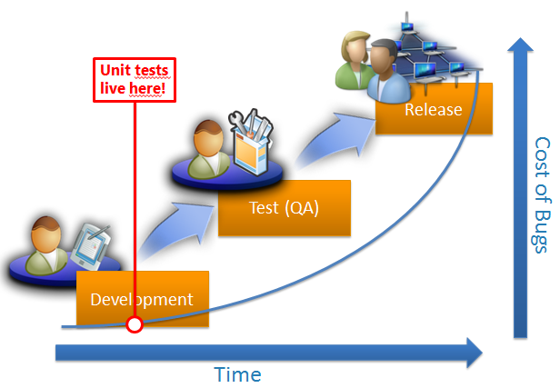
Why Unit Testing?
Notes:
Marian
*Este oarecum “general acceptat” ca, costurile de rezolvare a bugurilor sunt mult mai scazute daca acestea sunt “descoperite” in faza initiala -> in development
*Unit testele trebuie sa apara in aceasta zona pentru ca ele testeaza codul scris de developeri
*Odata descoperite bugurile in “development” costurile pentru rezolvarea lor va fi mult mai mic
*QA in acest fel se poate orienta catre functionalitate + “hard-to-find bugs”

Slide 9
Why Unit Testing?
Benefits
Find defects early
Notes:
Marian

Slide 10
Why Unit Testing?
Benefits
Find defects early
Prevent regressions
Notes:
Marian

Slide 11
Why Unit Testing?
Benefits
Find defects early
Prevent regressions
Provide living documentation (source code)
Notes:
Marian

Slide 12
Why Unit Testing?
Benefits
Find defects early
Prevent regressions
Provide living documentation (source code)
Automate testing efforts
Notes:
Marian

Slide 13
What Is A Unit Test?
Notes:
Alex
S-a vorbit despre importanta unit testelor si beneficiile pe care le aduc ele.
Cred ca acuma e cazul sa aflam si ce e un unit test.

Slide 14
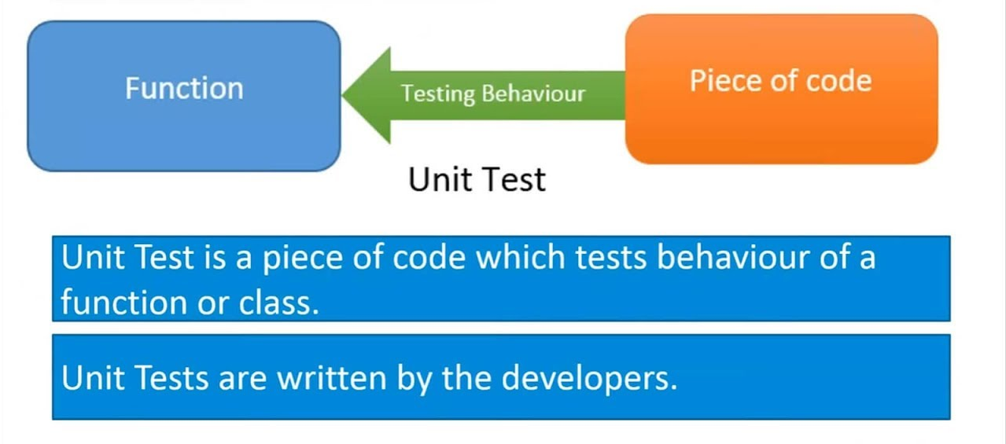
What Is A Unit Test?
Notes:
Alex
Cea mai simpla definitie a unui unit tests este : “cod ce testeaza alt cod”.

Slide 15
What Is A Unit Test?
“A unit test is a piece of code (usually a method) that invoke another piece of code and checks the correctness of some assumptions afterwards.”
Art of Unit testing
Notes:
Alex

Slide 16
What Is A Unit Test?
Essentially, a unit test is a method that instantiates a small portion of our application and verifies its behavior independently from other parts.
Notes:
Alex

Slide 17
Unit testing patterns
Notes:
Marian
A typical unit test contains 3 phases:
First, it initializes a small piece of an application it wants to test (also known as the system under test, or SUT), then it applies some stimulus to the system under test (usually by calling a method on it), and finally, it observes the resulting behavior.
If the observed behavior is consistent with the expectations, the unit test passes, otherwise, it fails, indicating that there is a problem somewhere in the system under test.
These three unit test phases are also known as Arrange, Act and Assert, or simply AAA.
SUT => stands from System Under Test, Code Under test or Class Under Test

Slide 18
Unit testing patterns
AAA
Arrange
Act
Assert
Notes:
Marian
The AAA (Arrange, Act, Assert) pattern is a common way of writing unit tests for a method under test.
The Arrange section of a unit test method initializes objects and sets the value of the data that is passed to the method under test.
The Act section invokes the method under test with the arranged parameters.
The Assert section verifies that the action of the method under test behaves as expected.

Slide 19
Unit testing patterns
Naming conventions
Should_ExpectedBehavior_When_StateUnderTest
Should_ThrowException_When_AgeLessThan18
Should_FailToWithdrawMoney_ForInvalidAccount
Should_FailToAdmit_IfMandatoryFieldsAreMissing
Notes:
Marian
The AAA (Arrange, Act, Assert) pattern is a common way of writing unit tests for a method under test.
The Arrange section of a unit test method initializes objects and sets the value of the data that is passed to the method under test.
The Act section invokes the method under test with the arranged parameters.
The Assert section verifies that the action of the method under test behaves as expected.

Slide 20
Unit testing patterns
Naming conventions
When_StateUnderTest_Expect_ExpectedBehavior
When_AgeLessThan18_Expect_isAdultAsFalse
When_InvalidAccount_Expect_WithdrawMoneyToFail
When_MandatoryFieldsAreMissing_Expect_StudentAdmissionToFail
Notes:
Marian
The AAA (Arrange, Act, Assert) pattern is a common way of writing unit tests for a method under test.
The Arrange section of a unit test method initializes objects and sets the value of the data that is passed to the method under test.
The Act section invokes the method under test with the arranged parameters.
The Assert section verifies that the action of the method under test behaves as expected.

Slide 21
Unit testing patterns
Naming conventions
Given_Preconditions_When_StateUnderTest_Then_ExpectedBehavior
Given_UserIsAuthenticated_When_InvalidAccountNumberIsUsedToWithdrawMoney_Then_TransactionsWillFail
Notes:
Marian
The AAA (Arrange, Act, Assert) pattern is a common way of writing unit tests for a method under test.
The Arrange section of a unit test method initializes objects and sets the value of the data that is passed to the method under test.
The Act section invokes the method under test with the arranged parameters.
The Assert section verifies that the action of the method under test behaves as expected.

Slide 22
Testing Frameworks
MSTest
NUnit
xUnit
Notes:
Marian
Using Trainers project
Using FIZZBUZZ as a backup

Slide 23
DEMO - FizzBuzz
Notes:
Marian
Using Trainers project
Using FIZZBUZZ as a backup

Slide 24
Mocking
Notes:
Alex

Slide 25
Mocking
What is mocking?
Notes:
Alex

Slide 26
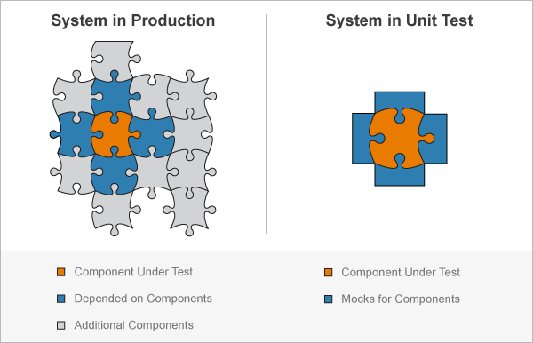
Mocking
Notes:
Alex

Slide 27
Mocking
What is mocking?
Mocking is a process used in unit testing when the unit being tested has external dependencies. The purpose of mocking is to focus on the code being tested and not on the behavior or state of external dependencies. In mocking, the dependencies are replaced by closely controlled replacements objects that simulate the behavior of the real ones.
Notes:
Alex

Slide 28
Mocking
Types of mocking
Notes:
Alex

Slide 29
Mocking
Types of mocking
Stub: has a predetermined behavior. Basically an implementation of the dependency with a fixed set of responses.
Notes:
Alex

Slide 30
Mocking
Types of mocking
Stub: has a predetermined behavior. Basically an implementation of the dependency with a fixed set of responses.
Mock: must be setup with your expectations in each test. They are in a way determined at runtime since the code that sets the expectations has to run before they do anything.
Notes:
Alex

Slide 31
Mocking
Benefits
Notes:
Alex

Slide 32
Mocking
Benefits
Improved test execution speed
Notes:
Alex

Slide 33
Mocking
Benefits
Improved test execution speed
Test logic of a class in isolation
Notes:
Alex

Slide 34
Mocking
Benefits
Improved test execution speed
Test logic of a class in isolation
Improve test reliability

Slide 35
Mocking
Open Source library: Moq (https://github.com/moq)
Notes:
Alex

Slide 36
Mocking - DEMO
Notes:
Alex

Slide 37
Unit Tests vs Integration Tests
Notes:
Marian

Slide 38
Unit Tests vs Integration Tests
“Integration tests ensure that an app's components function correctly at a level that includes the app's supporting infrastructure, such as the database, file system, and network.”
Notes:
Marian

Slide 39
Unit Tests vs Integration Tests
“Integration tests ensure that an app's components function correctly at a level that includes the app's supporting infrastructure, such as the database, file system, and network.”
“Integration tests evaluate an app's components on a broader level than unit tests.”
Notes:
Marian

Slide 40
Unit Tests vs Integration Tests
In contrast to unit tests, integration tests:
Notes:
Marian

Slide 41
Unit Tests vs Integration Tests
In contrast to unit tests, integration tests:
Use the actual components that the app uses in production.
Notes:
Marian

Slide 42
Unit Tests vs Integration Tests
In contrast to unit tests, integration tests:
Use the actual components that the app uses in production.
Require more code and data processing.
Notes:
Marian

Slide 43
Unit Tests vs Integration Tests
In contrast to unit tests, integration tests:
Use the actual components that the app uses in production.
Require more code and data processing.
Take longer to run.
Notes:
Marian

Slide 44
Tips For Writing Great Unit Tests
Notes:
Alex

Slide 45
Tips For Writing Great Unit Tests
Make each test independent to all the others
Notes:
Alex

Slide 46
Tips For Writing Great Unit Tests
Make each test independent to all the others
Any given behavior should be specified in one and only one test
Notes:
Alex

Slide 47
Tips For Writing Great Unit Tests
Make each test independent to all the others
Any given behavior should be specified in one and only one test
Mock out all external services and state
Notes:
Alex

Slide 48
Tips For Writing Great Unit Tests
Make each test independent to all the others
Any given behavior should be specified in one and only one test
Mock out all external services and state
“Any unit tests are better than none”
Notes:
Alex

Slide 49
TDD
What is TDD?
Notes:
Marian

Slide 50
TDD
What is TDD?
“Test Driven Development (TDD henceforth) is an iterative process in which test cases are written before a solution is implemented. This practice is contrary to the tradition involving coding first and testing second.”
Source - https://www.pluralsight.com/guides/software-delivery-using-test-driven-development-tdd
Notes:
Marian

Slide 51
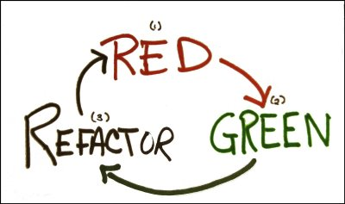
TDD
What is TDD?
Source - https://blog.cleancoder.com/uncle-bob/2014/12/17/TheCyclesOfTDD.html
Notes:
Marian
This cycle is typically executed once for every complete unit test, or once every dozen or so cycles of the three laws. The rules of this cycle are simple.
Create a unit tests that fails
Write production code that makes that test pass.
Clean up the mess you just made.
But this is an “incorrect” representation, due to the fact that doesn’t have all the steps.
Next representation is more accurate. So, at a high level, the process to develop a software using TDD is provided in the next figure.

Slide 52
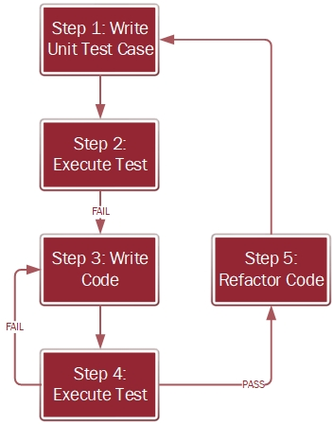
TDD
What is TDD?
Notes:
Marian
Source: https://www.pluralsight.com/guides/software-delivery-using-test-driven-development-tdd

Slide 53
TDD
Benefits
Notes:
Marian

Slide 54
TDD
Benefits
The code that comes out of this process is clean
Notes:
Marian

Slide 55
TDD
Benefits
The code that comes out of this process is clean
It is possible to achieve 100% code coverage
Notes:
Marian

Slide 56
TDD
Downsides
Notes:
Marian

Slide 57
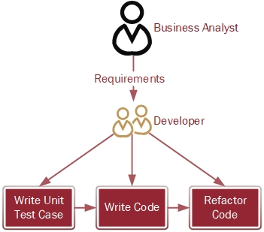
TDD
Downsides
Notes:
Marian
As you can see in the roleplay diagram, no testers are involved in TDD.
The developer writes the test case and also develops the code.
So, there is less validation of the requirements throughout the cycle than there is when testers are a part of the process.
Solutions:
Acceptance Test Driven Development (ATDD) - First, instead of writing unit test cases, acceptance test cases are written when user stories are written, and then the code is developed.
Second, the test cases are written by the tester, and the code is developed by the coder – which adds validation that the cod meets the customer's expectations as defined by the business analyst.
Behavioral Driven Development - BDD. (explanations based on Given_When_Then)

Slide 58
TDD
Best practices
Notes:
Marian

Slide 59
TDD
Best practices
The test code should be: readable and maintainable
Notes:
Marian

Slide 60
TDD
Best practices
The test code should be: readable and maintainable
We should address positive and negative test cases
Notes:
Marian

Slide 61
TDD
Best practices
The test code should be: readable and maintainable
We should address positive and negative test cases
We should separate our set-up and tear-down code
Notes:
Marian

Slide 62
TDD
Best practices
The test code should be: readable and maintainable
We should address positive and negative test cases
We should separate our set-up and tear-down code
Continuously review your tests and test practices with the Team
Notes:
Marian

Slide 63
TDD - DEMO
Notes:
Marian

Slide 64
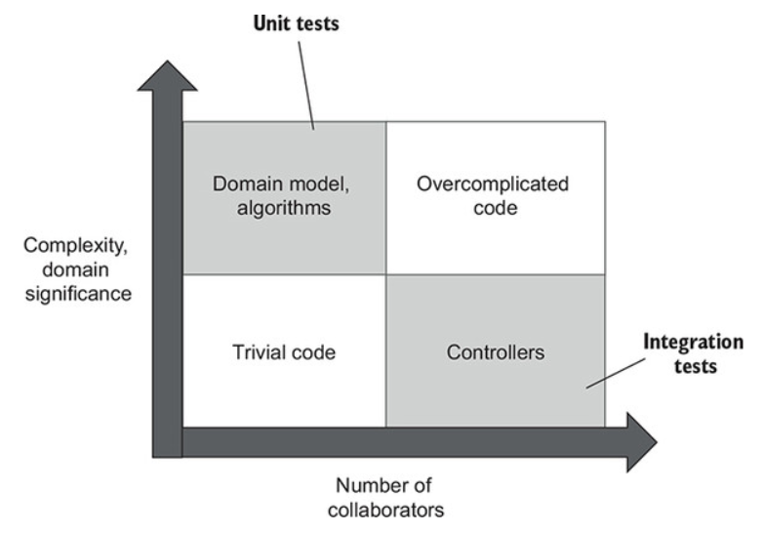
Code Coverage
What to test
Notes:
Alex

Slide 65
Questions

Slide 66
Thank you

