Slide 1


What if the engine
knew it was failing?
An explainable deep learning system that estimates remaining useful life and enables proactive aircraft maintenance
Deep Learning – Final Project
June 2026
Marian · Theo · Nour · Nuria · Ignacio · Alberto

Slide 2

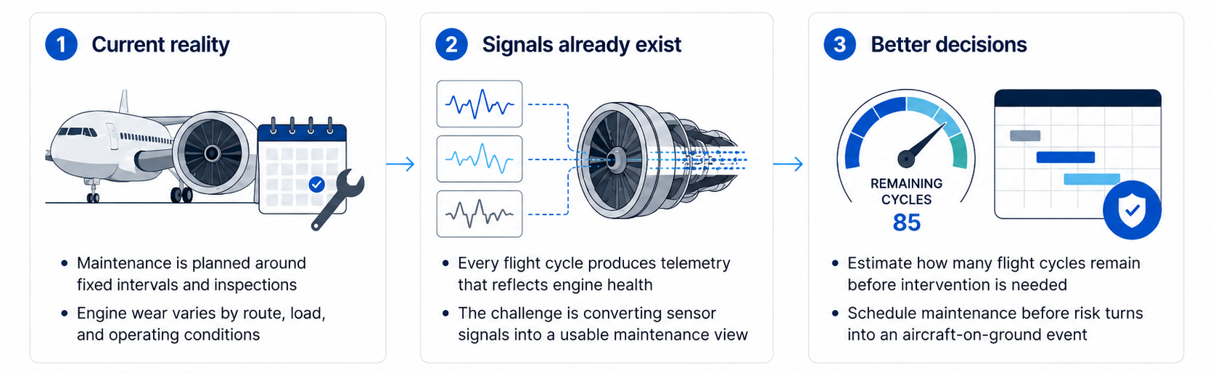



Fixed maintenance schedules leave airlines exposed to avoidable downtime
Aircraft engines already generate rich sensor data, but maintenance decisions often fail to reflect each engine’s true degradation state.
Unplanned failure
Planned maintenance
Value at stake
$500K+
$35K
$465K
Unplanned failure
Planned maintenance
Value at stake

Slide 3
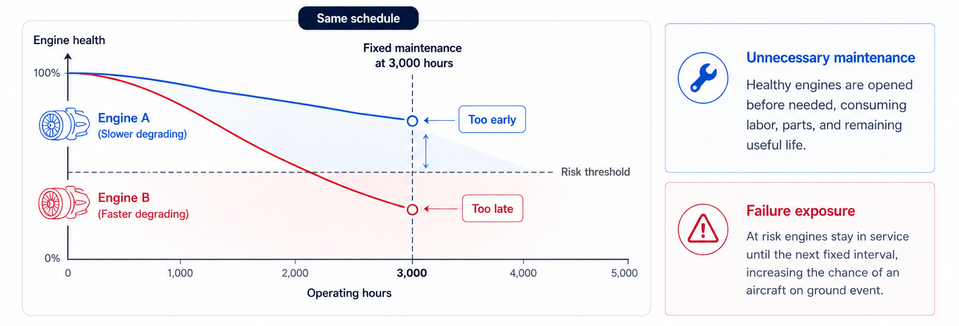
Fixed intervals force airlines to service engines either too early or too late
A single 3,000-hour rule ignores the fact that engines wear differently across routes, loads, and operating conditions.
The problem isn’t lack of data, but relying on one schedule for engines that wear at different speeds

Slide 4
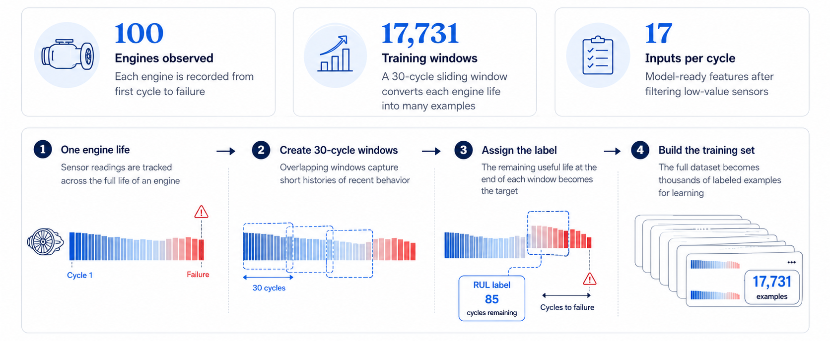
Run to failure hist histories give us the signal needed to predict remaining life
Our model follows 100 engines from first cycle to breakdown, turning each engine life into thousands of labeled examples.
Because every engine ends in failure, the data captures both normal wear patterns and the warning signs that appear before breakdown.

Slide 5
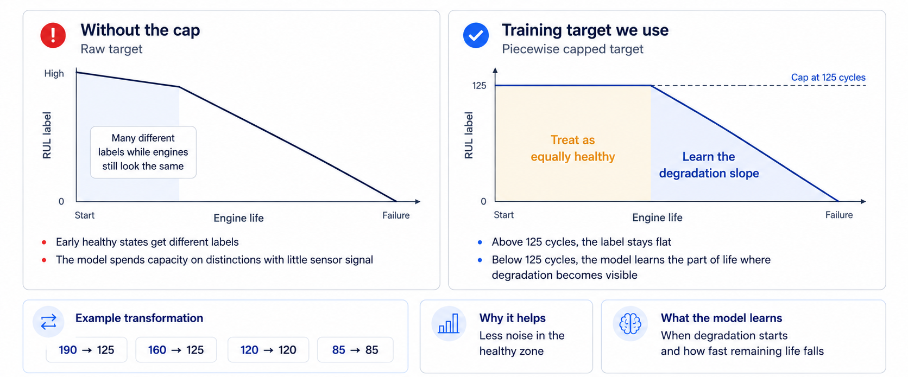
Capping RUL at 125 cycles focuses learning on meaningful degradation
Early sensor histories look similar, so treating very high RUL values as equally healthy gives the model a cleaner target to learn from.
The cap removes artificial precision from early life and concentrates learning on the signal that matters.

Slide 6
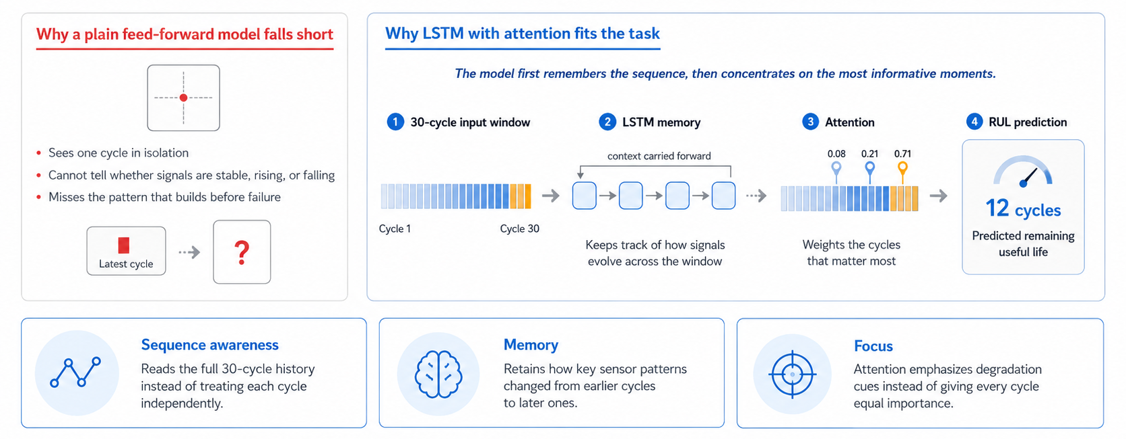
RUL prediction works best when the model remembers how the engine got there
The model must read the full 30-cycle history, retain context across steps, and focus on the moments where degradation is visible.
For engine RUL, failure risk as a trajectory, not a snapshot.

Slide 7
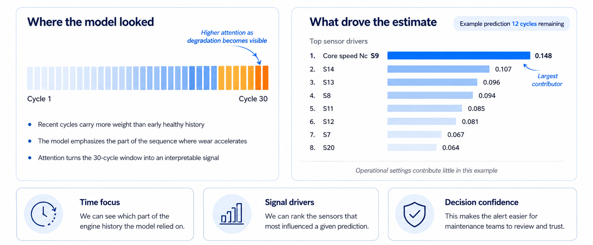
Attention makes each prediction easier to explain and trust
The model shows both where in the sequence it focused and which sensor signals contributed most.
Explainability turns a model output into a maintenance signal engineers can act on.

Slide 8
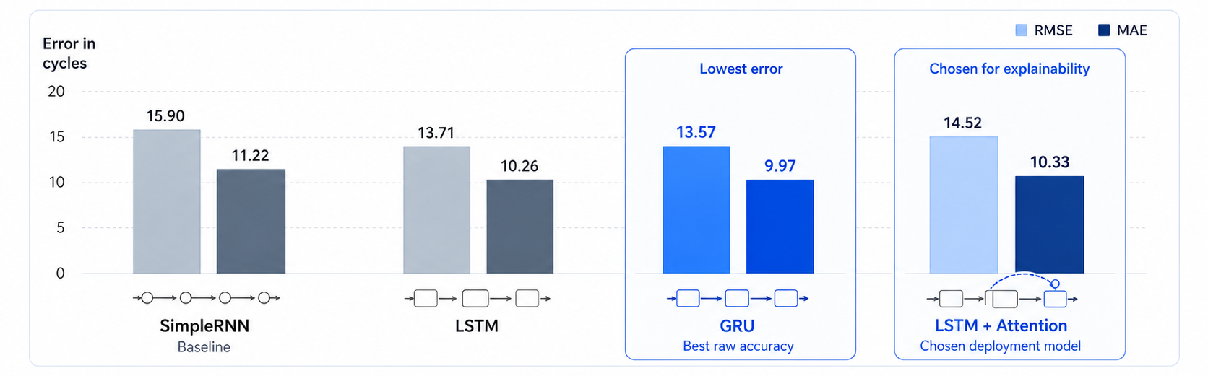
GRU achieved the lowest error while LSTM with attention offered the best balance
LSTM with attention was selected because it combines performance with an explainable prediction path.

Slide 9
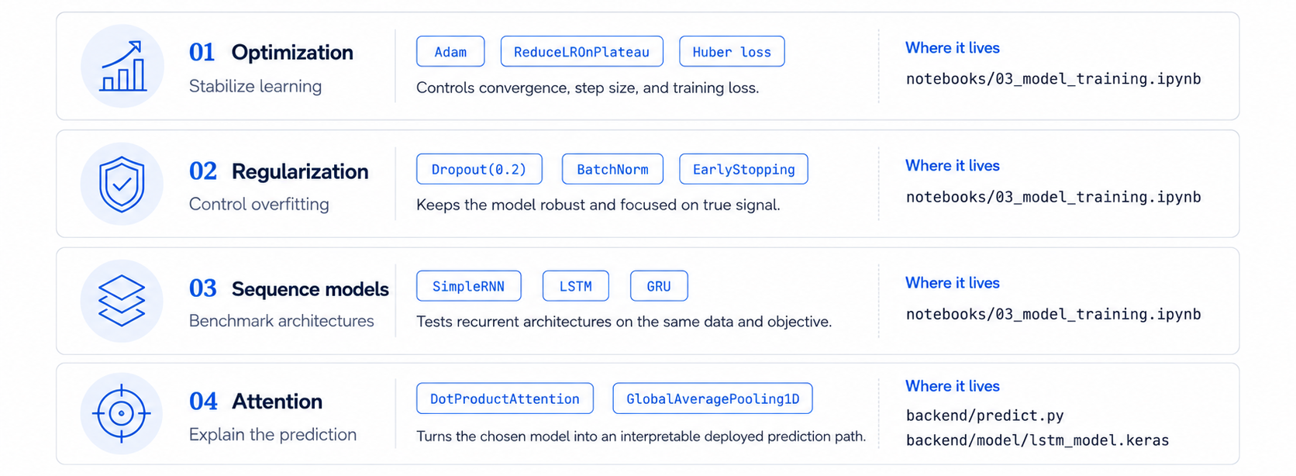
Each modeling choice maps directly to a clear component in the repo
The architecture is auditable because every capability is implemented in a named repo component.

Slide 10
Live demo
Deep Learning – Final Project
June 2026
Marian · Theo · Nour · Nuria · Ignacio · Alberto

Slide 11
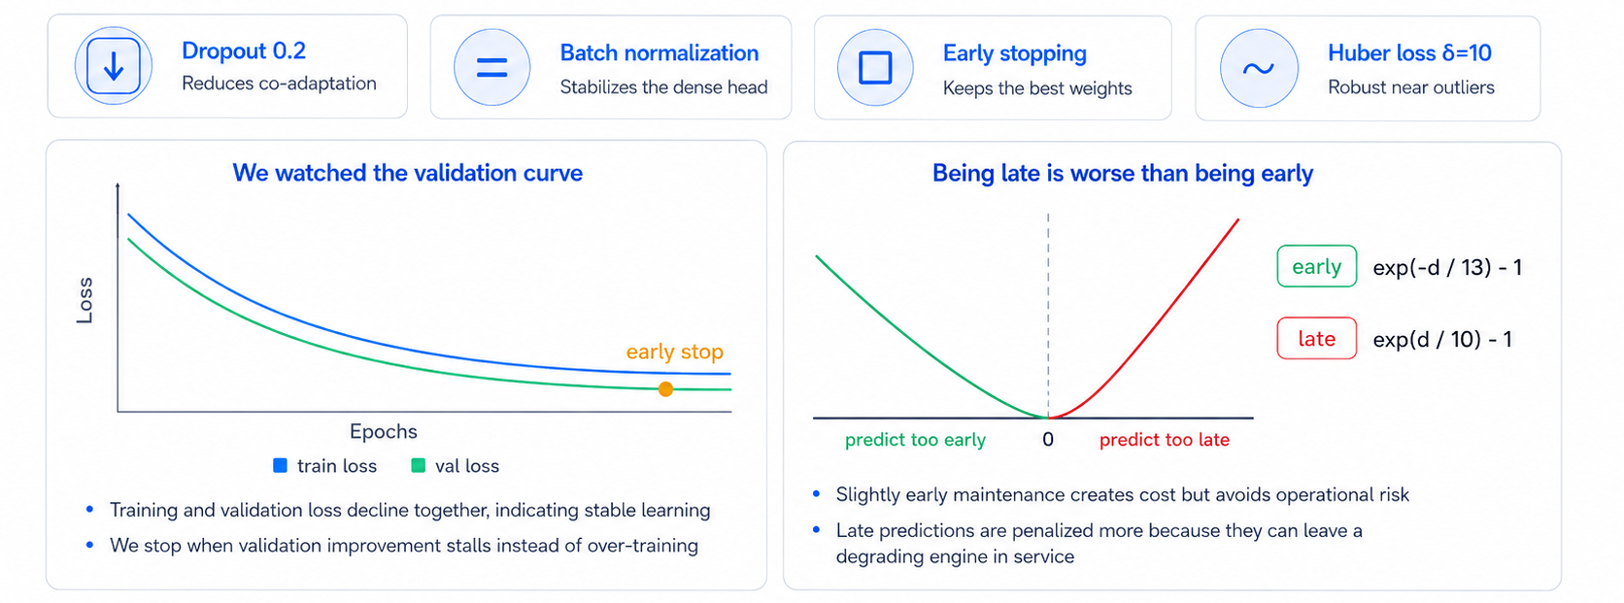
Training choices reduce overfitting and penalize late mistakes more heavily
We monitored generalization during training and used a cost-aware error treatment.
The training process favors robust generalization and treats late prediction errors as the riskier mistake

Slide 12
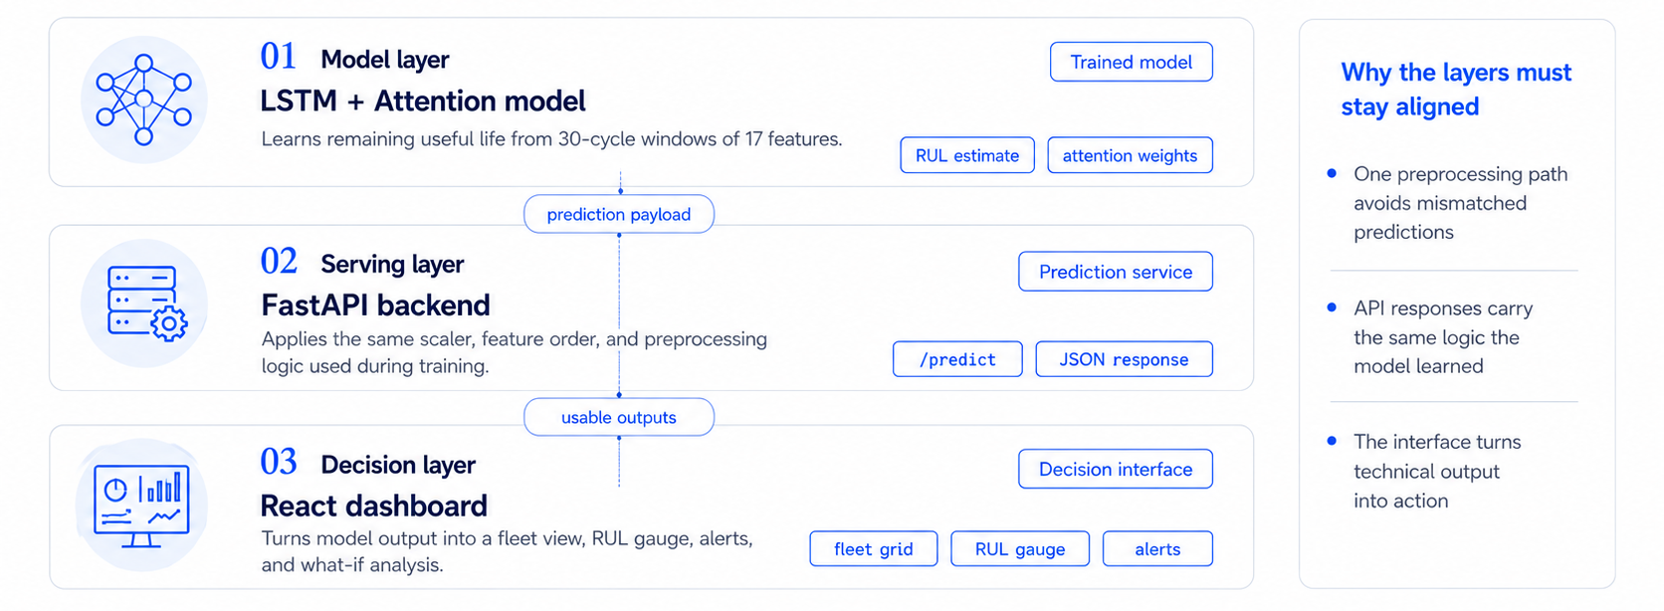
Keeping the model, API, and dashboard in sync makes the prediction usable
The same preprocessing and feature logic flow form training to serving to the interface, so the result stays consistent end to end.
The architecture matters because one consistent pipeline turns a model output into an actionable goal.

Slide 13
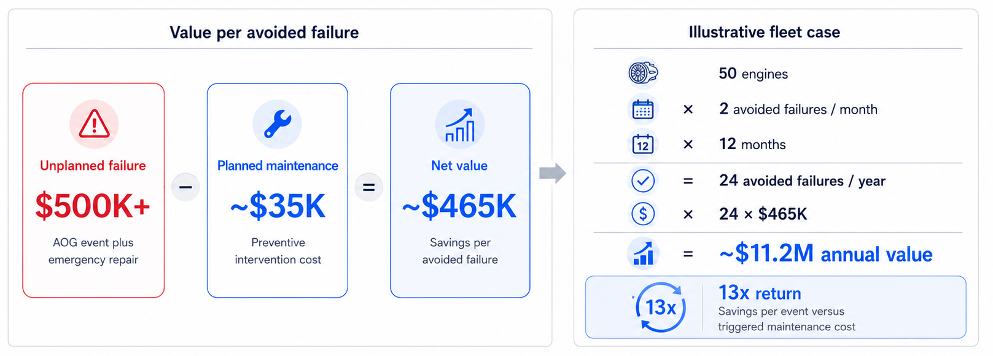
A 50-engine fleet can save about $11.2M a year by avoiding unplanned failures
The economics are attractive because one avoided aircraft on ground event is worth far more than the preventive maintenance.
The business case is driven by simple unit economics and turns predictive maintenance into measurable value

Slide 14
Thank you
Q&A
Deep Learning – Final Project
June 2026
Marian · Theo · Nour · Nuria · Ignacio · Alberto

