Slide 1

Tweet_search aho-corasick algorithm
Yiwei zhang, Chenbo Zhang
Shizhe Yang, Haoxiang Sun

Slide 2
Introduction of aho-corasick algorithm
the Aho–Corasick algorithm is a string_searching algorithmn invented by Alfred V. Aho and Margaret J. Corasick in 1975.^{[1]} It is a kind of dictionary-matching algorithm that locates elements of a finite set of strings (the "dictionary") within an input text.

Slide 3
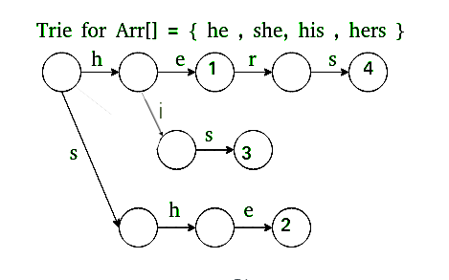
Preprocessing
1. Build the Trie of all words.
2. create success transactions

Slide 4
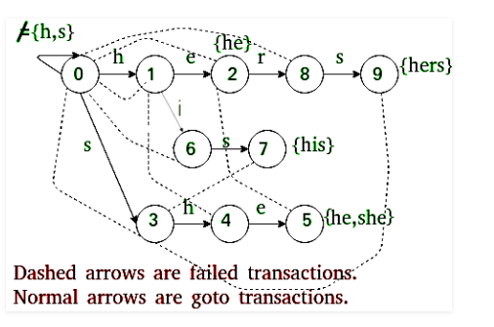
prepocessing
Create the failed transactions
Through BFS

Slide 5
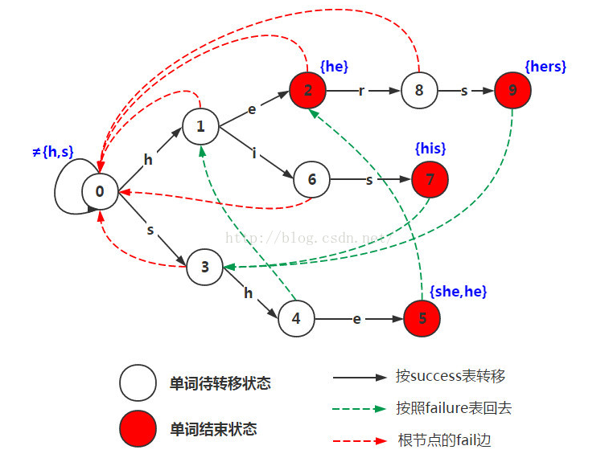
Matching
Traverse the given text over built automaton to find all matching words.

Slide 6
Time complexity
Given an input text and an array of k words, array[], find all occurrences of all words in the input text. Let n be the length of text and m be the total number characters in all words, i.e. m = length(array[0]) + length(array[1]) + … + length(array[k-1]). Here k is total numbers of input words.
Aho-Corasick Algorithm finds all words in O(n + m + z) time where z is total number of occurrences of words in text.
If we use a linear time searching algorithm like KMP, then we need to one by one search all words in text[]. This gives us total time complexity as O(n + length(word[0]) + O(n + length(word[1]) + O(n + length(word[2]) + … O(n + length(word[k-1]). This time complexity can be written as O(n*k + m).

Slide 7
Code Analysis

