Slide 1

Open Science, Open Future
Illustrations from the Turing Way book dashes | Zenodo

Slide 2

OSOF Code of conduct
Participate: proactively take part to the conversation and include others
Encourage transparency and sharing
Focus not only on yourself, but on the group you’re working with
Embrace diversity of backgrounds, opinions, and interests
If you feel uncomfortable at any point, please email osof@gmail.con, or report via the code of conduct report incident form. Every information shared will be treated as confidential.
More info on the code of conduct can be found here
Notes:
For live workshops only

Slide 3
What is Open Science?
…or?
TRANSPARENCY
EVERY RESEARCH STEP
SCIENTISTS
EQUITY
for
at
by
POLICY MAKERS
EFFICIENCY
THE PUBLIC
FUNDERS
The practice of making “the primary outputs of publicly funded research results publicly accessible in a digital format with no or minimal restriction.”
Organization for Economic Cooperation and Development
A NEW WAY OF DOING SCIENCE!

Slide 4
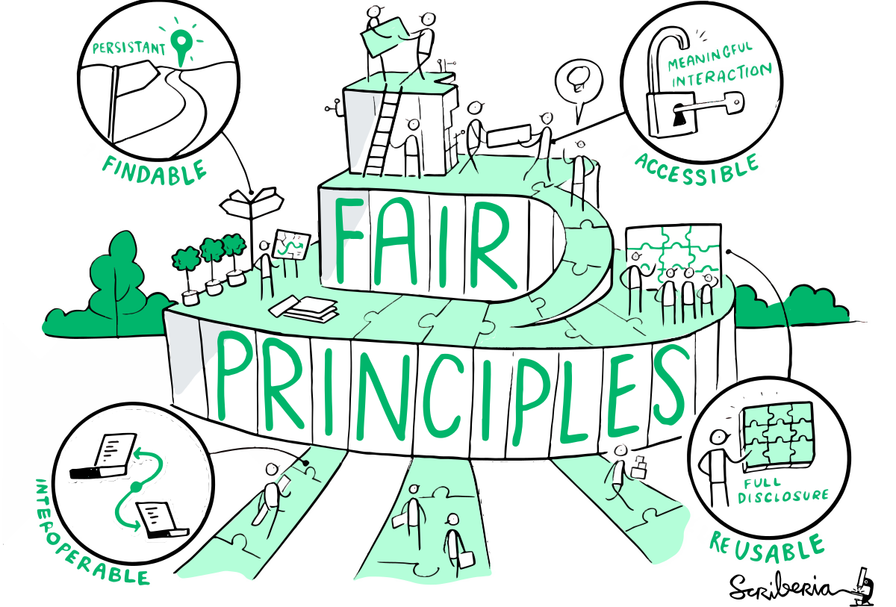
Get to know the slang!
Illustrations from the Turing Way book dashes | Zenodo

Slide 5

Overwhelmed? Take one step at the time!

Slide 6
Tips on how to get started
Identify your skills, needs, and influence
Start from the little changes (Matlab user? Explore Python. Already a coder? Add an extra line of comment to your code)
Stay curious!
Have conversations and share! With peers and senior members of your community
Check what your institution offers. (data management team? Librarians? Open research team?)
Adapt and use existing resources (more about this in a few slides)
Celebrate every step!
YOU
your peers/team
your institution/community

Slide 7
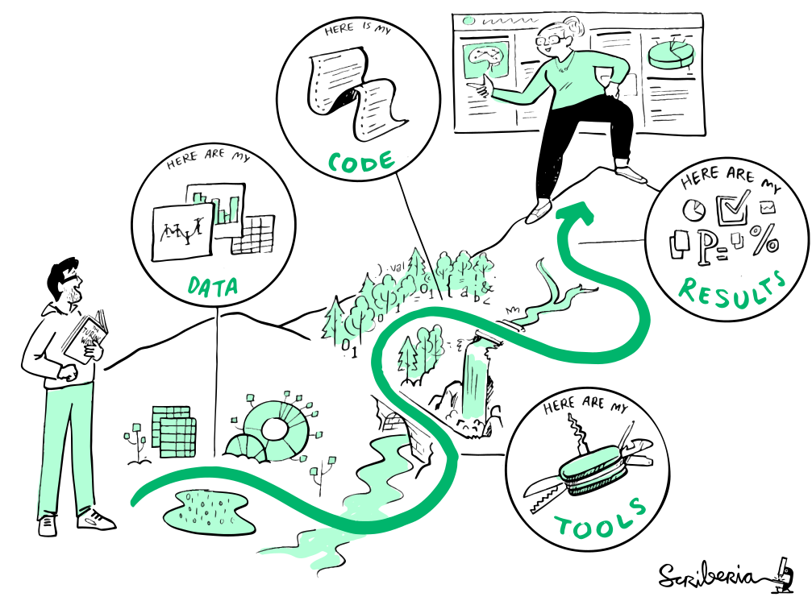
There’s something for everyone
Data management: make plans, make them into practice, and keep them up-to-date. (Organization freak? Use this strength! Not much organization skills? Talk to your peers/team )
Publishing practices: use preprints, open access
Data and code sharing: use repositories and open softwares.
Data reuse: promote and practice it!
Notes:
Based on background, research area, interests, career stage

Slide 8
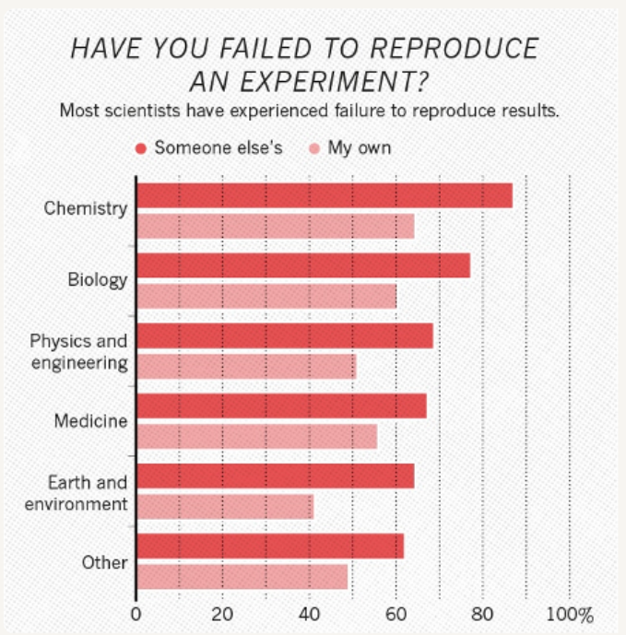
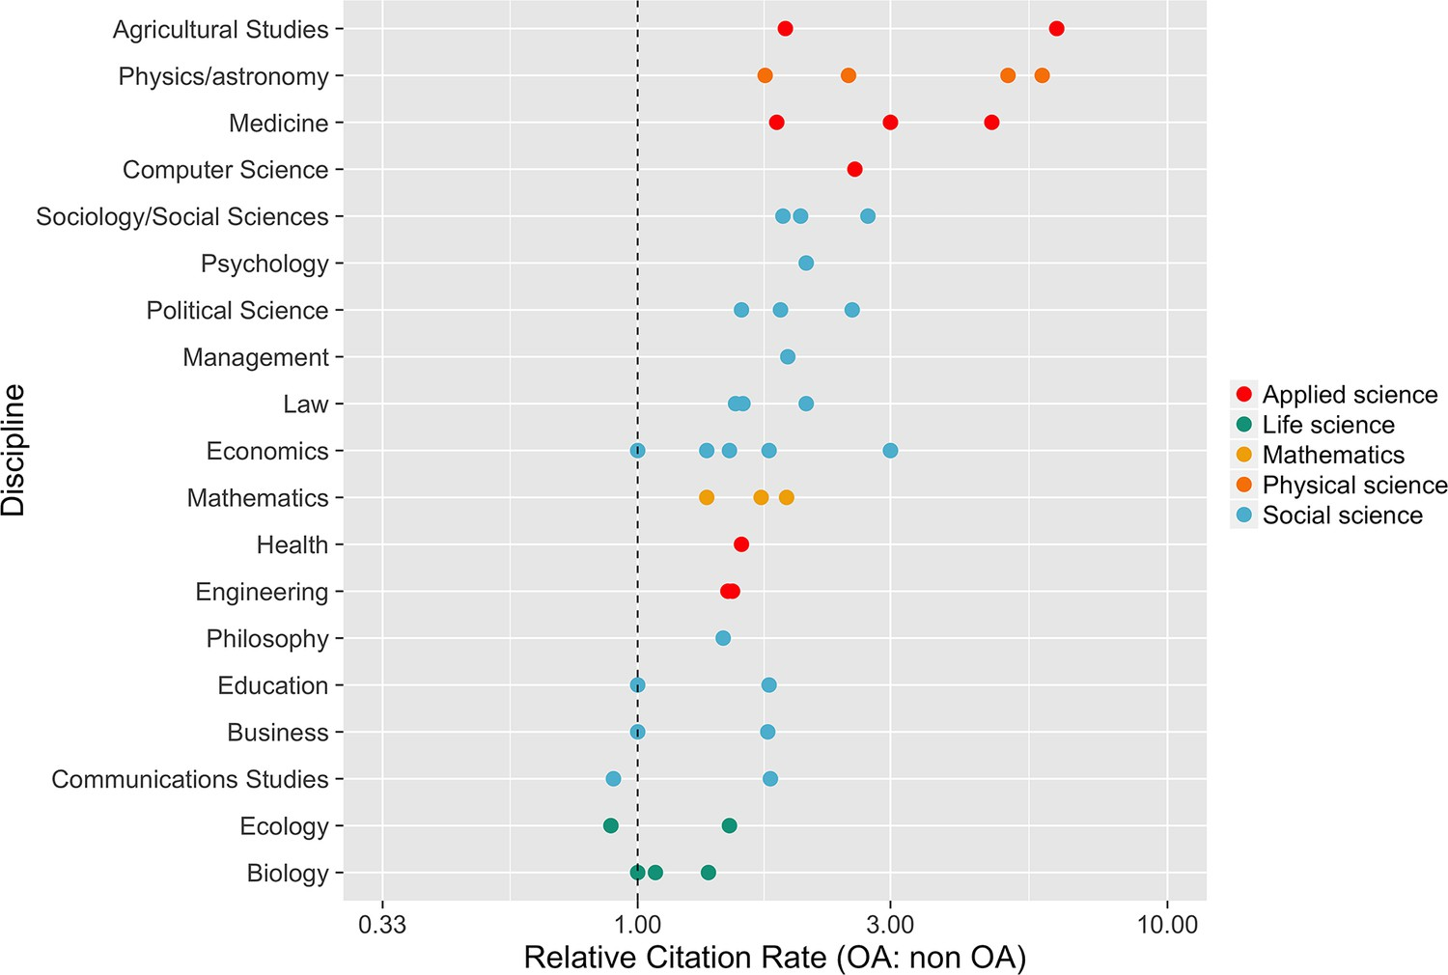
Why should I care?
REPRODUCIBILITY
OPEN-ACCESS

Slide 9






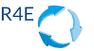

Make use of the resources available

