Slide 1
Problem Statement
GPS Toll-Based System Simulation Using Python
1. Vehicle Movement Simulation: Simulate vehicles moving along predefined routes with GPS coordinates.
2. Toll Zone Definition: Define toll zones or points with GPS coordinates.
3. Distance Calculation: Calculate the distance travelled by each vehicle within toll zones.
4. Toll Calculation: Compute toll charges based on distance travelled or zones passed.
5. Payment Simulation: Simulate the process of deducting toll charges from user accounts.

Slide 2
Unique Idea Brief (Solution)
Effective Simulation of Vehicle Movement: The project accurately models the real-time movement of vehicles using GPS coordinates, allowing for realistic tracking and toll calculation.
Automated Toll Collection: We implemented an efficient system for automatically calculating tolls based on distance traveled and toll points crossed, reducing the need for manual intervention.
Scalability and Flexibility: The simulation can handle various scenarios, including different toll rates, vehicle types, and traffic patterns, demonstrating the system’s adaptability.
Cost Efficiency and Reduced Congestion: By leveraging GPS technology, the system can potentially reduce operational costs and traffic congestion, providing a seamless experience for drivers.

Slide 3
Features Offered
Real-time data collection: Tracks vehicle journey in real-time.
Map Generation: Shows the road through which the vehicle is travelling, toll zone in that region and the toll zone through which the vehicle is travelling.
Data Storage: Stores vehicle data such as vehicle number, type, start and end points , balance , journey date, and payment status.
User Management: Associate vehicle details with user IDs and extract relevant information when a journey starts.
Toll Payment Status: Manages and updates the payment status for each journey.

Slide 4
Process flow
Setup Environment
Simulate Vehicle Movement
Detect Toll Zone Crossings
Calculate Toll Charges
Simulate Payments
6. Analytics and Reporting

Slide 5
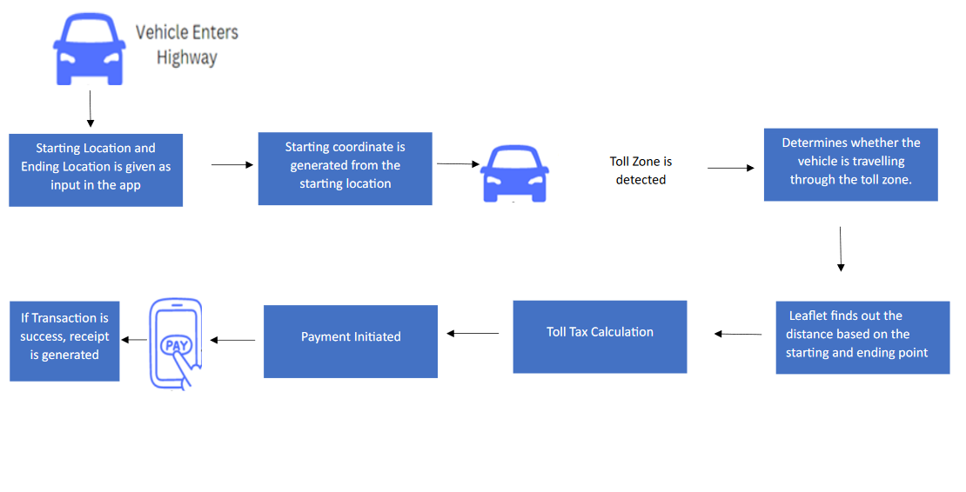
Architecture Diagram

Slide 6
Technologies used
HTML
CSS
Javascript
Leaflet
Python

Slide 7
Team members and contribution:
Sethunath A – Front-end development, Code integration, Debugging
Marianna Martin – Map generation, Coordinates collection, Toll zone detection, Tax calculation, Debugging
Rizia Sara Prabin – Documentation, Toll-rate calculation, Dataset preparation, Debugging
Sreya Anna Joseph – Documentation, Dataset preparation, Data storage, Vehicle detection, Debugging

Slide 8
Conclusion
The GPS Toll Collection Simulation project successfully demonstrates the integration of GPS technology with toll collection systems using Python. We have shown how modern toll collection can be automated and streamlined by simulating vehicles' movement and interactions with virtual toll checkpoints.

