Slide 1

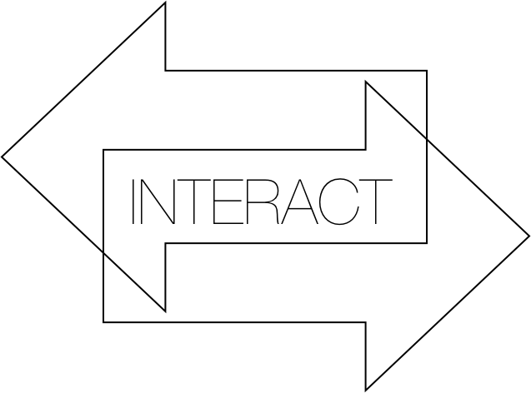
Team2
Marianna Hatzidemetriou
Agathe Duboue
Anastasia Yiannaki
Sotia Gregoriou

Slide 2
Project Goal And Approach
Simple Web Application for Professors and Students used for an interactive lecture.
Minimal design because it’s an application, used every day and we wanted it to be :
Easy to use
Easy to navigate
Easy to remember
Through this app the students will be able to learn more and test their selves by answering questions
The questions are assigned by the Professor with the possible and correct answers.

Slide 3
Project Goal And Approach
The professor has the ability to add, edit and delete a question or an answer at anytime.
The professor has to login first using his assigned username and password.
The student also logs in the app using the course code according to the course he is enrolled.

Slide 4
Technologies used
We used all the technologies we learned in this course.
HTML and CSS for designing the website
PHP
Javascript
Mysql for creating the database
Xampp for working locally and being able to watch php, html working together without needing to have a server.

Slide 5
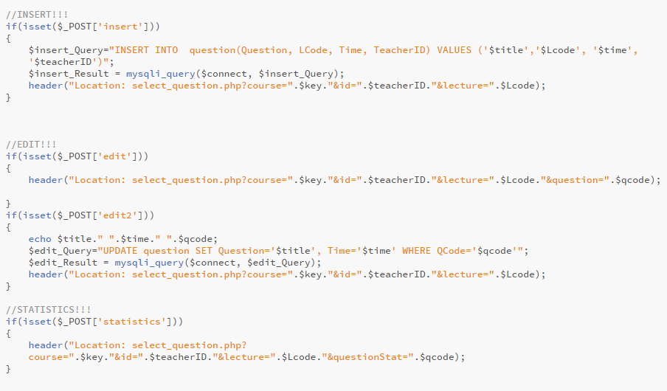
PHP – complexity sample code

Slide 6
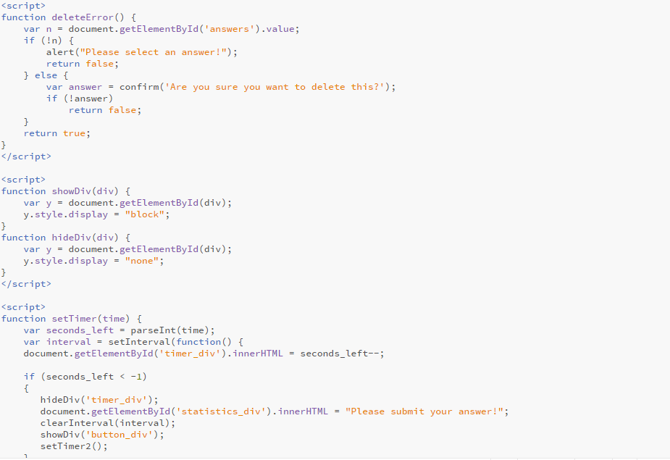
Javascript – complexity sample code

Slide 7
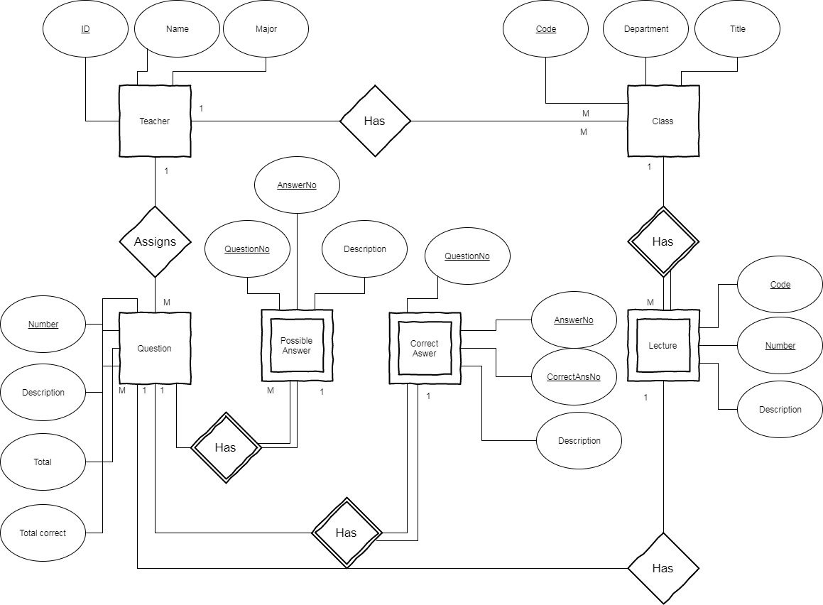
MySQL
Entity Relation diagram used for constructing our database
Each student is enrolled to some lessons
Each professor has some classes
The professor assigns questions
Each question has some possible answers
And each class has lectures with questions
The student chooses an answer from the possible ones.

Slide 8
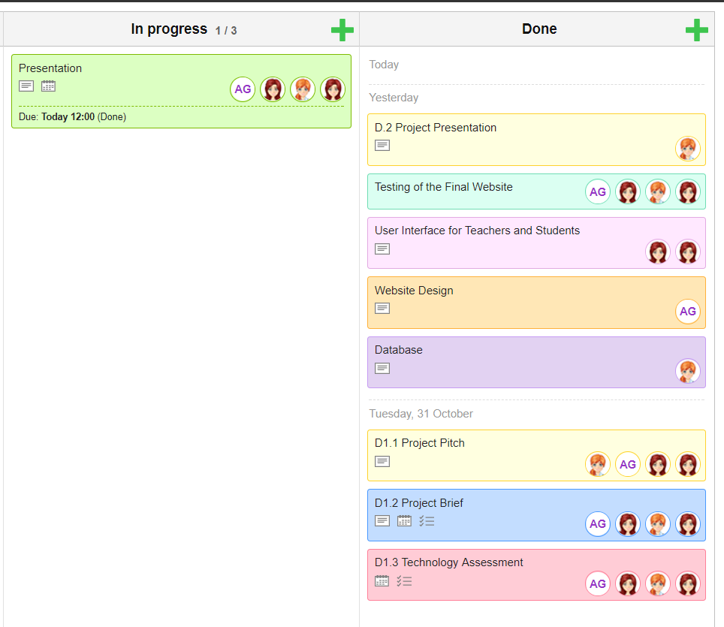
Timeline and Communication
We used Kanban flow to divide everything needed to do for the creation of this website.
We set timelines for each task.
Each of us worked on a different task but we also co-worked in other tasks.
This helped us to achieve the basic goal of this project.

Slide 9
Achievements & Evaluation
We tried to follow the principles of usability as we learned in this course.
Easy to learn
Efficient to use
Easy to memorise
Few errors
User friendly

Slide 10
Easy to learn
We used buttons with labels so the user can easily find a way to navigate to the website.
The structure and design is very simple, without too much functionality.
The scope of this project is very specific:
Students choose course and lecture and answer to questions within a time limit
Teachers add/edit and delete questions.
That’s why our approach was specific.

Slide 11
Efficient to use
Means performing or functioning in the best possible manner with the least waste of time and effort.
That means to find easily how to use this website.
Not having any problems with the functionalities
Not being redirected to pages to many times but to be able to change what the user sees using dynamic programming. (javascript and php)

Slide 12
Easy to memorize
As also mentioned, our web app is quite simple which makes it easy to learn and therefore to memorize.
The use of a specific background image and a use of a logo help too.
Because it makes the website unique and memorable!

Slide 13
Few Errors
We tried to avoid having any kind of errors on our code.
We tested every functionality so the website works properly in every case.
And with the help of Google we overcame every problem we faced!

Slide 14
User friendly
The user is the most important part of this project.
The user is the one to test it and if he likes it to use it.
So there it goes your part, and let’s see what do you think about our website…!

Slide 15
Conclusions
Best web site ever
You should use it all the time
It’s really nice looking
Questions ?

Slide 16
Thank you for your time!!!

