Slide 1
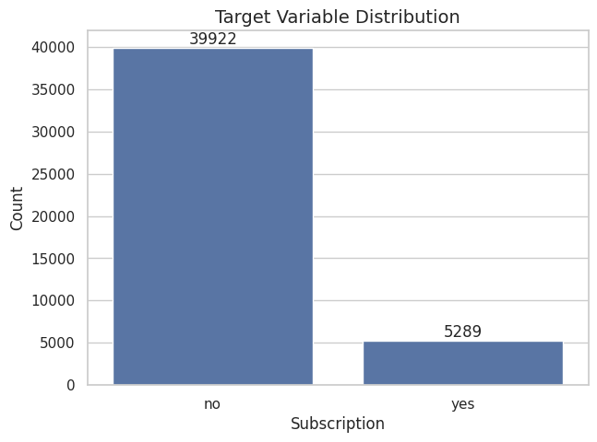
Real target imbalance
Bank Marketing
Subscription Prediction
FinTech final project
Portuguese bank direct marketing dataset
45,211
11.7%
Clients contacted
Positive class
From historical campaign outcomes to a client ranking for smarter marketing contacts
Salvatore Mariano Librici
FinTech — Politecnico di Milano
Notes:
Open by framing the project as a supervised learning solution for a real bank marketing use case. Point out the actual dataset size and the major target imbalance shown on the right.

Slide 2
Business Problem
Predict which clients will subscribe to a term deposit and prioritize marketing resources.
Core decision question
Which clients should the bank contact first?
Business value
• Rank clients by subscription probability
• Focus calls on higher-potential segments
• Improve ROI by reducing low-value contacts
• Adapt threshold to campaign budget
• Each phone call has cost and capacity limits
• Most clients do not subscribe
• The useful output is a probability ranking, not only a yes/no label
Target: y = yes / no → encoded as no = 0, yes = 1 → evaluated as an imbalanced binary classification problem
Bank Marketing Subscription Prediction
02
Notes:
Explain that the problem is operational: contact capacity is limited, so the bank needs a ranked list of clients. The model supports that prioritization by estimating subscription probabilities.

Slide 3
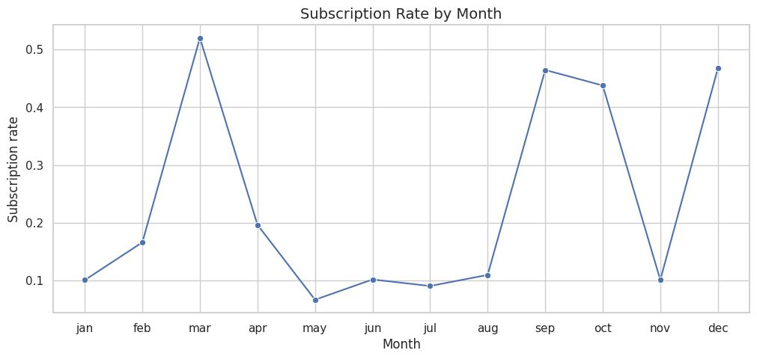
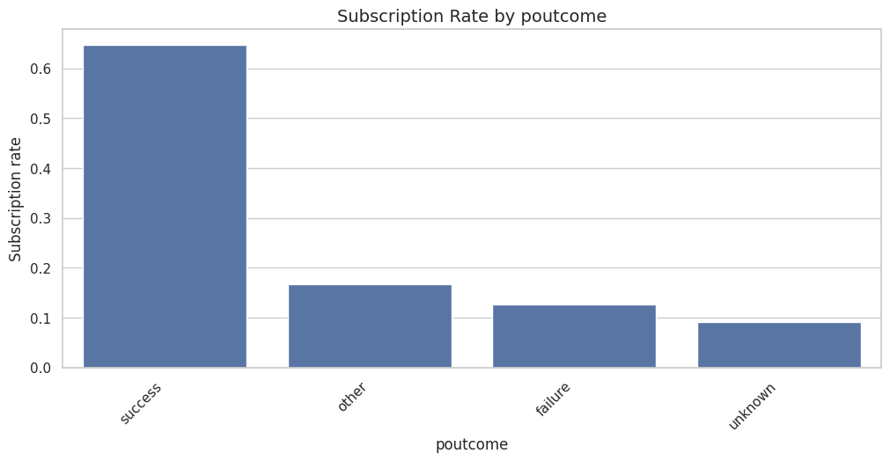
Dataset and Target
Dataset4.csv contains client, campaign and previous-outcome variables; the target is highly imbalanced.
39,922
5,289
11.7%
Subscription by month
no subscriptions
yes subscriptions
yes share
Target distribution
Subscription rate based on past contact result
Implication: accuracy can be misleading, because a model can look strong by mostly predicting “no”.
Bank Marketing Subscription Prediction
03
Notes:
Use the plots to discuss data imbalance and heterogeneity by campaign month and previous campaign outcome. Stress that because the positive class is only 11.7 percent, evaluation requires metrics beyond accuracy.

Slide 4
Methodology Overview
A reproducible machine-learning workflow from EDA to explainable business recommendations.
Evaluation metrics used:
Accuracy · Balanced accuracy · Precision · Recall · F1-score · ROC-AUC · PR-AUC
Main Idea:
Fit preprocessing only on training data; compare models on validation; report final performance on the held-out test set.
1
EDA
5
3
Pipelines
Interpret
Distributions, imbalance, categorical patterns
Feature selection, permutation importance, SHAP
Model-specific preprocessing to avoid leakage
2
Split
4
Models
60/20/20 train-validation-test with stratification
Baseline, Logistic Regression, Random Forest
Bank Marketing Subscription Prediction
04
Notes:
Walk through the pipeline. Emphasize that stratified splitting preserves the target distribution and that pipelines prevent leakage from preprocessing into validation or test evaluation.

Slide 5
Preprocessing and Architectural Decisions
Separate pipelines were built because Logistic Regression and Random Forest need different transformations.
Data split
Logistic Regression
Random Forest
• Training: 60%
• Validation: 20%
• Test: 20%
• Stratified by target class
• StandardScaler for numerical features
• OneHotEncoder for categorical features
• Simple, interpretable benchmark
• Numerical features passed through
• OneHotEncoder for categorical features
• Captures nonlinear effects and interactions
≈11.7%
0.907
0.929
positive rate retained
validation ROC-AUC
validation ROC-AUC
Bank Marketing Subscription Prediction
05
Notes:
Explain why the two preprocessing pipelines differ. Logistic Regression needs standardized numerical variables; Random Forest does not. Both handle categorical variables with one-hot encoding and are wrapped in pipelines.

Slide 6
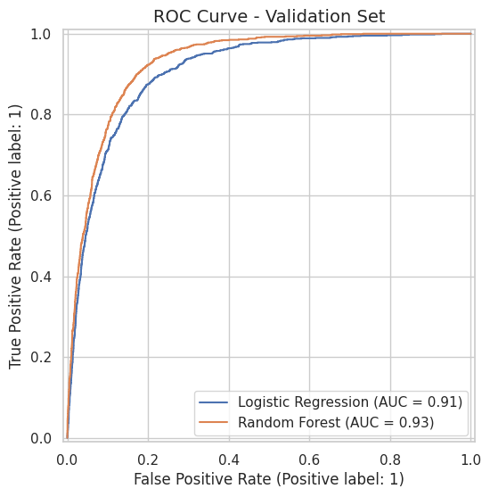
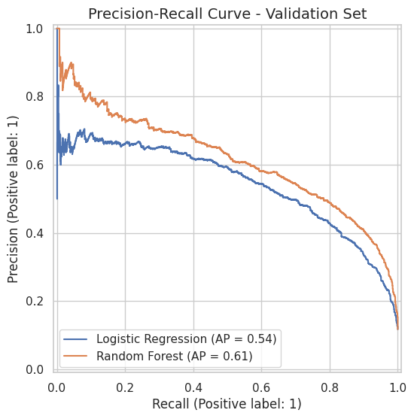
Models Compared
The baseline exposes the limits of accuracy; the Random Forest is the strongest predictive model.
Model
Accuracy
Balanced Acc.
Precision
Recall
F1
ROC-AUC
PR-AUC
Baseline
0.883
0.500
0.000
0.000
0.000
0.500
0.117
Logistic Reg.
0.844
0.832
0.414
0.817
0.550
0.907
0.544
Random Forest
0.903
0.776
0.580
0.610
0.594
0.929
0.615
Validation ROC curve
Validation Precision-Recall curve
Why the baseline matters: it achieves high accuracy by predicting the majority class, but has zero recall for subscribers.
Bank Marketing Subscription Prediction
06
Notes:
Use the table to show why accuracy alone is insufficient. The baseline accuracy is high because most clients do not subscribe, but its precision, recall and F1 for the positive class are zero. Random Forest gives stronger ranking metrics than Logistic Regression.

Slide 7
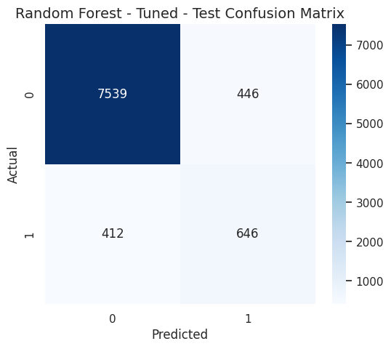
Final Evaluation and Preferred Model
The tuned Random Forest is selected and confirmed on the held-out test set.
0.9328
0.6339
0.6009
0.5916
0.6106
0.9051
Test ROC-AUC
Test PR-AUC
Test F1
Precision
Recall
Accuracy
Test confusion matrix
Why Random Forest is preferred
• Highest validation ROC-AUC and PR-AUC among the compared models
• Better precision than Logistic Regression, useful when calls are costly
• Provides feature importance signals for feature selection and interpretation
• Final test metrics confirm stable performance
Selected model: tuned Random Forest Classifier at threshold = 0.50
Bank Marketing Subscription Prediction
07
Notes:
Present the held-out test metrics for the tuned Random Forest. The preferred model is chosen because it combines strong ranking performance with reasonable precision and recall, and it offers useful interpretability through feature importances.

Slide 8
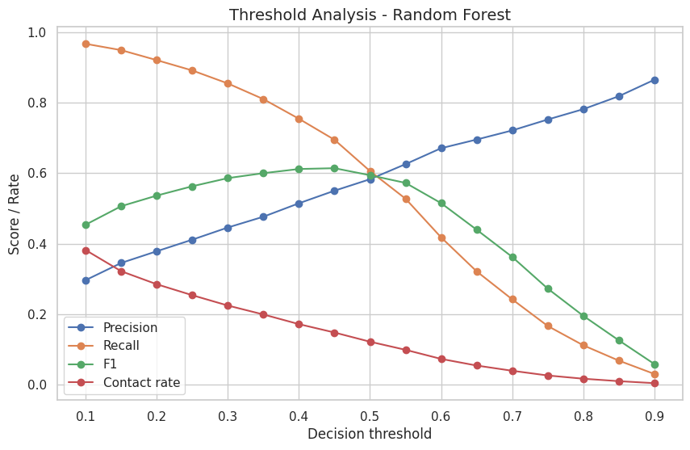
Threshold Analysis and Business Trade-Off
Changing the threshold changes contact volume, recall and precision.
Threshold analysis
Examples from validation set
Threshold
Precision
Recall
Contact
0.30
0.446
0.854
22.4%
0.50
0.583
0.606
12.2%
0.70
0.721
0.242
3.9%
• Lower threshold: more clients contacted and more subscribers captured
• Higher threshold: fewer contacts and higher conversion quality
• Bank should choose based on campaign capacity and opportunity cost
Bank Marketing Subscription Prediction
08
Notes:
Explain thresholding as the bridge from model scores to marketing action. A lower threshold increases recall and contact volume, while a higher threshold prioritizes precision and a smaller campaign list.

Slide 9
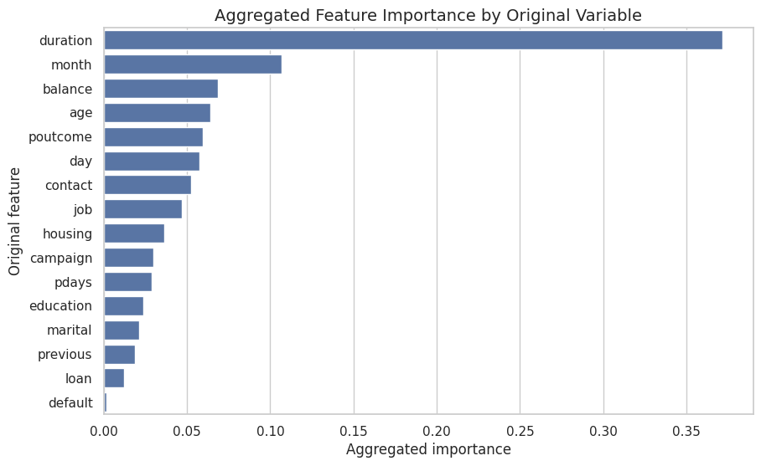
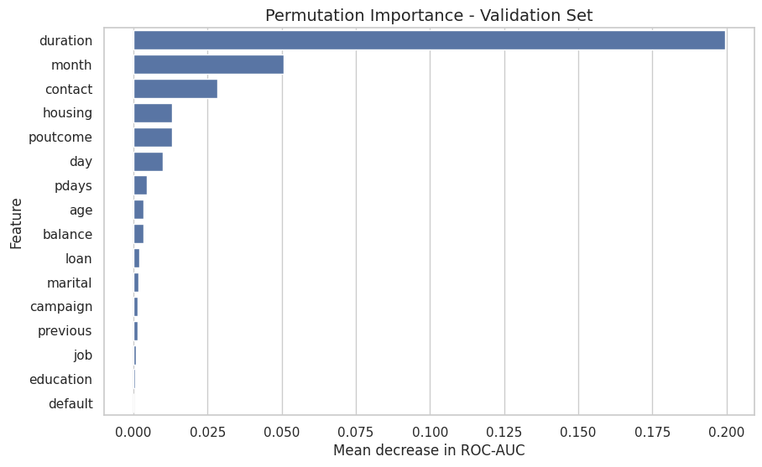
Feature Selection and Interpretability
A reduced set of original variables preserves performance and improves actionability.
Aggregated original feature importance
Permutation importance
Model
Accuracy
Balanced Acc.
Recall
F1
ROC-AUC
PR-AUC
Full RF
0.905
0.777
0.611
0.601
0.9328
0.6339
Top 10
0.906
0.799
0.659
0.621
0.9335
0.6347
Top drivers: duration, month, balance, age, poutcome, day, contact, job, housing and campaign.
Bank Marketing Subscription Prediction
09
Notes:
Explain that feature importances were aggregated back to original variables after one-hot encoding. The Top 10 model performs similarly and even improves F1 and recall on the test set, which supports simpler deployment.

Slide 10
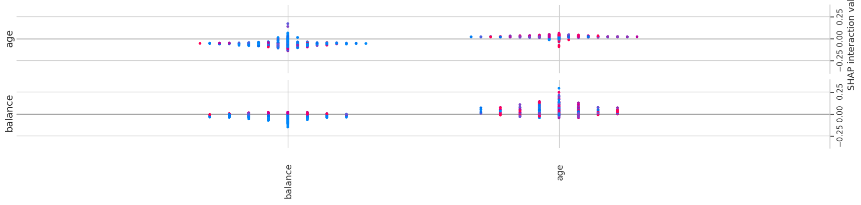
Conclusions and Limitations
The model can support campaign prioritization, but duration must be handled carefully.
Business conclusions
Critical limitation: duration
• Use predicted probabilities to rank clients for outreach
• Random Forest gives the strongest validation ranking metrics
• A reduced feature set can preserve similar performance
• Threshold can be adapted to campaign capacity
• duration is highly predictive but known only after the call starts
• Good for explaining past outcomes
• Problematic for pre-campaign targeting
• A duration-free robustness check is necessary
SHAP summary explanation
Model
Balanced Acc.
F1
ROC-AUC
PR-AUC
RF tuned
0.774
0.594
0.929
0.615
Without duration
0.663
0.435
0.792
0.444
Recommended deployment: decision-support ranking tool, monitored on future campaigns, with a duration-free version for pre-call targeting.
Bank Marketing Subscription Prediction
10
Notes:
Close with the practical takeaway. The model is valuable for prioritization, but the duration variable creates leakage for pre-call targeting because it is only known after the call begins. Therefore, deployment should use a duration-free model or treat duration only as an explanatory feature.

