Slide 1
🌱
ClimateCoach AI
WhatsApp AI Agent for Nigerian Farmers
Hackathon MVP — April 2026
Evergreen Team 03 | Olajumoke Morenikeji & Titilayo Ayodele

Slide 2
THE PROBLEM
📉
🌦️
📵
No Access to Expert Advice
Weather Uncertainty
Technology Gap
Most Nigerian farmers lack access to agronomists or agricultural extension workers, especially in rural areas.
Unpredictable weather destroys crops. Farmers do not know when to plant, irrigate, or harvest.
Most farmers only have basic phones. Complex apps are useless but almost everyone uses WhatsApp.

Slide 3
THE SOLUTION
ClimateCoach AI
An AI-powered WhatsApp chatbot that gives Nigerian farmers instant advice on crops, weather, and best farming practices in their own language.
💬
🌍
🌤️
⚡
Works on WhatsApp
Responds in Pidgin and Local Languages
Weather and Crop Advice
Instant AI Responses

Slide 4
HOW IT WORKS
1
2
3
4
📱
🔗
🤖
💬
→
→
→
Farmer Sends Message
Webhook Captures It
AI Processes Request
Farmer Gets Reply
Farmer sends a WhatsApp message asking about crops, weather or farming advice
Twilio receives the message and sends it to n8n via webhook in real-time
Groq AI (Llama 3.1) powered by ClimateCoach system prompt generates a response
Answer is sent back to farmer on WhatsApp in their own language

Slide 5
TECH STACK
n8n
Workflow Automation
Orchestrates the entire pipeline — receives webhooks, calls AI, sends replies
Twilio
WhatsApp Gateway
Receives and sends WhatsApp messages via sandbox API
Groq + Llama 3.1
AI Engine
Ultra-fast LLM that powers ClimateCoach responses in multiple languages
Webhook
Real-time Trigger
Instantly fires the workflow when a farmer sends a message

Slide 6
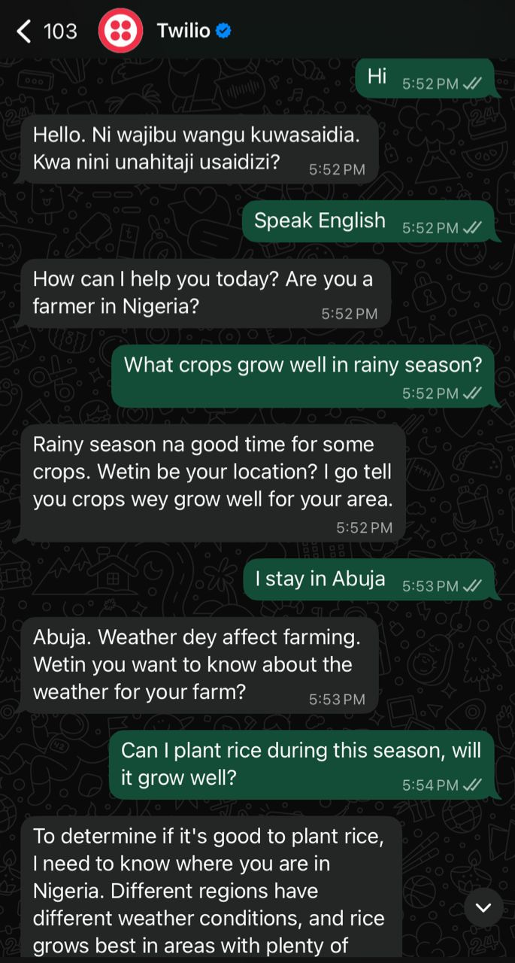
LIVE MVP DEMO
Core Use Case Demonstrated
✓
Farmer sends WhatsApp message in Pidgin
✓
AI responds instantly in same language
✓
Crop recommendations based on season
✓
Asks for location to give precise advice
✓
Handles follow-up questions in conversation
✓
No app download needed

Slide 7
IMPACT & VISION
36M+
90%+
24/7
Smallholder farmers in Nigeria
WhatsApp penetration in Nigeria
Always available, no internet app needed
Future Roadmap
🌤️ Integrate live weather API for real-time forecasts per location
🗣️ Add voice message support for farmers who cannot type
📊 Crop disease detection via image recognition
🌍 Expand to Yoruba, Hausa, Igbo language support

Slide 8
🌱
Thank You
ClimateCoach AI — Empowering Nigerian Farmers, One WhatsApp Message at a Time
Evergreen Team 03
Olajumoke Morenikeji | Titilayo Ayodele
Powered by Groq + Llama 3.1 + Twilio + n8n

