Slide 1


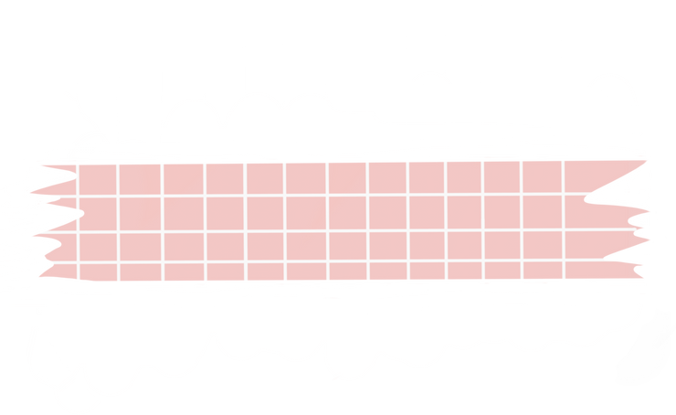


Good morning!

Slide 2
CLASS RULES

Slide 3
E – Engage actively
Q – Question respectfully
U – Use time wisely
A – Always raise your hand if you want to speak.
T – Think critically
I – Interact thoughtfully.
O – Observe rules at all times
N – Nurture respect and kindness

Slide 4
QUADRATIC EQUATION

Slide 5
What is quadratic equation?

Slide 6
How do you determine the values of 𝑎, 𝑏, and 𝑐 of the quadratic equations?

Slide 7
ACTIVITY 1: Follow the Standards.
Directions: I will flash quadratic equations on the screen and the one who will raise his/her hand first will be the one to answer. 1 correct answer is equivalent to 1 point. Whoever got the highest score will receive reward after our discussion.

Slide 8

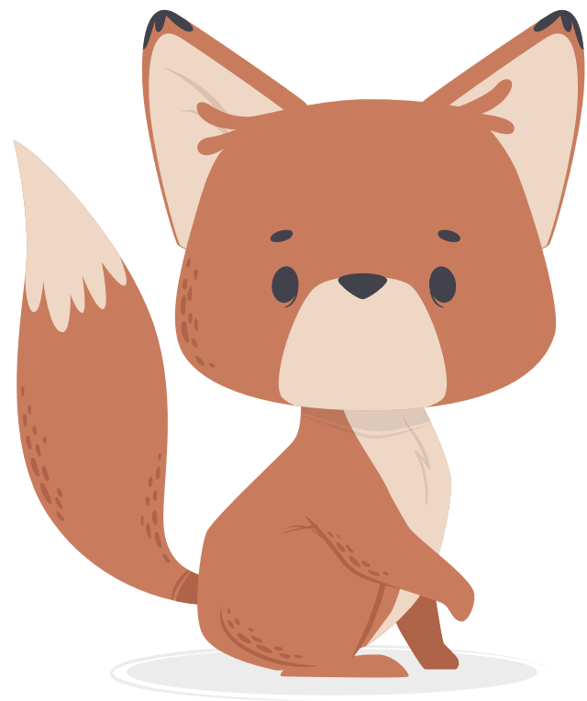
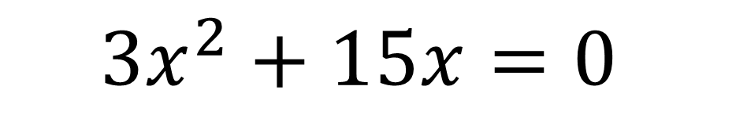
EQUATION
There are 3 type of quiz
$$3x^{2}+15x=0$$

Slide 9
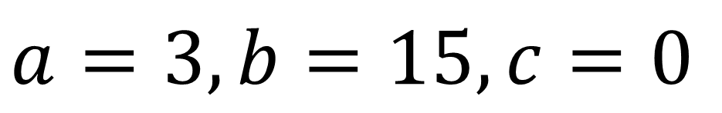
ANSWER
There are 3 type of quiz
$$a=3,b=15,c=0$$

Slide 10
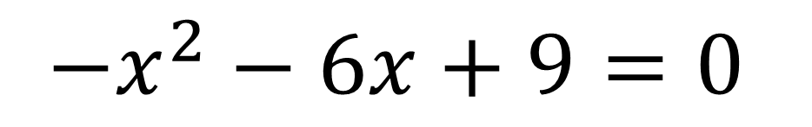
EQUATION
There are 3 type of quiz
$$−x^{2}−6x+9=0$$

Slide 11
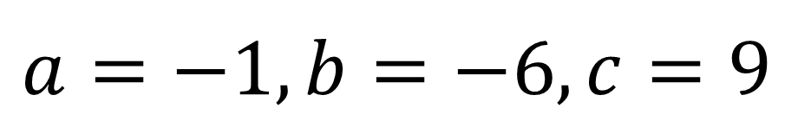
ANSWER
There are 3 type of quiz
$$a=−1,b=−6,c=9$$

Slide 12
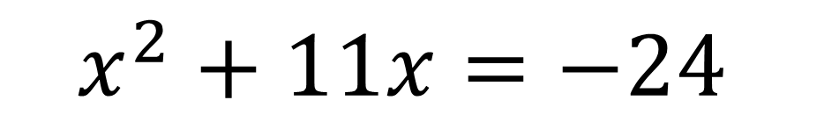
EQUATION
There are 3 type of quiz
$$x^{2}+11x=−24$$

Slide 13
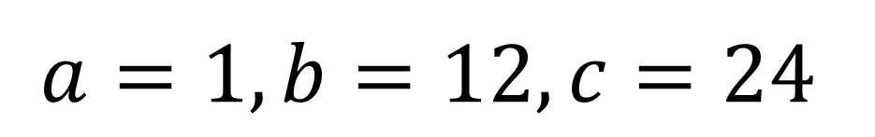
ANSWER
There are 3 type of quiz
$$a=1,b=12,c=24$$

Slide 14

EQUATION
There are 3 type of quiz
$${4x}^{2}−15=0$$

Slide 15
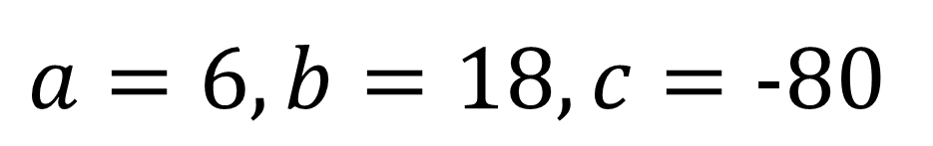
ANSWER
There are 3 type of quiz
$$a=6,b=18,c=−80$$

Slide 16
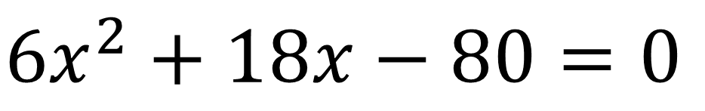
EQUATION
There are 3 type of quiz
$$6x^{2}+18x−80=0$$

Slide 17
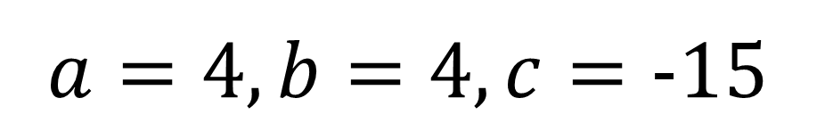
ANSWER
There are 3 type of quiz
$$a=4,b=4,c=−15$$

Slide 18
ACTIVITY 2: Find My Roots.
In this activity, I will group you into four groups. Work together with your groups to solve the roots of quadratic equation using extracting square roots, factoring, and completing the square. I will flash the equation in the screen, and you are only given 1 minute to solve the problem.

Slide 19
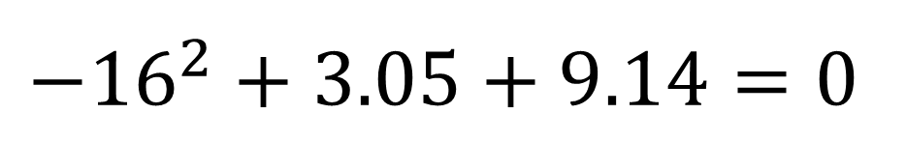
EQUATION
There are 3 type of quiz
$$−{16}^{2}+3.05+9.14=0$$

Slide 20
What do you think is our lesson today?

Slide 21
Quadratic equations using quadratic formula.

Slide 22
“Its good to be simple”.

Slide 23
ACTIVITY 3.
In this activity, you are given 15 seconds to solve each expression. Write your answer in the whiteboard. After I count 1 to 3, each group will raise their answer.

Slide 24

EQUATION
$$\frac{6+\sqrt{9}}{2(3)}$$

Slide 25

ANSWER
$$\frac{3}{2}$$

Slide 26
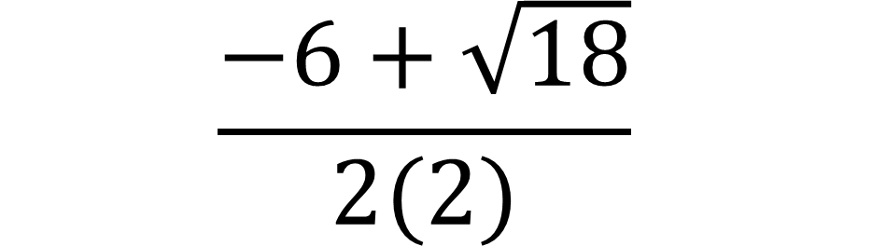
EQUATION
$$\frac{−6+\sqrt{18}}{2(2)}$$

Slide 27
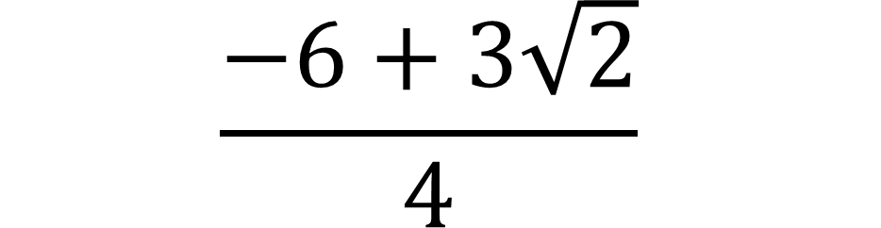
ANSWER
$$\frac{−6+3\sqrt{2}}{4}$$

Slide 28
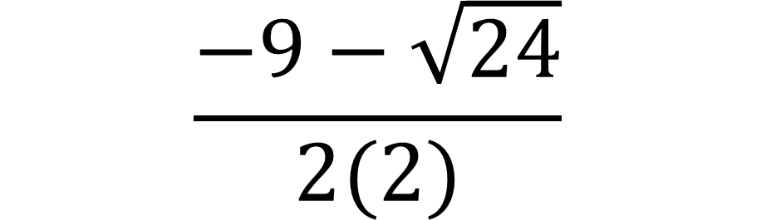
EQUATION
$$\frac{−9−\sqrt{24}}{2(2)}$$

Slide 29

ANSWER
$$\frac{−9−2\sqrt{6}}{4}$$

Slide 30
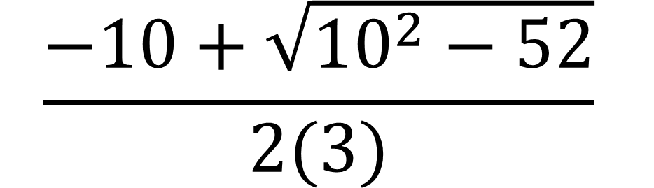
EQUATION
$$\frac{−10+\sqrt{{10}^{2}−52}}{2(3)}$$

Slide 31
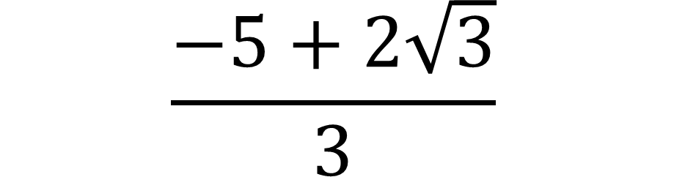
ANSWER
$$\frac{−5+2\sqrt{3}}{3}$$

Slide 32
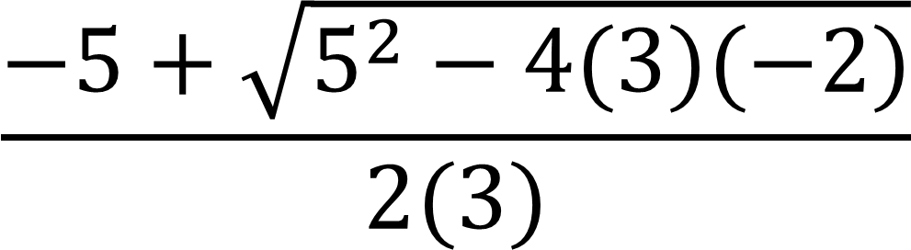
EQUATION
$$\frac{−5+\sqrt{5^{2}−4(3)(−2)}}{2(3)}$$

Slide 33

ANSWER
$$\frac{1}{3}$$

Slide 34
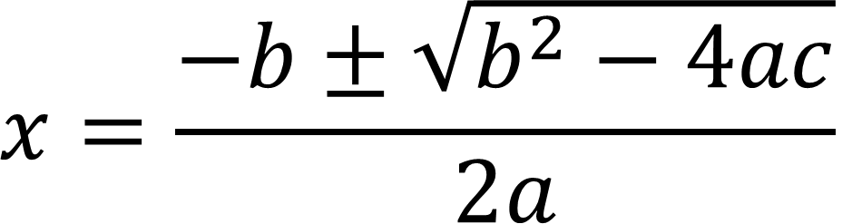
QUADRATIC FORMULA
$$x=\frac{−b±\sqrt{b^{2}−4ac}}{2a}$$

Slide 35
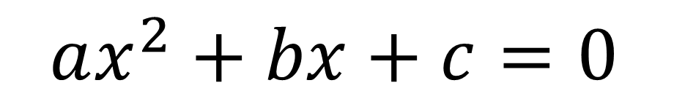
STANDARD FORM
$$ax^{2}+bx+c=0$$

Slide 36
STEP 1.
Place the constant term on the right side of the equation. All the terms with unknowns are on the left side.

Slide 37

$$ax^{2}+bx=−c$$

Slide 38
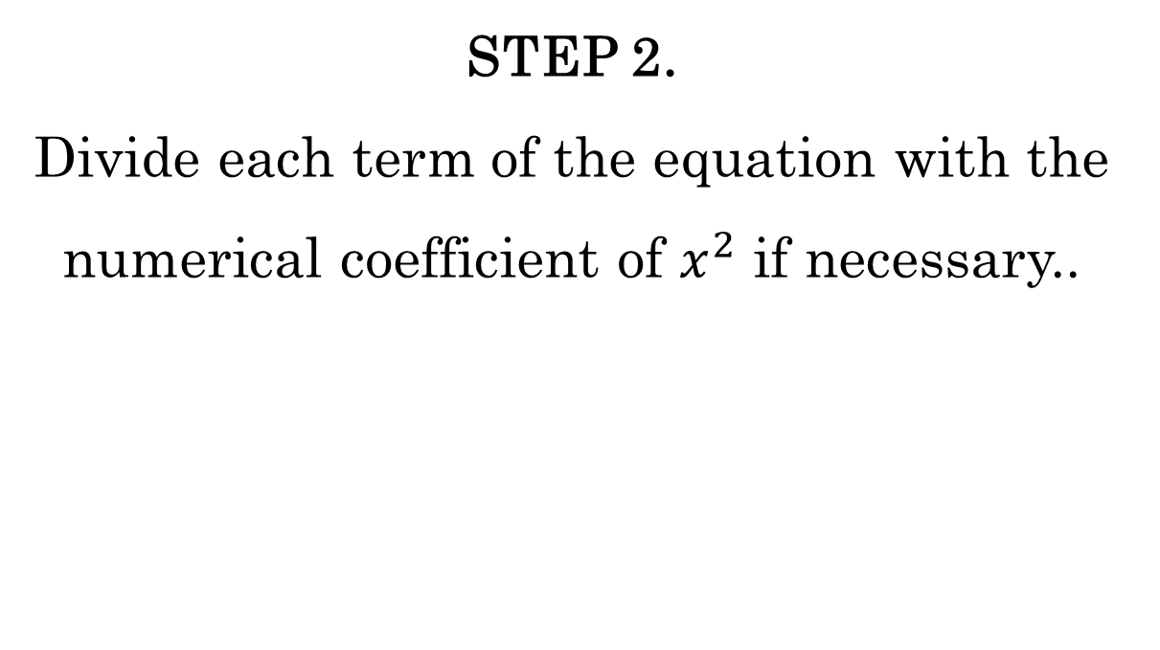
STEP 2.
Divide each term of the equation with the numerical coefficient of $x^{2}$ if necessary..

Slide 39

$$x^{2}+\frac{bx}{a}=\frac{−c}{a}$$

Slide 40
STEP 3.
Get the numerical coefficient of x, divide it by 2 and square
it. Add the result to both sides of the equation.
.

Slide 41

${(\frac{\frac{b}{a}}{2})}^{2}={(\frac{b}{2a})}^{2}$=$\frac{b^{2}}{4a^{2}}$

Slide 42

$$x^{2}+\frac{bx}{a}+\frac{b^{2}}{4a^{2}}=\frac{−c}{a}+\frac{b^{2}}{4a^{2}}$$

Slide 43
STEP 4.
Factor the perfect square trinomial.

Slide 44
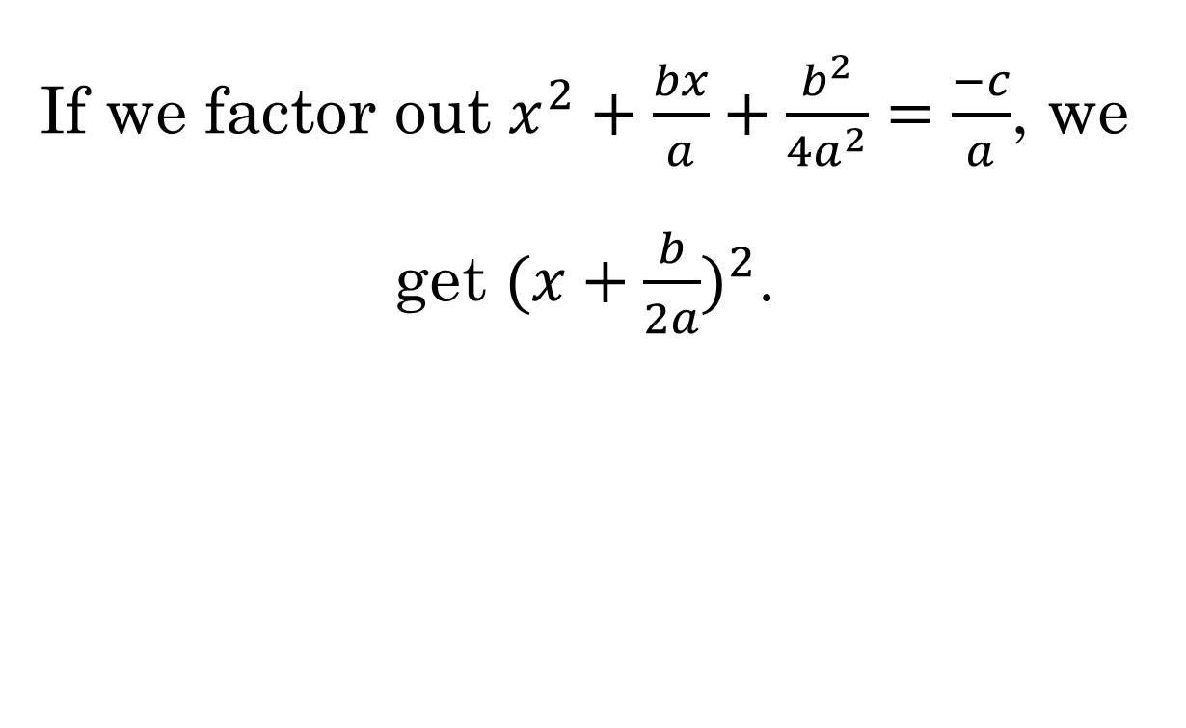
If we factor out $x^{2}+\frac{bx}{a}+\frac{b^{2}}{4a^{2}}=\frac{−c}{a}$, we get ${(x+\frac{b}{2a})}^{2}$.

Slide 45

$${(x+\frac{b}{2a})}^{2}=\frac{b^{2}−4ac}{4a^{2}}$$

Slide 46
STEP 5.
Extract the square root from both sides. Two values will be obtained for the right side of the equation.

Slide 47

$$x+\frac{b}{2a}=±\sqrt{\frac{b^{2}−4ac}{4a^{2}}}$$

Slide 48

$$x+\frac{b}{2a}=±\sqrt{\frac{b^{2}−4ac}{2a}}$$

Slide 49
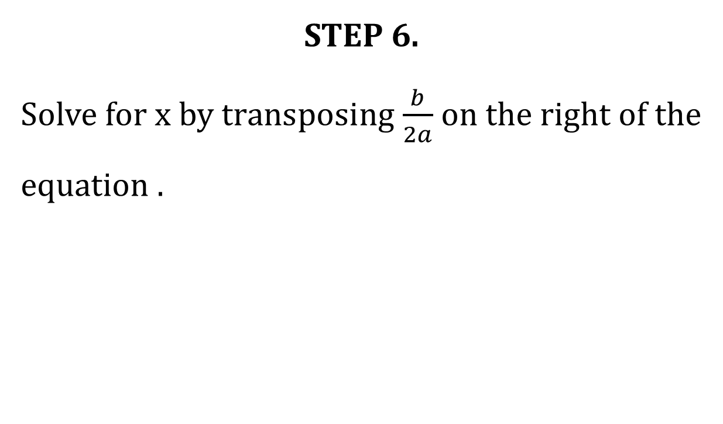
STEP 6.
Solve for x by transposing $\frac{b}{2a}$ on the right of the equation .

Slide 50

$$x=±\sqrt{\frac{b^{2}−4ac}{2a}}−\frac{b}{2a}$$

Slide 51
STEP 7.
Combine like terms on the right side.

Slide 52

$$x=\frac{−b±\sqrt{b^{2}−4ac}}{2a}$$

Slide 53
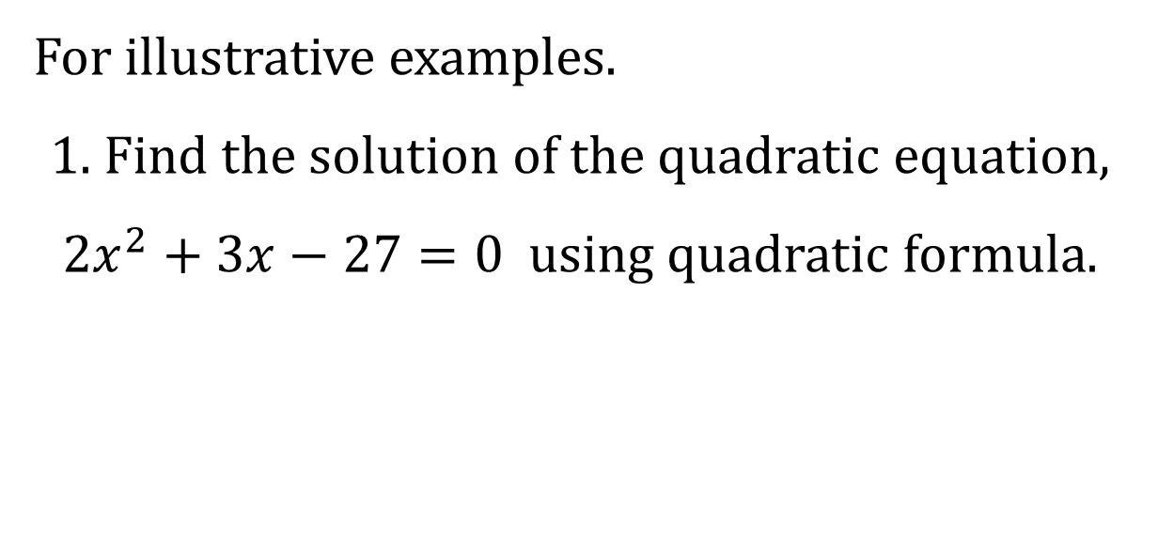
For illustrative examples.
1. Find the solution of the quadratic equation, $2x^{2}+3x−27=0$ using quadratic formula.

Slide 54
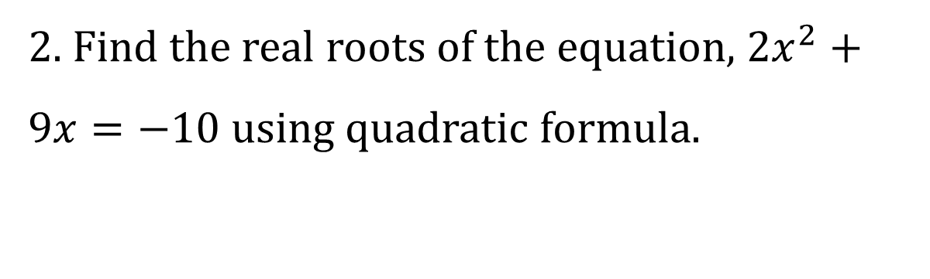
2. Find the real roots of the equation, $2x^{2}+9x=−10$ using quadratic formula.

Slide 55
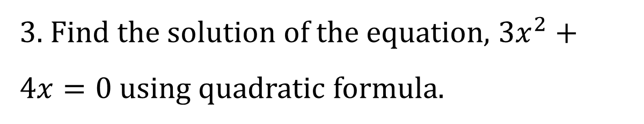
3. Find the solution of the equation, $3x^{2}+4x=0$ using quadratic formula.

Slide 56
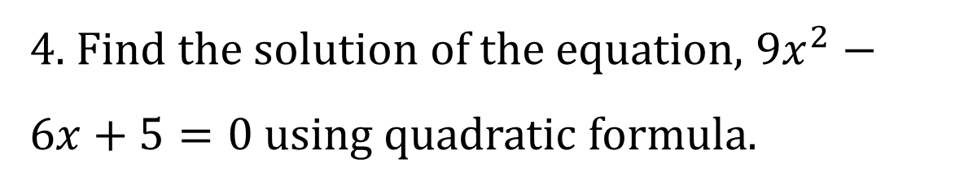
4. Find the solution of the equation, $9x^{2}−6x+5=0$ using quadratic formula.

Slide 57
“Solve and Mount”.

Slide 58
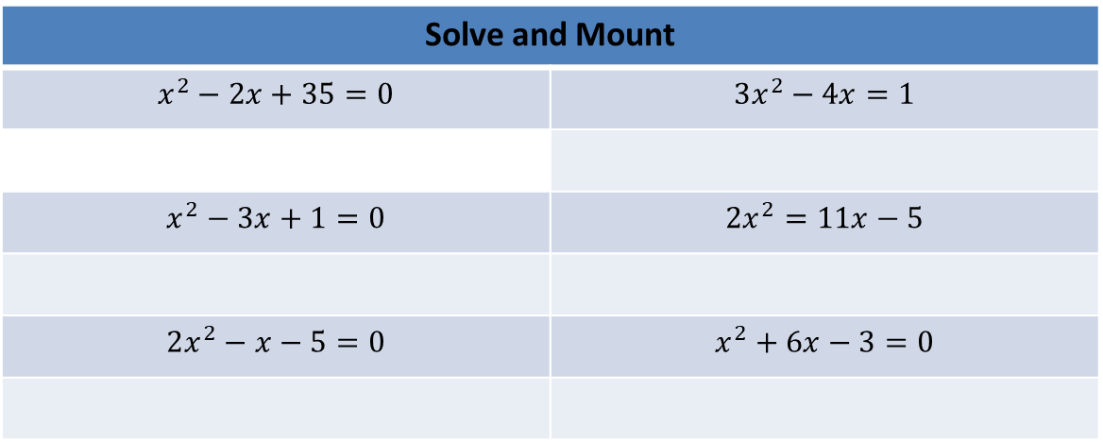
Solve and Mount
$$x^{2}−2x+35=0$$ | $$3x^{2}−4x=1$$
$$x^{2}−3x+1=0$$ | $$2x^{2}=11x−5$$
$$2x^{2}−x−5=0$$ | $$x^{2}+6x−3=0$$

Slide 59
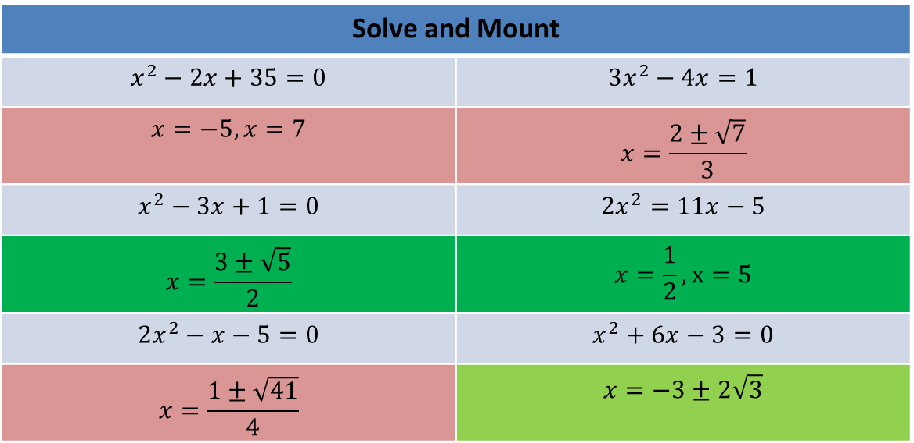
Solve and Mount
$$x^{2}−2x+35=0$$ | $$3x^{2}−4x=1$$
$$x=−5, x=7$$ | $$x=\frac{2±\sqrt{7}}{3}$$
$$x^{2}−3x+1=0$$ | $$2x^{2}=11x−5$$
$$x=\frac{3±\sqrt{5}}{2}$$ | $$x=\frac{1}{2}, x=5$$
$$2x^{2}−x−5=0$$ | $$x^{2}+6x−3=0$$
$$x=\frac{1±\sqrt{41}}{4}$$ | $$x=−3±2\sqrt{3}$$

Slide 60
Directions: Find the roots of the following quadratic equation using quadratic formula. Solve the following equation and choose the correct answer from the set of cards inside the envelope and mount into the space below each equation.

Slide 61
Directions: Find the solutions of each of the following quadratic equations using the quadratic formula. Show your complete solution. Write your answer on a clean sheet of bond paper.

Slide 62
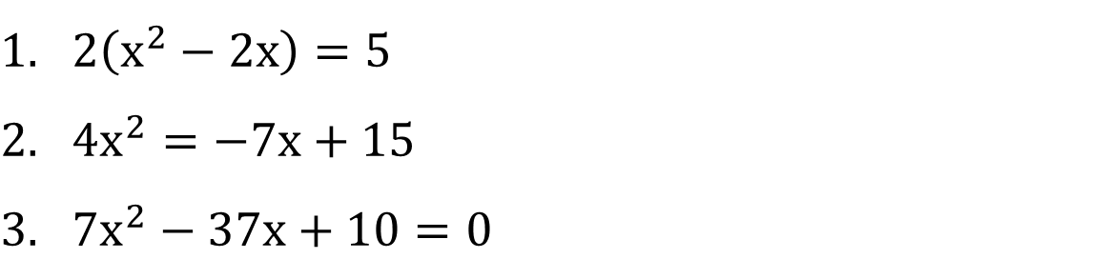
$2\left(x^{2}−2x\right)=5$
$4x^{2}=−7x+15$
$7x^{2}−37x+10=0$

Slide 63

$2x^{2}+x−6=0$
$3x^{2}+1=5x$
$2x^{2}+5x−4=0$
$4x^{2}+20x=−25$
$7x^{2}+10=37x$

Slide 64
“Assignment”.

Slide 65
Directions: Find the solution of the following equation using quadratic formula.

Slide 66
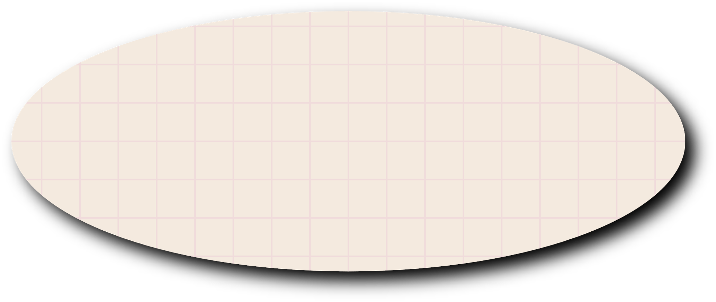
THANK YOU AND HAVE A GOOD DAY!

