Slide 1
UNDERSAMPLE
# # UNDERSAMPLE - Most efficient with still high accuracy
sampling_method=0
sampling_strategy=.42
x_oversample, y_oversample = sample_imbalanced_data(X_train,y_train, sampling_method, sampling_strategy=sampling_strategy)
# X_test,y_test = sample_imbalanced_data(X_test,y_test, 0, sampling_strategy=sampling_strategy)
min_samples_leaf=10
max_depth=7
estimators=50
samples_leaf_sizes = [2,4,6,7,8,10,20,30,40,50]
tree_depths = range(1,25)
class_weight='balanced'
execute_crossval=True

Slide 2
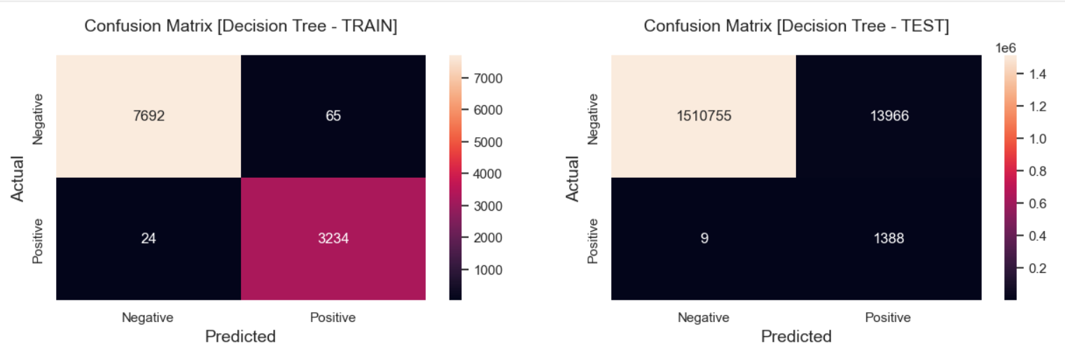

Slide 3
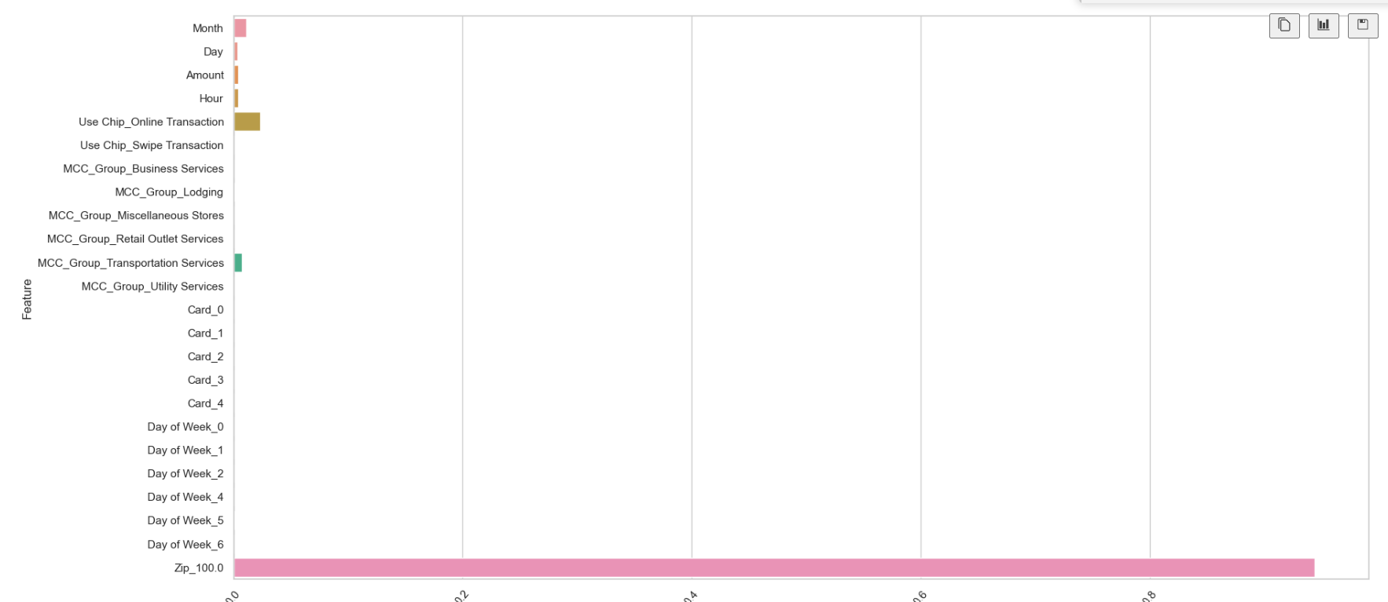

Slide 4
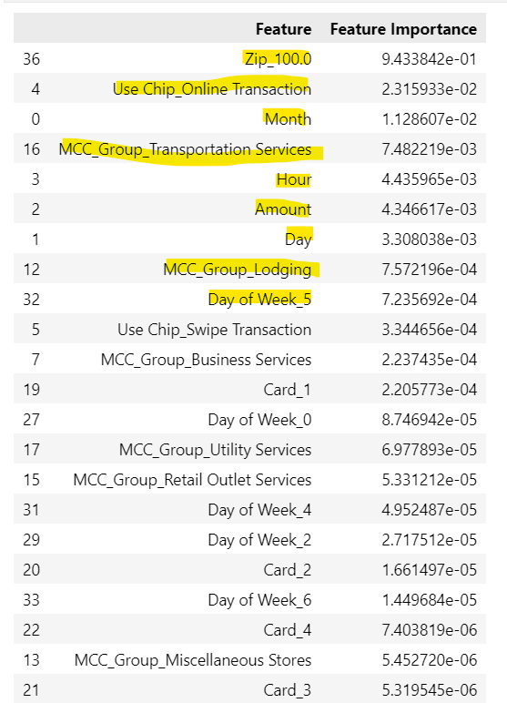
Ascending

Slide 5
