Slide 1
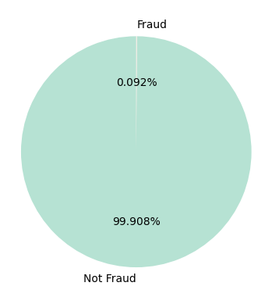
DATA SHAPE
Class Distribution 0 5082403
1 4655
(5087066, 15)
Try xgboost

Slide 2
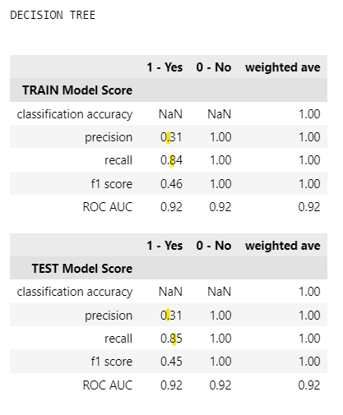
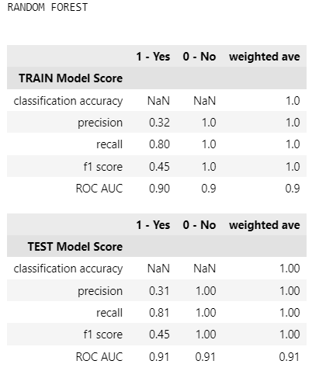
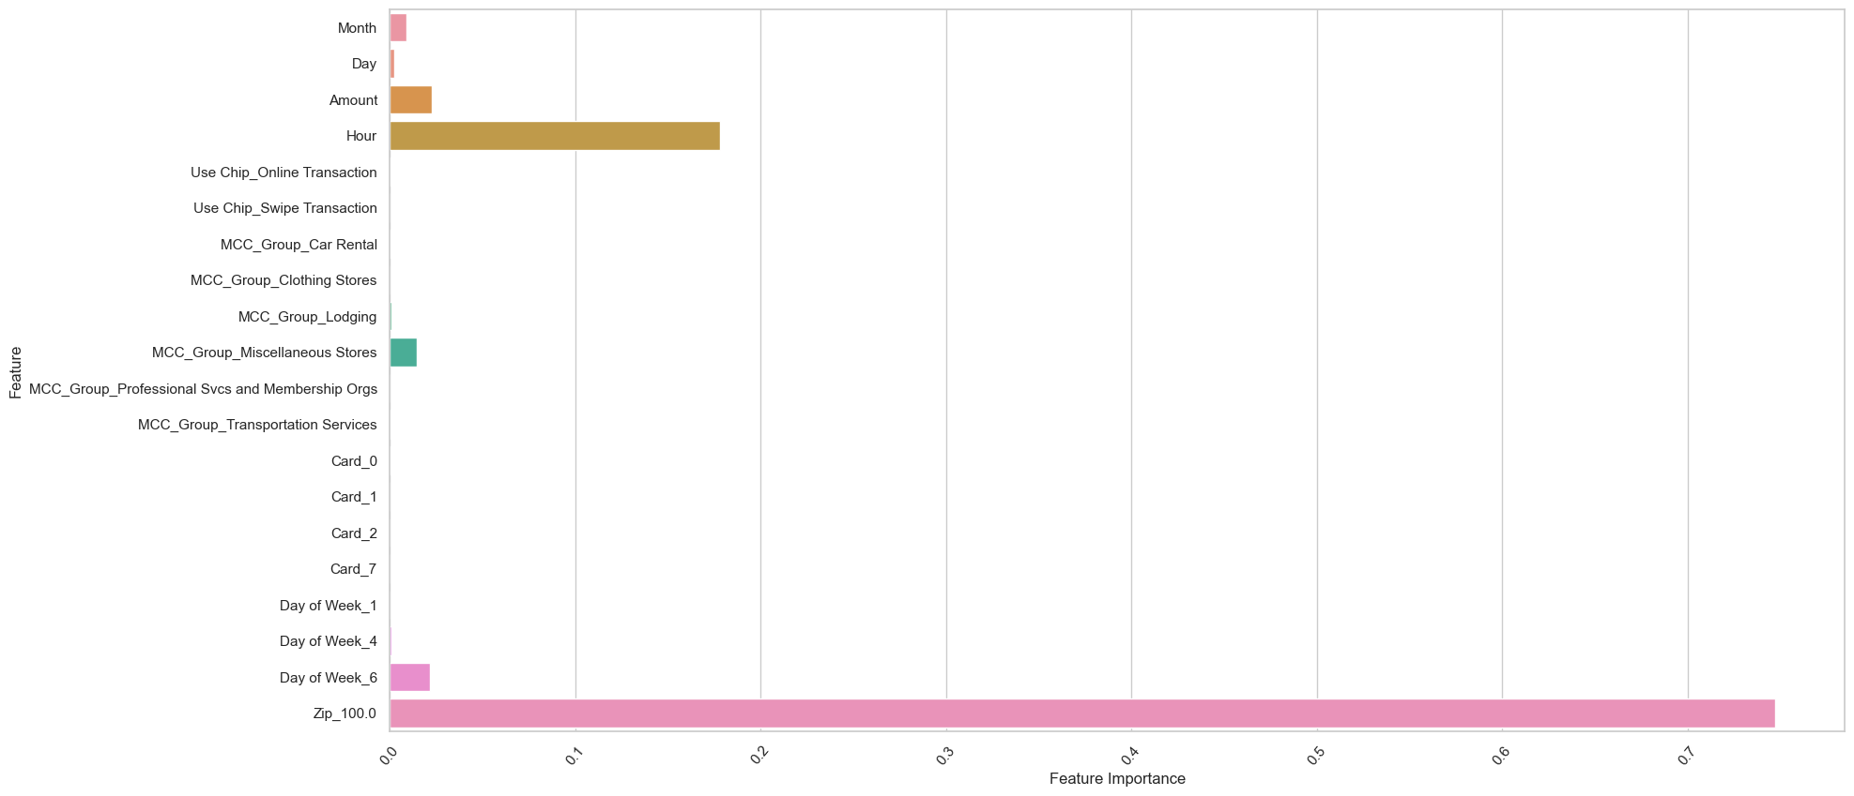
weights = 0: 0.1 , 1: 99.9

Slide 3
UNDERSAMPLE AFTER SPLIT
# # UNDERSAMPLE - Most efficient with still high accuracy
sampling_method=0
sampling_strategy=.42
x_oversample, y_oversample = sample_imbalanced_data(X_train,y_train, sampling_method, sampling_strategy=sampling_strategy)
# X_test,y_test = sample_imbalanced_data(X_test,y_test, 0, sampling_strategy=sampling_strategy)
min_samples_leaf=10
max_depth=7
estimators=50
samples_leaf_sizes = [2,4,6,7,8,10,20,30,40,50]
tree_depths = range(1,25)
class_weight='balanced'
execute_crossval=True

Slide 4
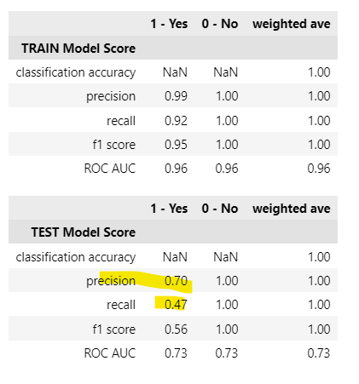
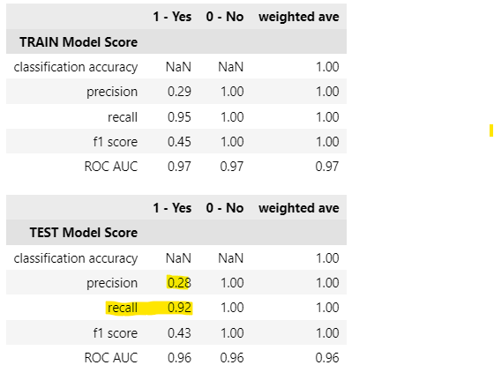
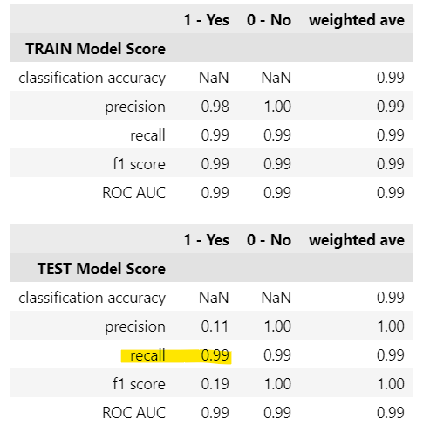
ACTUAL SCENARIO weights = 0: 0.1 , 1: 99.9

Slide 5
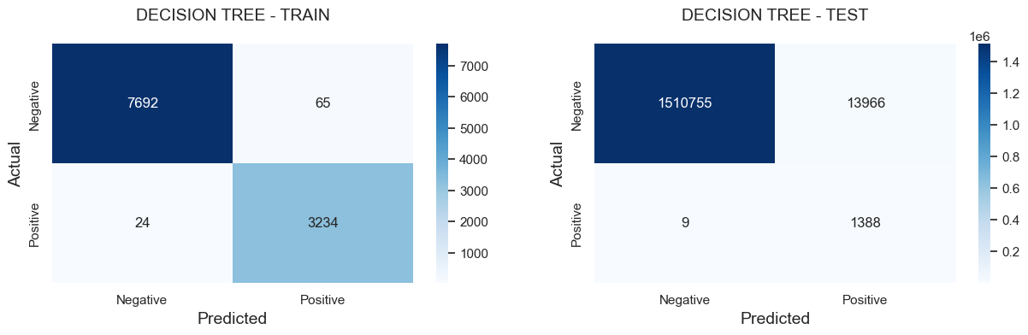

Slide 6
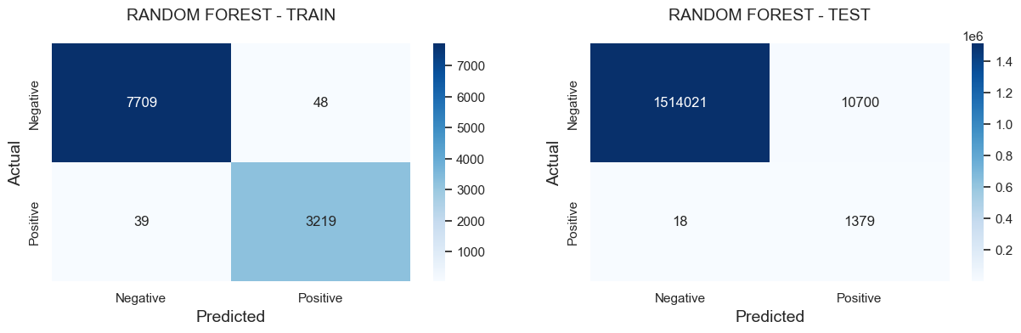

Slide 7
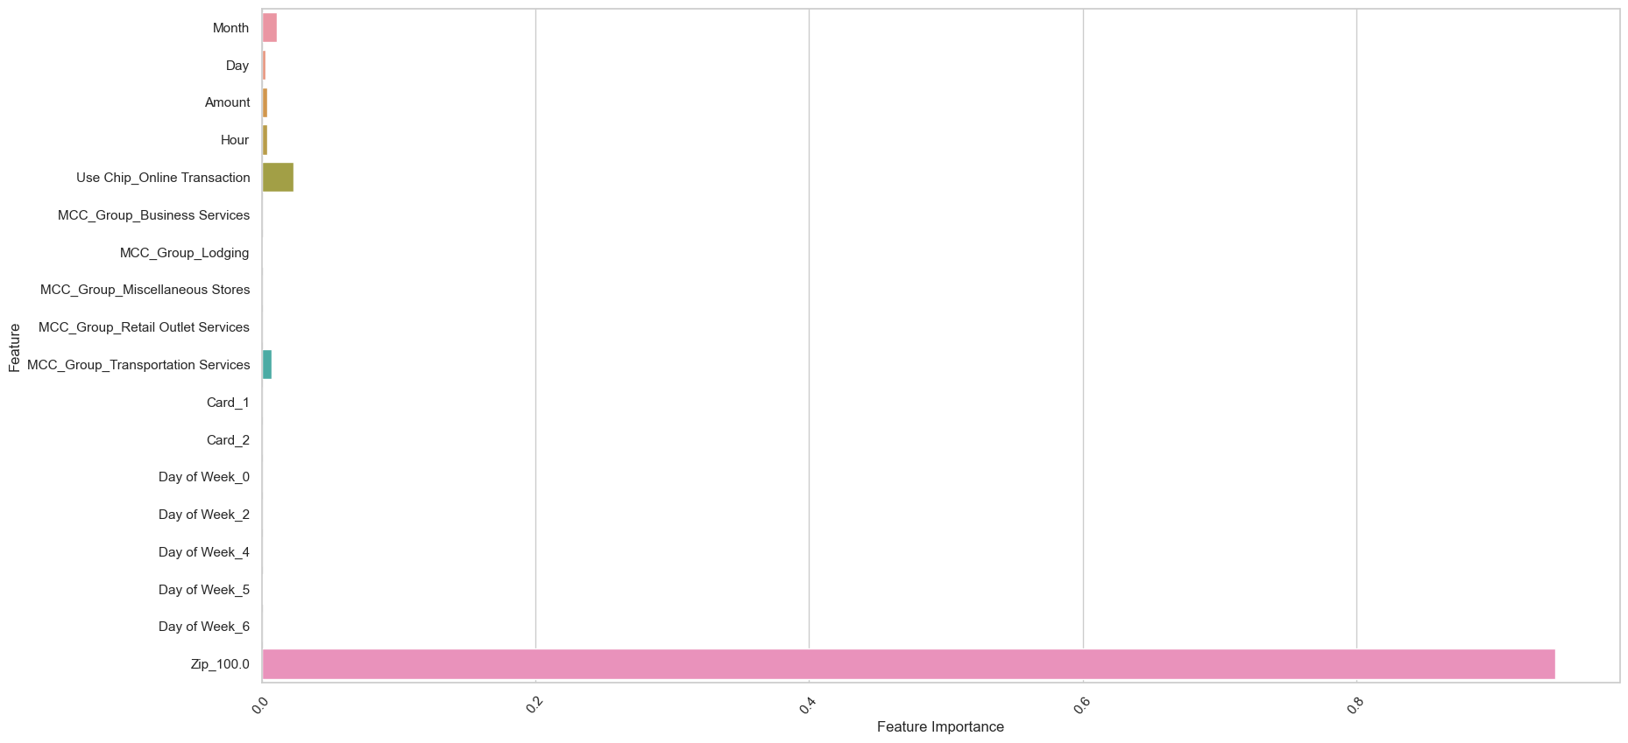

Slide 8
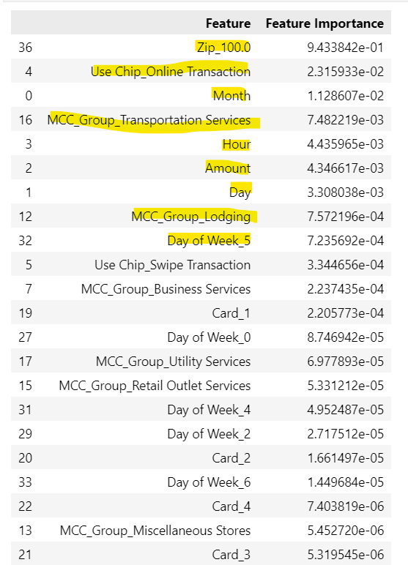
Feature Importance

Slide 9
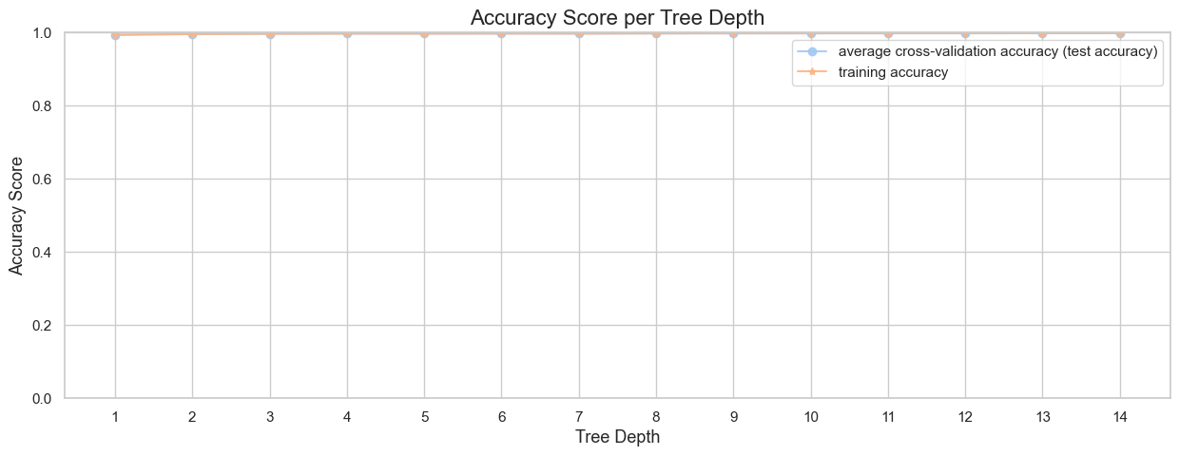

Slide 10
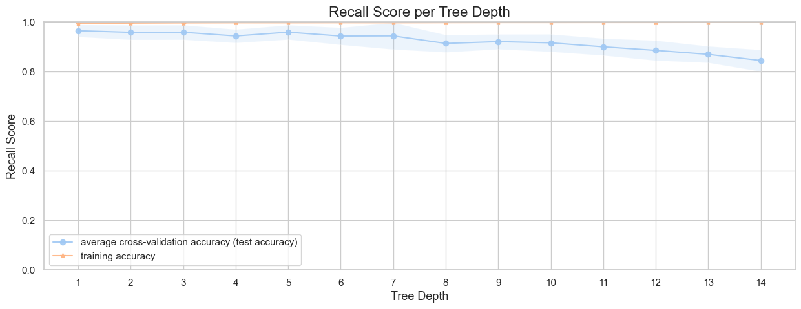

Slide 11
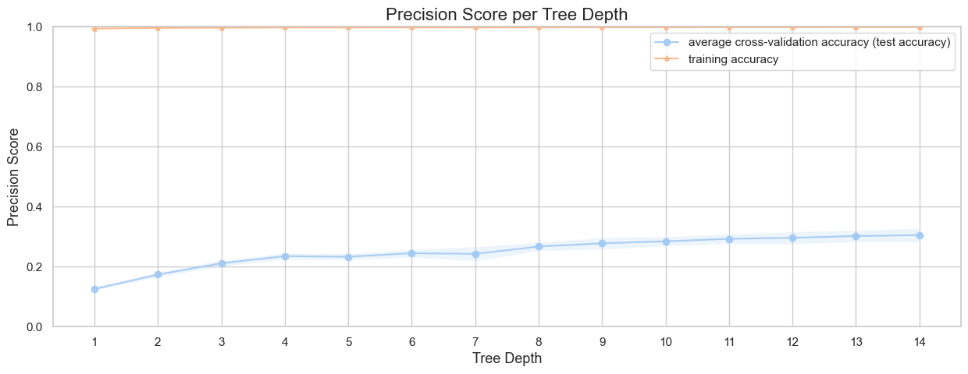

Slide 12
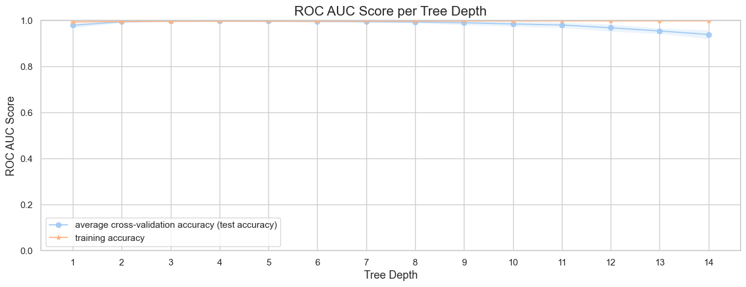

Slide 13
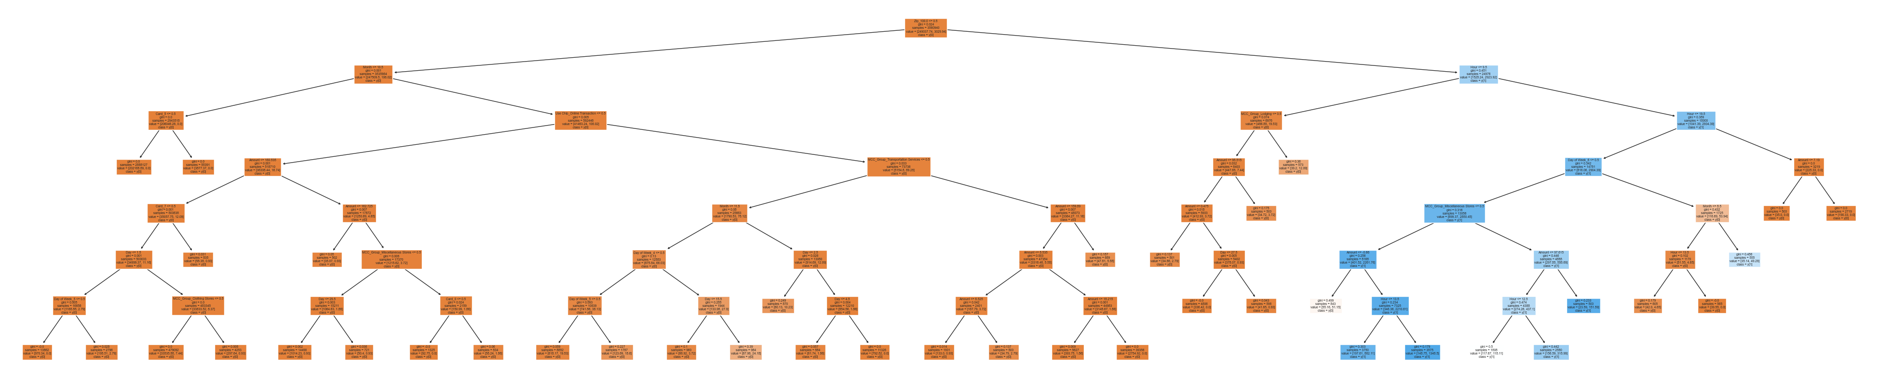

Slide 14
UNDERSAMPLE BEFORE SPLIT
sampling_method=2
k_neighbors=5
sampling_strategy=.42
k_neighbors=10 #10 #20
x_oversample, y_oversample = sample_imbalanced_data(X_values,y_values, sampling_method, sampling_strategy=sampling_strategy, k_neighbors=k_neighbors)
min_samples_leaf=10
max_depth=7
estimators=50 #50
samples_leaf_sizes = [2,4,6,7,8,10,50]
tree_depths = range(1,30)
execute_crossval=False
sampling_method=10

Slide 15
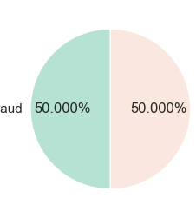
Class Distribution 1 11083
0 11083

Slide 16
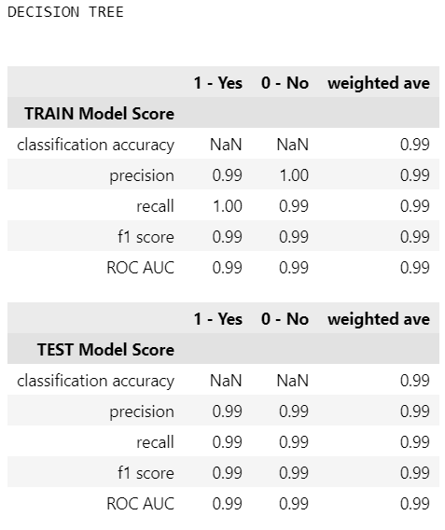
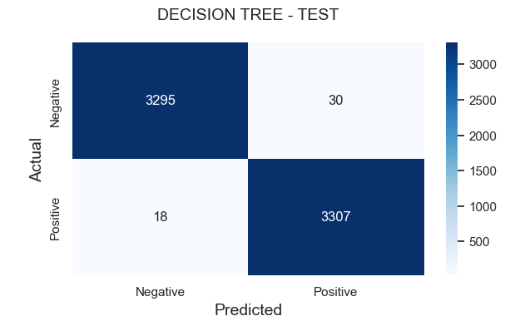
IDEAL SCENARIO

Slide 17
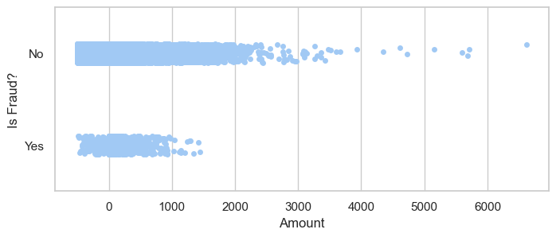
EDA

Slide 18
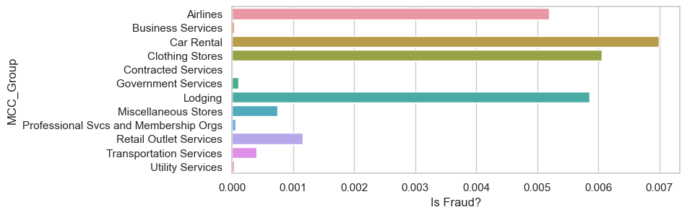
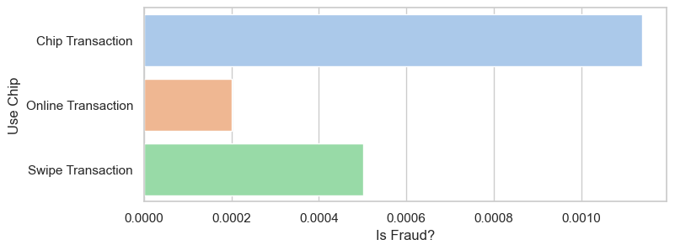
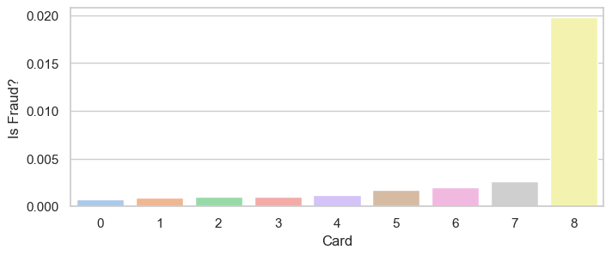

Slide 19
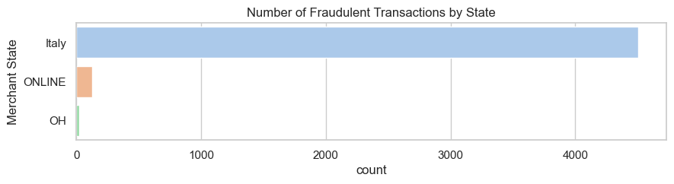
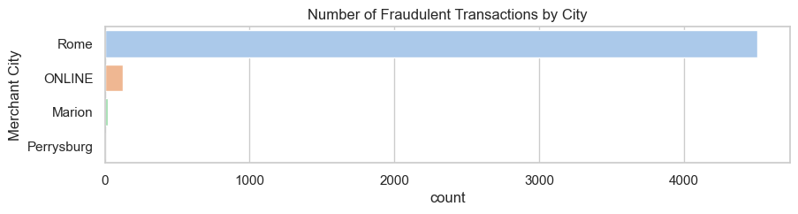
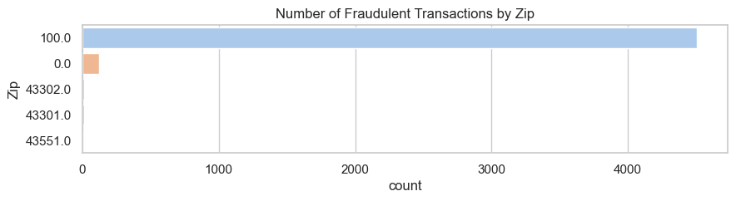

Slide 20
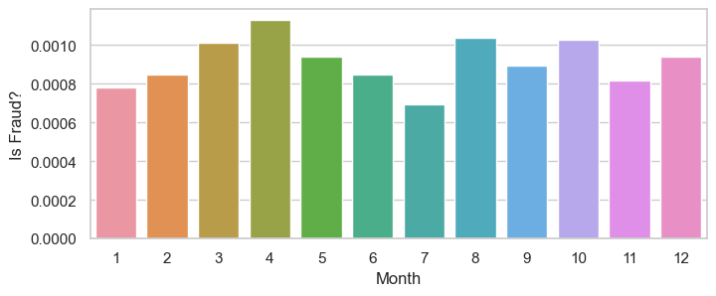
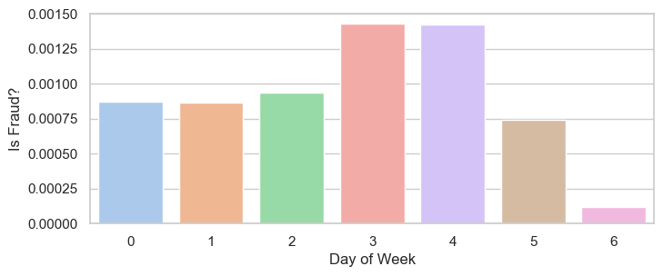
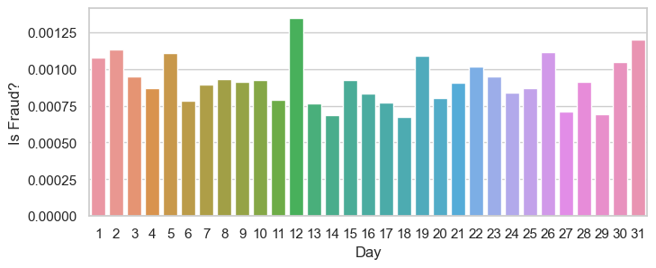
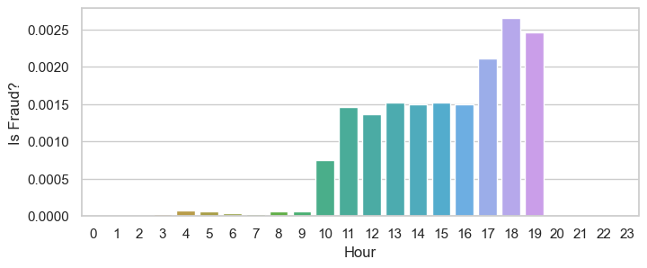

Slide 21
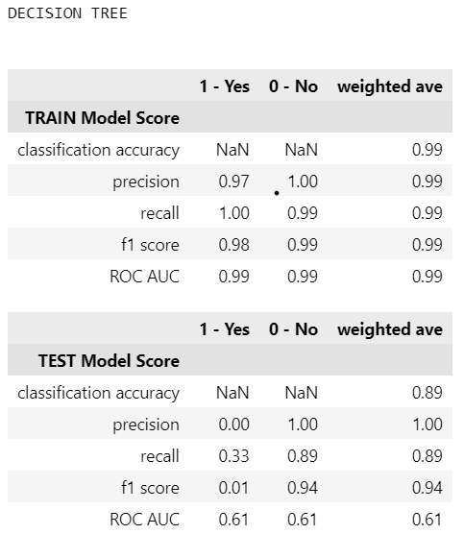
PCA no

