Slide 1
Understanding Scrum-Agile vs. Waterfall Development Approaches
Key Facets and Considerations for Leadership

Slide 2
Presented by: Maridelle Gonzales
CS-250
August 15, 2024

Slide 3
Key Roles in Scrum-Agile Teams
Product Owner
Responsibilities: Defines and prioritizes the product backlog based on business goals and customer needs. Ensures that the team delivers value in each sprint.
Importance: Directly impacts the product's alignment with customer expectations and market requirements.
Scrum Master
Responsibilities: Facilitates the Scrum process, removes impediments, and ensures that Agile practices are followed.
Importance: Helps the team stay focused, resolves issues that may hinder progress, and supports a productive work environment.
Development Team
Responsibilities: Self-organizes to complete tasks, produces high-quality increments of the product, and adapts to changes.
Importance: Delivers the product incrementally, ensuring quality and responsiveness to feedback.
Source: Scrum Alliances Website

Slide 4
Phases of the Agile SDLC
Sprint Planning
Purpose: Set goals for the sprint, define tasks, and plan the work to be done.
Importance: Ensures that the team is aligned on what needs to be achieved and how.
Daily Stand-ups
Purpose: Brief meetings to discuss progress, obstacles, and plans for the day.
Importance: Keeps the team synchronized and addresses issues quickly.
Sprint Review
Purpose: Review completed work with stakeholders to gather feedback.
Importance: Provides a platform for stakeholder input and ensures the product meets their expectations.
Sprint Retrospective
Purpose: Reflect on the sprint to identify what went well and what can be improved.
Importance: Facilitates continuous improvement and enhances team processes.
Source:https: Scrum org

Slide 5
Waterfall vs. Agile: A Comparative Overview
Waterfall Model
Sequential Phases: Requirements -> Design -> Implementation -> Testing -> Deployment -> Maintenance.
Challenges: Changes are costly and difficult to implement once a phase is complete. Delays in one phase can affect the entire project timeline.
Agile Model
Iterative Development: Frequent iterations and feedback loops.
Flexibility: Adapts to changes and evolving requirements, allowing for continuous improvement and adjustment.
Example Comparison:
Waterfall: Design flaws discovered late in the testing phase lead to costly redesigns and delays.
Agile: Continuous feedback during sprints allows early identification and resolution of issues, minimizing disruptions.
Source: Atlassian - Dan Radigan

Slide 6
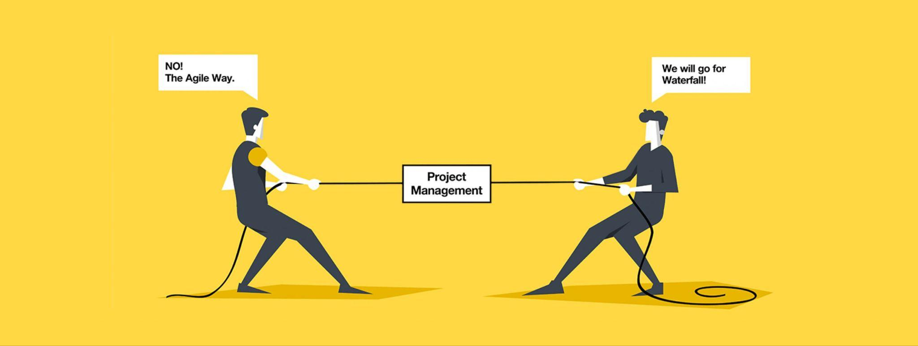
Factors to Consider: Waterfall vs. Agile
Project Scope
Waterfall: Best for projects with well-defined and stable requirements (Fair, 2012.).
Agile: Ideal for projects with evolving requirements and the need for iterative development.
Project Size and Complexity
Waterfall: Suitable for projects where requirements are clear and unlikely to change.
Agile: Well-suited for complex projects requiring flexibility and regular updates.
Risk Management
Waterfall: Risks are assessed and managed at each phase, but changes can be difficult to implement.
Agile: Provides continuous risk management through iterative feedback and regular adjustments.
Image Source: https://www.exposit.com/wp-content/uploads/2021/12/Blog_cover-139-scaled.jpeg
Source: Project Management Institute

Slide 7
Conclusion and Recommendations
Summary:
Agile provides flexibility, frequent feedback, and iterative development, making it suitable for projects with evolving needs.
Waterfall offers a structured, sequential approach, ideal for projects with stable, well-defined requirements.
Recommendation:
Consider Agile for projects that require adaptability and iterative enhancements.
Use Waterfall for projects where requirements are fixed and a structured approach is needed.

Slide 8

Thanks!
References: (Links)
Scrum Alliance. (n.d.). About Scrum. Retrieved from https://www.scrumalliance.org/about-scrum?_gl=1*9qvatd*_gcl_au*MTkwMjk3NTk1Ny4xNzIzNzYzNjA5*_ga*MzQ1ODk2NDI2LjE3MjM3NjM2MDk.*_ga_FQREGB3E3L*MTcyMzc2MzYwOC4xLjEuMTcyMzc2MzYzNS4zMy4wLjA
Scrum.org. (n.d.). What is Sprint Planning?. Retrieved from https://www.scrum.org/learning-series/what-is-scrum/the-scrum-events/what-is-sprint-planning
Radigan, D. (2020). Agile project management: What is Agile?. Retrieved from https://www.atlassian.com/agile/project-management/project-management-intro
Fair, J. (2012). Agile vs. Waterfall approach in ERP projects. Retrieved from https://www.pmi.org/learning/library/agile-versus-waterfall-approach-erp-project-6300
Second Nature. (2019, August). Successful team presentation [Image]. Retrieved from https://www.secondnature.com.au/wp-content/uploads/2019/08/Successful-team-presentation--1024x669.jpg
I did not include in-text citations directly on the slides to maintain a clean and professional appearance. Instead, I've included the reference links for all sources used. Additionally, each slide contains a brief text indicating the source of the information.

